Slide 1

Introduction Slide Title goes here [Font: Arial Bold/Size: 16]
P1.2-275
Moment Tensor Inversion for Moderate to Strong Earthquakes in Albania and Surrounding Region
Using Grond
O. Gjuzi, D. Muçaj, Rr. Ormeni
Academy of Sciences of Albania
In this study, we use the probabilistic inversion framework Grond (part of the Pyrocko package) to analyze moderate-to-strong earthquakes (Mw 3.5–6.4) in Albania and the surrounding region. The results provide stable and reliable source parameters, highlighting Grond’s capability to investigate seismic events in a complex tectonic setting and to distinguish natural from anthropogenic earthquakes.
DISCLAIMER: This presentation has been generated for illustration purposes only.

Slide 2
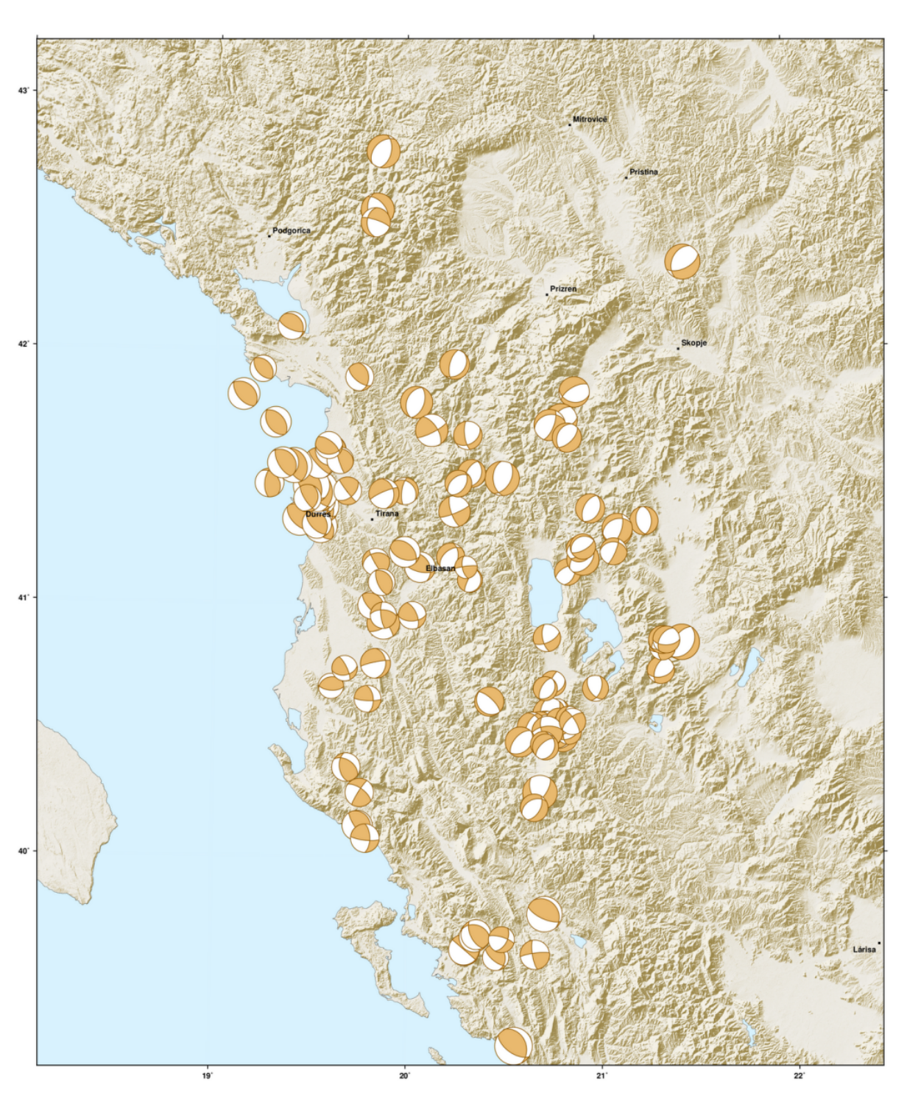
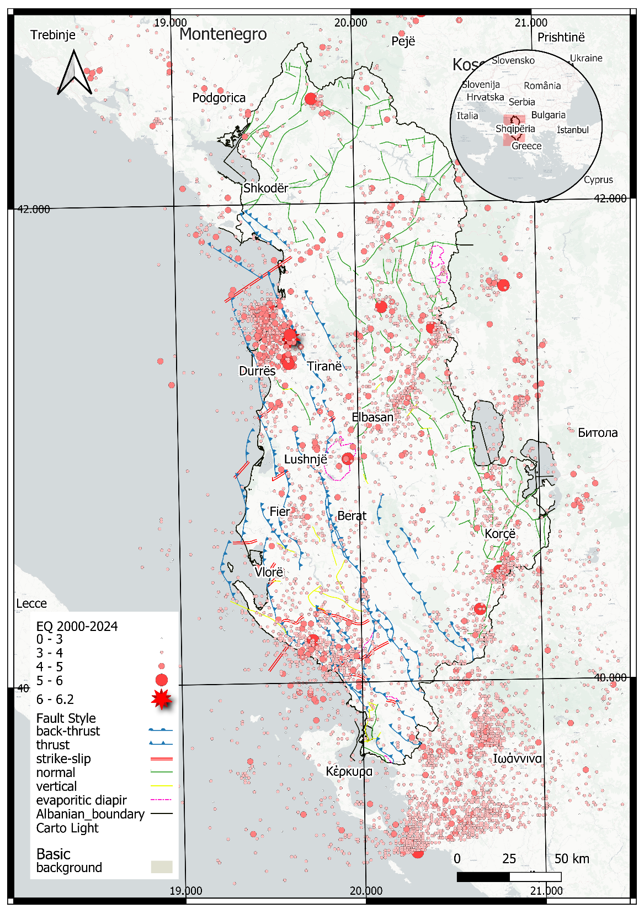
Moment Tensor Inversion for Moderate to Strong Earthquakes in Albania and Surrounding Region Using Grond
O. Gjuzi, D. Muçaj, Rr. Ormeni
Introduction
Methodology
Results
P1.2-275
Albania is one of the most seismically active regions of the Alpine–Mediterranean belt. In our study, we present the distribution of 6,551 earthquakes with magnitudes greater than 3.0 recorded between 2000 and 2024. From this seismicity, only 122 events provided focal mechanisms of satisfactory quality, enabling a reliable analysis of faulting processes.
Moment tensor inversion was carried out with Grond (part of the Pyrocko package), which applies Bayesian and residual bootstrapping to quantify uncertainties and ensure stable solutions. The inversion process compares observed and synthetic waveforms through a weighted misfit function, balancing the contributions of different stations and data types. Model optimization is achieved using the BABO algorithm, which explores a wide range of possible solutions without assuming a fixed model shape.Forward modeling relied on Green’s Functions generated with Fomosto QSEIS, based on a 1D velocity model of Albania (Ormeni, 2011). This pre-computation increases efficiency by avoiding repeated waveform simulations. Waveforms were filtered in the 0.01–0.07 Hz band, and three-component data were processed and quality-controlled using Snuffler. Inversions were carried out in both time- and frequency-domain configurations, depending on event characteristics.
Conclusions
Grond (Pyrocko) provides stable and reliable moment tensor solutions for Albanian earthquakes.Results show a complex tectonic regime with thrust, normal, and strike-slip faulting.Probabilistic bootstrapping ensures robust parameters even with limited data.Grond proves effective for regional seismotectonic studies and for distinguishing natural vs. anthropogenic events.
    Regional seismicity of Albania (2000–2024, M≥3.0)

Slide 3
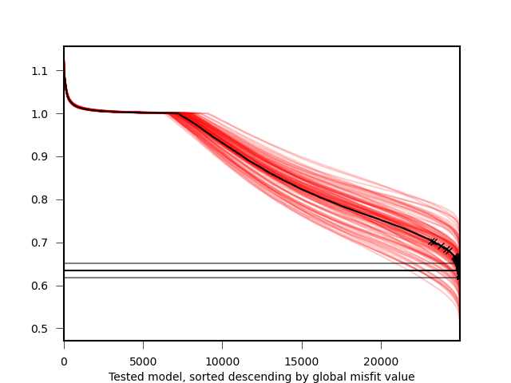
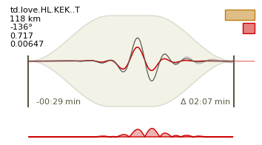
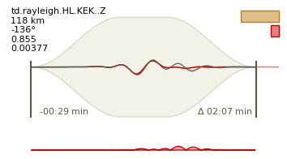
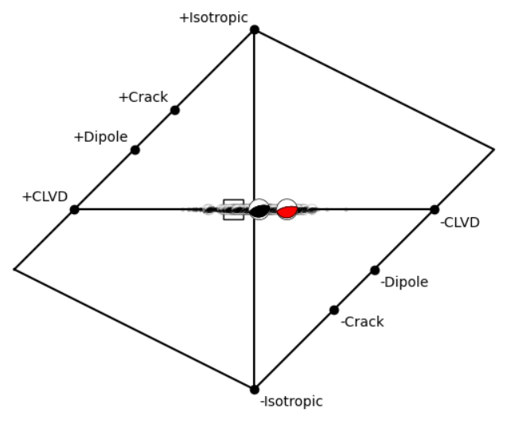
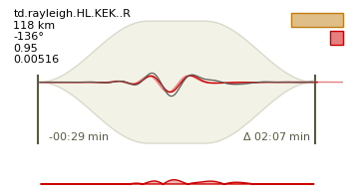
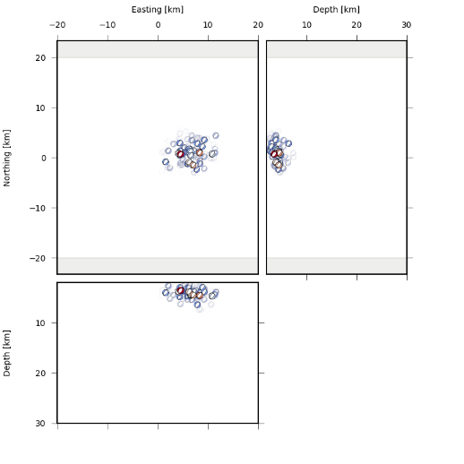
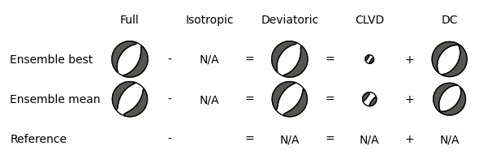
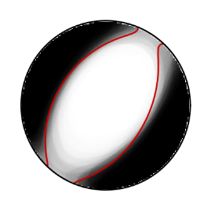
Moment Tensor Inversion for Moderate to Strong Earthquakes in Albania and Surrounding Region Using Grond
O. Gjuzi, D. Muçaj, Rr. Ormeni
Grond Results: Visual Quality Assessment
Waveform Fits for Best Model
P1.2-275
Bootstrap Misfit
Hudson Plot
Observed and synthetic waveforms are compared for the best-fitting solution. Plots show station info, tapering, residuals, and misfit contribution. Good agreement between traces indicates reliable inversion results.
Hudson's source type plot with the ensemble of bootstrap solutions. For about 10% of the solutions (randomly chosen), the focal mechanism is depicted, others are represented as dots. The square marks the global best fitting solution.
Bootstrap misfit analysis was used to evaluate the stability of the inversion results. By comparing individual bootstrap configurations, we assess whether solutions converge toward a consistent region in model space. In our case, the majority of bootstrap runs show similar convergence patterns, indicating robust solutions, while minor deviations may reflect data noise or station orientation effects.
MT Location
MT Decomposition & Fuzzy MT
Plot of best solutions in three cross-sections within the defined search space. Symbols show double-couple mechanisms, while colors represent misfit (red = low, blue = high).
Shows solution uncertainty; clear black–white fields = stable result
Best solution split into isotropic, deviatoric, DC; consistency = stability

Slide 4
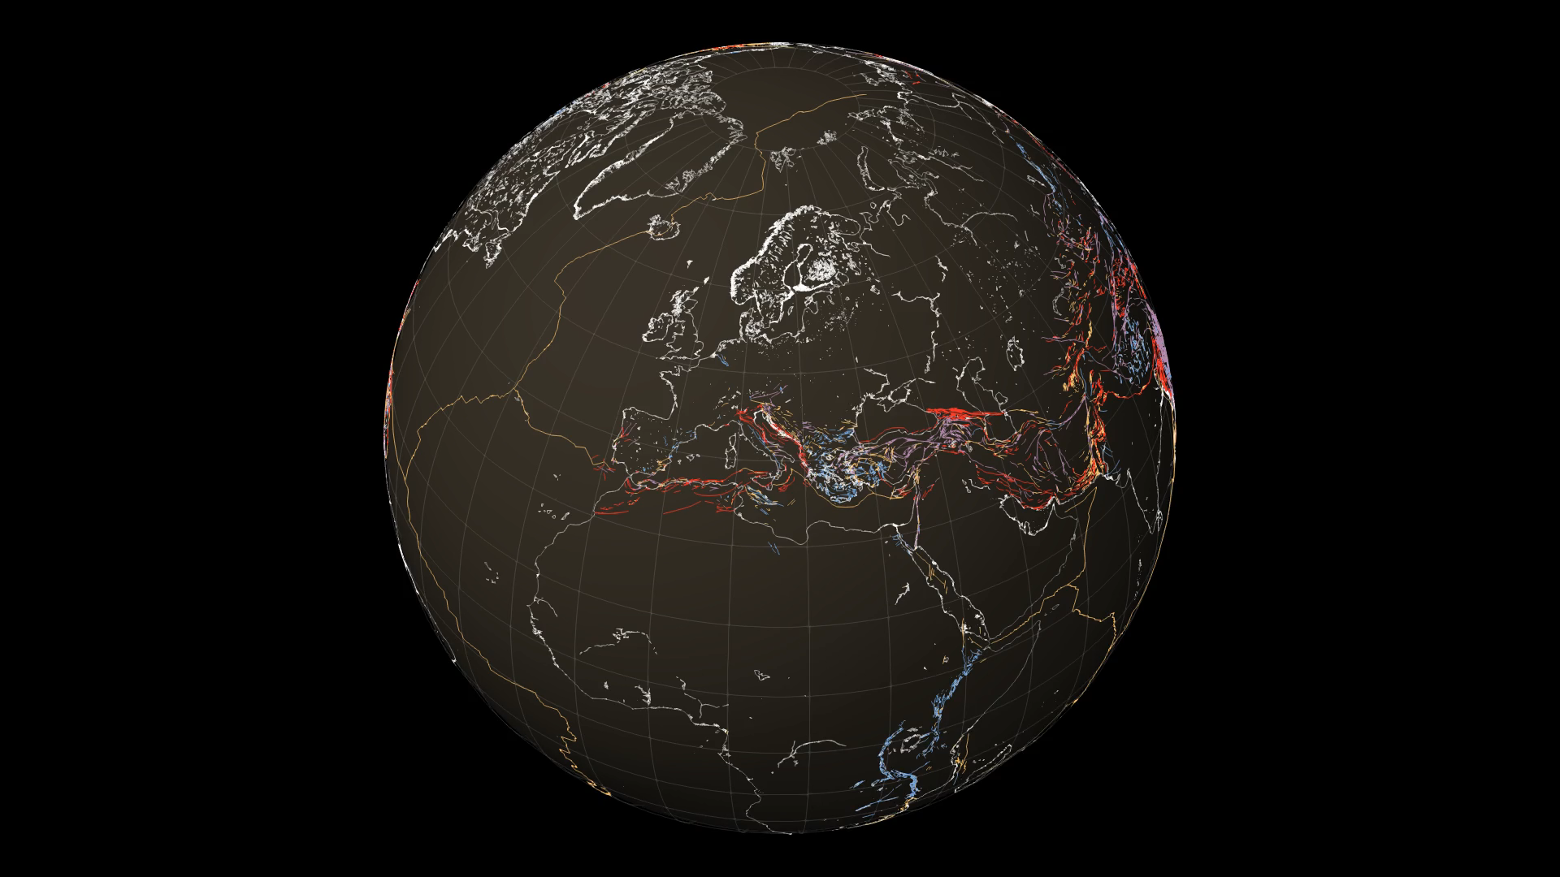
Moment Tensor Inversion for Moderate to Strong Earthquakes in Albania and Surrounding Region Using Grond
O. Gjuzi, D. Muçaj, Rr. Ormeni
Video illustration of Seismic activity of Albania
P1.2-275

