Slide 1

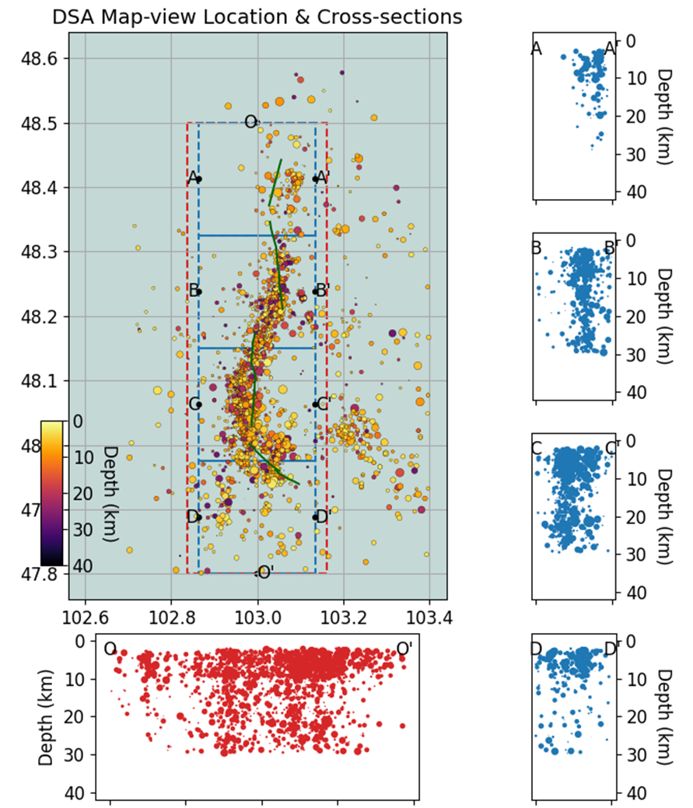
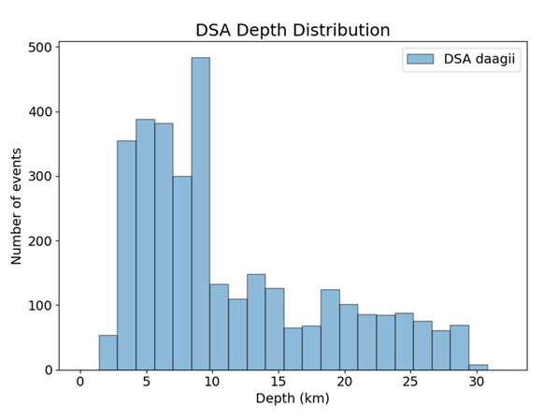

P1.2-681
Advancing Focal Depth Estimation Techniques: A Case Study from Mongolia
L. Dagzinmaa¹, M. Ulziibat¹
¹Institute of Astronomy and Geophysics, Mongolian Academy of Sciences
Our poster is about applying the Depth Scanning Algorithm (DSA) to earthquakes in the Mogod fault zone, Mongolia.
Focal depth is crucial for understanding earthquake sources, fault behavior, and seismic hazard.
Yet, in Mongolia, accurate depths have been limited due to sparse seismic coverage.
Within collaboration from the Korea Institute of Geoscience and Mineral Resources (KIGAM), 10 temporary stations were added to the KG network, allowing us to analyze over 6,300 earthquakes (2022–2024). Using DSA, we obtained reliable focal depths for 3,388 events.
The key result is that over 70% of earthquakes are shallow (2–10 km), but we also find deeper events down to ~30 km, pointing to complex fault structures and stress regimes.
This shows DSA is an effective tool for automated depth estimation, providing new insights into seismic hazard in Mongolia.
If you’d like to learn more about the depth distributions and cross-sections, come visit me at my poster.
Figure 2. DSA map-view location plot illustrating the depth distribution of seismic events, with a color bar representing the depth ranges
Figure 1. A histogram of the depth distribution by the number of events. It’s providing a visual summary of the focal depth characteristics in the dataset
Notes:
Good [morning/afternoon/evening], everyone.
My name is [Your Name], and I am [your position] at [your organization/institution]. I am delighted to be here today to present*******************

