Slide 1


P1.2-681
Advancing Focal Depth Estimation Techniques: A Case Study from Mongolia
L. Dagzinmaa¹, M. Ulziibat¹
¹Institute of Astronomy and Geophysics, Mongolian Academy of Sciences
We applied the Depth Scanning Algorithm (DSA) to over 6,000 earthquakes in the Mogod fault zone, Mongolia. Reliable depths were determined for 3,388 events, showing that most seismicity occurs at shallow depths (2–10 km), while some deeper events (~20–30 km) reveal complex fault structures and tectonic processes.

Slide 2
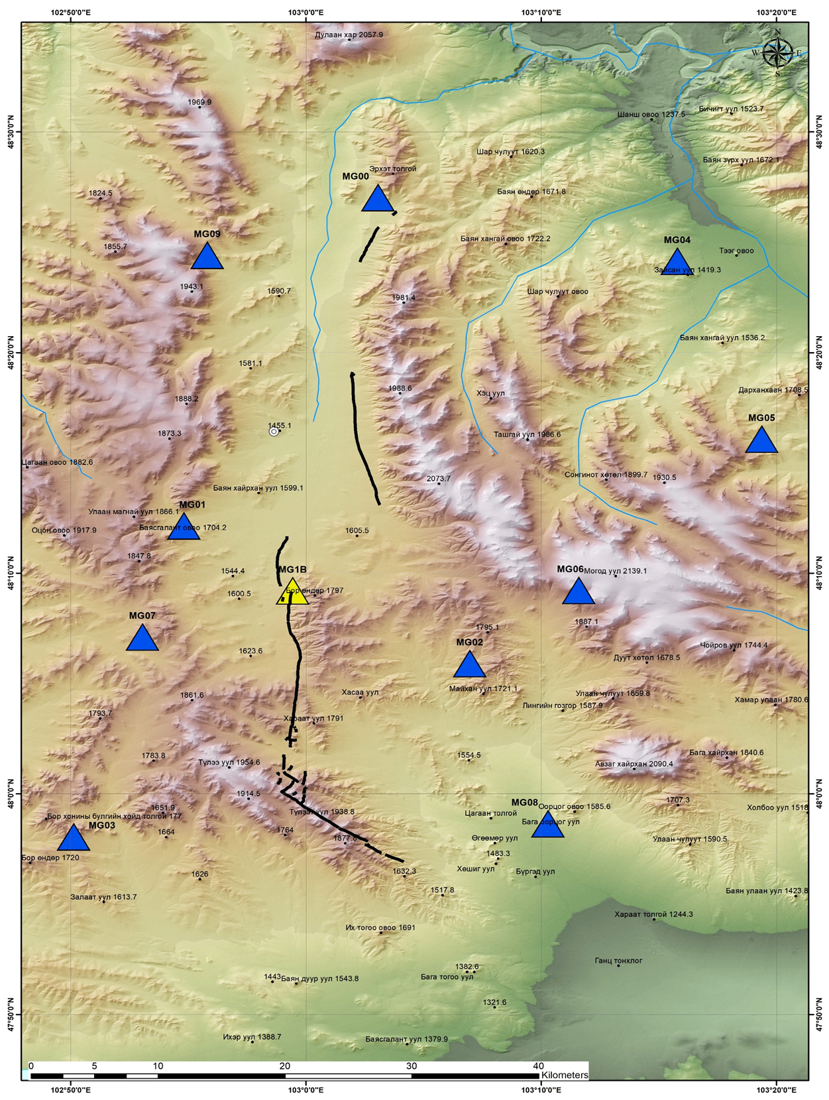
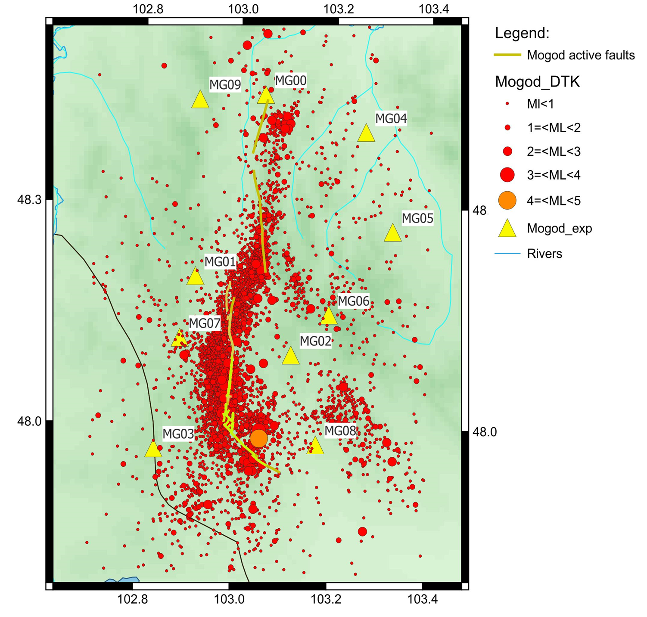
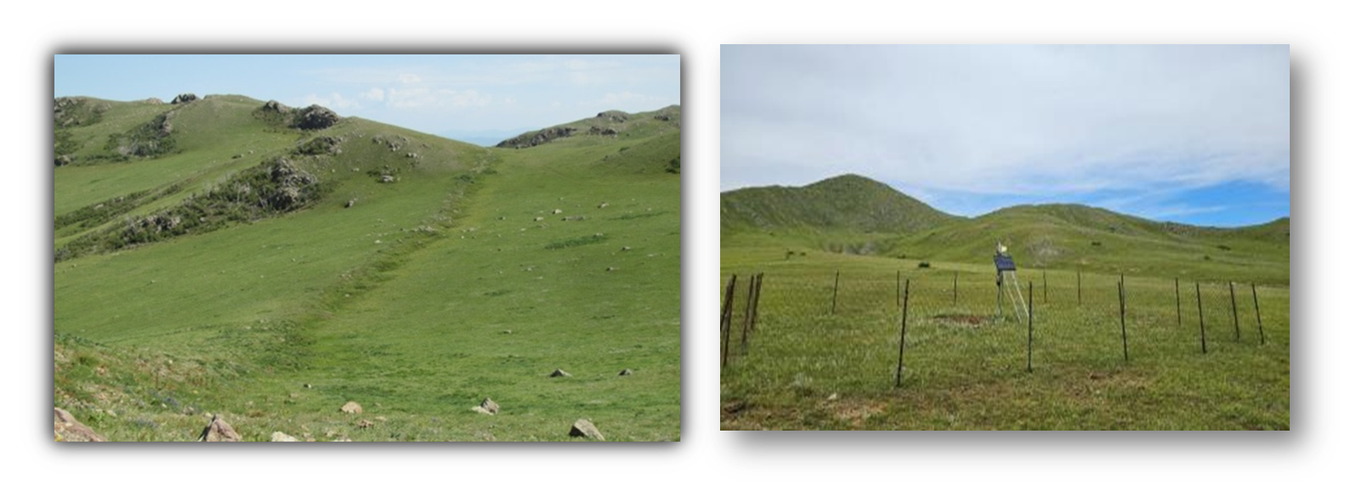
Advancing Focal Depth Estimation Techniques: A Case Study from Mongolia
L. Dagzinmaa¹, M. Ulziibat¹
OBJECTIVE & INTRODUCTION
Focal depth is a key parameter in earthquake monitoring, providing critical insights into seismic source processes and hazard assessment. Accurate depth estimation improves our understanding of local tectonics, fault behavior, and earthquake risk. In this study, we apply the Depth Scanning Algorithm (DSA) to determine absolute focal depths of earthquakes in the Mogod fault zone, a seismically active region in Mongolia. This work is part of an international collaboration with the Korea Institute of Geoscience and Mineral Resources (KIGAM), under which 10 temporary seismic stations were deployed to enhance network coverage. These additional stations enable more precise event localization and provide an opportunity to test automated depth determination tools, ultimately contributing to enhanced seismic monitoring and a deeper understanding of regional seismicity.
DATA
Dataset: 6,356 seismic events (Dec 2022 – Aug 2024) from the KG network.
DSA Results: Reliable focal depths obtained for 3,388 events by identifying depth phases (pPg, sPg, sPmS).
Figure 2. Distribution of the KIGAM experiments along the “Mogod” fault. (The map developed by A.Amarmend, researcher from IAG, EEW laboratory)
Figure 1. “Mogod” fault and the fence at the station MG01
Figure 3. Epicenter distribution of all earthquakes utilized for Depth Scanning Algorithm (DSA) calculations from December 19, 2022, to August 26, 2024.

Slide 3
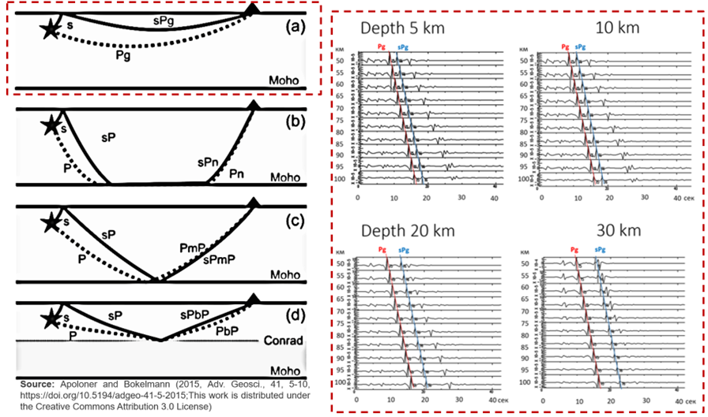
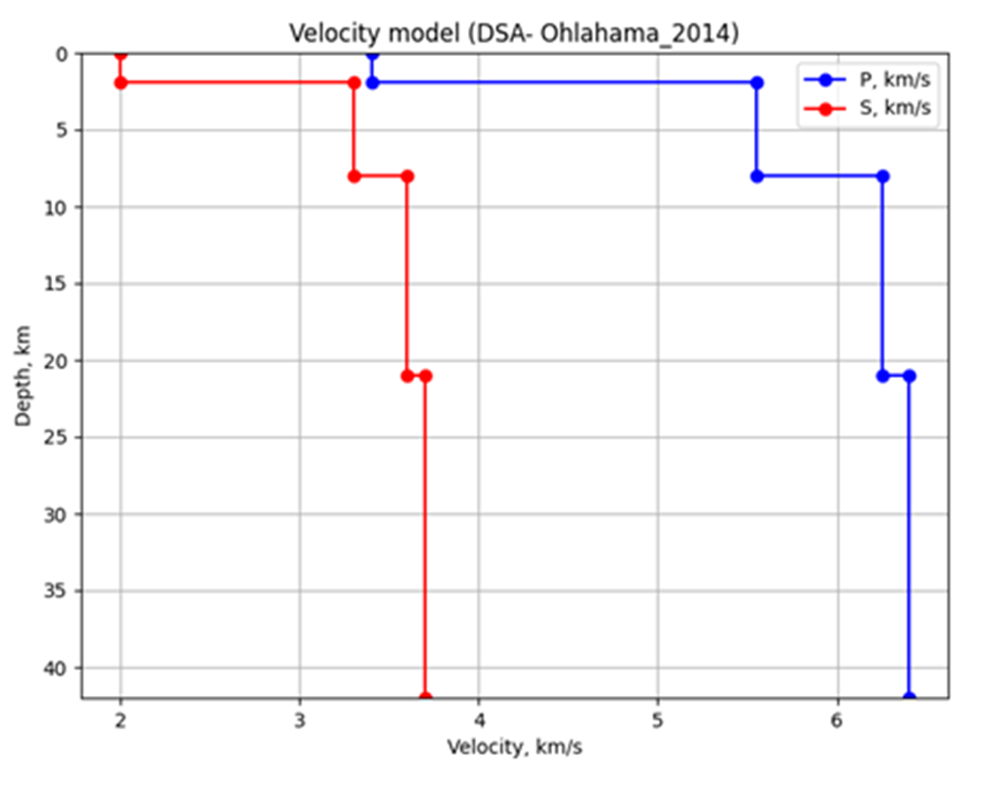
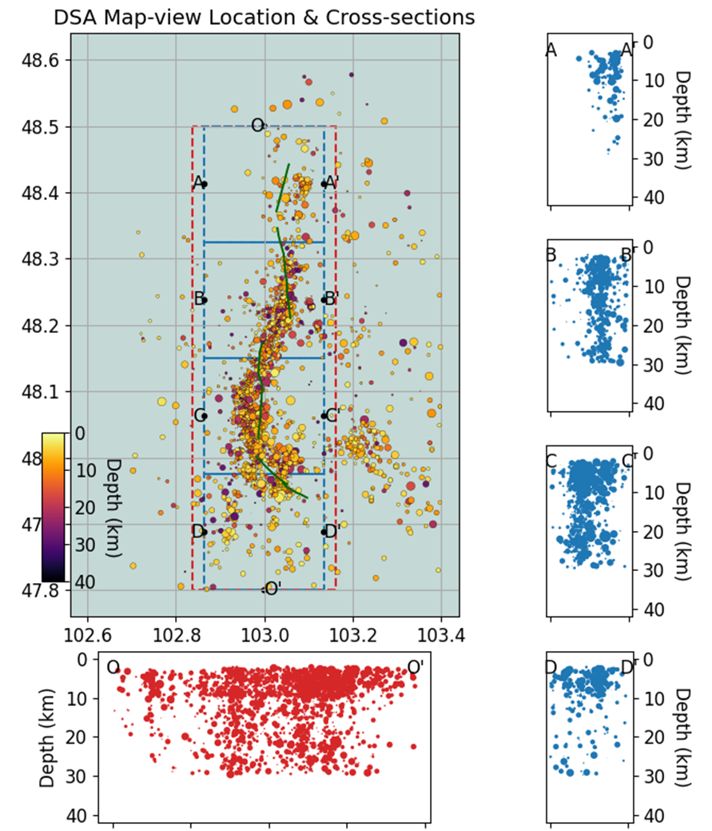
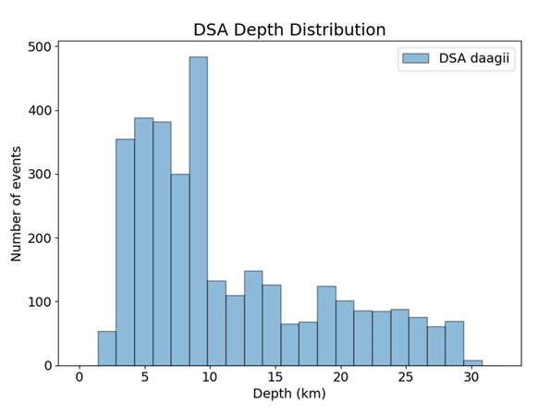
Advancing Focal Depth Estimation Techniques: A Case Study from Mongolia
L. Dagzinmaa¹, M. Ulziibat¹
METHODS & PROCEDURE
Depth Scanning Algorithm (DSA): Identifies depth phases (pPg, sPg, sPmS) in local and regional waveforms.
Velocity Model: 1D four-layer AK135 model (sediment, upper crust, lower crust, mantle) used for synthetic seismograms.
Procedure:
  Select events and retrieve waveforms.
  Compare observed depth-phase arrivals with synthetic travel times.
  Determine focal depth from best-fitting matches.
RESULT & DISCUSSION
Focal depths: 2–30 km; over 70% shallow (2–10 km). Deeper events (>20 km) are likely linked to tectonic structure changes.
Cross-sections revealed variable fault geometries: Some vertical seismic clusters.
Shallow seismicity dominates, reflecting brittle deformation in the upper crust.
Sub-cross-sections highlight heterogeneous stress fields.
DSA proved effective for automated focal depth estimation, especially with dense local networks.
Refine depth estimates with regional velocity models & alternative methods (PhaseNet, double-difference).
Figure 5. Velocity model used for synthetic calculations, showing the velocities of P-waves (blue line) and S-waves (red line).
Figure 4. Ray paths of depth phases and example synthetic seismograms (Pg, sPg) for 50–100 km distances, showing how focal depth affects phase identification.
Figure 5. A histogram of the depth distribution by the number of events. It’s providing a visual summary of the focal depth characteristics in the dataset
To estimate the focal depth of earthquakes, we applied the Depth Scanning Algorithm (DSA), which systematically compares observed arrival times of depth phases with synthetic travel times from a 1D Earth model. The following steps summarize the full procedure, from data selection to depth determination.
Figure 6. DSA map-view location plot illustrating the depth distribution of seismic events, with a color bar representing the depth ranges

