Slide 1



P1.2-870
Ground Motion and Aftershock Seismicity Characteristics following the Mw 6.5 Earthquake in Paphos, Cyprus on January 11, 2022
Sherif M. Ali ⁽¹⁾, and Shimaa H. Elkhouly ^{(2*)}
⁽¹⁾ Comprehensive Nuclear-Test-Ban Treaty Organization (CTBTO)
⁽²⁾ National Research Institute of Astronomy and Geophysics (NRIAG)
On 11 Jan 2022, a Mw 6.5 earthquake struck Paphos, Cyprus, affecting the eastern Mediterranean. PGA and PGV indicated strong shaking. Over two years, 693 events (Mc = 1.4) were recorded. Analysis yielded b = 0.65 ± 0.09, p = 0.73, c = 5.0, k = 10.0, Dc = 1.75 ± 0.01, and slip ratio 0.58, showing high stress, rapid aftershock decay, clustering along a fault, and significant slip. These results provide insights into fault dynamics, stress distribution, and seismic hazard forecasting.
DISCLAIMER: The views expressed on this e-poster are those of the author and do not necessarily reflect the views of the CTBTO

Slide 2
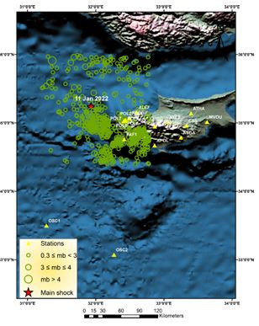
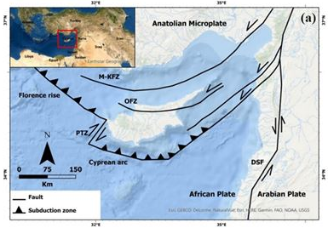
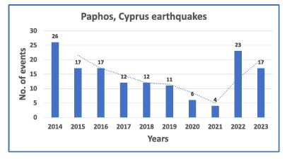
Ground Motion and Aftershock Seismicity Characteristics following the Mw 6.5 Earthquake in Paphos, Cyprus on January 11, 2022
Sherif M. Ali and Shimaa H. Elkhouly
P1.2-870
Data and Analysis
Channel | PGA (cm/s²) | PGV (cm/s) | Event Distance (km) | Event Azimuth | Intensity
POL6 | 24.210 | 2.297 | 49.95 | 116.0° | IV
POL7 | 13.280 | 1.499 | 49.95 | 118.0° | III
POL5 | 23.790 | 2.011 | 51.06 | 117.0° | IV
POL8 | 24.84 | 2.52 | 51.06 | 116.0° | IV
POL9 | 20.38 | 2.75 | 51.06 | 115.0° | IV
POL2 | 13.90 | 1.059 | 54.39 | 111.0° | IV
POL1 | 9.644 | 0.750 | 54.90 | 110.0° | I
ALEF | 6.889 | 0.389 | 62.16 | 98.0° | III
PAF1 | 15.020 | 1.112 | 69.93 | 140.0° | IV
TROD | 2.278 | 0.291 | 91.02 | 110.0° | II
XYLS | 2.51 | 0.255 | 105.1 | 120.0° | II
APOL | 2.49 | 0.240 | 106 | 120.0° | II
ASGA | 3.759 | 0.340 | 130.98 | 112.0° | III
CSS | 3.749 | 0.613 | 131.4 | 112.0° | III
ATHA | 3.423 | 0.523 | 134 | 115.0° | III
MVOU | 0.913 | 0.124 | 156.51 | 98.0° | II
OSC1 | 0.189 | 0.015 | 202.02 | 198.0° | I
OSC2 | 0.265 | 0.026 | 241.98 | 172.0° | II
ELL | 0.251 | 0.021 | 247.4 | 170.0° | II
ARG | 0.132 | 0.011 | 361.1 | 175.0° | II
Seismic data from the Cyprus Geological Survey Department (CGSD) includes 693 earthquakes (0.3–6.5 Mw) recorded between 11 January 2022 and 21 February 2024 within latitudes 34.40°–36.00° N and longitudes 31.20°–32.80° E. Data analysis employed the Gutenberg–Richter frequency–magnitude law and the Modified Omori’s Law using the ZMAP software package. The Mw 6.5 mainshock on 11 January 2022 was detected by 20 seismic stations situated 50–250 km from the epicenter, with azimuth coverage between 98° and 198°. Waveforms and first onset detections from 22 stations captured the event, providing the basis for assessing seismic activity and aftershock characteristics in the region.
Figure 2: The epicenter of the January 11, 2022, mainshock, the subsequent seismic activity in the study area with magnitudes ranging from 0.3 to 5.1, and the location of seismic stations in Cyprus
Table 1: Earthquake ground motion parameters recorded by the Cyprus geological survey for the Paphos on 11 January 2022
Figure 1: Geotectonic map of Cyprus, modified after Evelpidou et al.2022
Figure 3: A chart illustrating the number of recorded seismic events within a 300km radius of Paphos from 2014 to 2023
DISCLAIMER: The views expressed on this e-poster are those of the author and do not necessarily reflect the views of the CTBTO

Slide 3
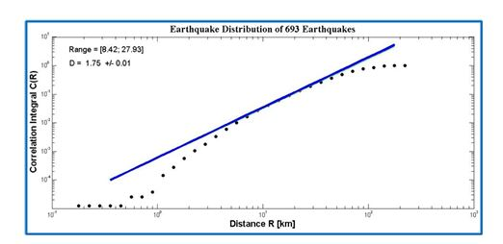
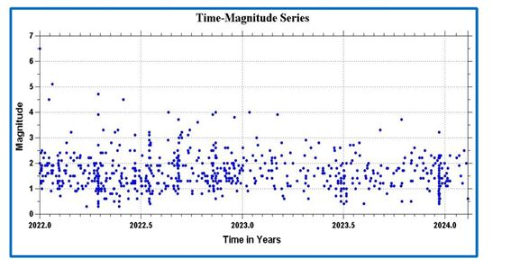
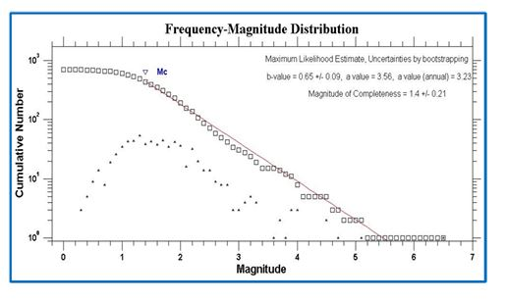
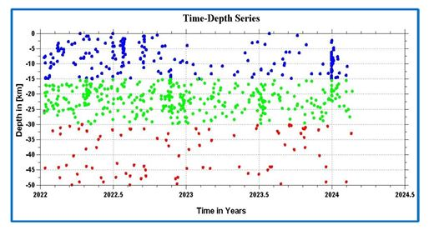
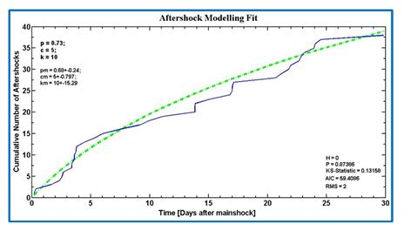
PLEASE DON‘T FORGET TO PUT THE E-POSTER TITLE AND YOUR NAME IN THE PRESENTATION HEADER.
DUPLICATE THIS SLIDE IF YOUR E-POSTER HAS MORE THAN 1 PAGE
P1.2-870
Ground Motion and Aftershock Seismicity Characteristics following the Mw 6.5 Earthquake in Paphos, Cyprus on January 11, 2022
Sherif M. Ali and Shimaa H. Elkhouly
Results and Discussions
The time–magnitude distribution shows a decline in large earthquakes from 2022 to late 2023, with four events above magnitude 4.0 in early 2022 and none thereafter. Most earthquakes are shallow (≤50 km), concentrated between 15–30 km, with additional activity below 15 km and between 30–50 km, reflecting diverse seismic and geological dynamics in the region.
The 𝑀_{c} of 1.4 was determined, resulting in a b-value of 0.65±0.09. This value is relatively low compared to the global average. Lower b-values often suggest higher stress levels in the crust. The observed p-value was found to be as low as 0.73, which is smaller than the mean value of 1.0. This value indicates that the rate of aftershock decay is moderate.
The fractal dimension of 1.75 ± 0.01, derived from correlation integral and hypocenter spacing, indicates a moderately complex epicenter distribution, with events clustered along a fault but not in a strictly linear pattern.
Figure 8: The fractal Dimension Dc calculated for the 693 recorded seismic events in the studied region
Figure 4: The time magnitude distribution of the two years following the Paphos, Cyprus earthquake on January 11, 2022
Conclusion
This study offers a detailed analysis of the aftershock dynamics following the January 11, 2022, Mw 6.5 earthquake, Paphos, Cyprus, addressing important gaps in our understanding of stress distribution and release in areas with complicated fault systems. The findings emphasize the rapid decrease in stress levels after the mainshock and a clear clustering pattern of aftershocks. These findings benefit the scientific community by enhancing strategies for reducing seismic hazards and disaster risks, leading to better preparedness for future earthquakes in Cyprus and other regions
Figure 6: The magnitude frequency distribution of the two years following the Paphos, Cyprus earthquake on January 11, 2022
Figure 5: The time depth distribution of the two years following the Paphos, Cyprus earthquake on January 11, 2022 (blue circles represent depth ranges 0-15 km. Green circles represent depth ranges 15-30 km, and red circles represent depths exceeding 30 km
Figure 7: Aftershock modeling fit showing the decay parameters using the modified Omori law
DISCLAIMER: The views expressed on this e-poster are those of the author and do not necessarily reflect the views of the CTBTO

