Slide 1

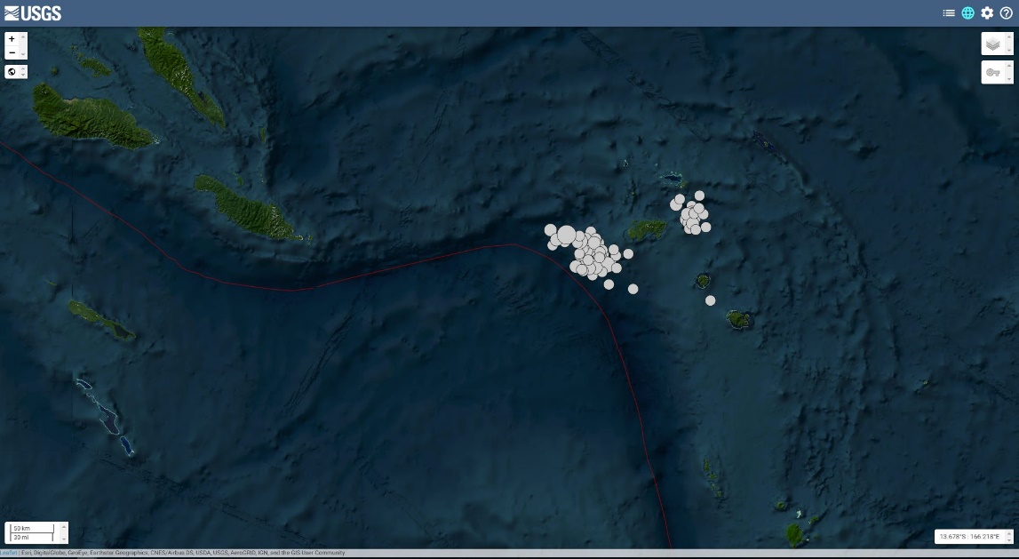

The Detection of the Earthquake Swarm of the 2013 Solomon Islands M8.0 Earthquake at Santa Cruz Islands
P1.2-858
Belinda Waokahi
IMS Station AS098 / Seismological Observatory Section/ Ministry of Mines, Energy & Rural Electrification, Solomon Islands
Earthquake swarm
To investigate the occurrence, analysis and interpretation before the main seismic event of magnitude 8.0 had occurred.
To determine and identify the seismic activities of the underlying factors that is responsible for triggering such earthquake swarms.
Serves as a foundational reference for future researchers who is interested in exploring the causes and characteristics of the earthquake swarms particularly in relation to the major seismic event.
If you want to learn more about Earthquake swarm, you are welcome to come over for a chat in front of our poster P1.2-858
Ministry of Mines, Energy & Rural Electrification
Geological Survey Division
Seismological Observatory Section
Solomon Islands Government
DISCLAIMER: This presentation has been illustrated for generated purposes only

