Slide 1


P1.2-858
Detection of Earthquake Swarm of the Main Shock of M8.0, 2013 Santa Cruz Islands, Solomon Islands
Belinda.Waokahi
Ministry of Mines, Energy & Rural Electrification
Solomon Islands Government
IMS Station AS098
Ministry of Mines, Energy & Rural Electrification
Geological Survey Division
Seismological Observatory Section
Solomon Islands Government
An earthquake swarm is defined as a series of seismic events occurring in a localized area over a short period of time. In the Solomon Islands, the occurrence of clusters of moderate earthquake activity within just a few days before a mainshock is unusual based on historical seismic data records. However, prior to the magnitude 8.0 earthquake that triggered a tsunami on February 6, 2013, clusters of earthquake swarms were detected for more than a week. These swarms consisted of earthquakes ranging in magnitude from 4.0 ML to greater than 6.0 ML.
This study aims to investigate the occurrence, analysis, and interpretation of the earthquake swarm that preceded the M8.0 mainshock in the Santa Cruz Islands region of the Solomon Islands. The objective is to identify the earthquake activities that caused the clustering of these swarms, focusing on three main phenomena: fluid movements, volcanic magma activity, and slow slip events on the fault.
DISCLAIMER: This presentation has been generated for illustration purpose only.

Slide 2
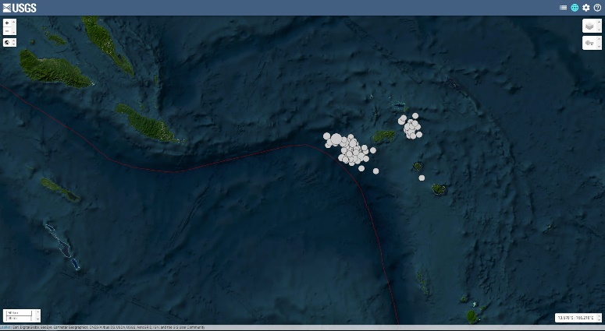
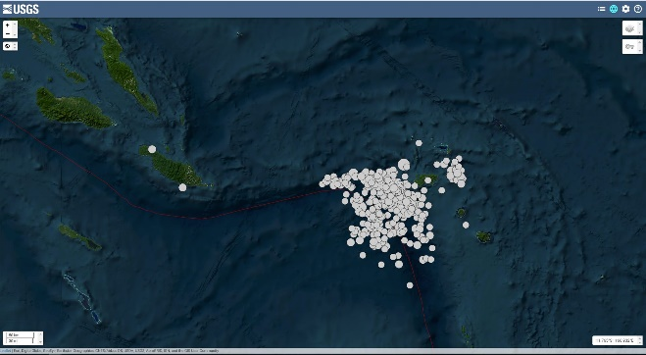
PLEASE DON‘T FORGET TO PUT THE E-POSTER TITLE AND YOUR NAME IN THE PRESENTATION HEADER.
DUPLICATE THIS SLIDE IF YOUR E-POSTER HAS MORE THAN 1 PAGE
Detection of Earthquake Swarm of the Main Shock of M8.0, 2013 Santa Cruz Islands, Solomon Islands
P1.2-858
Belinda. Waokahi
INTRODUCTION
METHOD
On February 6, 2013, at 01:12:25 UTC, a magnitude 8.0 earthquake struck the Santa Cruz Islands. The event was the result of shallow thrust faulting occurring on or near the plate boundary interface between the Indo-Australian Plate and the Pacific Plate. In the days leading up to the mainshock, a series of earthquake swarms was recorded in the region.
The tectonic setting of this area is characterized by the convergence of the Australian Plate, which was subducting beneath the Pacific Plate at an approximate rate of 94 mm/year in an east-northeast direction. The February 6 earthquake occurred near a geologically complex section of the Australian-Pacific plate boundary. To the west, this boundary is associated with the Solomon Trench, which connects to the New Hebrides (Vanuatu) subduction zone. North and west of the epicenter, the plate boundary changes orientation to a more west–east trend, linking the rupture area with the broader Solomon Islands Arc subduction system.
In the month leading up to the mainshock, significant seismic activity was observed in the epicentral region. More than 40 earthquakes with magnitudes of 4.5 or greater were recorded in the 7 days prior to the mainshock, including 7 events exceeding magnitude 6.0. The focal mechanisms of these events reveal a complex mix of strike-slip, normal, and thrust faulting. Within an hour of the M8.0 mainshock, two major aftershocks, each exceeding magnitude 7.0, were also recorded.
The purpose of this data collection was to identify and analyze the sequence of earthquake swarms leading up to the main event. Seismic data for this study were obtained from the United States Geological Survey (USGS) earthquake catalogue, covering the period from January 1, 2012, to February 6, 2013, at 01:12:25 UTC—the date and time of the magnitude 8.0 mainshock.
The data were initially reviewed on a monthly basis to observe overall seismic activity and identify periods of increased clustering. This was followed by a more detailed daily analysis, focusing specifically on the period from January 2013 to February 6, 2013, to determine the precise onset of swarm activity.
Using the retrieved data, seismicity maps were generated and saved to visualize the temporal and spatial distribution of earthquakes prior to the mainshock. These maps played a key role in identifying the initial event and progression of the earthquake swarm. This method serves as a baseline approach for researchers interested in conducting further investigations into earthquake swarm behavior and its potential as a precursor to major seismic events.
The earthquake swarm activity began on January 27, 2013, and continued up until approximately 20 minutes before the mainshock on February 6, 2013. During this period, a total of 77 seismic events were recorded in the USGS seismic database.
The magnitude of these events ranged from 4.0 to greater than 7.0. Of the total swarm events, several (≥6 events) had magnitudes equal to or exceeding 6.0. The minimum magnitude threshold for data inclusion was set at 4.0, with the majority of events registering magnitude 5.0 or higher.
These results highlight a significant increase in seismic activity leading up to the mainshock, suggesting the presence of a clear and measurable earthquake swarm sequence prior to the M8.0 event.
The seismic map of the two clusters of earthquake swarms that has the main event of magnitude 8.0 that occurred in the Santa Cruz Islands, Solomon Islands in 2013.
The 2013 magnitude 8.0 earthquake in the Santa Cruz Islands was preceded by a significant sequence of earthquake swarms, consisting of two distinct clusters. These swarms occurred within a highly seismically active region, where the complex tectonic setting involves the subduction of the Indo-Australian Plate beneath the Pacific Plate.
The Santa Cruz Islands are located in an area characterized by upper-plate strike-slip and normal faulting, in addition to other faulting mechanisms associated with active subduction. The swarm activity began approximately one week prior to the mainshock and continued up to 20 minutes before the event, with earthquake magnitudes ranging from 4.0 to over 6.0, based on data retrieved from the USGS seismic database.
This study serves as a preliminary investigation for researchers interested in understanding the processes that lead to large seismic events. A key focus for further research is to determine which of the following three mechanisms may have triggered the earthquake swarm: Fluid movement within the crust, Volcanic magma migration, or Slow-slip fault events.
CONCLUSION
RESULT
The series of seismic swarms and seismic events that occurred at January 1 to February 6. These seismic events combine the earthquake swarm and the after shocks of the main event of 8.0M on the February 6 (01:12:25 UTC), (Curtesy map of USGS)
Ministry of Mines, Energy & Rural Electrification
Geological Survey Division
Seismological Observatory Section
Solomon Islands Government
DISCLAIMER: This presentation has been illustrated for generated purposes only. .

