Slide 1

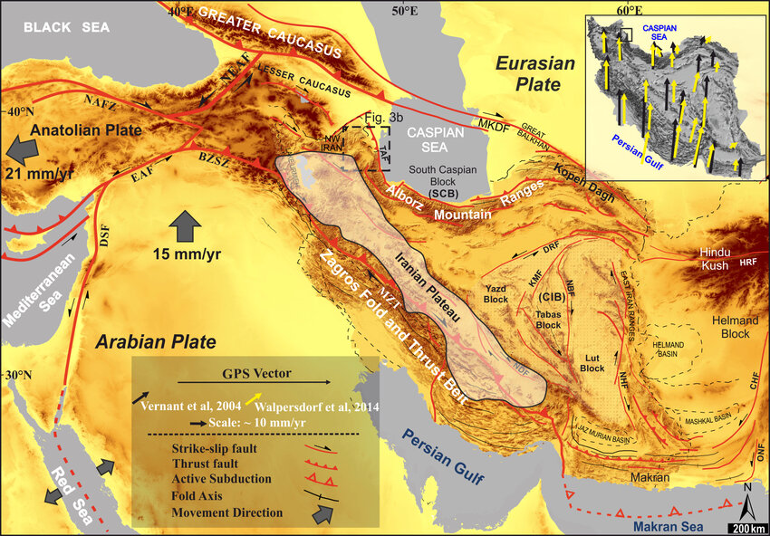
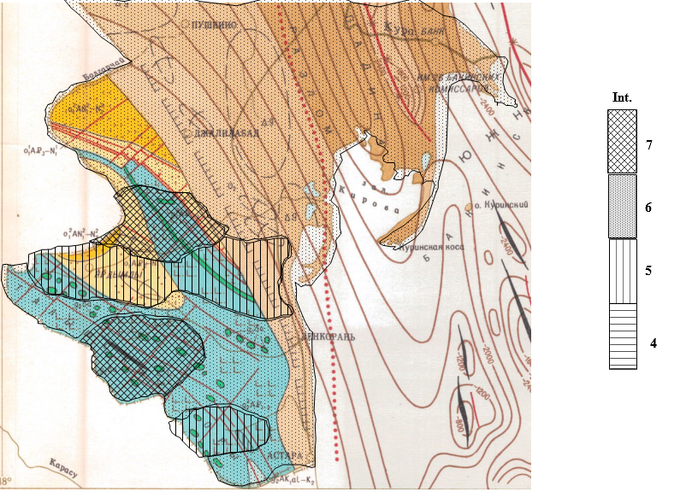
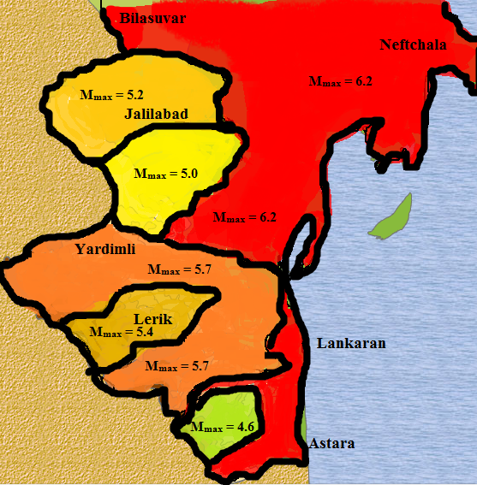

Empirical relationship among seismic and fault parameters
on the Talysh dynamic earthquake zone (southern Azerbaijan)
Aliyev M.M., Aliyev Y.N., Babayev G.R, Ismayuil-zade T.T.
Methods / Data
Seismic catalog (instrumental + historical events)
Fault geometry and slip data (mapped & literature)
Applied empirical regression & scaling laws (e.g., Mw–rupture length, displacement)
P1.2-101
Geology and Geophysics Institute
Ministry of Science and Education of Azerbaijan
Highlighting the Talysh zone within the larger Arabia–Eurasia collision framework, with a clean shaded-relief style
Location
The Talysh region is situated in southern Azerbaijan and extends into northwestern Iran. It lies along the western margin of the South Caspian Basin, forming part of the broader Arabia–Eurasia collision zone.
Boundaries
East: Caspian Sea and the Lankaran Lowland.
Southwest: Northern slopes of the Alborz Mountains (Iran).
North: Transitions into the Kur Depression.
Approximate coordinates: 47.3°–49.5°E longitude and 37.8°–39.4°N latitude.
Geological/Tectonic Setting
This area is part of an active orogenic belt, shaped by compressional and transpressional tectonics. It hosts thrust, reverse, and strike-slip faults, which segment the landscape and govern local seismicity.
Seismic Importance
The Talysh zone is a dynamic earthquake-prone region, with recorded moderate-to-strong earthquakes (Mw 5.0–6.5). Its tectonic complexity and proximity to populated areas make it a critical focus for seismic hazard studies
Results
Strong correlation: Magnitude vs. rupture length & displacement
Larger faults = host Mw 5.5–6.5 earthquakes
Fault segmentation controls recurrence & seismic clustering
Conclusion
Empirical scaling validates fault-based hazard assessment
Talysh zone = significant seismic risk for southern Azerbaijan
Findings aid regional hazard mapping & risk mitigation
DISCLAIMER: This presentation has been generated for illustration purposes only

