Slide 1

Introduction Slide Title goes here [Font: Arial Bold/Size: 16]
Empirical relationship among seismic and fault parameters
on the Talysh dynamic earthquake zone (southern Azerbaijan)
P1.2-101
Aliyev M.M., Aliyev Y.N., Babayev G.R, Ismayuil-zade T.T.
Geology and Geophysics Institute
Ministry of Science and Education of Azerbaijan
This presentation examines the empirical relationships linking seismic parameters—such as magnitude, displacement, and recurrence intervals—with fault characteristics in the Talysh dynamic earthquake zone of southern Azerbaijan. It discusses the methodological framework, illustrates scaling trends with representative analyses, and highlights how these findings can enhance seismic hazard assessment, scenario modeling, and risk mitigation strategies in the region.
DISCLAIMER: This presentation has been generated for illustration purposes only.

Slide 2
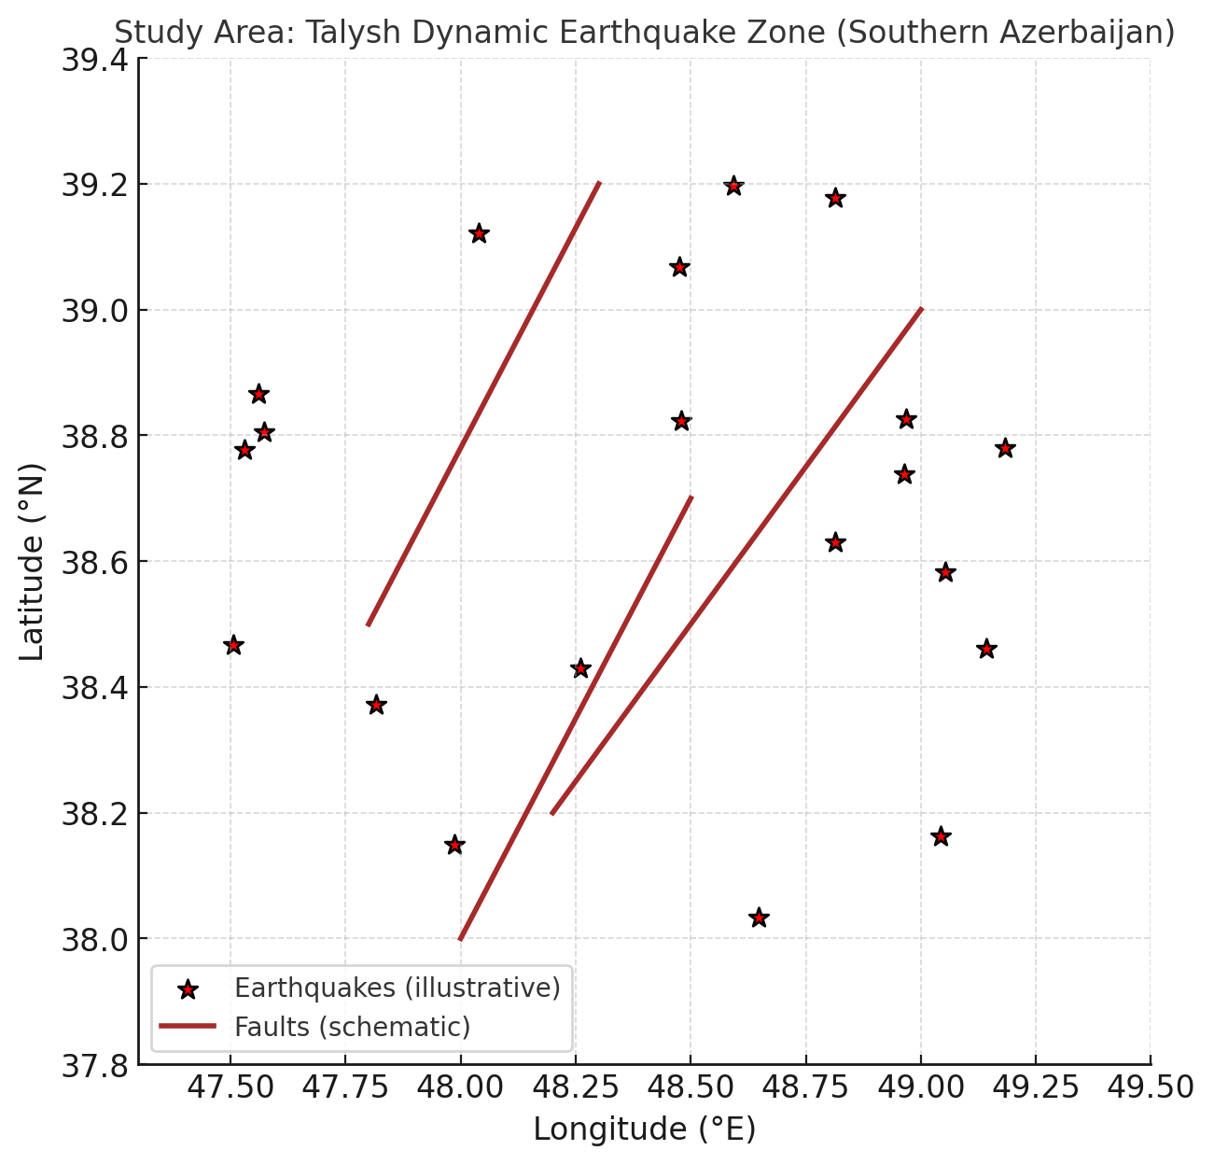
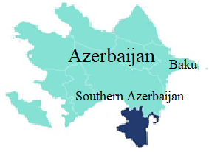
Empirical relationship among seismic and fault parameters
on the Talysh dynamic earthquake zone (southern Azerbaijan)
Introduction
Aliyev M.M., Aliyev Y.N., Babayev G.R, Ismayuil-zade T.T.
The Talysh dynamic earthquake zone, located in southern Azerbaijan along the Talysh Mountains near the Azerbaijan–Iran border, is a region of significant seismotectonic activity. Understanding the relationships between seismic parameters—such as moment magnitude, ground motion, and recurrence intervals—and fault characteristics like length, displacement, and slip rate is crucial for seismic hazard assessment. This study aims to develop empirical scaling relationships specific to this region, providing a foundation for scenario earthquake modeling, risk evaluation, and infrastructure planning. By comparing regional trends with established global models, the study also seeks to identify unique characteristics of the Talysh fault systems.
Results
P1.2-101
Methods/Data
The study identified clear correlations between moment magnitude (Mw) and fault length and displacement, indicating that longer and more active faults tend to produce larger earthquakes. Recurrence intervals were inversely related to slip rates, consistent with general tectonic principles, though local variations reflect structural complexity and segmentation in the Talysh zone. These empirical relationships, while broadly aligned with global trends, reveal distinct regional patterns likely influenced by compressional and transpressional tectonics, fault geometry, and lithologic contrasts. Illustrative figures show log–linear scaling for Mw versus fault length and displacement, and recurrence intervals versus slip rates, highlighting both the trends and scatter inherent to natural systems.
A comprehensive dataset was compiled, including historical and instrumental earthquake catalogs, fault geometry data (length, surface displacement and segmentation), and geologic and geodetic information. Statistical analyses were conducted to explore log–linear and multivariate relationships between seismic and fault parameters. Regression techniques, including least-squares methods, were applied to identify scaling trends, while bootstrapping was used to estimate uncertainties. Spatial association of earthquakes to mapped fault segments was verified, and data quality control measures, such as magnitude homogenization, declustering were implemented to ensure reliability.
Conclusions
Empirical relationships derived for the Talysh dynamic earthquake zone provide a practical basis for regional seismic hazard assessment and scenario earthquake modeling. These findings facilitate more accurate estimation of potential earthquake magnitudes, recurrence times, and fault behavior. Future work should incorporate refined paleoseismic and geodetic data, improve slip-rate constraints, and expand the earthquake catalog to enhance predictive capability. Integration of these relationships into probabilistic and deterministic hazard models will improve regional earthquake preparedness, risk mitigation, and infrastructure resilience.
DISCLAIMER: This presentation has been generated for illustration purposes only

