Slide 1
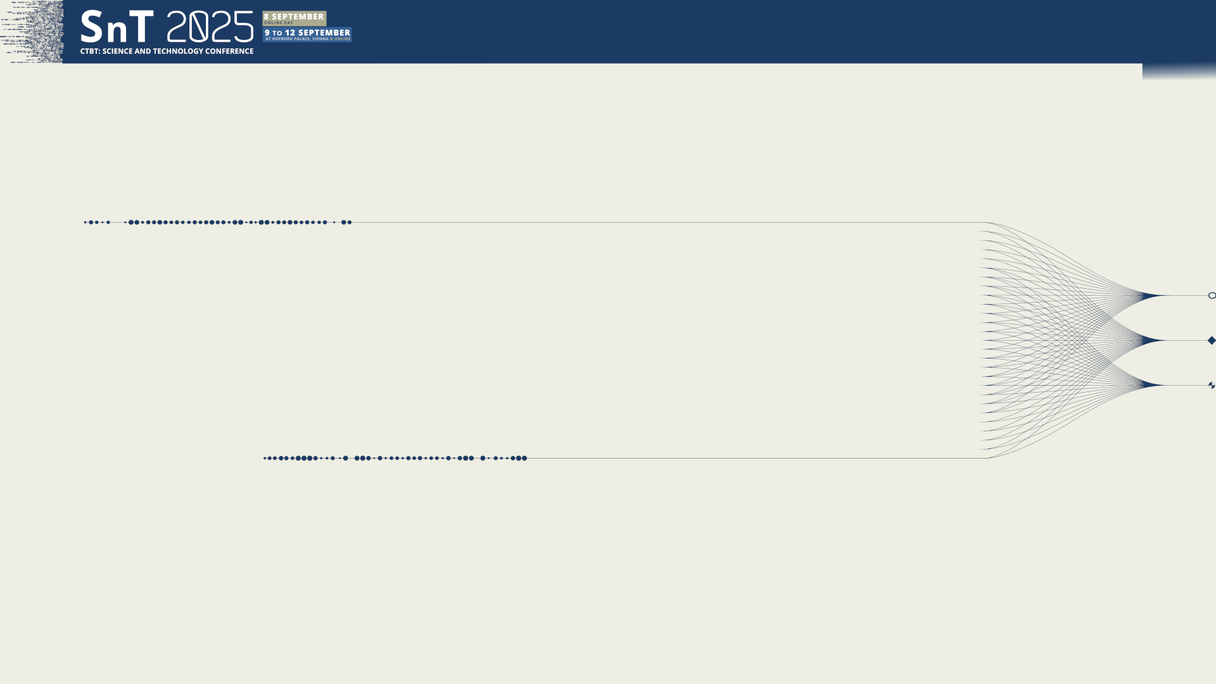
O1.2-510
Image Earth’s Inner Core Fine-scale Heterogeneity and Temporal Changes using IMS arrays
Guanning Pang
Assistant Professor / University of Science and Technology of China
Presentation Date: 08 Sep 2025
Collaborators: Keith Koper; Sin-Mei Wu; Wei Wang; Ruoyan Wang; John Vidale

Slide 2
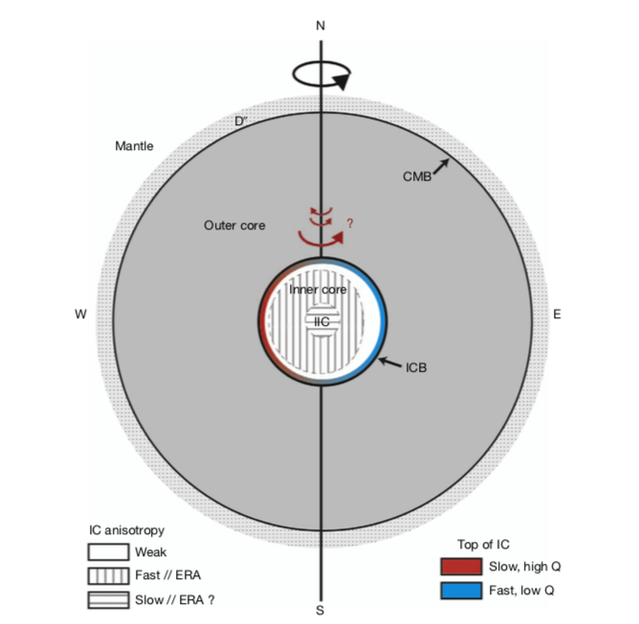
O1.2-510
Image Earth’s Inner Core Fine-Scale Heterogeneity and Temporal Changes using IMS arrays
“Standard” Inner Core Model
Solid-ish (viscosity of 10¹⁰⁻²⁰ pas)
Radius of 1221 km (bigger than Pluto)
~95% Fe/Ni, 5% (Si, S, ??)
Elastically anisotropic (conductively too?)
Hemispheric dichotomy
Maybe rotating faster or slower than the rest of the Earth
Souriau & Calvet (2015)

Slide 3
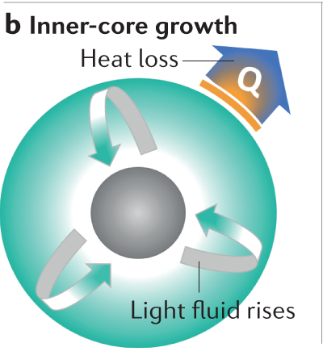
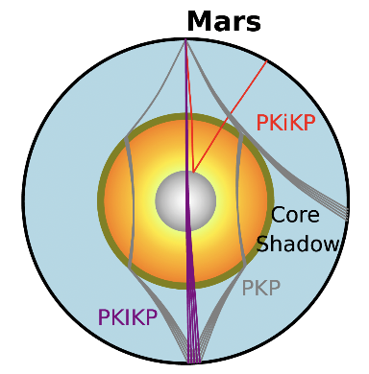
O1.2-510
Image Earth’s Inner Core Fine-Scale Heterogeneity and Temporal Changes using IMS arrays
Importance of Inner Core
Generation of the geomagnetic field
Reference for terrestrial planets, e.g., Martian inner core
Bi et al. (in press)
Landeau et al. (2022)

Slide 4
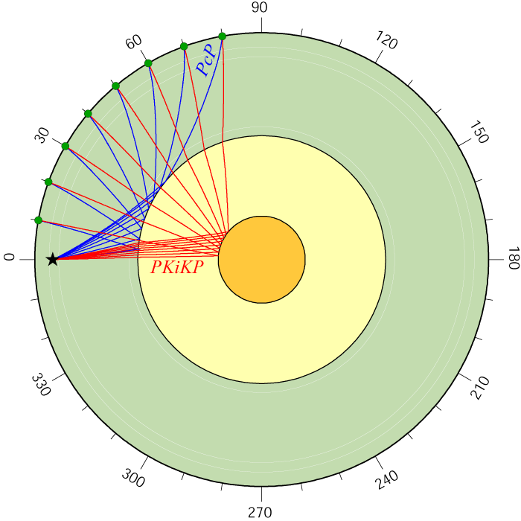
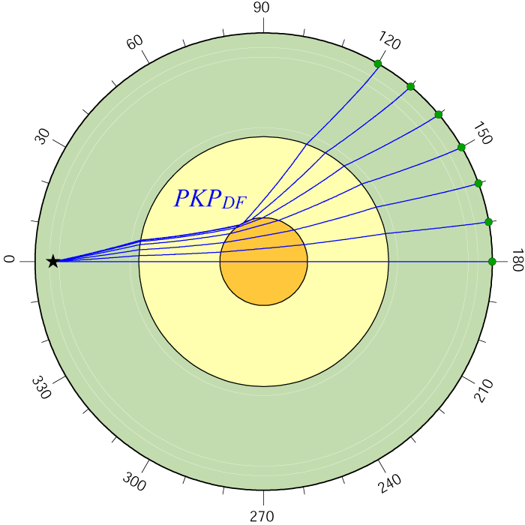
O1.2-510
Image Earth’s Inner Core Fine-Scale Heterogeneity and Temporal Changes using IMS arrays
Seismic Core Probe
Reflected waves
Refracted waves
Figures from Ed Garnero

Slide 5
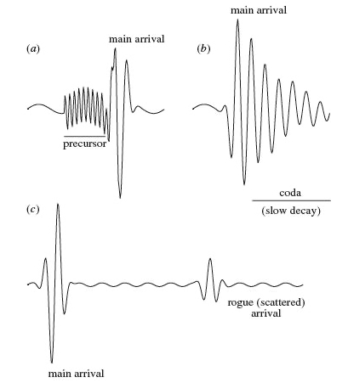
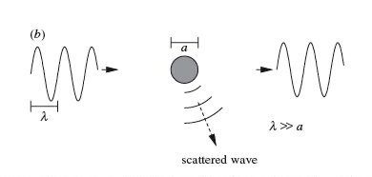
O1.2-510
Image Earth’s Inner Core Fine-Scale Heterogeneity and Temporal Changes using IMS arrays
Scattered and Coda Waves
Density or Velocity anomalies
Helffrich (2002)

Slide 6
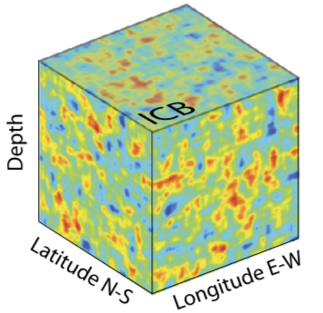
O1.2-510
Image Earth’s Inner Core Fine-Scale Heterogeneity and Temporal Changes using IMS arrays
Inner Core is NOT homogeneous in 1–10 km scale
Tiny inner core scattered signal after PKiKP
Pang et al. (2023)
Calvet & Margerin (2018)

Slide 7
O1.2-510
Image Earth’s Inner Core Fine-Scale Heterogeneity and Temporal Changes using IMS arrays
Global imaging of inner core fine-scale heterogeneity
Pang et al. (2023)
Global IMS small aperture arrays
Global PKiKP coda dataset

Slide 8
O1.2-510
Image Earth’s Inner Core Fine-Scale Heterogeneity and Temporal Changes using IMS arrays
Global imaging of inner core fine-scale heterogeneity
PKiKP coda characterizations
Global Inner core sampling of IMS arrays
Pang et al. (2023)

Slide 9
O1.2-510
Image Earth’s Inner Core Fine-Scale Heterogeneity and Temporal Changes using IMS arrays
Global imaging of inner core fine-scale heterogeneity
Ubiquitous heterogeneity
No hemispheric dichotomy
Regional variations
Stronger in the equator region
Increasing strength with depth
Pang et al. (2023)

Slide 10
O1.2-510
Image Earth’s Inner Core Fine-Scale Heterogeneity and Temporal Changes using IMS arrays
Inner core delayed nucleation and two-step growth
IC steady growth
IC supercooling
Inner core nucleation was delayed by ~0.07–0.12 𝝉_{ic}, supercooling 20–30 K
Pang et al. (2023)

Slide 11
O1.2-510
Image Earth’s Inner Core Fine-Scale Heterogeneity and Temporal Changes using IMS arrays
Inner core temporal change
Decadal-scale changes have been observed in the inner core seismic waveform
Inner core superrotation Vs. Non-rotational changes
Intermittent changes in inner core PKIKP coda
Pang & Koper (2022)

Slide 12
O1.2-510
Image Earth’s Inner Core Fine-Scale Heterogeneity and Temporal Changes using IMS arrays
Inner core changed only in 2001–2003
PKIKP coda only changes if the earthquake doublets cross 2001–2003
Polar seismic ray paths have more significant changes, expected from inner core differential rotation
Pang & Koper (2022)

Slide 13
O1.2-510
Image Earth’s Inner Core Fine-Scale Heterogeneity and Temporal Changes using IMS arrays
Inner core burst of differential rotation
A burst of differential rotation of ~0.5° during 2001–2003
Relatively small differential rotation during 1991–2001 and 2003–2017
What is happening after 2003?
Pang & Koper (2022)

Slide 14
O1.2-510
Image Earth’s Inner Core Fine-Scale Heterogeneity and Temporal Changes using IMS arrays
Inner core backtracking
Focus on SSI–ILAR & YKA and expand earthquake doublet to 2023
PKIKP changes between 2002–2009, but match up again between 2002–2022
Wang et al., (2024)

Slide 15
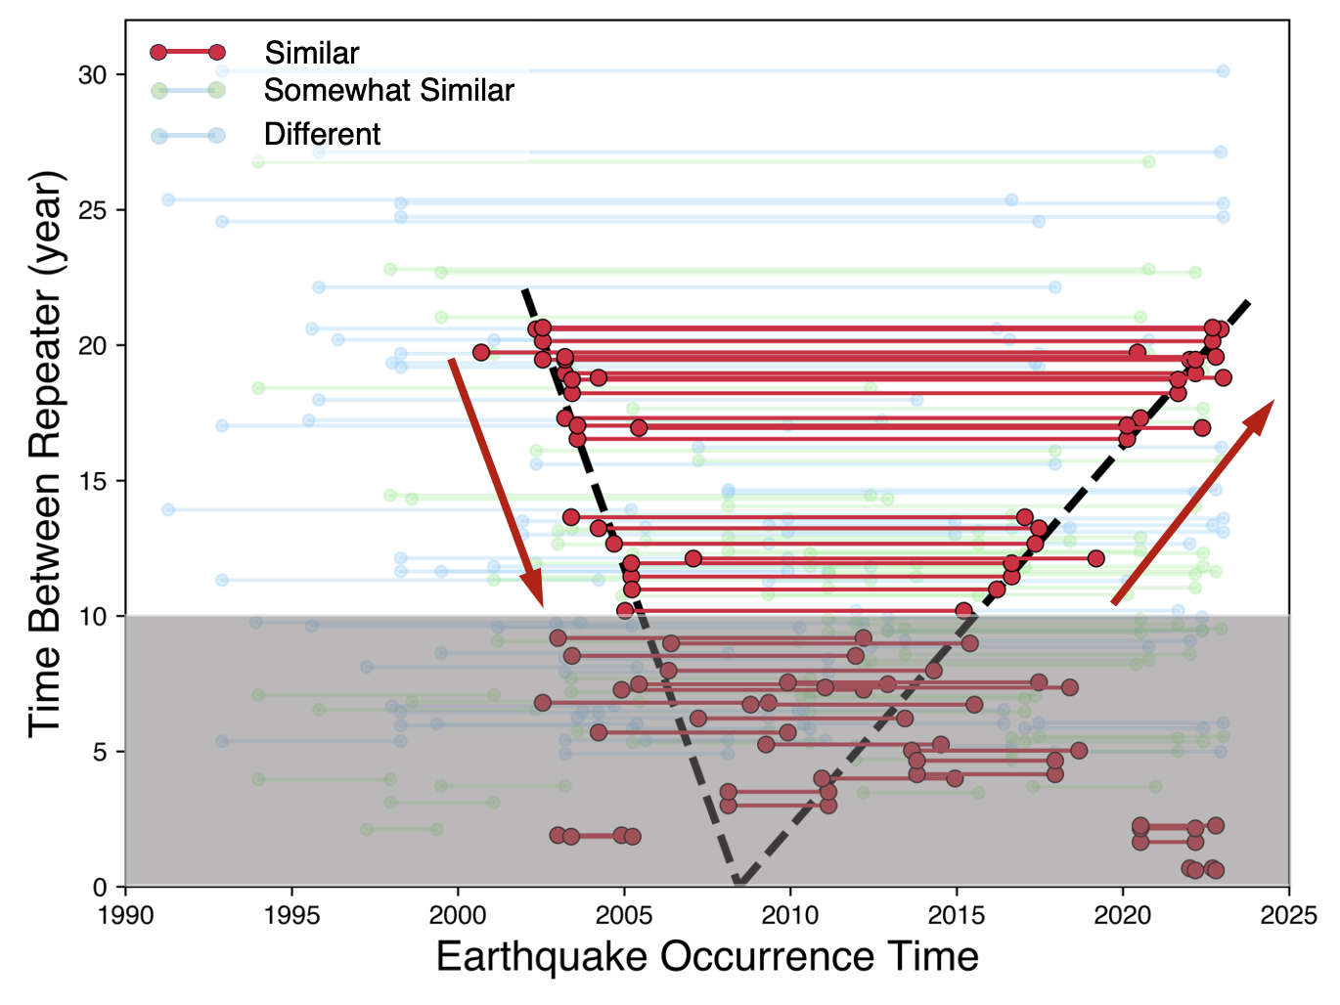
O1.2-510
Image Earth’s Inner Core Fine-Scale Heterogeneity and Temporal Changes using IMS arrays
Inner core backtracking
Inner core super-rotation from 2003–2008
From 2008–2023, sub-rotate 2–3 times more slowly back to the same path
Wang et al. (2024)

Slide 16
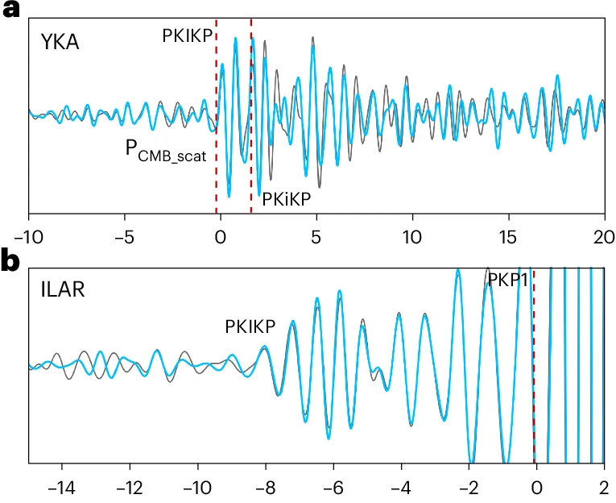
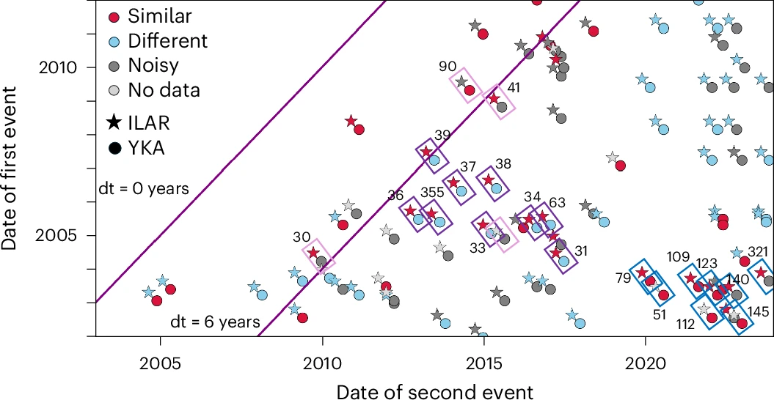
O1.2-510
Image Earth’s Inner Core Fine-Scale Heterogeneity and Temporal Changes using IMS arrays
More than rotation: Changes in Inner core’s shape
Tiny changes in waveform in YKA but not ILAR
Changes in Inner core’s shape that only change the shallow ray paths at YKA
Vidale et al. (2025)

Slide 17
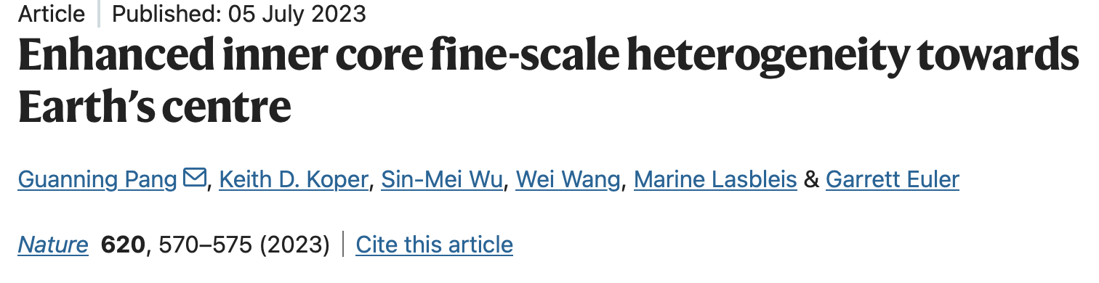
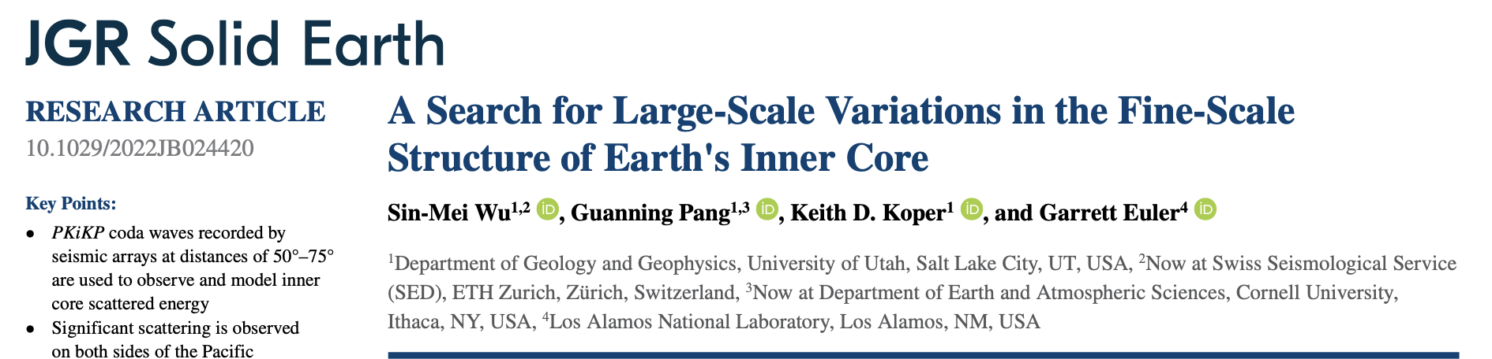
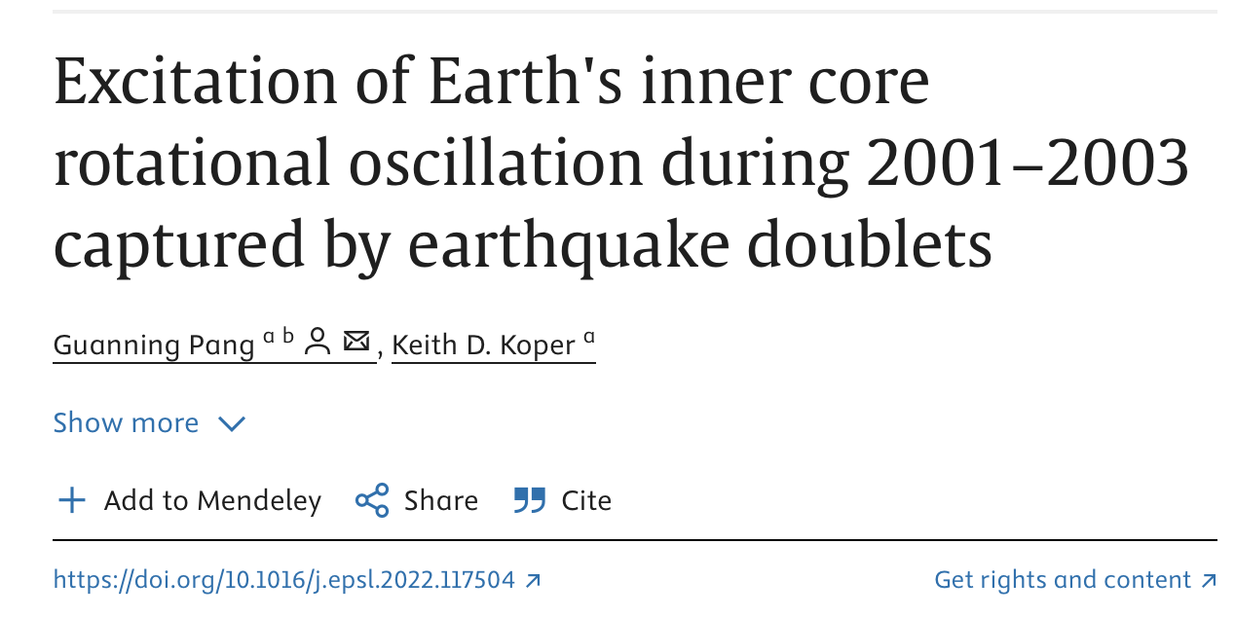
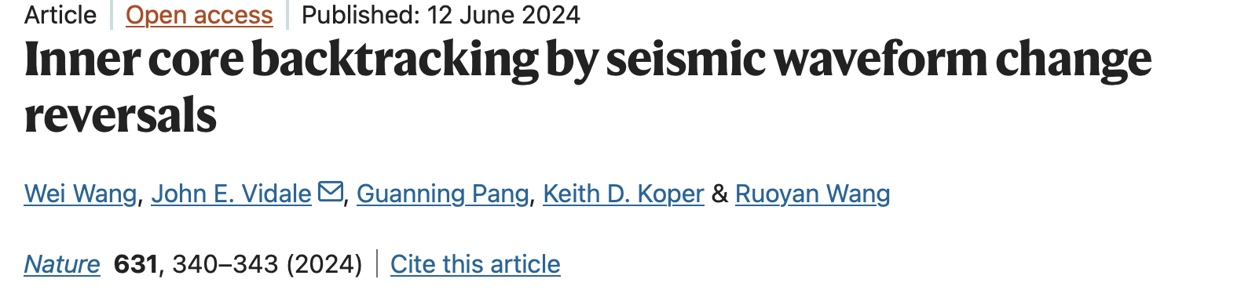
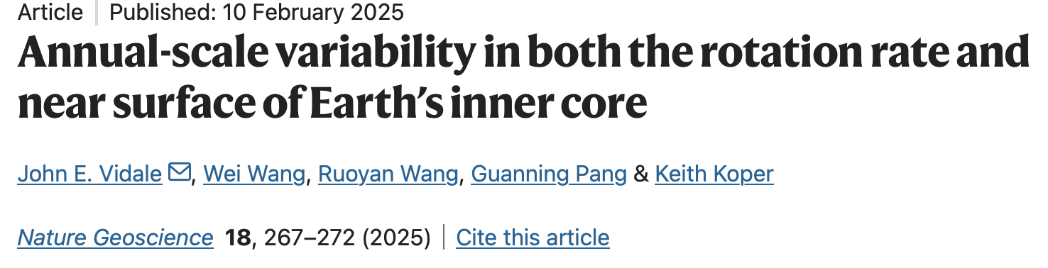
O1.2-510
Image Earth’s Inner Core Fine-Scale Heterogeneity and Temporal Changes using IMS arrays
All works are published

