Slide 1


P1.1-228
Investigation of anomalously fast infrasound phases from global bolide events
Elizabeth A. Silber¹, Christoph Pilger², Miro Ronac Giannone¹, Summer Czarnowski^{3,*}, Vedant Sawal¹
¹Sandia National Laboratories, Albuquerque, NM, 87123; ²Federal Institute for Geosciences and Natural Resources (BGR), Hannover, Germany; ³North Dakota State University, Fargo, ND, 58108, USA
Infrasound signals from energetic events sometimes arrive earlier than predicted. Among 172 global bolide detections, some show anomalously fast arrivals at distances up to thousands of kilometers. We investigate whether these early arrivals result from source or propagation effects, aiming to improve interpretation and global monitoring capabilities.
*work performed during summer internship at Sandia
SNL is managed and operated by NTESS under DOE NNSA contract DE-NA0003525. The views expressed here do not necessarily reflect the opinion of the United States Government, the United States Department of Energy, or NTESS. SAND2025-11113C

Slide 2
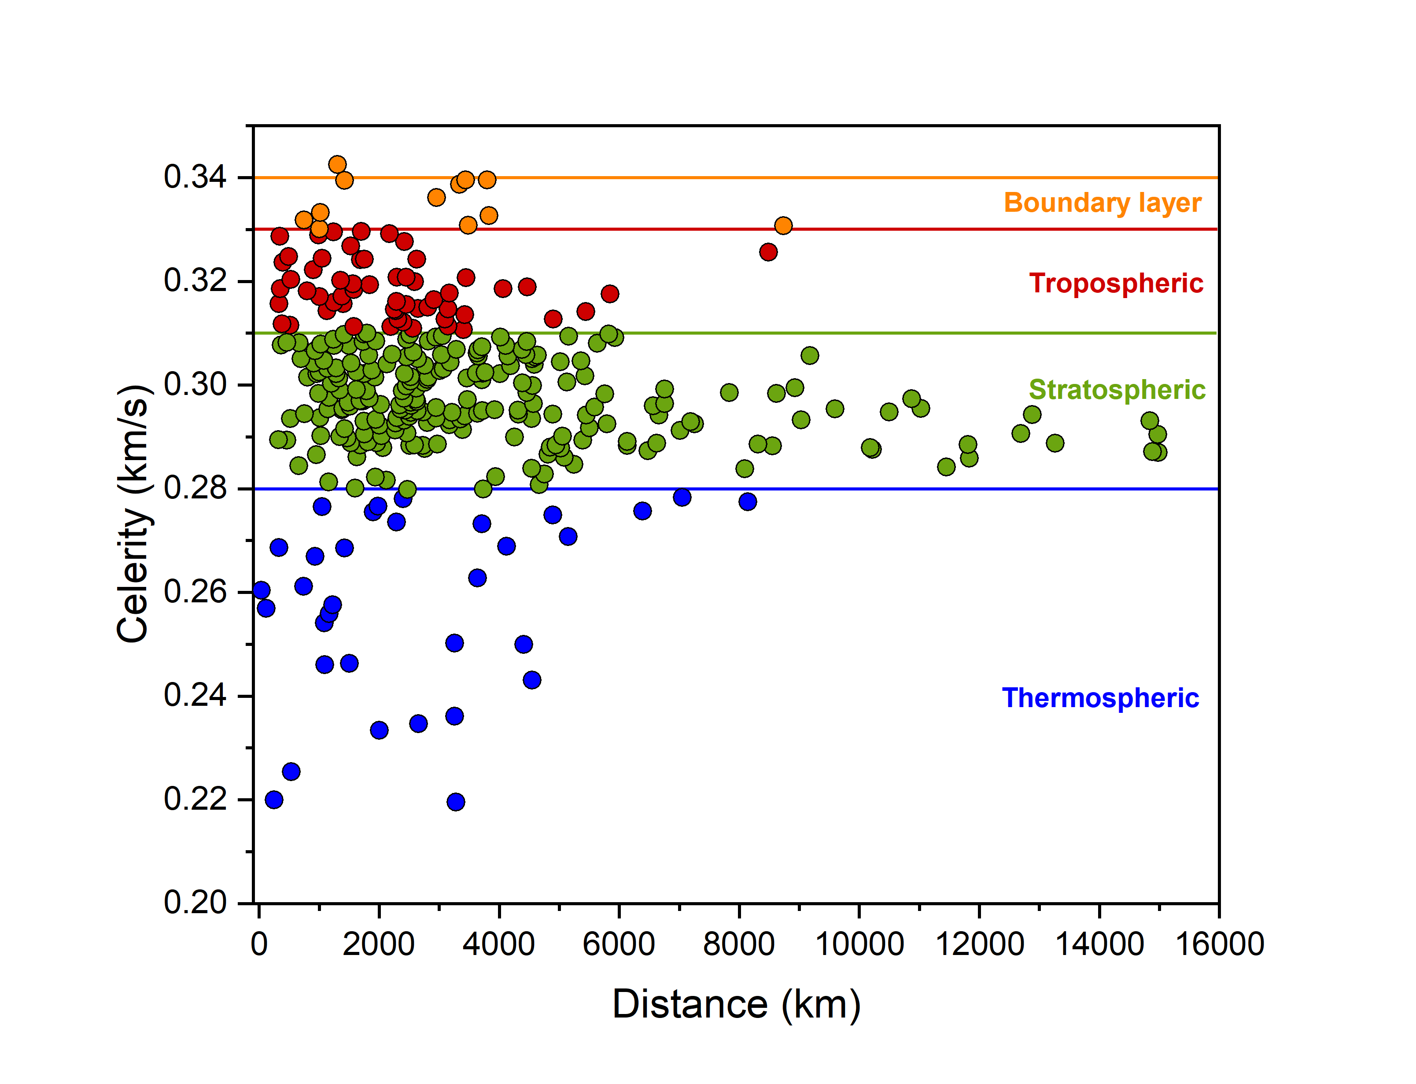
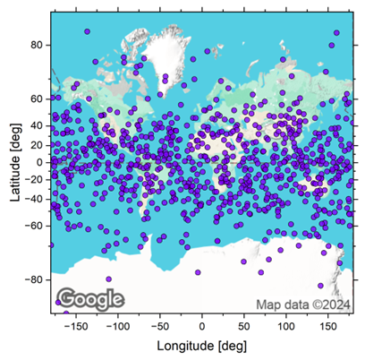

P1.1-228
Investigation of anomalously fast infrasound phases from global bolide events
Elizabeth A. Silber, Christoph Pilger, Miro Ronac Giannone, Summer Czarnowski, Vedant Sawal
A. Silber
Background and Motivation
Data Set and Preliminary Results
Summary
Bolides can generate infrasound signals detectable globally; understanding their propagation patterns aids global monitoring and event characterization [1,2].
While typical infrasound signals follow predicted arrival times, some bolide events produce anomalously early arrivals, challenging current models and interpretations.
Examining a global dataset of bolide detections (shown below) helps identify and investigate causes of these unexpected early arrivals, improving our understanding of infrasound signal propagation.
We analyze a dataset of 172 globally distributed bolide detections, combining data from US government sensors and published global infrasound detections [2].
Observed signal celerities, defined as the ratio of source-to-station distance to measured travel time, were calculated and compared to theoretical values for standard atmospheric waveguides (boundary layer, tropospheric, stratospheric, and thermospheric).
Preliminary results (above) indicate most signals align with expected stratospheric arrivals. However, a notable subset exhibits anomalously fast arrivals, even at distances exceeding several thousand kilometers.
Early-arriving signals suggest influences from atmospheric propagation conditions or source characteristics, warranting further investigation.
Identifying underlying causes, such as wind-driven stratospheric ducts, waveguide characteristics, or specific source properties, is critical for refining signal interpretation accuracy.
Understanding anomalously fast infrasound arrivals advances event characterization, contributing directly to improvements in global infrasound monitoring capabilities, including verification efforts for the Comprehensive Nuclear-Test-Ban Treaty (CTBT).
Improved interpretation of early-arriving signals can strengthen the reliability of global monitoring networks by distinguishing between natural energetic events (bolides) and anthropogenic sources, thereby supporting international monitoring and verification objectives.
References:
[1] Pilger et al. (2020) doi: 10.3390/atmos11010083.
[2] Silber, et al. (2025) doi: 10.3847/1538-3881/add47d
SNL is managed and operated by NTESS under DOE NNSA contract DE-NA0003525. The views expressed here do not necessarily reflect the opinion of the United States Government, the United States Department of Energy, or NTESS. SAND2025-11113C

Slide 3

P1.1-228
Investigation of anomalously fast infrasound phases from global bolide events
Elizabeth A. Silber¹, Christoph Pilger², Miro Ronac Giannone¹, Summer Czarnowski^{3,*}, Vedant Sawal¹
¹Sandia National Laboratories, Albuquerque, NM, 87123; ²Federal Institute for Geosciences and Natural Resources (BGR), Hannover, Germany; ³North Dakota State University, Fargo, ND, 58108, USA
At long ranges, infrasound predominantly propagates through the stratospheric waveguide.
However, some infrasound signals arrive at stations earlier than anticipated.
We investigate the causes for fast infrasound phases to determine if earlier than anticipated arrivals are caused by source or propagation effects, or both.
For more details, visit our poster!
*work performed during summer internship at Sandia
SNL is managed and operated by NTESS under DOE NNSA contract DE-NA0003525. The views expressed here do not necessarily reflect the opinion of the United States Government, the United States Department of Energy, or NTESS. SAND2025-11113C

