Slide 1

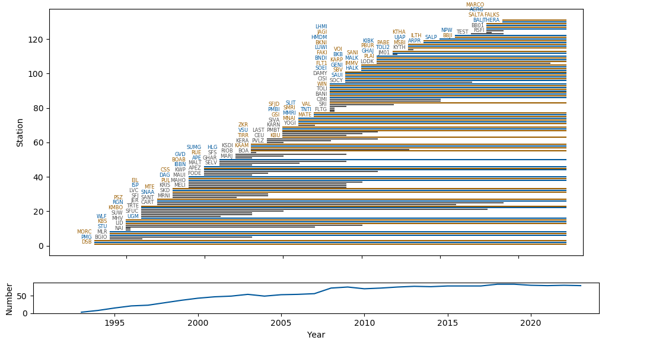
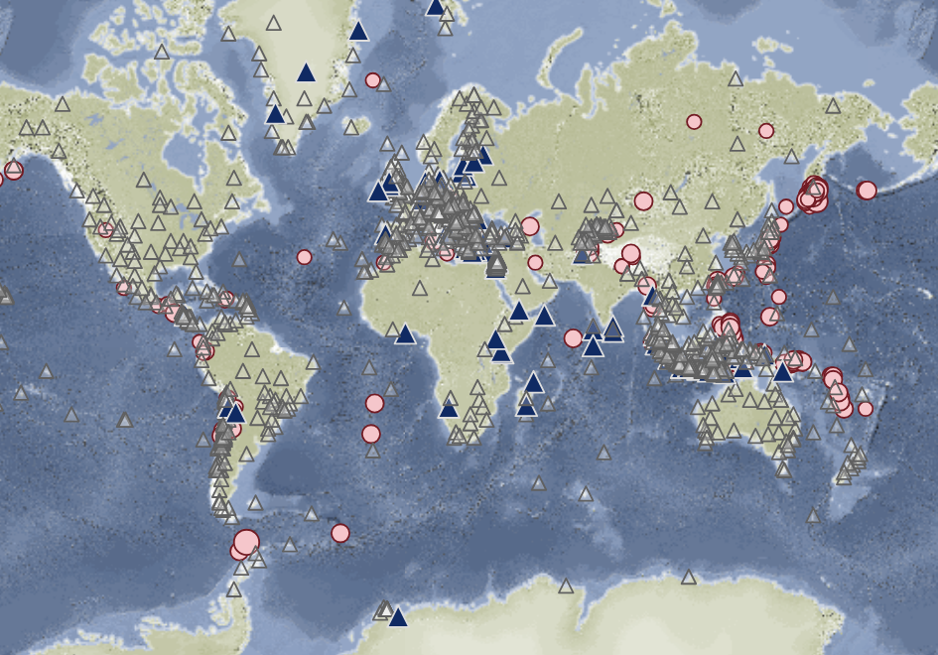
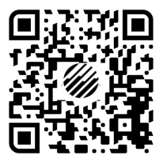

International Monitoring System Sustainment into the future
PANEL
Pa07
Angelo Strollo
GEOFON Program Manager
GFZ Helmholtz Centre for Geosciences
Our mission: GEOFON seeks to facilitate cooperation in seismological research and earthquake and tsunami risk mitigation by providing rapid transnational access to seismological data and source parameters of large earthquakes, and keeping these data accessible in the long term.
It pursues these aims by operating and maintaining a global network of permanent seismic stations in cooperation with local partners, facilitating real-time access to data from this network and those of many partner networks and plate boundary observatories, and providing a FAIR archive for seismological data. Using real-time data streams, GEOFON provides rapid automatic earthquake parametric information to the scientific community, tsunami warning centres worldwide, organizations involved in rescue operations, news media and the general public (https://geofon.gfz.de/)
100+ stations
30+ years

