Slide 1


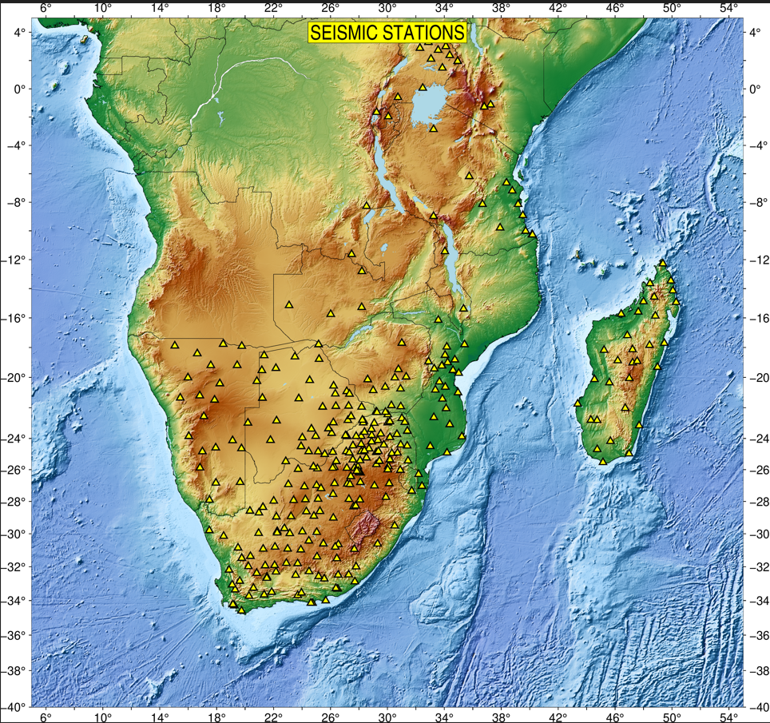
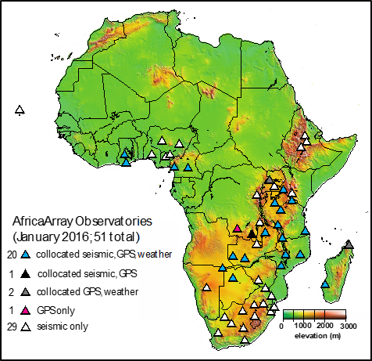
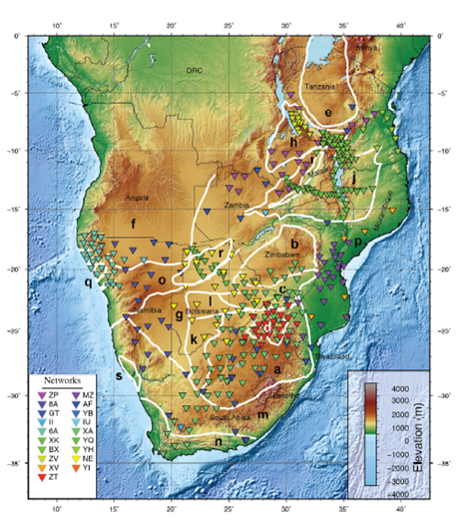

IMS sustainment now and into the future
PANEL
Pa07
Professor Raymond Durrheim
School of Geosciences, University of the Witwatersrand, SOUTH AFRICA
Backbone network ~50 stations; >100 temporary stations; ~20 countries
Training and technical support for station operators and analysts,
Crust and mantle structure,
Geodynamics,
Ground‐Truth Criteria for local events recorded on regional networks,
Discrimination between tectonic and mining-induced earthquakes and explosions
Research & Capacity-building Programme (2005 – present)
Backbone network
Temporary arrays
Stations used for recent studies

