Slide 1

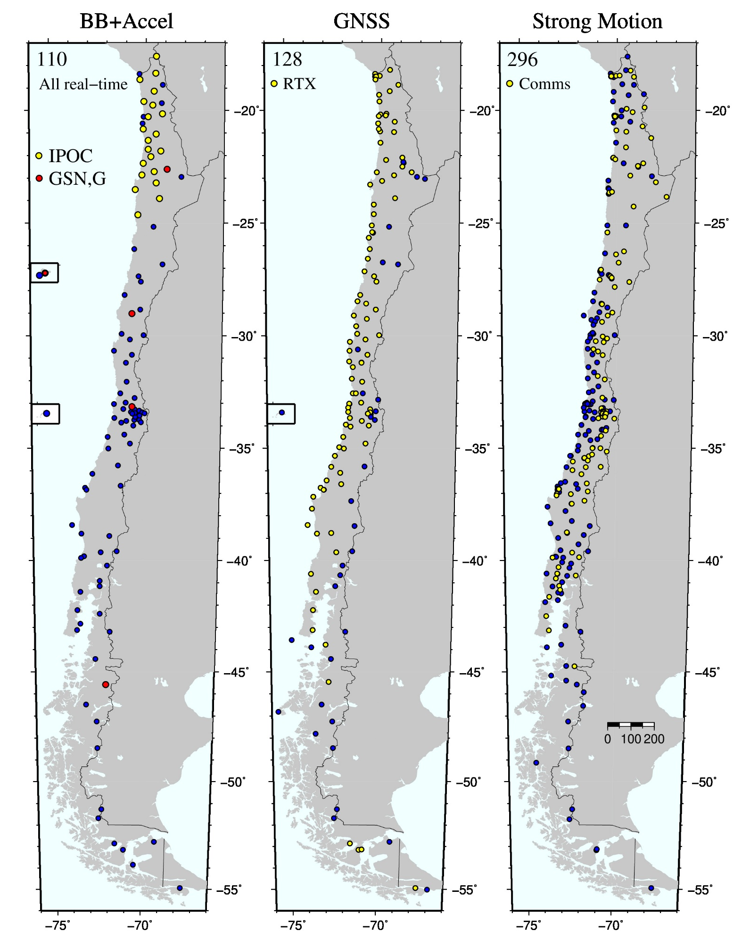

International Monitoring System Sustainment into the future
PANEL
Pa07
Sergio Barrientos
National Seismological Center, University of Chile
Seismological Network
More than 500 instruments (110 BB+accelerometers, 128 GNSS and 296 accelerographs) comprise the Chilean National Seismic Network.
Al the signals of the BB+accel network together with the signals of the GNSS with RTX capabilities (real-time positioning on site) are transmitted in real time. The Strong Motion network was designed for earthquake engineering purposes, so no need to be on-line. At present, more than 150 have been connected in real-time.
Network is aging. More than 15 yrs in the field.
Main purposes of the National Network:
a) Prompt information for tsunami warnings of local origin,
b) Rapid estimation of most likely earthquake affected areas.
c) Earthquake hazard maps preparation
d) Input for design of earthquake-resistant structures
.
DISCLAIMER (if any) [Arial Regular/ Font Size 8]

