Slide 1
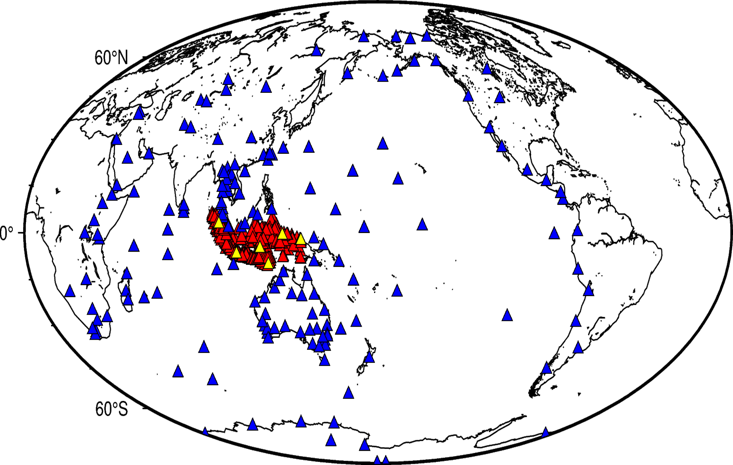
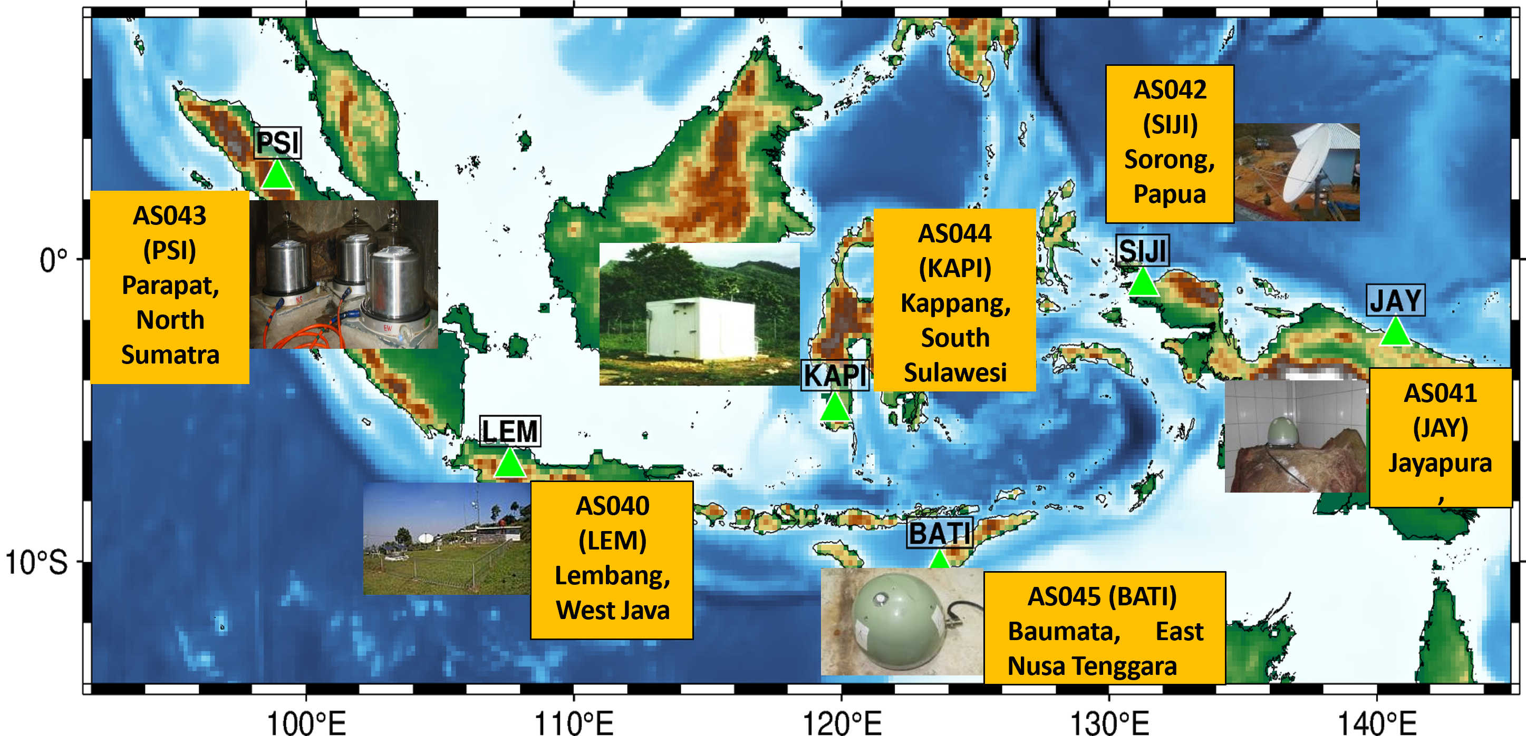

International Monitoring System Sustainment into the future
PANEL
Lestari Naomi Lydia Pandiangan
Meteorology, Climatology, and Geophysics Agency of Indonesia (BMKG)
Pa07
SCOPE OF THE NDC
CHALLENGES AND LESSON LEARNED
Integration with National Data
NDC are integrated with national earthquake and tsunami monitoring system
Real-time waveform data is shared through IRIS/EIDA
Collaboration with national agencies under MOU enhances data exchange and joint operations
.
Common Challenges
Tsunami modeling and sensors focus only on seismic/tectonic events.
Limited expertise in non-seismic IMS technologies.
Communication bandwidth via VSAT limited (150 Mbytes/day), hindering real-time data transmission.
.
Waveform Monitoring
BMKG as NDC accesses data from the 6 Auxiliary Seismic Station (AS040-AS045: LEM, JAY, SIJI, PSI, BATI, KAPI)
The NDC also manages national Seismic network and processes waveform data for both treaty related and disaster warning purposes
.
Lesson learned
Integrating multiple monitoring technologies improves detection.
CTBTO training enhances national technical capacity.
Software development increases earthquake detection accuracy.
Multilateral cooperation strengthens trust and preparedness.
.
FUTURE SUSTAINMENT
Expand expert exchange and capacity building.
Improve durability and quality of monitoring stations for longer operation.
Integrate multi-sensor technologies for better detection.
Strengthen international cooperation for real-time data sharing.
Upgrade communication infrastructure for higher bandwidth
Develop automated, reliable monitoring systems for sustainability.
.
Indonesian owned seismographs (549)
CTBTO seismograph stations (6 sensors)
Neighboring countries seismograph network (185)
INFRASTRUCTURE INFORMATION : GLOBAL COMMUNICATION INFRASTRUCTURE
Name of Establishment to host GCI Interface: Center for Communication Network of Meteorology, Climatology, and Geophysics Agency
Method of connection: Using a Very Small Aperture Terminal (VSAT) connection via the CTBTO GCI to receive real-time IMS data and IDC products at the rate of 150 Mbytes/day.
.
DISCLAIMER (if any) [Arial Regular/ Font Size 8]

