Slide 1


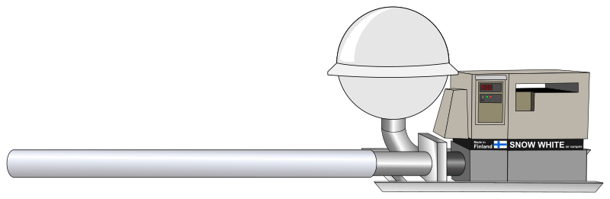
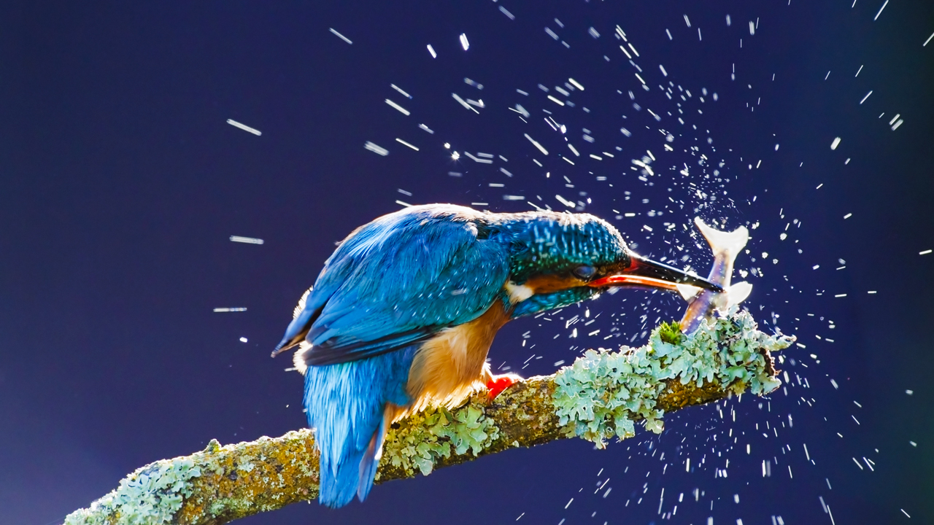
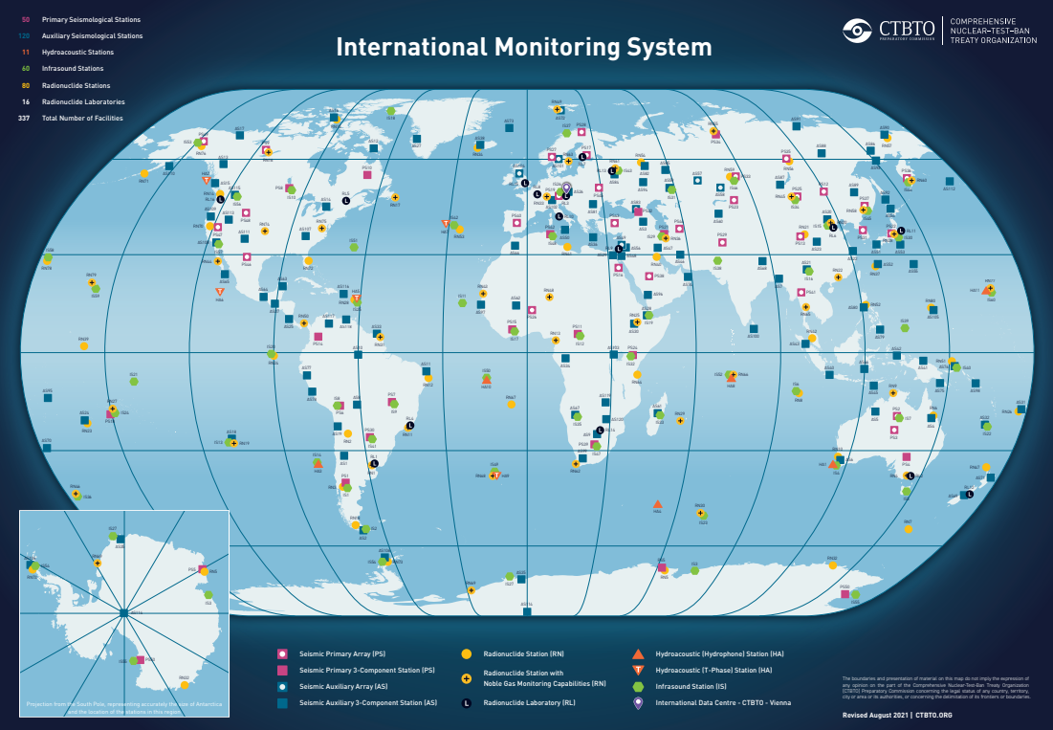
Impact of Extreme Conditions on the CTBTO Monitoring System
PANEL
Joanne Chapman
New Zealand Institute for Public Health and Forensic Science (PHF Science)
(formerly, New Zealand Institute of Environmental Science and Research (ESR))
Pa04
DISCLAIMER: The views expressed are mine alone and do not necessarily reflect the view of PHF Science or the CTBTO
Notes:
Joanne’s work has shown that air filters collected by Snow White and Cinderella samplers at IMS stations for monitoring atmospheric gases and radionuclides also trap DNA from species in the local vicinity.
She has sequenced the DNA collected on air filters from CTBTO headquarters in Vienna and identified a variety of taxa.
This work could be extended to archived air filters to characterise biodiversity changes on a global scale.

Slide 2
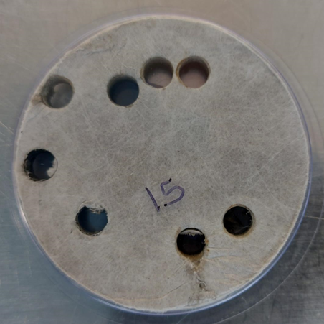
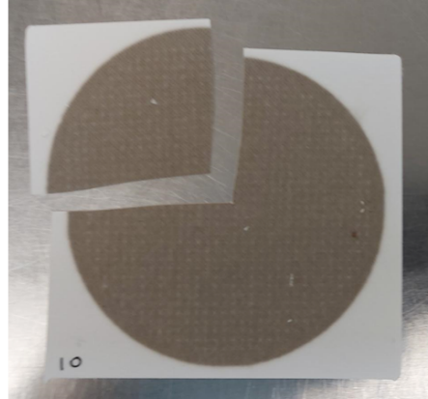
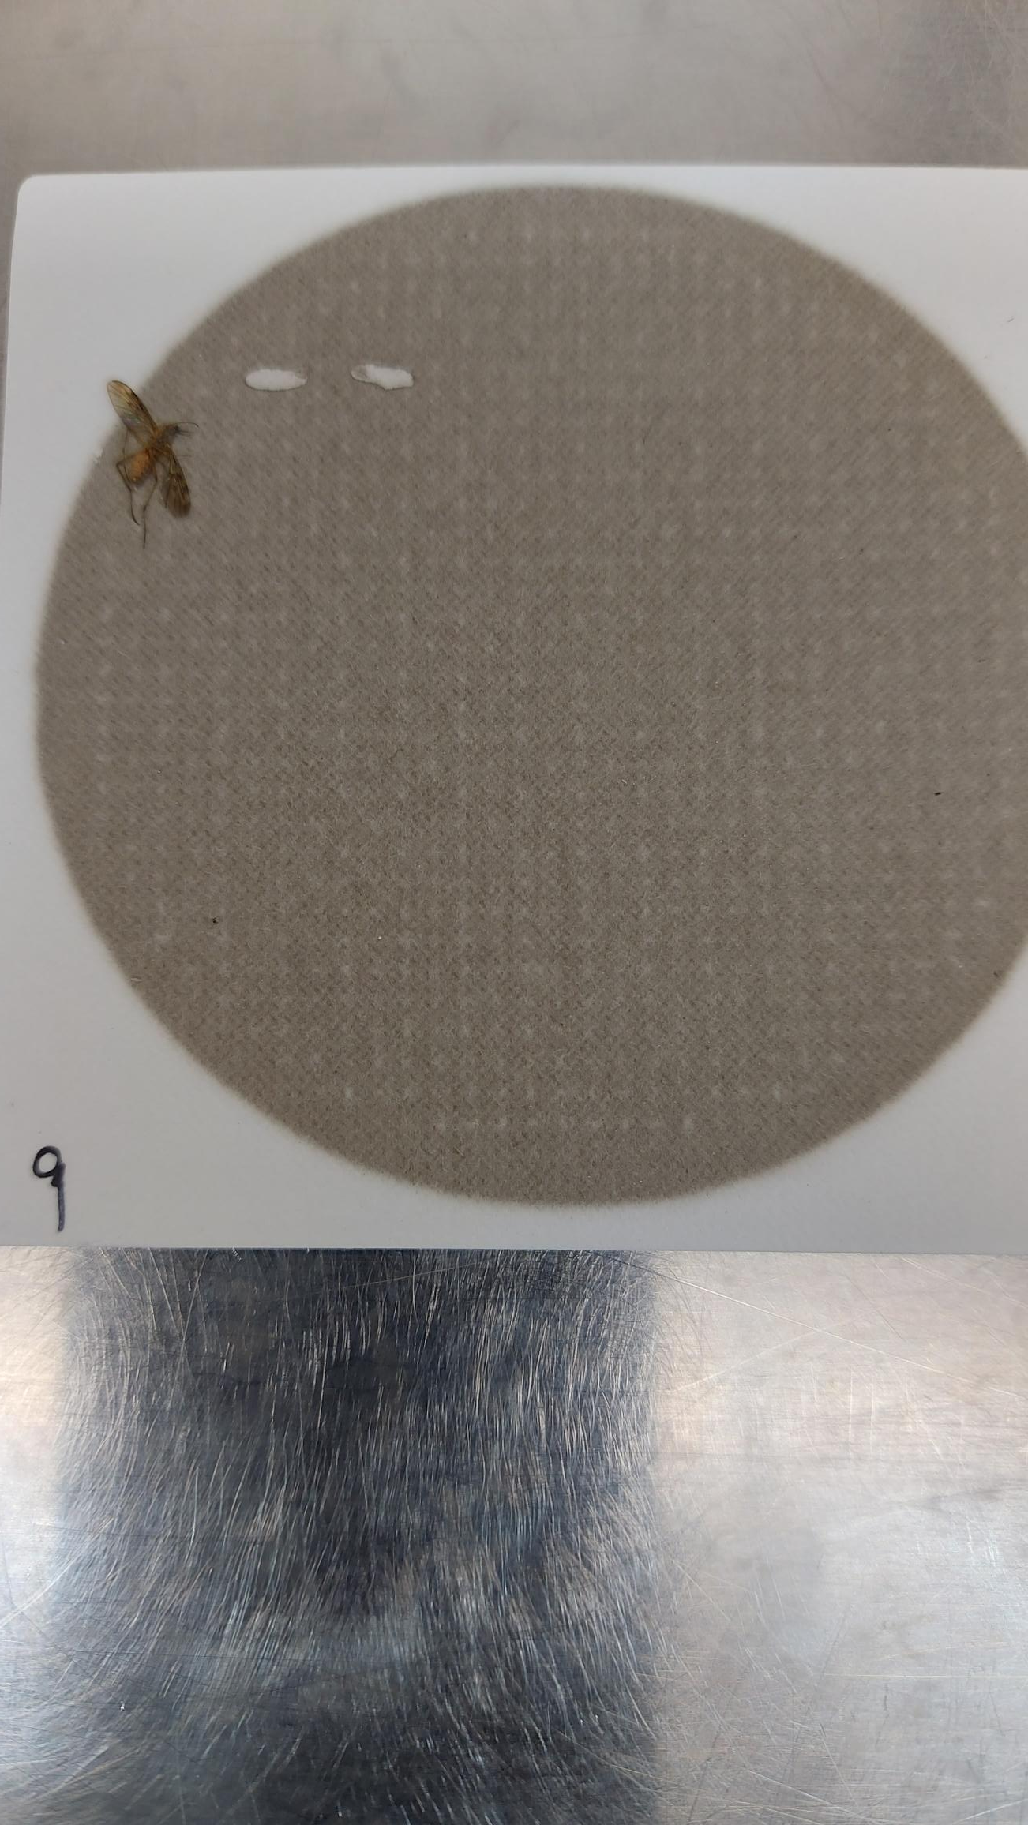
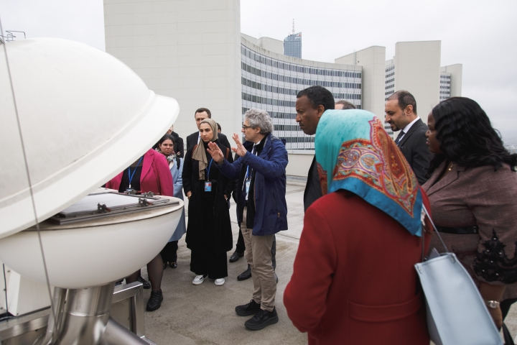
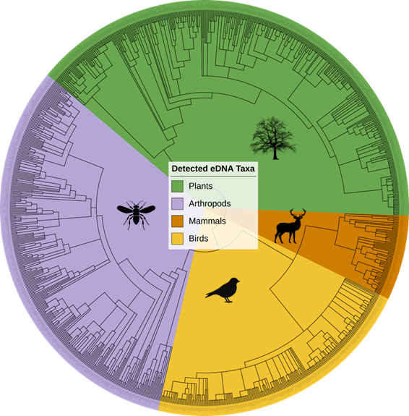
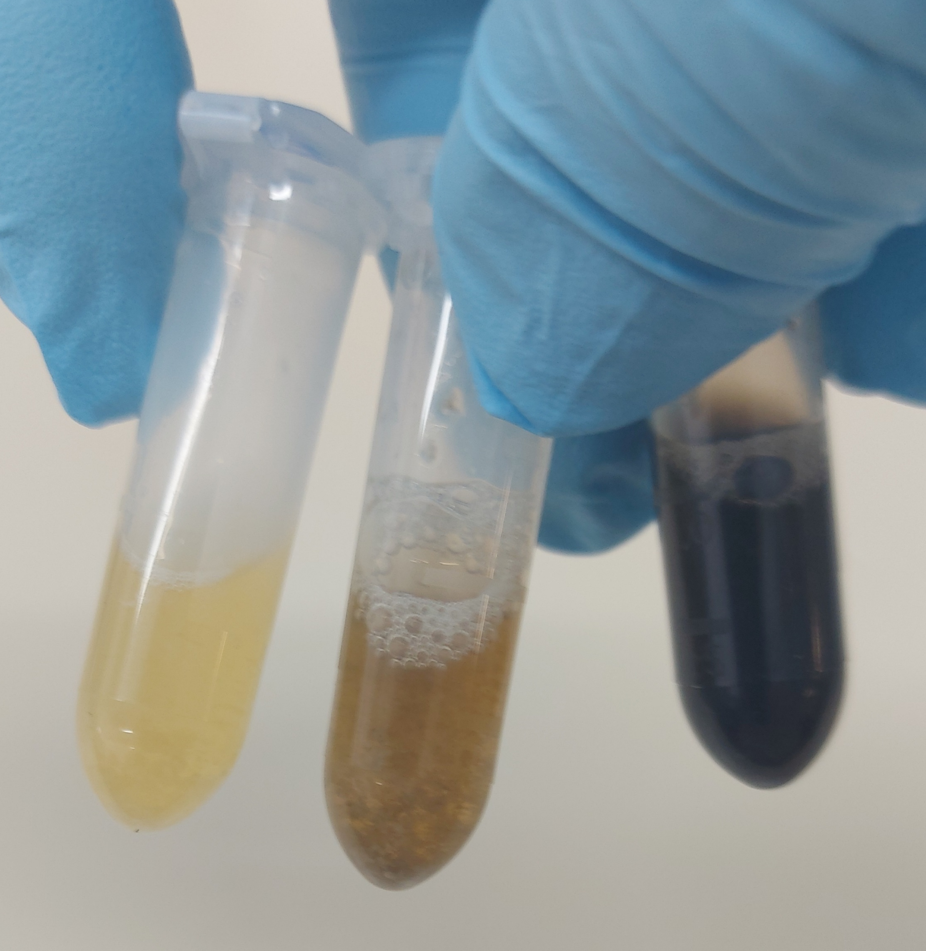
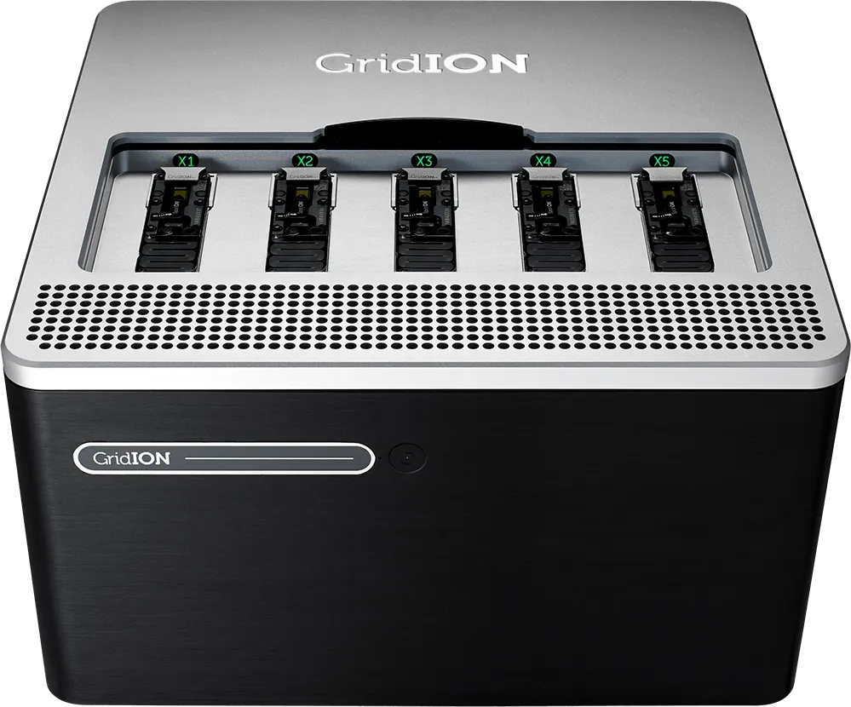
Impact of Extreme Conditions on the CTBTO Monitoring System
PANEL
Joanne Chapman
New Zealand Institute for Public Health and Forensic Science (PHF Science)
(formerly, New Zealand Institute of Environmental Science and Research (ESR))
Pa04
DISCLAIMER: The views expressed are mine alone and do not necessarily reflect the view of PHF Science or the CTBTO
Notes:
Joanne’s work has shown that air filters collected by Snow White and Cinderella samplers at IMS stations for monitoring atmospheric gases and radionuclides also trap DNA from species in the local vicinity.
She has sequenced the DNA collected on air filters from CTBTO headquarters in Vienna and identified a variety of taxa.
This work could be extended to archived air filters to characterise biodiversity changes on a global scale.

