Slide 1

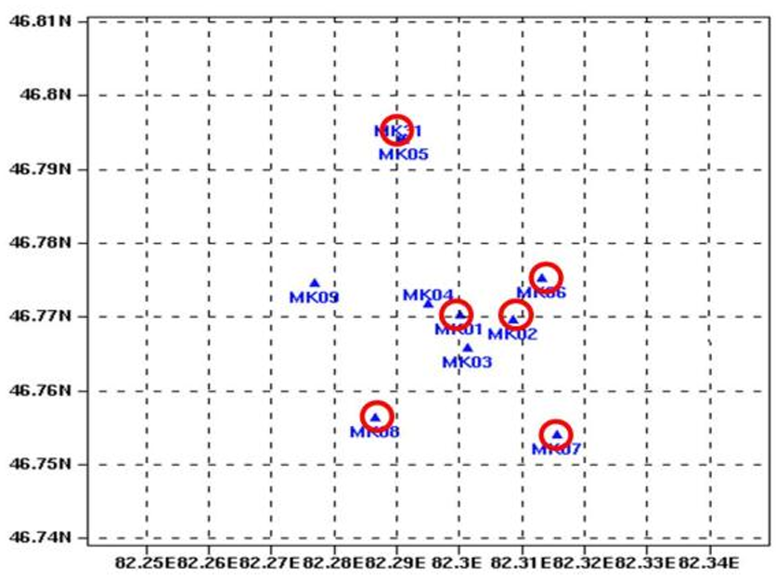
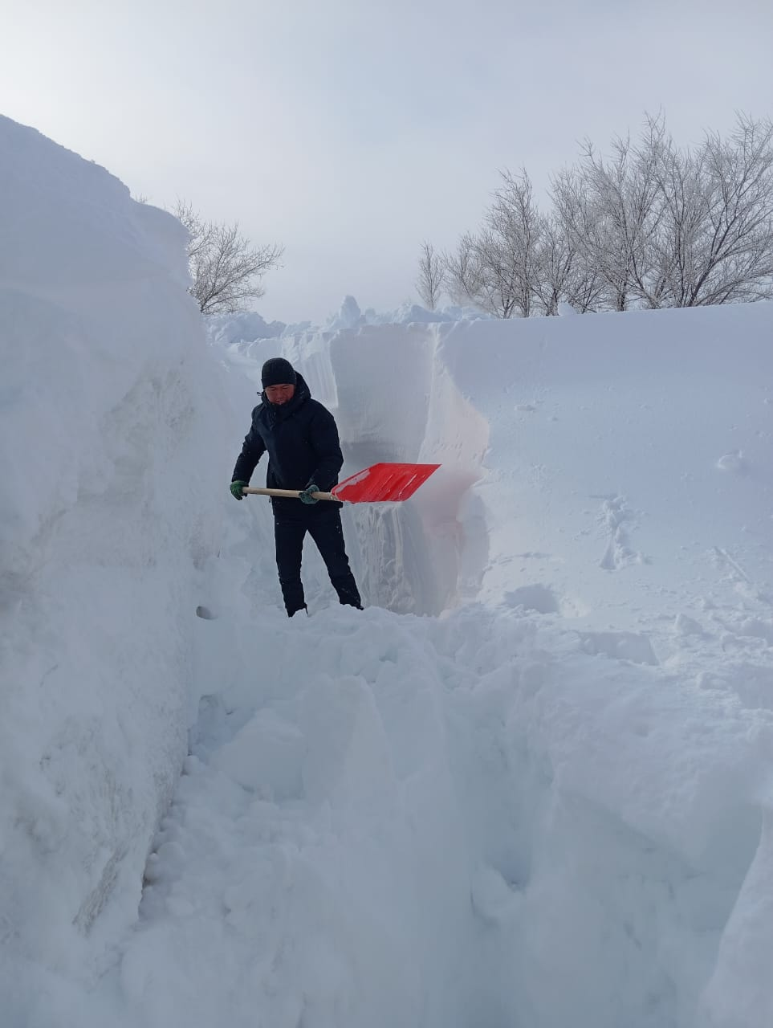
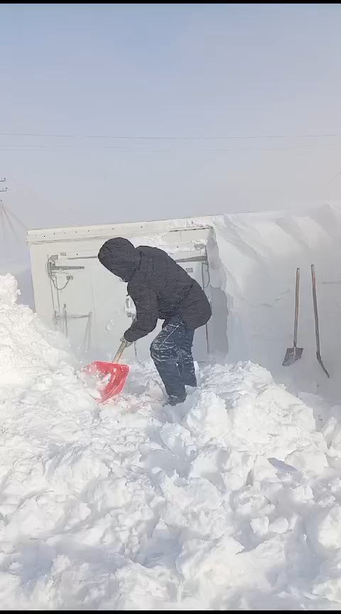
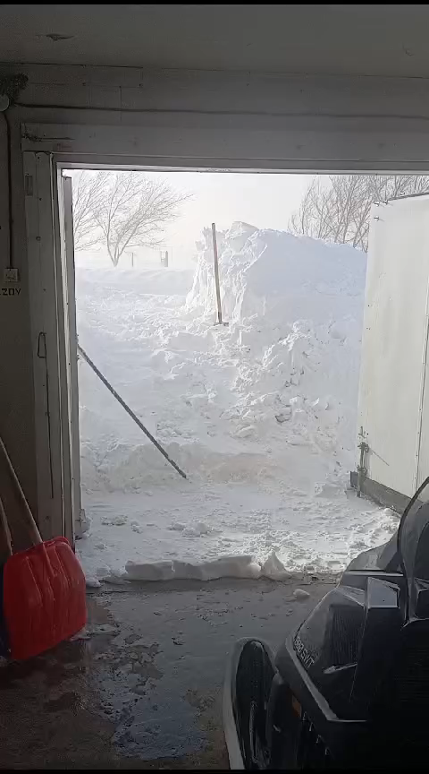
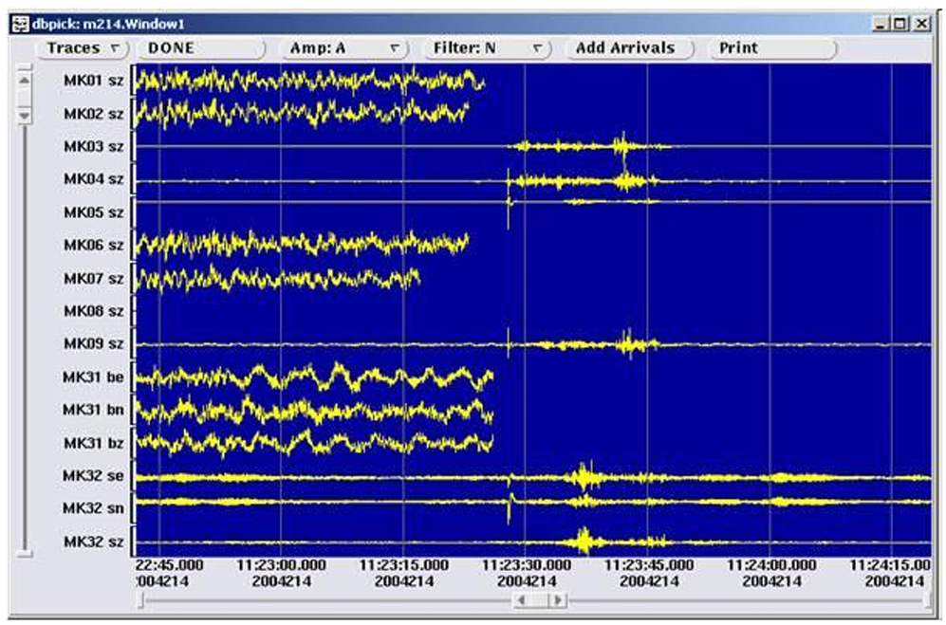
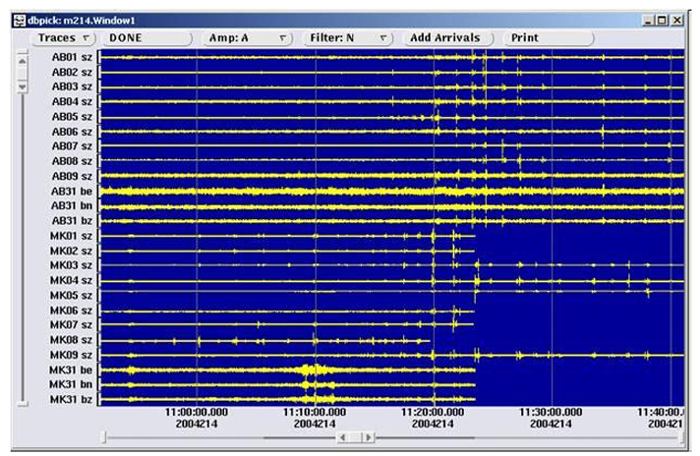
Impact of Extreme Conditions on the CTBTO Monitoring System
PANEL
lightning strike 01.08.2004
Blizzards (2025)
Pa04
DISCLAIMER: The views expressed are mine alone and do not necessarily reflect the view of PHF Science or the CTBTO

