Slide 1

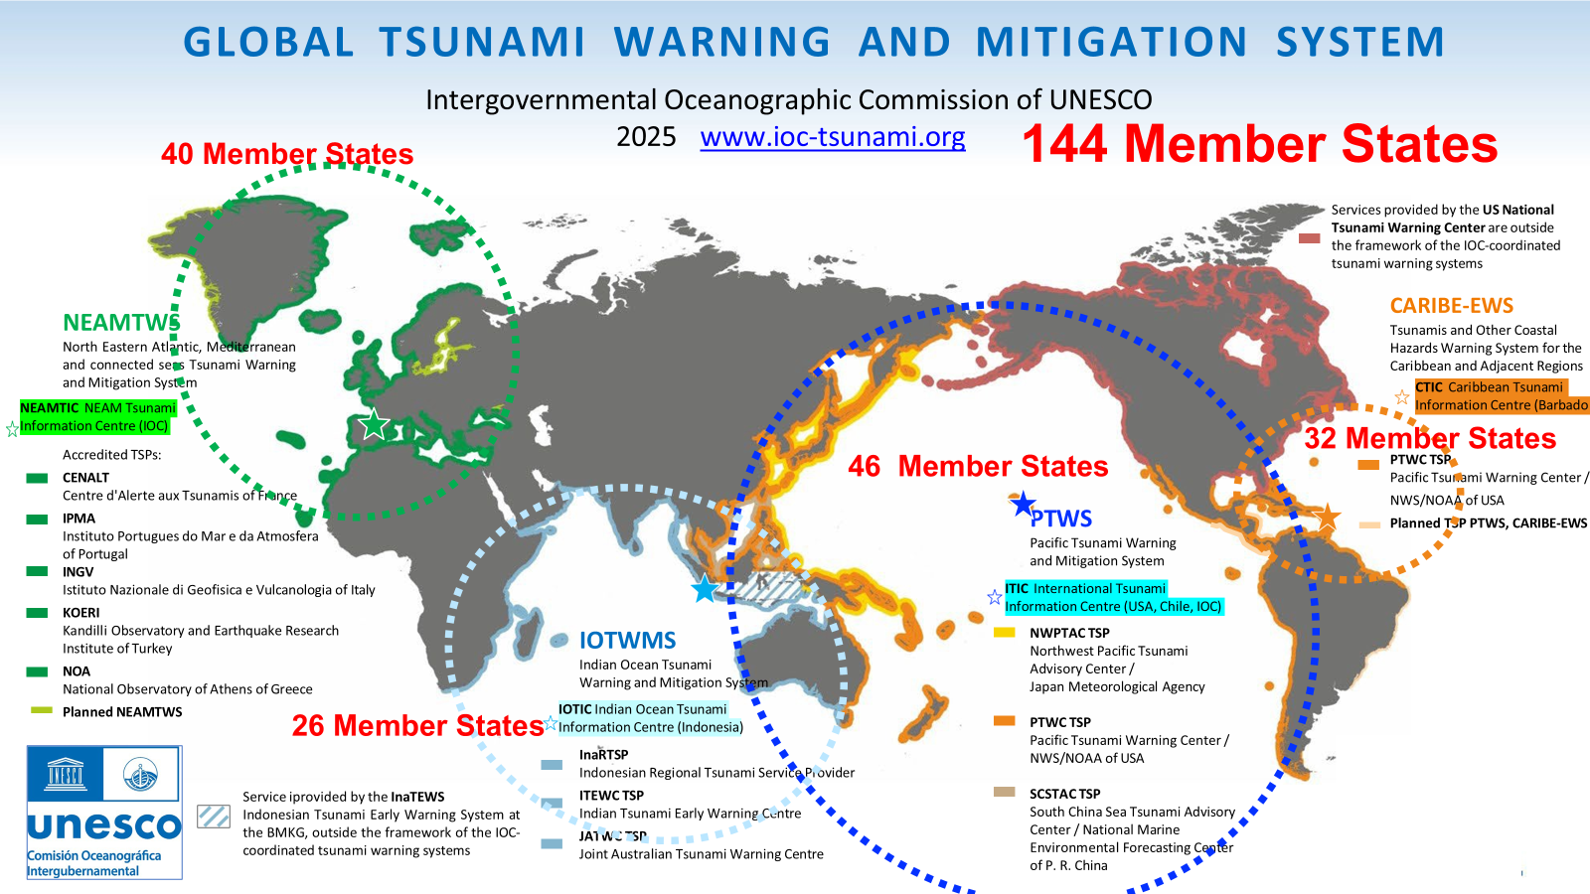

The impact of extreme conditions on the CTBT monitoring
PANEL
Pa04
Bernardo Alonso Aliaga Rossel
UNESCO Intergovernmental Oceanographic Commission – Head Tsunami Resilience Section
DISCLAIMER (if any) [Arial Regular/ Font Size 8]
Notes:
The Global Tsunami Warning and Mitigation System has 12 Tsunami Service Providers delivering regional services and a network of approximately 400 focal points working and communicating on daily basis.
Today, 20 years after the 2004 Indian Ocean Tsunami we can say that we have a mature and sustainable system

Slide 2
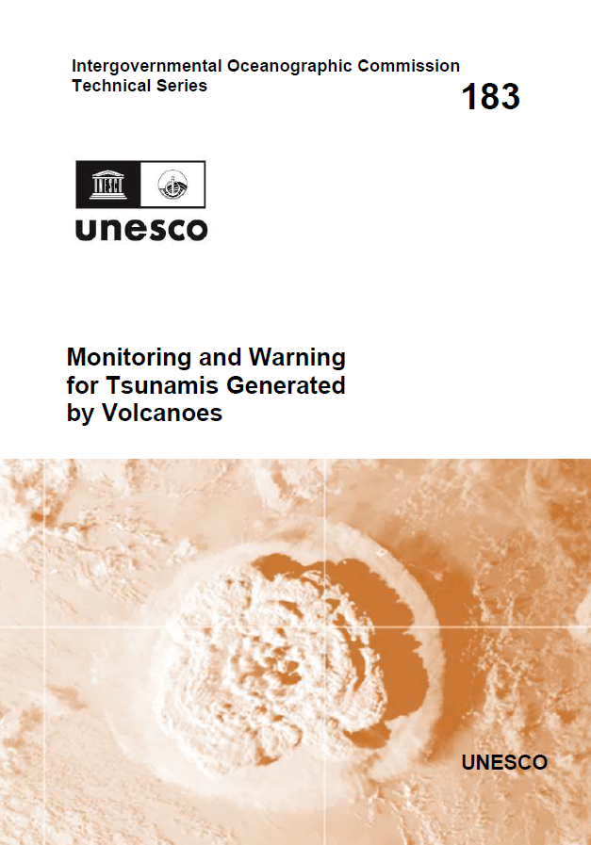
The impact of extreme conditions on the CTBT monitoring
PANEL
Pa04
IMS seismic data (primary/auxiliary) has proven to be essential to the Global Tsunami Early Warning and Mitigation System).
We are building the case to go one step beyond with the current testing phase of real time global assessment of tsunami risk using acoustic waves (check Session P1.4 on Thursday 11 September at 10:00).
National Tsunami Warning Centers (NTWCs) and (Regional) Tsunami Service Providers (TSPs) could access seismic, hydroacoustic and infrasound data under the current CTBTO-UNESCO Agreement.
2025 marks 15 years of CTBTO-UNESCO Agreement from which 21 NTWCs of 20 CTBTO Member States benefit.
Ongoing and promising: connect CTBTO and UNESCO-IOC Capacity Building Activities.
DISCLAIMER (if any) [Arial Regular/ Font Size 8]

