Slide 1

Introduction Slide Title goes here [Font: Arial Bold/Size: 16]
Px.x-yyy
CTBTO VDEC as a Way to Access Data Collected by the International Monitoring System (E-Poster slides example)
T. Oliveira, H. Hassani, S. Ali, L. Gaya Pique, M. Zampolli, P. Mialle, and M. Krysta
Comprehensive Nuclear-Test-Ban Treaty Organization (CTBTO)
This presentation provides insights related to the vDEC platform and gives a statistical overview of all past and current scientific applications, including several examples of topics addressed with IMS data accessed under vDEC contracts.
DISCLAIMER: This presentation has been generated for illustration purposes only.

Slide 2
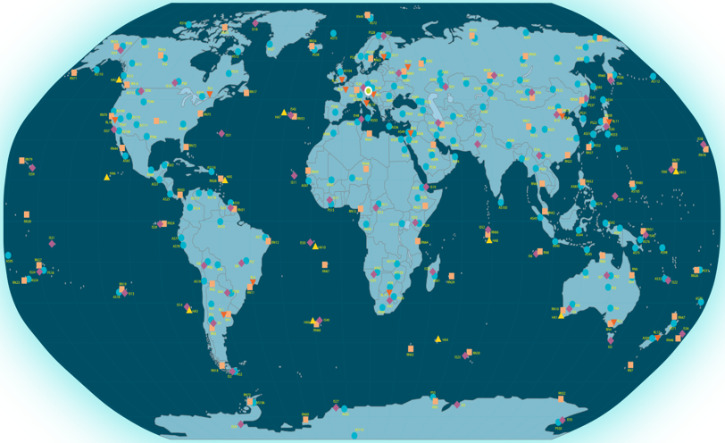
CTBTO VDEC as a Way to Access Data Collected by the International Monitoring System (E-Poster slides example)
T. Oliveira, H. Hassani, S. Ali, L. Gaya Pique, M. Zampolli, P. Mialle, and M. Krysta
Px.x-yyy
Introduction
Methods/Data
Results
The CTBT International Monitoring System (IMS), once complete, will consist of 337 facilities (321 monitoring stations and 16 radionuclide laboratories) located in 89 countries around the globe, including 4 technologies for seismic, hydroacoustic, infrasound and radionuclide monitoring (see Figure below).
The main objective of acquiring IMS data is to detect and identify nuclear explosions on land, in the oceans, and in the atmosphere. However, the data are also extremely valuable for scientific studies e.g., to investigate the migration pattern and population density of marine mammals, or to track radiation on a global scale. These applications provide a benefit to the main purpose of detecting nuclear explosions by improving monitoring algorithms and our ability to discriminate between explosion signals and what is considered noise from the CTBT perspective.
What do you need to know about the Virtual Data Exploitation Centre?
The virtual Data Exploitation Centre (vDEC) provides scientists and researchers from many different disciplines and from around the globe access to IMS data and IDC products to conduct research to publish new findings.
Data access through vDEC is based on a zero-cost contract. It is an agreement (also referred to as vDEC contract in this paper) which does not contain any monetary remuneration between the parties for services or property but contains legal requirements.
The vDEC agreement is concluded between the CTBTO and a legal entity involved in engineering or scientific research. It is valid for two years and allows for up to three specified users affiliated with the legal entity to have access to vDEC data after each user signs a separate confidentiality agreement.
How to apply?
Applications for a vDEC agreement can be initiated by filling out and submitting an online application form: https://www.ctbto.org/resources/for-researchers-experts/vdec
From 2011 to 2023, vDEC contracts have been concluded with institutions representing 29 countries and 3 International Organizations: Argentina, Australia, Austria, Belgium, Brazil, Canada, China, Cyprus, Denmark, Egypt, Finland, France, Germany, India, Iran, Ireland, Israel, Italy, Japan, Nigeria, Portugal, Russia, South Korea, Spain, Sweden, Switzerland, UK, Ukraine and USA.
Conclusions
The core mission of the comprehensive verification regime of the CTBT is nuclear explosion monitoring, however, the IMS provides a treasure trove of data that can be used for a variety of applications, such as marine biology, seismic and climate change research as well as disaster warning and mitigation.
Map showing the location of IMS stations. Status of the IMS network as of April 2023
DISCLAIMER: This presentation has been generated for illustration purposes only.

