Slide 1
Station Standard Interface (SSI)
Recent Development

Slide 2
SSI – Basic Functionalities
SSI (Standard Station Interface) is a software for data acquisition designed, developed and owned by CTBTO.
Long term maintainability
Flexibility
Reliability
PTS owned
Standardization
Developed since 2001
Command & Control
> 92% SHI stations
Compliance
Available to all Authorized Users
IMS2.0
Authentication
CD1.1
2

Slide 3
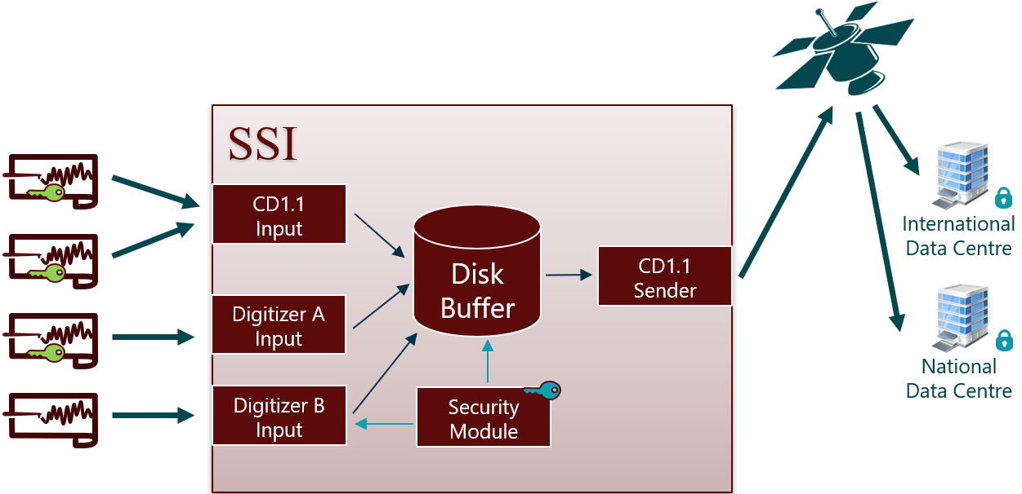
SSI – Basic Functionalities
Basic functionalities: Data acquisition, formatting, signing, buffering and transmission
3

Slide 4
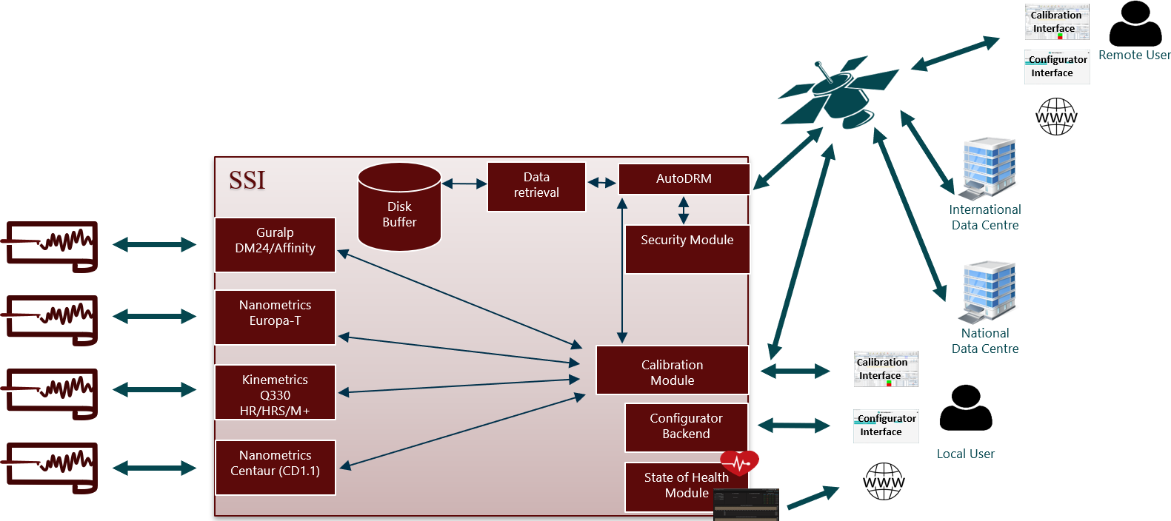
SSI – Advanced Functionalities
Configuration
Calibration
State-of-Health
Command & Control
4

Slide 5
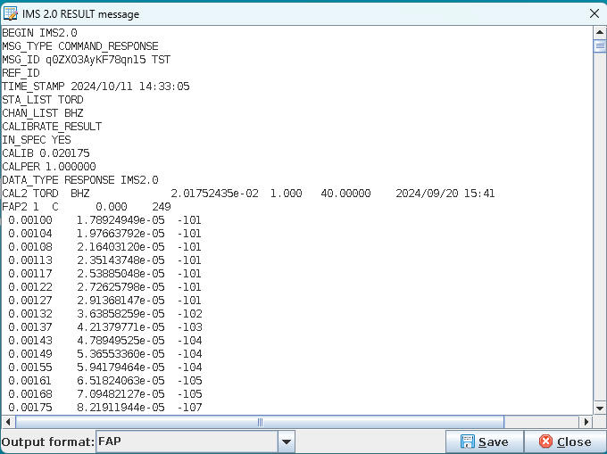
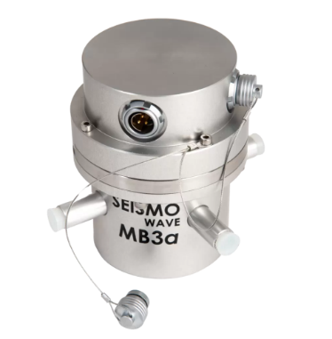
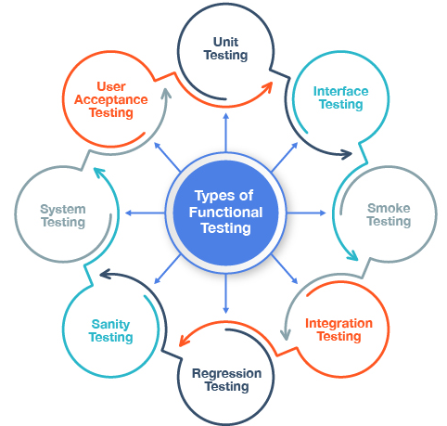
SSI Recent Developments
CentOS 7 replacement – Migration to Rocky Linux 8
Bug fixes and improvements in SSI, Configurator and ssiCalibView
Adapt SSI calibration results format to CAMT formatting
Improving SSI processes management
Circuit correction can be viewed in ssiCalibView
Station DA and TDA fields are updated correctly
CPU temperature parameter added to Grafana
Increased test coverage (Unit, Robot, User Interface, …)
MB3a calibration
Installation with Kickstart files
5

Slide 6
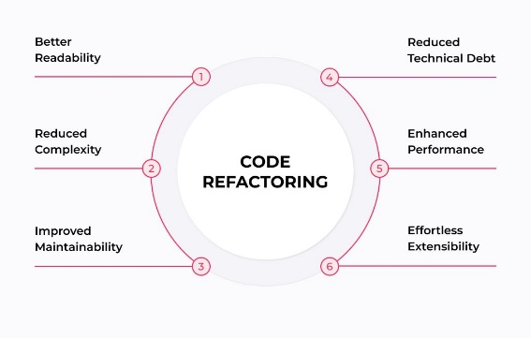
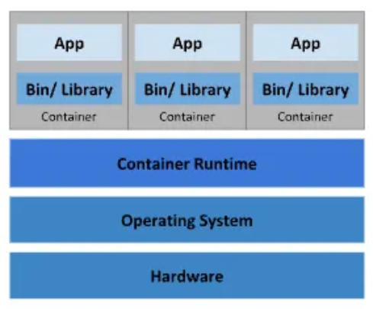
SSI future Developments
SSI code refactoring
SSI packaging
SOH from Q330M+
Integrate Calxpy libraries for SSI Calibration Module
6

Slide 7
SSI workstations Why they matter?
Standardizing interface to a very heterogeneous network of IMS stations
SSI
Hub to concentrate and transmit data coming from all sites (e.g. arrays)
+
Enables authentication at data frame level
Operating System
+
Enables Station Operators in conducting their daily tasks
Computer HW
SSI workstation is an equipment PTS provides to Auxiliary stations
SSI workstation
The maintainability, supportability and sustainability of
SSI workstations are key to efficiently support IMS stations
7

Slide 8
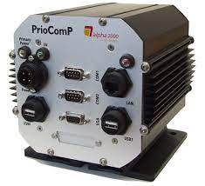
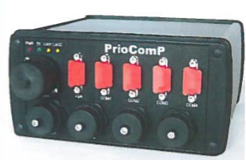
SSI workstations lifecycle in 2024
Hardware specifications and procurement done by IMS
SSI upgrades have been implemented on case-by-case basis
IMS supports Station Operators in SSI workstations installation, configuration and troubleshooting
Once installed, SSI workstations become the responsibility of the Station Operator. IMS actions triggered by:
Troubleshooting (e.g. data availability issue)
Station visits (maintenance, upgrade)
Request for support from Station Operator (delegated calibration)
8
No systematic way to keep track of deployed SSI workstations
Challenge for sustainment planning at network level

Slide 9
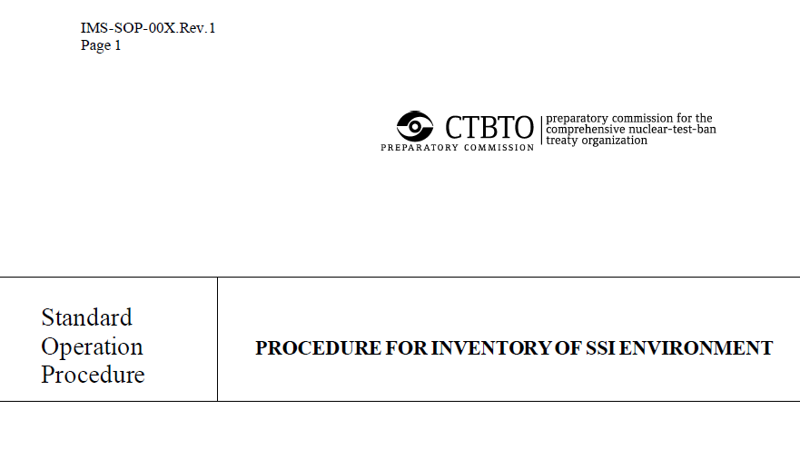
SSI Survey 2021-2022
Define a standard way to retrieve exhaustive information from any SHI station running SSI
Collect, back-up and convert current SSI configuration files
Collect information (OS & SSI versions, available spares, …)
Prepared and conducted with the support of the SSI Version Assessment group IMS/ED, IMS/MFS and IDC/OPS/MFO
9

Slide 10
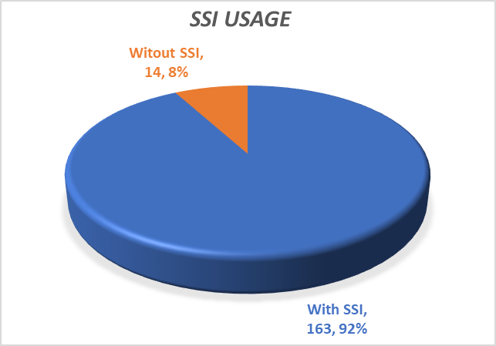
SSI Survey 2021-2022- Outcome (1/2)
93% corrected response rate => Survey data is representative
SSI by far the most used acquisition software on the IMS SHI network (92% of respondents)
10

Slide 11
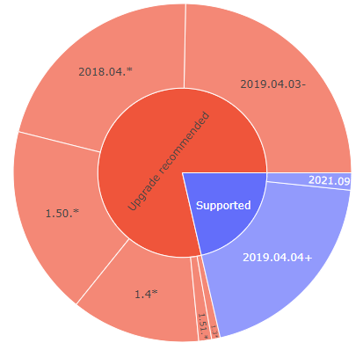
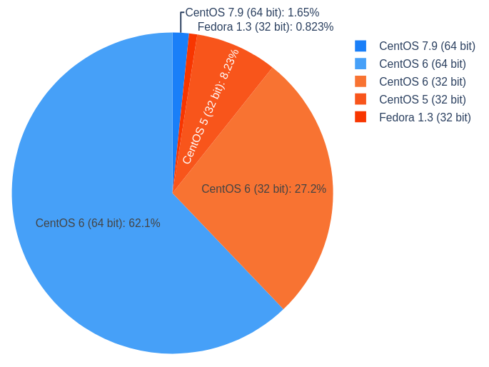
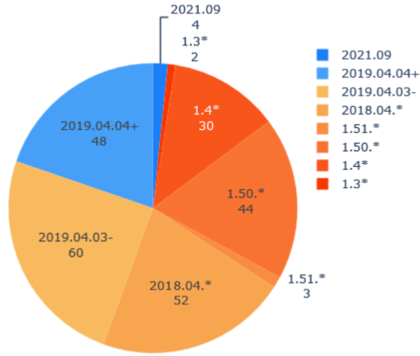
SSI Survey 2021-2022- Outcome (2/2)
Over 79% of deployed workstations would require an SSI upgrade
98% of SSI workstations run an OS out of support
38% of SSI workstations run on 32bit OS
Survey results outline the value of keeping a closer view on SSI workstations through their lifecycle
Possibility to automate part of the survey process in future SSI versions
11

Slide 12
SSI Large roll-out
Great opportunity to upgrade and homogenize SSI workstations and provide Station Operators with the latest features.
SSI: Installation script
Installation is a lot of work
OS, SSI & SSI Configuration: Kickstart file
Configuration requires expertise and manual testing
Configurations backed-up 2021-2022
Configurations upgradeable to latest SSI
Provide an SSI solution (including HW, OS & SSI configuration) that is ready for large scale roll-out in support to sustainability
12

Slide 13
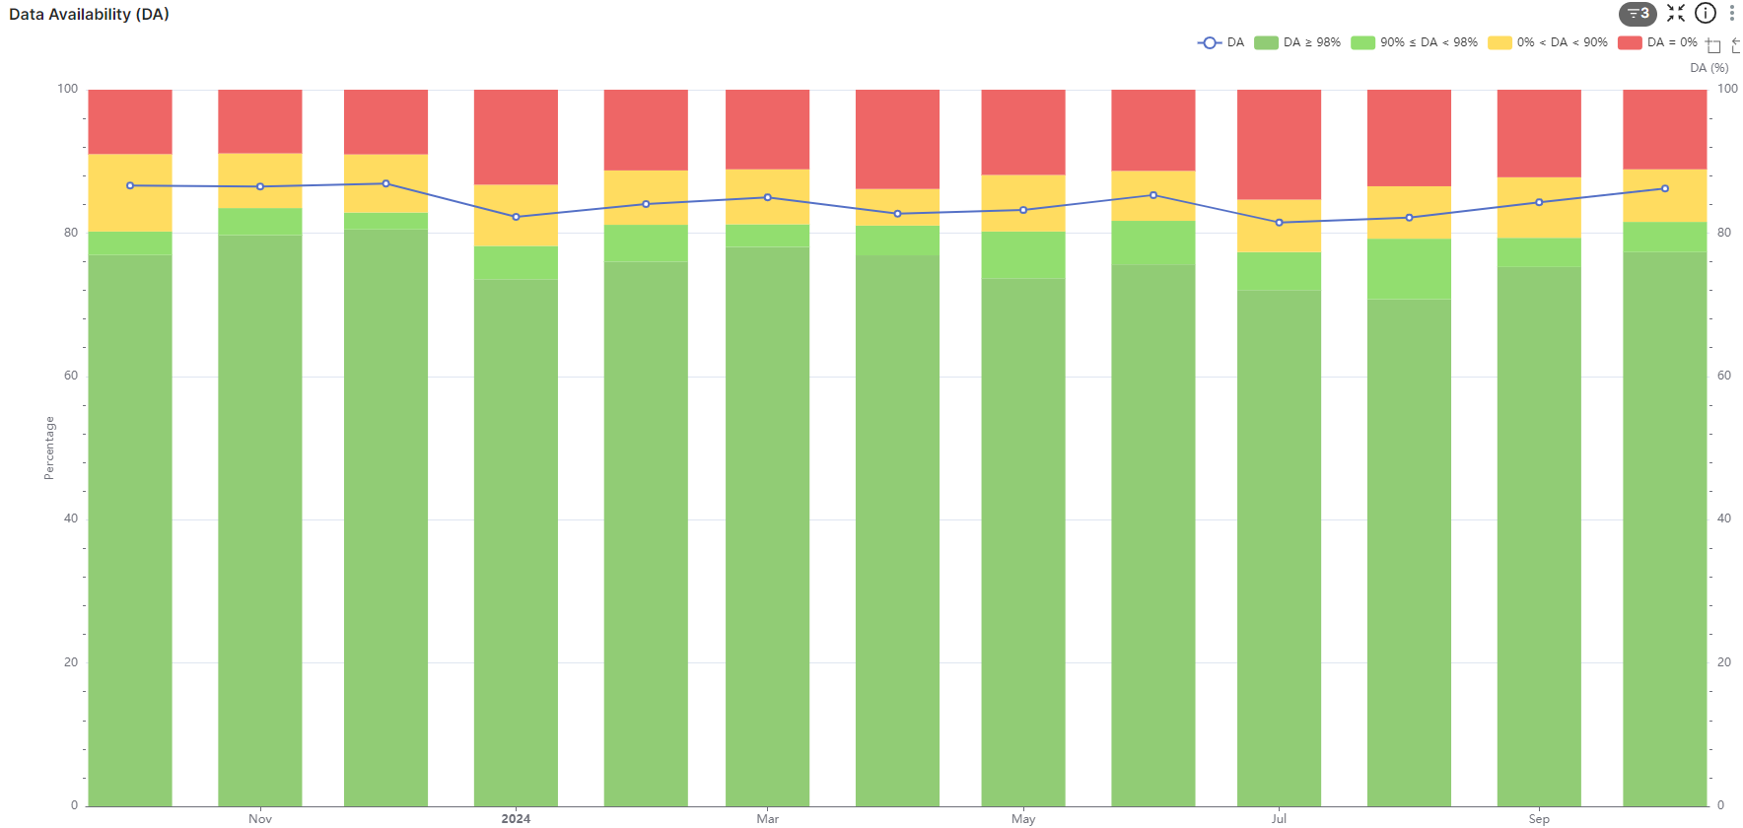
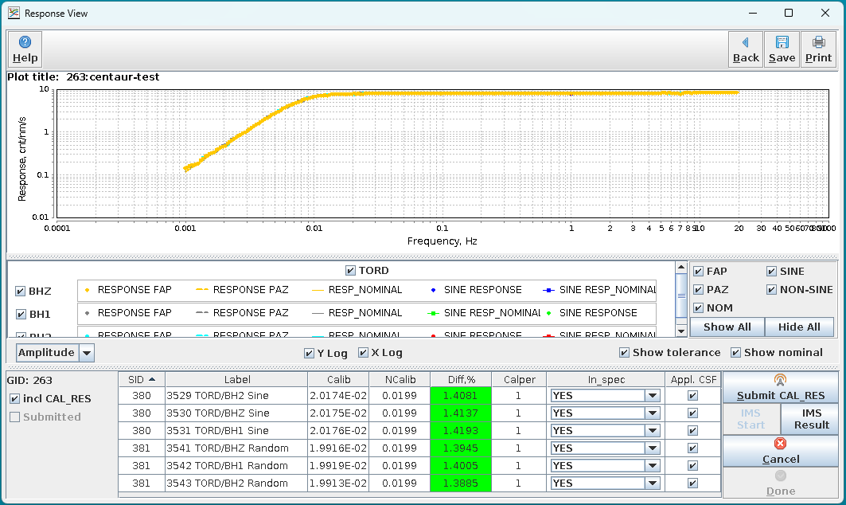
SSI Large roll-out
Expected outcomes
Increase in Data availability (better sparing, more resilient SSI)
Continued increase in ECDSA authentication
Improvement in number and quality of successful calibrations
Better tracking of SSI workstations through their lifecycle
Closer link with PTS (through API calls to the Configurator)

Slide 14
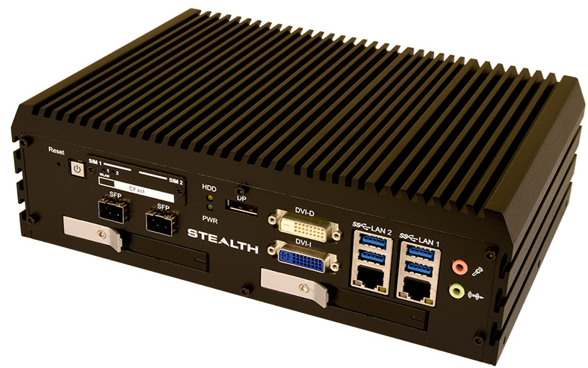
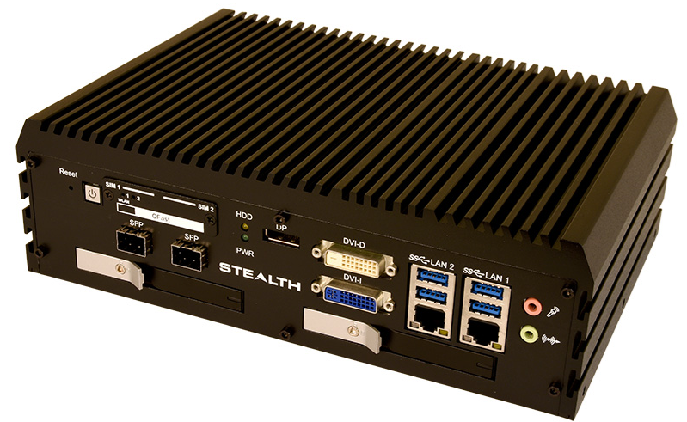
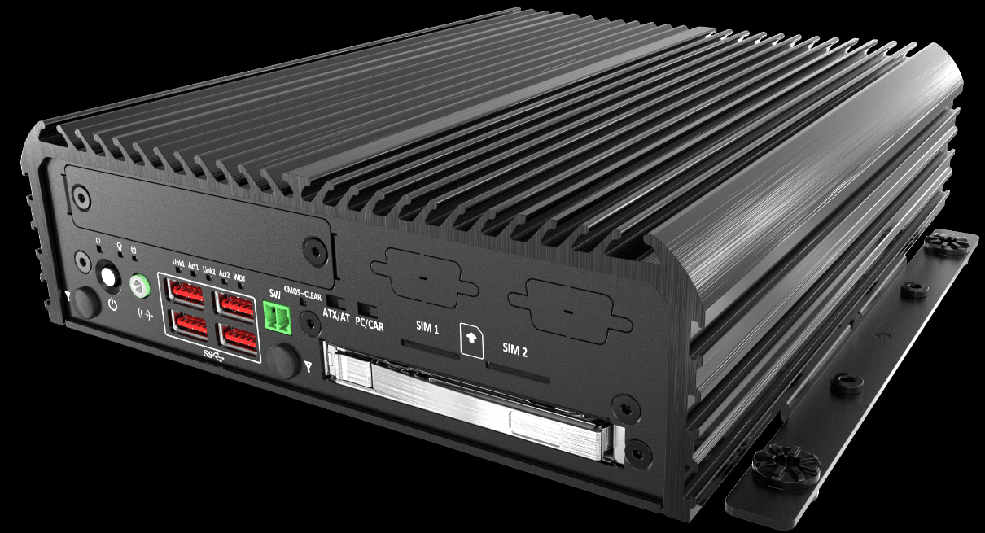
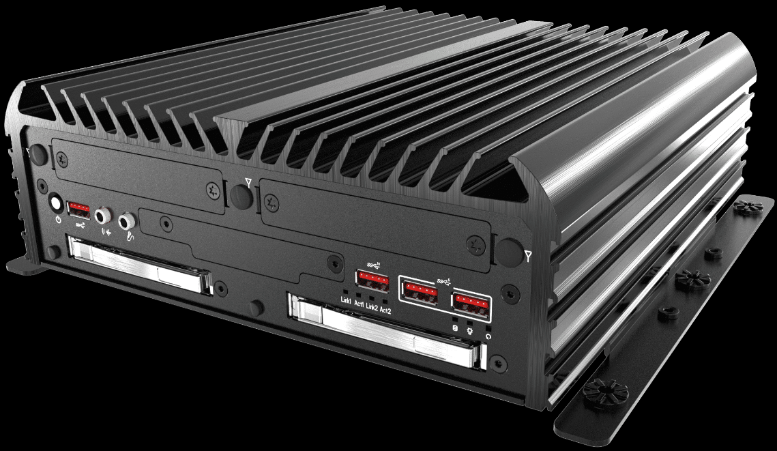
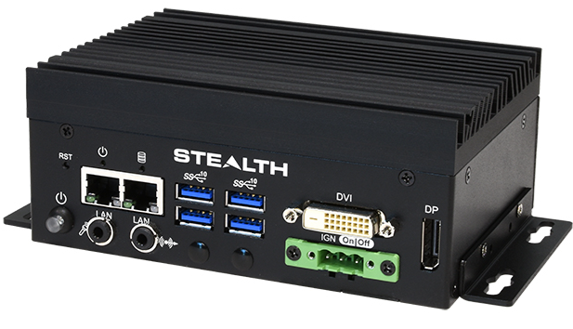
Stealth computers testing (1/2)
Testing scope
Validate that the new computer models fulfil the desired functionality and performance.
Verify that the integrated system meets the functional requirements.
Ensure that all authentication tokens supported by SSI are fully compatible with the new computer.
Identify any issue that may arise when integrating the Software into Hardware.
Evaluate the compliance of the system with specified functional requirements.
14
LPC-965
LPC-960
LPC-845
LPC-870
LPC-915

Slide 15
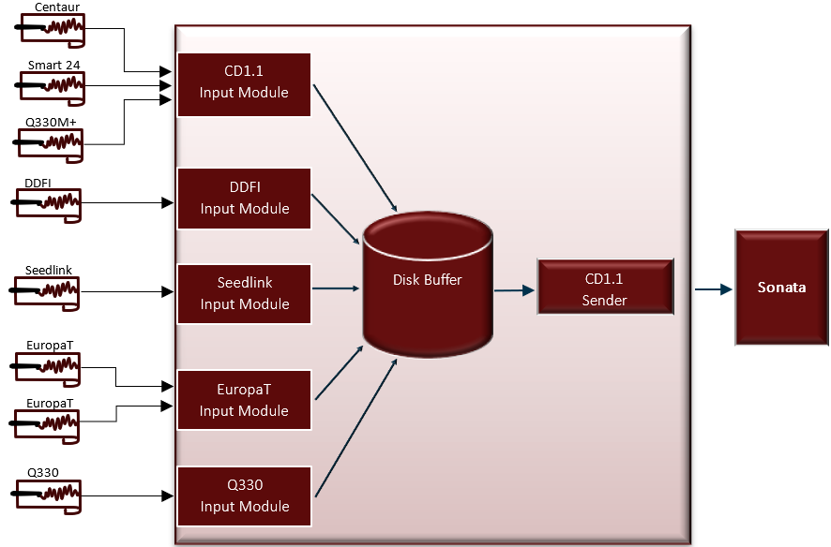
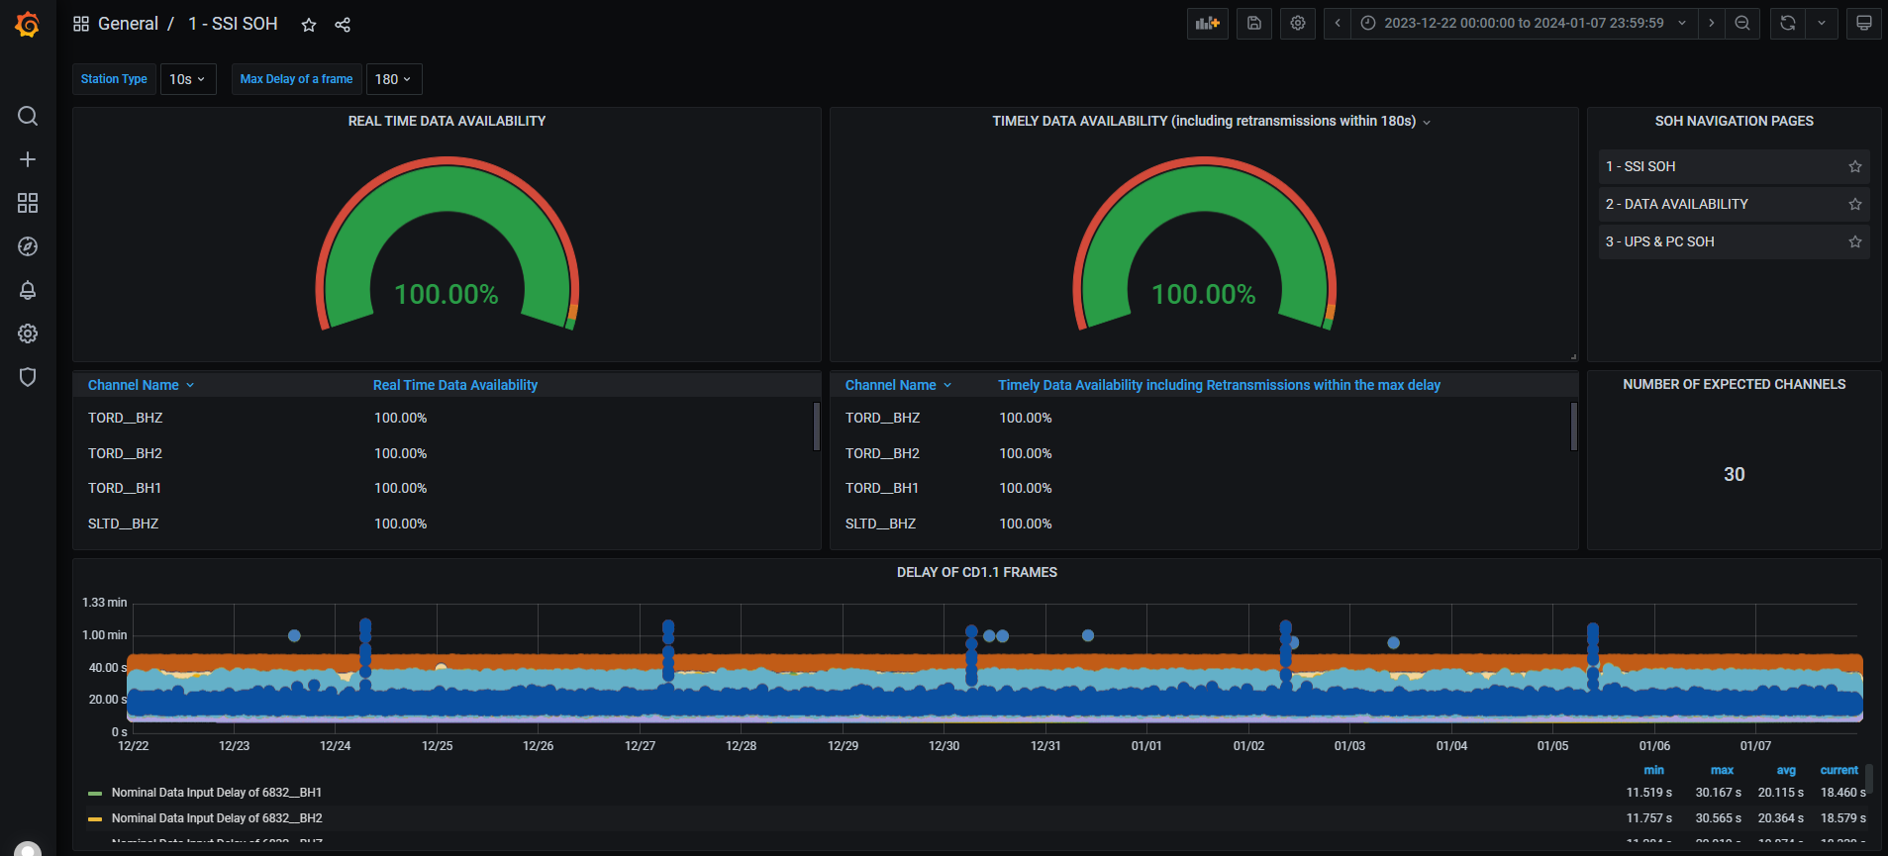
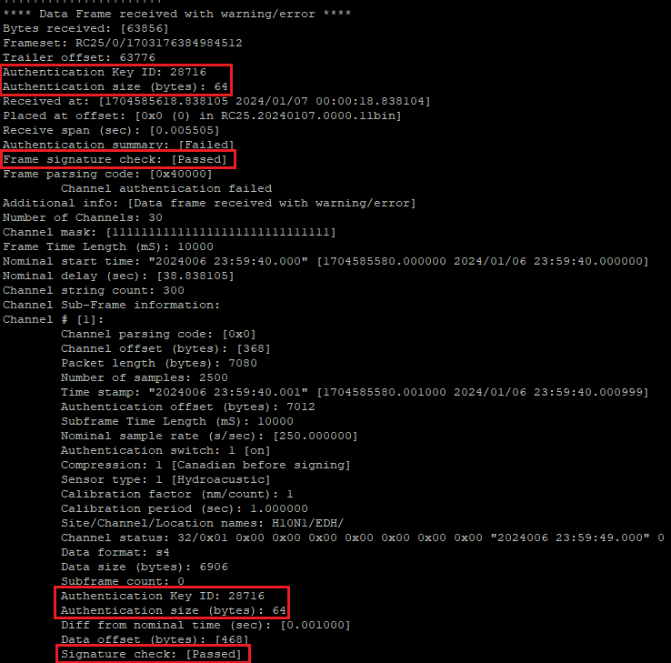
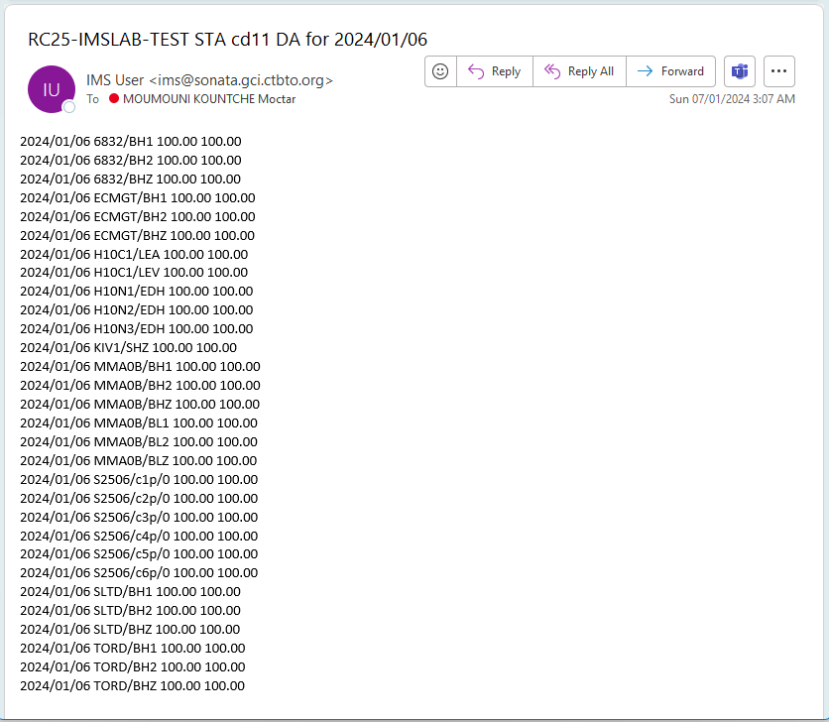
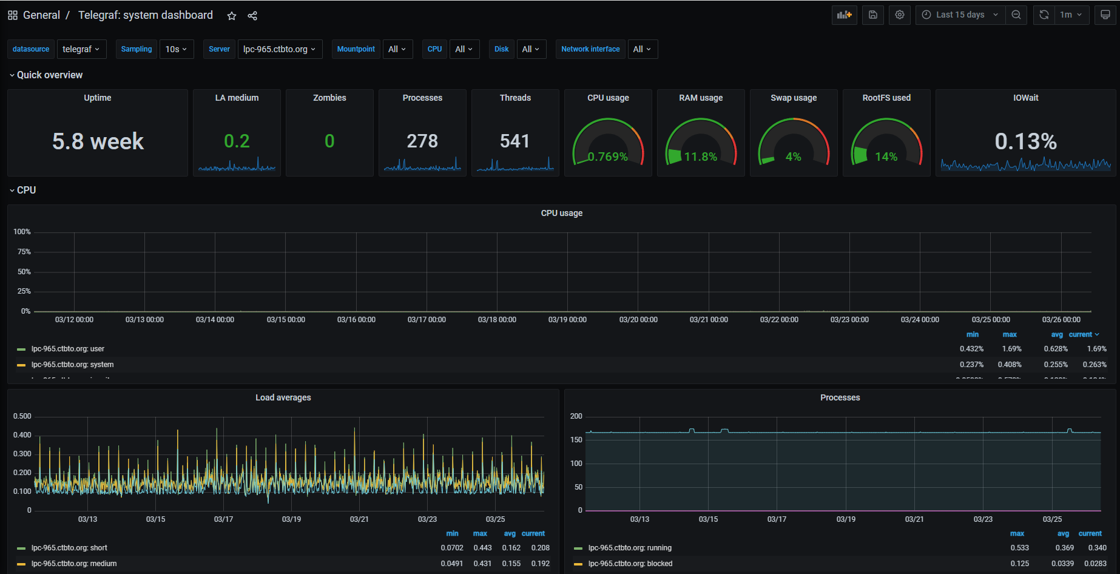
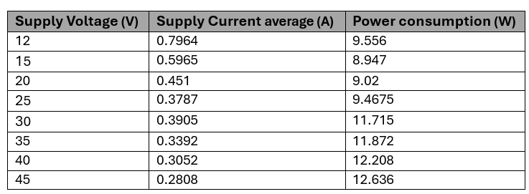
Stealth computers testing (2/2)
Average power consumption: 10.67 W for LPC-915

Slide 16
Questions ?

