Slide 1
Exploiting the outcomes of recent research in metrology for the benefit of the IMS
Infrasound Technology Workshop 2024
Vienna International Centre 4-8 November 2024
Dr Richard Barham (Acoustic Sensor Networks)
Mr Alfred Kramer (CTBTO Preparatory Commission)
Mr Benoit Doury (CTBTO Preparatory Commission)
Dr Dominique Rodrigues (Laboratoire National de Métrologie et d'Essais)
Ms Paola Campus (CTBTO Preparatory Commission)

Slide 2
Recent metrology community developments
Infrasound Technology Workshop 2024
The EURAMET Infra-AUV project was completed in Dec-2023 and was featured widely in past meetings including ITW2022 and SNT2024
It made significant progress on laboratory-based metrology for the calibration and traceability of infrasound and seismic sensors.
The project also conducted several field studies providing new insights as well as highlighting issues for further investigation.
The project outputs can now be mapped to CTBTO interests.
Some aspects are likely to be ready for immediate take-up and can be factored into technical practices.
Others impact strategy.
In general, the metrology outputs provide solutions to
previously identified CTBTO needs.
Notes:
The full title of Infra-AUV was “Metrology for low frequency sound and vibration”
Field studies considered naturally occurring and man-made stimuli for outdoor infrasound and seismic calibration, on-site calibration studies (Gabrielson), correcting WNRS defects (mentioned later), demonstration of extending traceability to field calibrations.
The project outputs can be found at the Infra-AUV website, and in particular are mostlty collected in the Good Practice Guide produced by the project team.

Slide 3
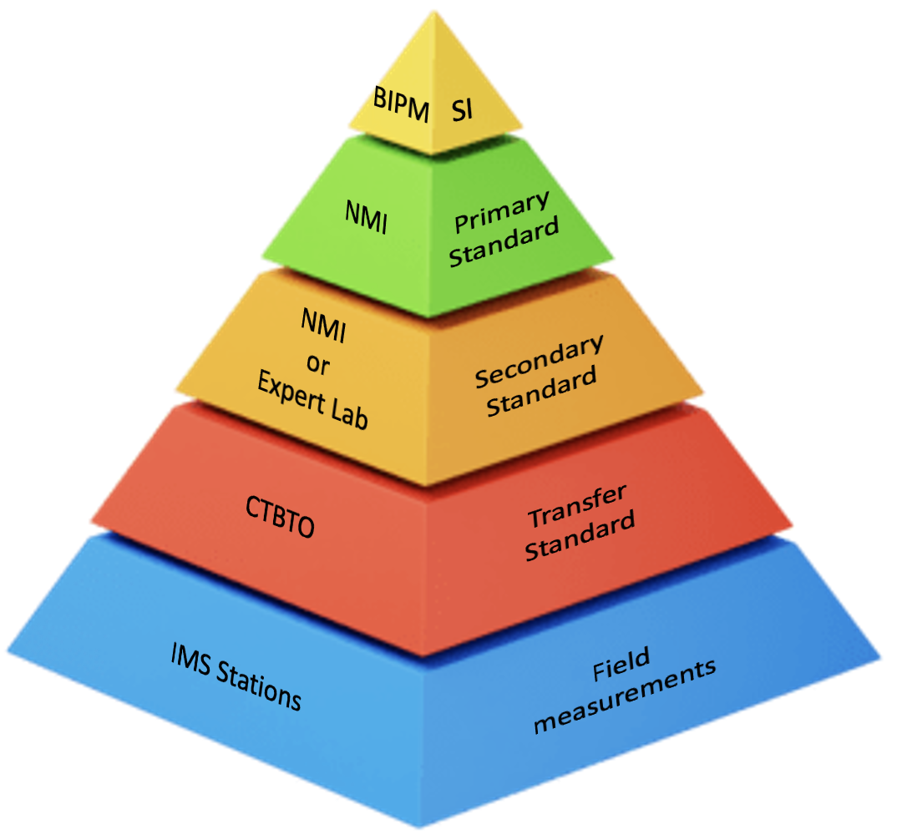
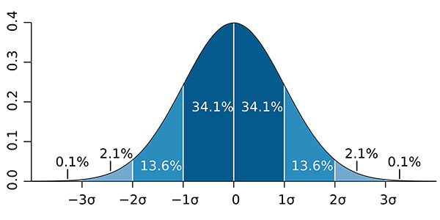
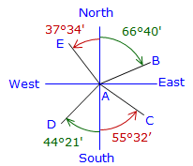
What are the relevant outputs
The key output of the Infra-AUV project are:
New primary calibration capability for infrasound within the International System of Measurement (SI)
New primary and secondary calibration capabilities for microphones, microbarometer and other types of infrasound sensor covering the frequency range 0.02 Hz to 4 Hz
Systematically estimated (and validated) measurement uncertainty associated with the calibration processes
Requirements for transfer standard infrasound sensors for transferring measurement traceability from the laboratory to the field
Estimation of the measurement uncertainty associated with methods of on-site calibration
Estimation of measurement uncertainty associate with field parameters calculated from the infrasound data
Several field studies demonstrating new capabilities
Notes:
.
Actually the range is a little wider than the IMS passband, 0.01 Hz to >20 Hz
.
The MB2000 and MB2005 were identified as good transfer standard devices for infrasound
Uncertainty propagation from laboratory calibration – field calibration – impact of uncertainty on derived parameters – Samual will present on this in the same session
For example back azimuth and time delay of arrival
.

Slide 4
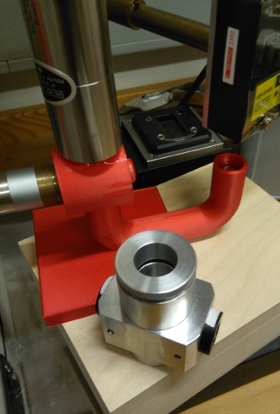
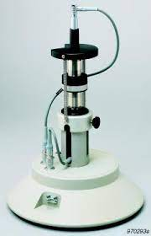
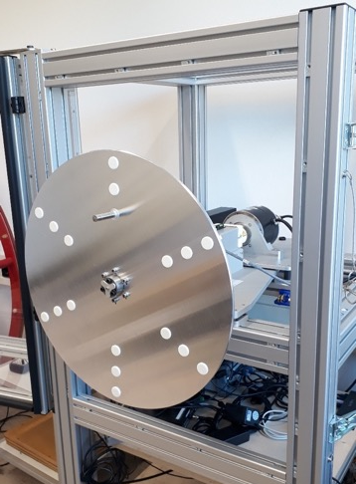
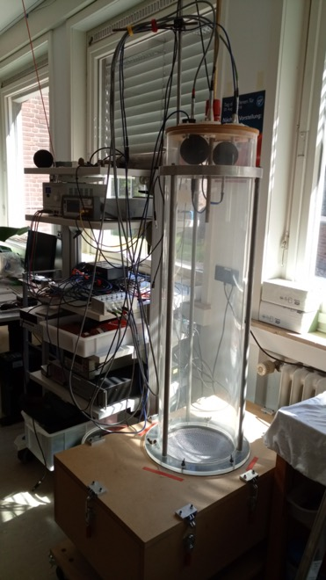
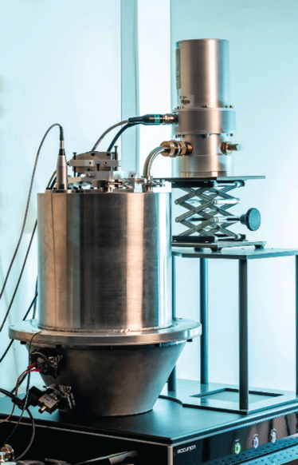
Measurement traceability – for the first time
New primary calibration capabilities
Reciprocity calibration for reference microphones
Pistonphone for microphones and microbarometers
Barometric methods (rotating disc, manometer)
Measurement uncertainty typically 0.1 dB (1.2%) at 0.02 Hz, decreasing to <0.05 dB (<0.6%) above 0.1 Hz for primary calibration
Calibration services based on these capabilities becoming available from the metrology community
Notes:
The pictures show new calibration facilities implemented at various NMIs
Left to right
The sound tube at PTB for secondary calibration
The prototype manometer tube for absolute calibration to DC, at DFM
The spinning disc at PTB
Reciprocity calibration apparatus at HBK
Pistonphone at LNE for both primary and secondary calibration
Before these developments, the pyramid was missing the Orange and Green layers, and the vital link to the SI

Slide 5
Fulfilment of existing procedures for traceability
PTS already has in place the principles for establishing measurement traceability, via the calibration of retained transfer standard microbarometers
The retained transfer standard then provide a means of calibrating travelling standard sensors that can be sent to stations and used for initial calibration or re-calibration of the operational sensor systems.
Until now full implementation has not been possible as the primary standards have not existed.
Notes:
The diagram is coming on the next slide
.
.

Slide 6
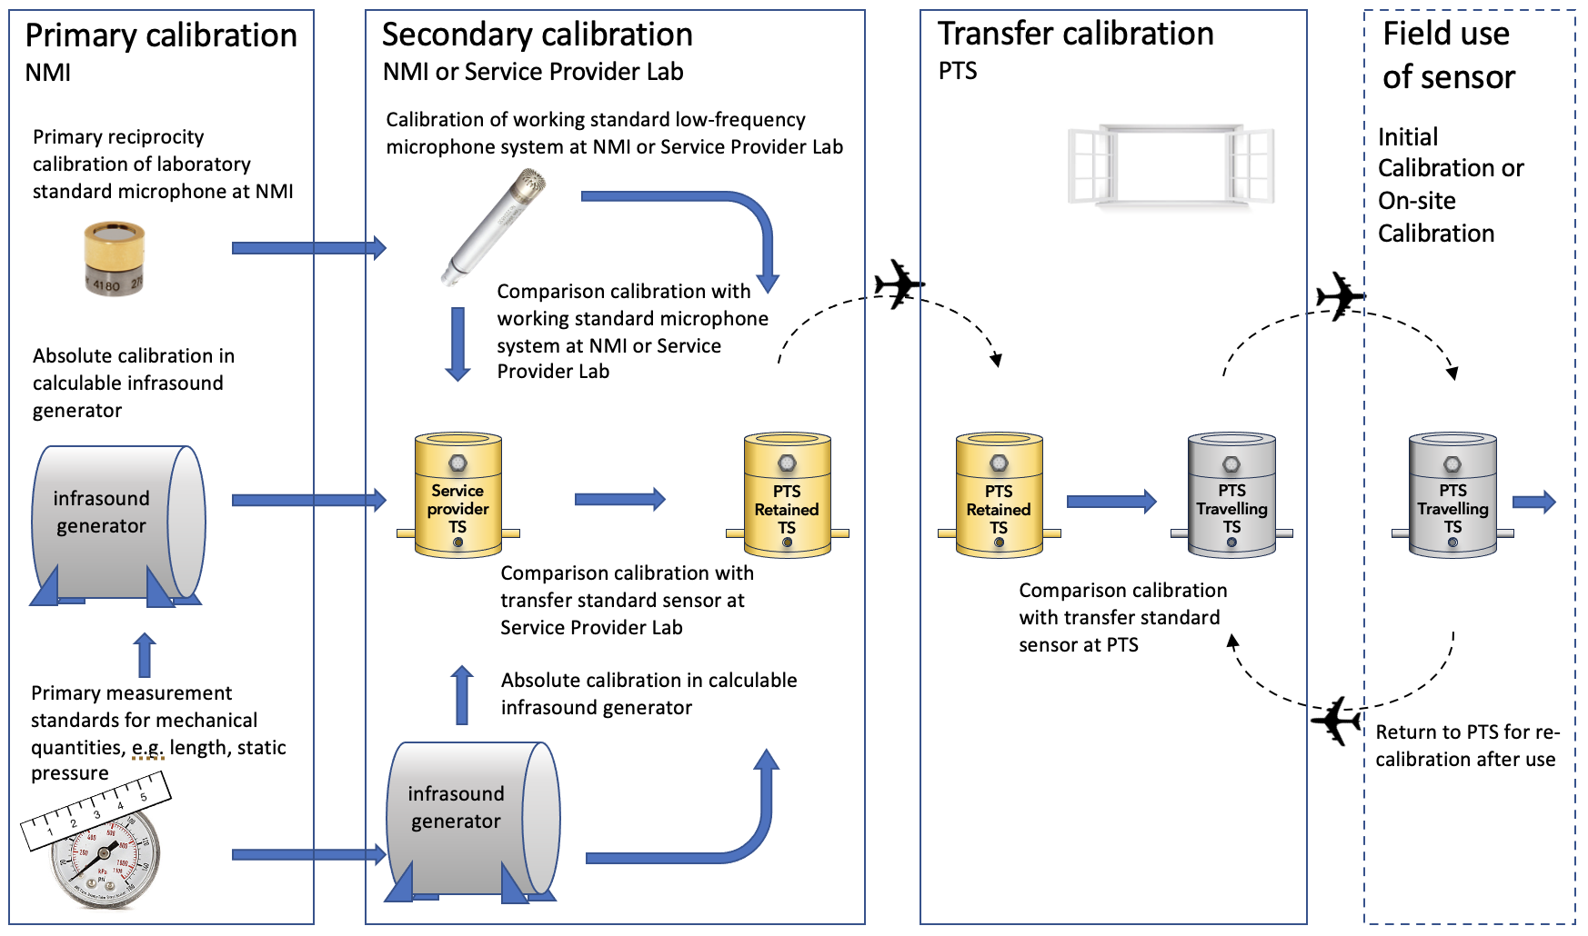
Outline of the PTS protocol for measurement traceability
Notes:
There are several options for obtaining traceability
Typically primary or secondary calibration will take place at an NMI or even at an expert laboratory.
The advantage of an NMI is that they are linked into the processes of BIPM that formally recognises the calibration capability once verified, and provides a direct link with the SI.
The end-to-end process is outlined here, but several practical details need to be added…(next slide)

Slide 7
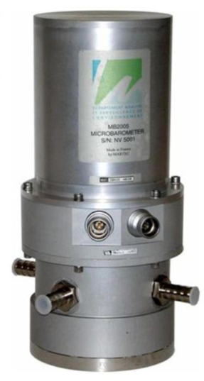
Implementation
While the concept is well-stablished, many practical details need to be considered now that implementation is possible:
who owns and maintains the transfer standard sensors?
how many there need to be and the associated calibration schedule for them?
how often is traceability transferred to the field sensors?
who carries out the on-site traceable calibration?
what method is used to calibrate the field sensors with the transfer standard?
Once such details are decided, the next step is to demonstrate the end-to-end process.
Bringing into routine operations may further involve:
Development of a PTS process for validating the calibration of the transfer standard between deployments
Training of station operators to carry out the traceable calibration
Notes:
Demonstration will include
sourcing NMI/Expert Laboratory calibration of transfer standards
Initial check within PTS
Sending calibration transfer standard to station
Carrying out recalibration of station sensors
Handling calibration data in the IDC
Establishing a return-from-duty process to check the transfer standards

Slide 8
Impact on on-site calibration
CTBTO has successfully demonstrated a method of on-site calibration for infrasound sensor systems using ambient infrasound as a calibration stimulus and a co-located reference sensor.
Suitably equipped stations are therefore generating a wealth of data and that data that has potential to be used for more than on-site calibration
For example, in an Infra-AUV Case Study, Samuel Kristoffersen demonstrated the possibility of re-processing the on-site calibration data and using a traceable sensor calibration response to correct for identified WNRS defects.
The on-site calibration data also holds information about the general health of the sensor system and the data quality, enabling ongoing review based on a set of Quality Control metrics.
Notes:
Infra-AUV made some interesting studies that can potentially provide new tools to improve the operation and reliability of the IMS
These need to be evaluated further and potentially added to existing toolboxes and analytics
Part of this could be the wider use of quality control metrics that can be extracted or derived from the on-site calibration data

Slide 9
Quality Control Metrics
The implementation of data Quality Control (QC) processes for infrasound measurement systems can provide an important complement to the QA approach
Both ongoing and retrospective analysis of key metrics allows
monitoring the impact and added value of newly implemented QA processes,
identifying potential deficiencies and finding solutions to strengthen the QA approach,
feedback supporting the sustainability and continuous improvement of the QA infrastructure over the long run.
Metrics to be monitoring might include:
calibration results, back-azimuth residuals, Power Spectral Densities (PSDs), magnitude or time residuals
A process needs to be established based on a limited number of metrics initially

Slide 10
Utilising measurement uncertainty (1)
The IMS Operational Manuals generally require sensor performance parameters to lie within a particular range (a tolerance interval).
An almost ubiquitous value of 5% (or 5º for phase) is quoted or adopted in practice.
Without knowledge of the underlying measurement uncertainty it has been difficult to assess whether this is actually being achieve in many practical situations.
Now that the measurement uncertainty associated with traceable calibration is available, it becomes possible to estimate the propagation of measurement uncertainty at each stage in the deployment of sensor systems, and to set this in the context of the de-facto 5% requirement.
Notes:
The graphic here shows how measurement uncertainty reduces the amount of tolerance available when deciding of a measurement complies.
If measurement uncertainty is large, it can actually consume nearly all available tolerance.
In this case, either the acceptable tolerance needs to be increased, or efforts made to reduce measurement uncertainty
Neither are attractive options, but the measurement uncertainty allows the reality to be understood clearly.

Slide 11
Utilising measurement uncertainty (2)
The concept of measurement uncertainty needs to be factored into several QA process including Type Approval and device acceptance, as well as operational requirements for the stability of the measurement systems.
Knowledge of measurement uncertainty may therefore lead to a more realistic estimate of the margins being achieved for key measurement system performance parameters like frequency response.
The data itself inherits the measurement uncertainty of the measurement systems, which in turn allows the measurement uncertainty of the service field parameters to be estimated.
Ultimately these allow a quantified measure of confidence to be estimated for the information or decisions derived from the data.
Notes:
The concept of guarded tolerance bands (where measurement uncertainty is allowed for), is common practice in conformance assessment.
The TA and DA processes are conformance assessments so should take account of measurement uncertainty when conformance is evaluated.
There may yet be difficulties in practice. The acceptance interval of 5% was set before any knowledge of measurement uncertainty was available.

Slide 12
Items for future development
Implementation of the process for obtaining traceable calibrations
Formulating a prototype QC process
Refinement of the Operational Manual requirements with respect to performance limits
Improvement of Type Approval and Device Acceptance procedures taking account of measurement uncertainty
Implementing the propagation of measurement uncertainty into the field parameters and metrics derived from the infrasound data.

Slide 13
Items for future development
These development have resource implications and need to be factored into the overall strategic roadmaps for the technology.
However, in the era of sustainment of the IMS Network, QA initiatives such as calibration and testing, lead to enhanced data quality that raises effectiveness in the ongoing operation of the IMS Network.
+++++ Thank you +++++

