Slide 1
Is calibration really worth the effort?
Infrasound Technology Workshop 2024
Vienna International Centre 4-8 November 2024
Dr Richard Barham (Acoustic Sensor Networks)

Slide 2
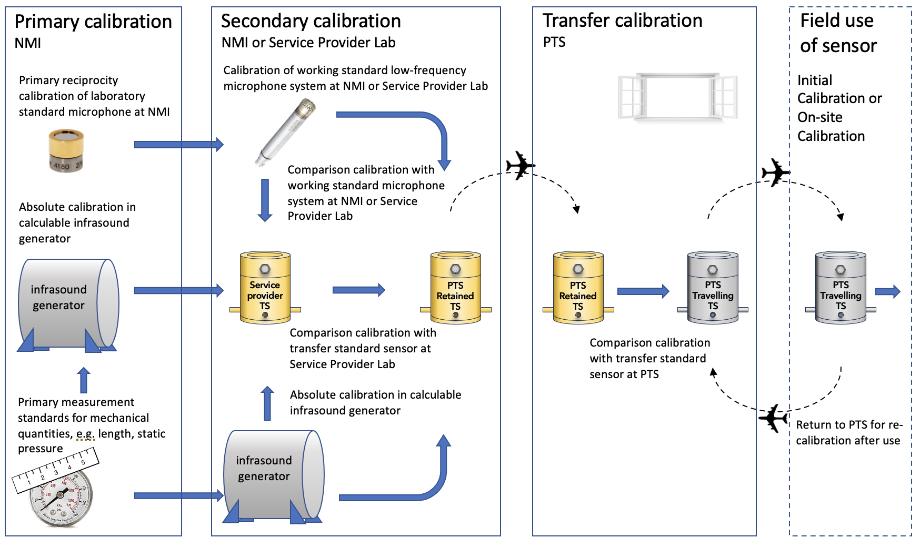
Brief review of the calibration process
Notes:
Before we seek an answer, lets see what the necessary efforts look like
This was shown in an earlier presentation – the process of establishing traceability and link to primary standards

Slide 3
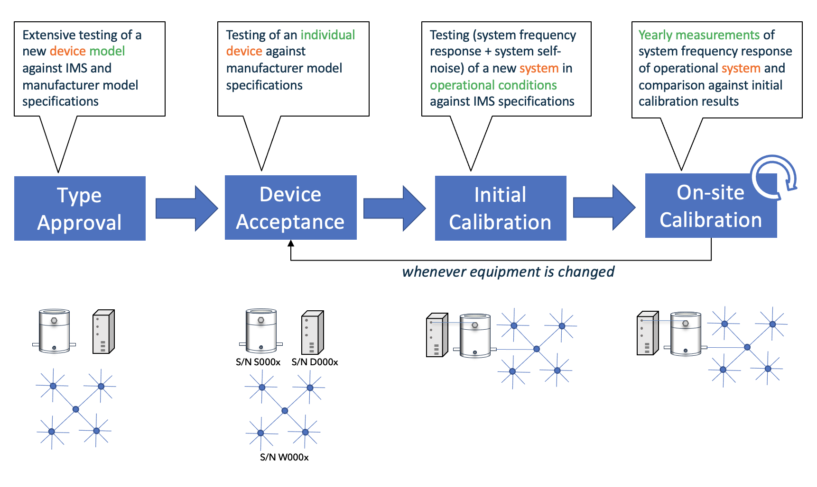
Brief review of the calibration process

Slide 4
Improved accuracy
Infrasound sensors may be supplied with a nominal set of performance specifications, with assurances that individual devices are within a given tolerance of the nominal value
Individual values for some key parameters may also be provided.
We will use sensitivity and frequency response for illustration.
Now PTS require the sensitivity and frequency response of an infrasound sensor to be within 5% of the model sensitivity and frequency response for deployment in the IMS
With precise calibration by the best of service providers, this margin may reduce to 3-4%
However, it is difficult to argue that such small improvements are the sole rationale for calibration

Slide 5
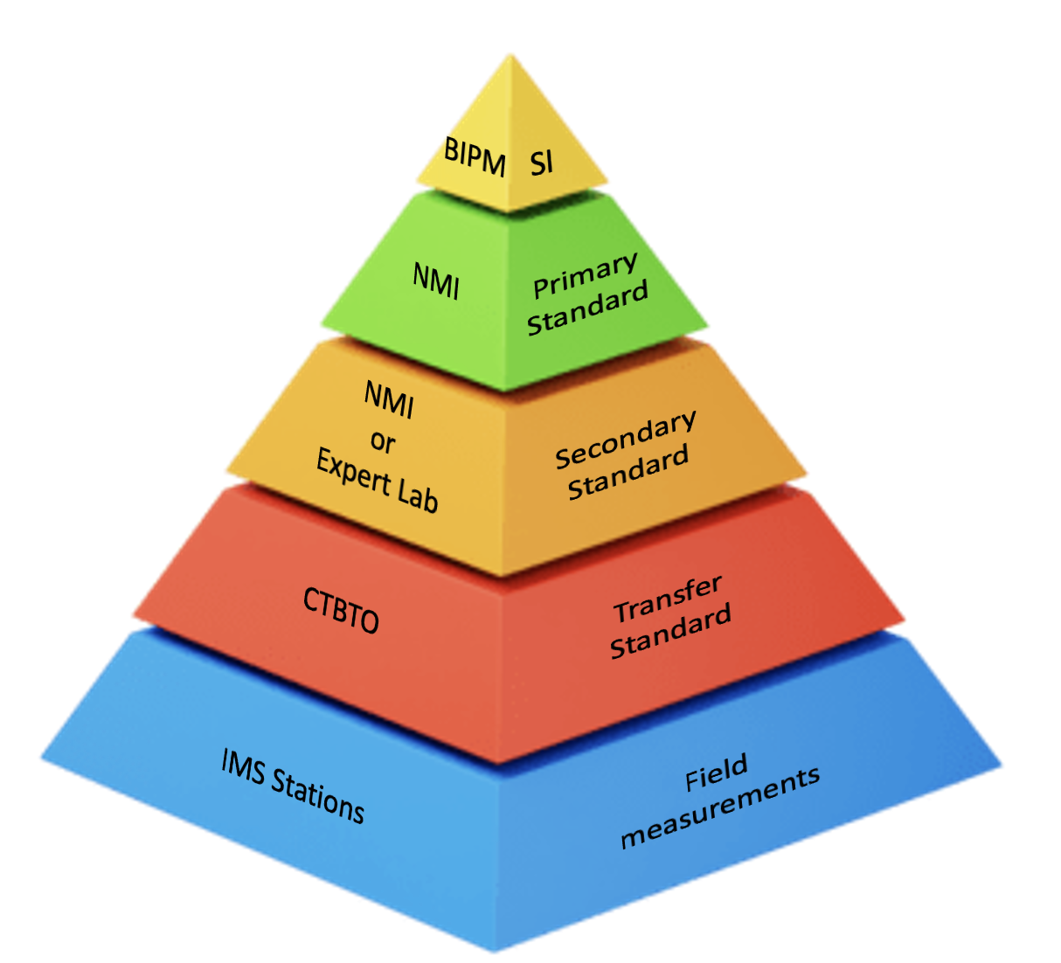
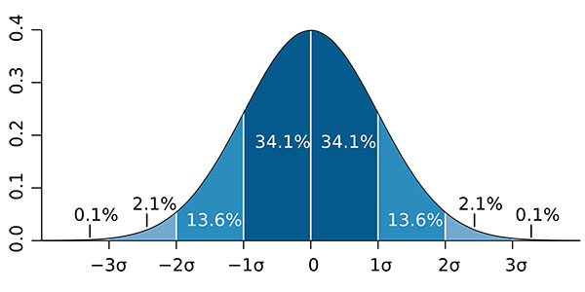
Other benefits of calibration
Metrology is the discipline of measurement science, where the two goals of calibration are:
Measurement traceability and consistency with the International System of Measurement (SI)
Systematic estimation of measurement uncertainty

Slide 6
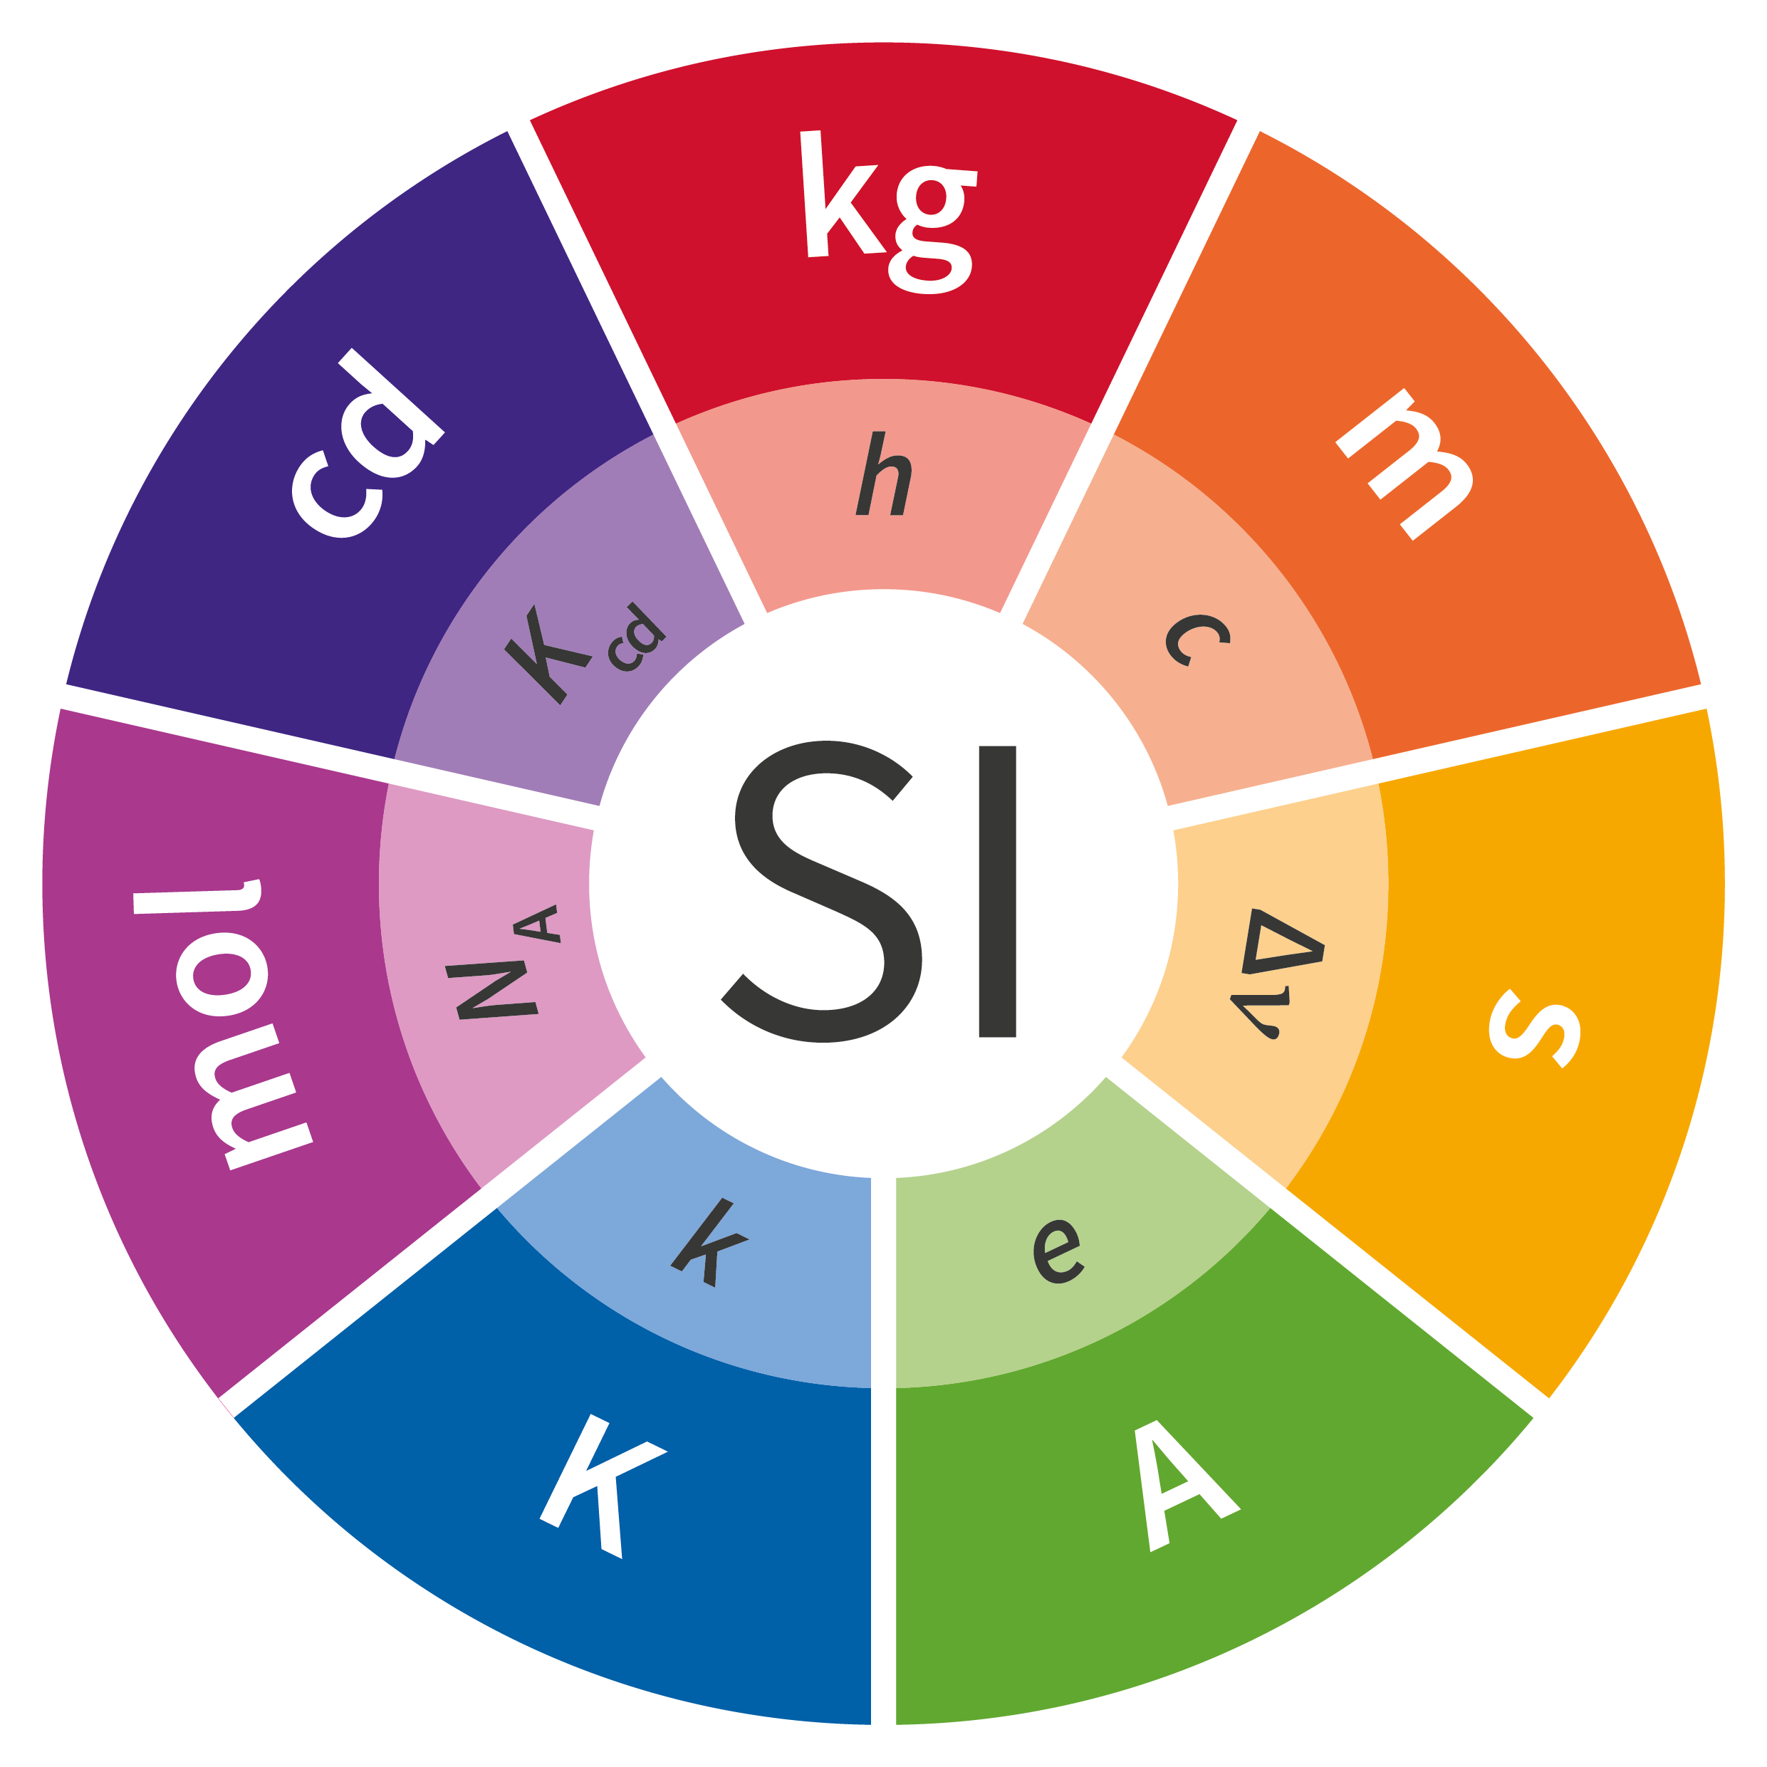
Consistency with the SI
When making a measurement of a physical parameter like infrasound pressure, the result is expected to be physically meaningful.
It should be linked to an authentic realisation of the parameter that is defined via base quantities such as mass, length, time and voltage.
These base quantities are in turn linked to a set of fundamental physical constants and quantum phenomena which provide the physical basis for the whole SI.

Slide 7
Consistency with the SI
Calibration of an infrasound sensor provides a measure of the sensitivity of its electrical output to an applied infrasound pressure
When this calibration can be linked back to an absolute realisation of a sound pressure, even by several steps, it is said to be traceable…ultimately all the way back to those fundamental constants!
A measurement with the calibrated infrasound sensor is then physically meaningful and universally recognised.
Measurements that are physically meaningful and universally recognised creates several additional benefits

Slide 8
Transparency
The SI system is globally recognised and is underpinned by the work of the International Bureau of Weights and Measures (BIPM) and its Consultative Committees.
This serves to demonstrate equivalence of measurement standard held around the world and ensures that no matter where calibrations are sourced, provided they are traceable, measurement consistency can be guaranteed.
Therefore, different measurement system each with a traceable calibration will produce equivalent data regardless of where they were calibrated and deployed.
Consistency with the SI removes any potential for biases and data artefacts, and provides a clear physical basis for the measurement.

Slide 9
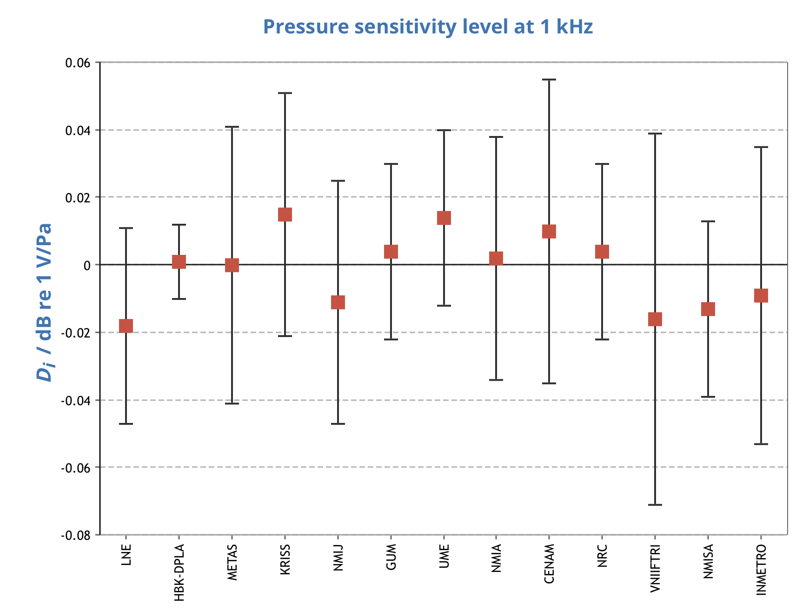
Results of an exercise to demonstrated global equivalence in microphone calibration

Slide 10
Impartiality
The global equivalence of measurement standards and therefore any data collected by a calibrated measurement system that can be traced to these standards means that:
The data relates purely to a physical phenomenon
International equivalence of calibration services consistent with the SI is guaranteed through the work of BIPM and its Mutual Recognition Arrangement - the framework through which National Metrology Institutes demonstrate the international equivalence of their measurement standards and the calibration and measurement certificates they issue.
Therefore, measurement data can contain no national biases or differences in interpretation in the meaning of the data

Slide 11
Reliability
The combination of traceability and a quantified measurement uncertainty means that data has a prescribed level of confidence.
That knowledge determines whether or not the data is fit-for-purpose in the intended use, without need for further assumptions or speculation, or any remaining doubt about the reliability of the data.

Slide 12
Measurement uncertainty
A typical statement of a calibration might be:
The measured sensitivity of the infrasound sensitivity is X ± U dB. The measurement uncertainty U is based on a standard uncertainty multiplied by a coverage factor k = 2, providing a level of confidence of approximately 95%.
The estimation of measurement uncertainty is an essential element of calibration
It provides a statement of the confidence that can be placed in the calibration result
The level of confidence in any information derived from the data is then a function of the measurement uncertainty, and can itself be estimated with reliability.
Together, the data + traceable calibration + the associated measurement uncertainty represent a complete account of the measurement and lead to the benefits being discussed

Slide 13
Summary
Calibration that leads to measurement traceability intrinsically bring data with the SI
While calibration may not necessarily increase accuracy significantly, consistency with the SI confers
Transparency, Impartiality and Trustworthiness and similar associated traits that can address any question of the integrity of the the data
Calibration provides know level of confidence in the data which transfer to the information and decisions derived from the data
As the development of the IMS Network transforms from establishment to sustainment, issues such as calibration and data quality come to the fore, ensuring that IMS data represents reality and can be relied on without question.
These points represent the real value of calibration so I hope the answer to the question posed in my title is clear,
But for the avoidance of doubt…

Slide 14
Is calibration really worth the effort?
YES
traceable calibration is not only worth the effort,
it is indispensable.
+++++ Thank you +++++

