Slide 1
Regional infrasound detections of the Osiris Rex capsule re-entry
Jeremy Webster, Jordan W. Bishop, Phil Blom
September 18, 2024
ROSY: cccf1bf8
Unclassified

Slide 2
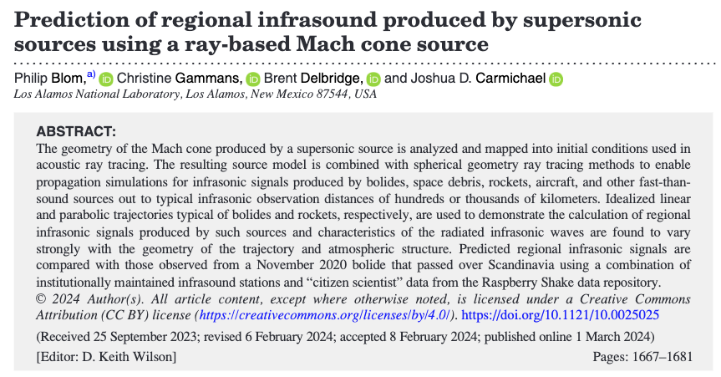
Unclassified

Slide 3
Mach Cone
Ray paths normal to cone surface
$$θ=\sin^{−1}\left(\frac{1}{M}\right)$$
Unclassified

Slide 4
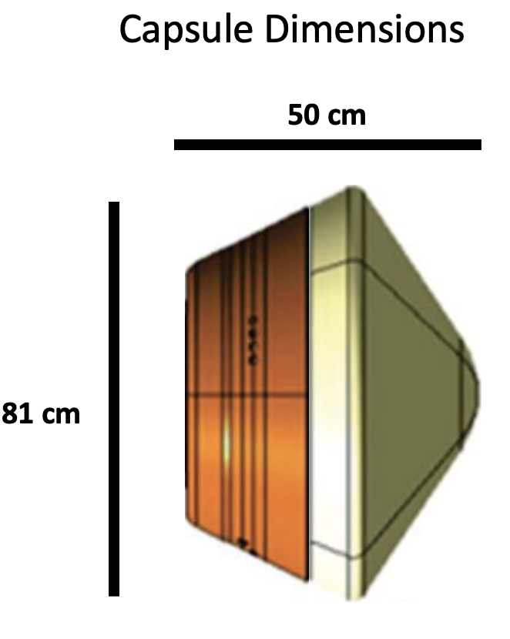
The re-entry of the OSIRIS-REx sample return capsule presented a rare opportunity to test the InfraGA predictions against a known source trajectory.
Unclassified

Slide 5
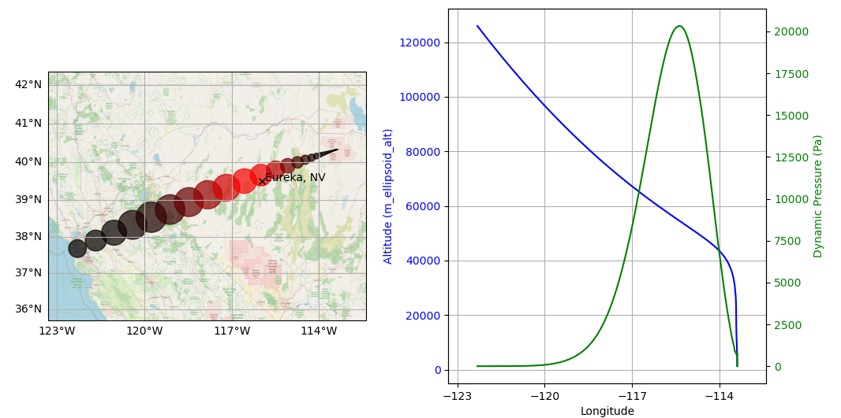
Plots from NASA’s re-entry predictions
Trajectory, Mach Number (radius) and heating (color)
Altitude (blue) and Dynamic Pressure (green)
Unclassified

Slide 6
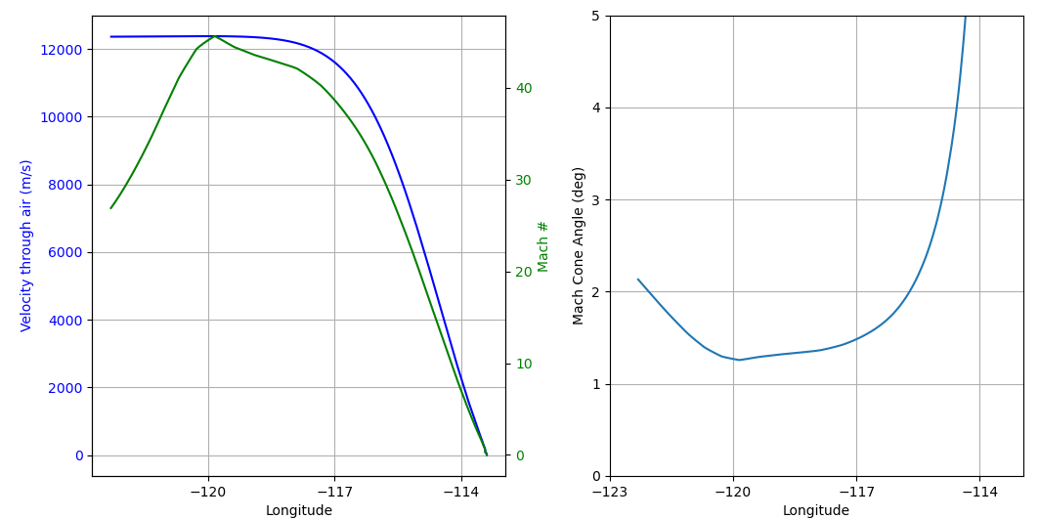
Plots from NASA’s re-entry predictions
The velocity (left, blue) is so fast, and the Mach Cone angle (right) is so small, this could almost be considered a line source.
Unclassified

Slide 7
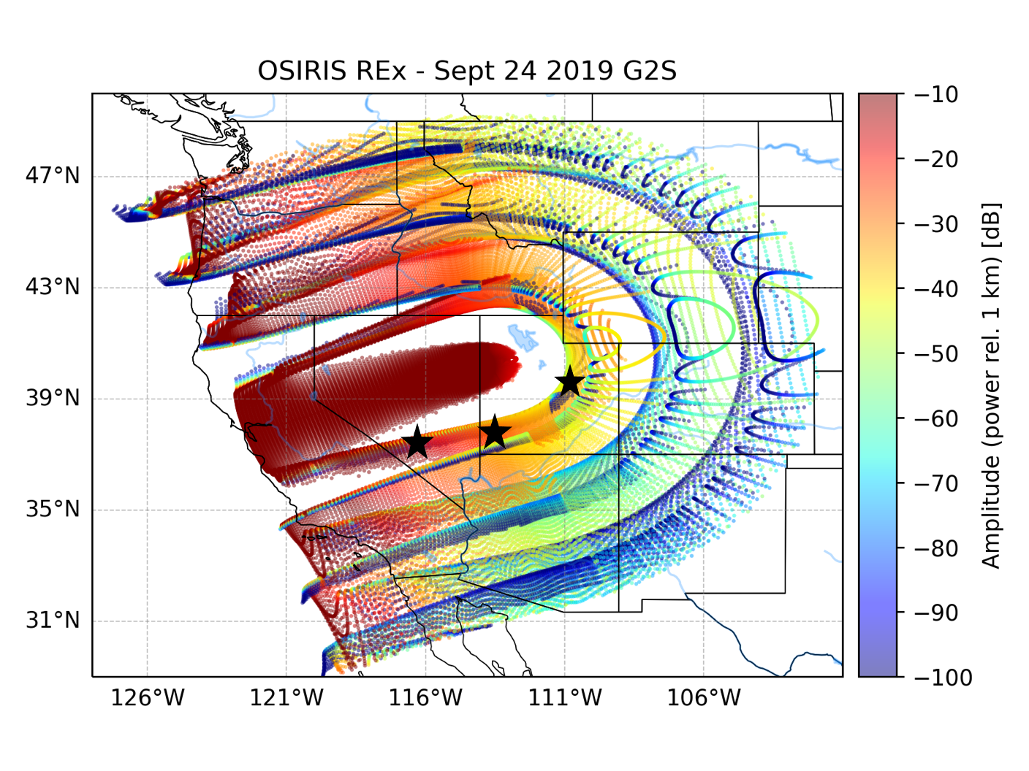
InfraGA predictions using expected trajectory from NASA and the atmosphere from 9/24/2019
Stars indicate locations of arrays that were deployed for this event
Unclassified

Slide 8
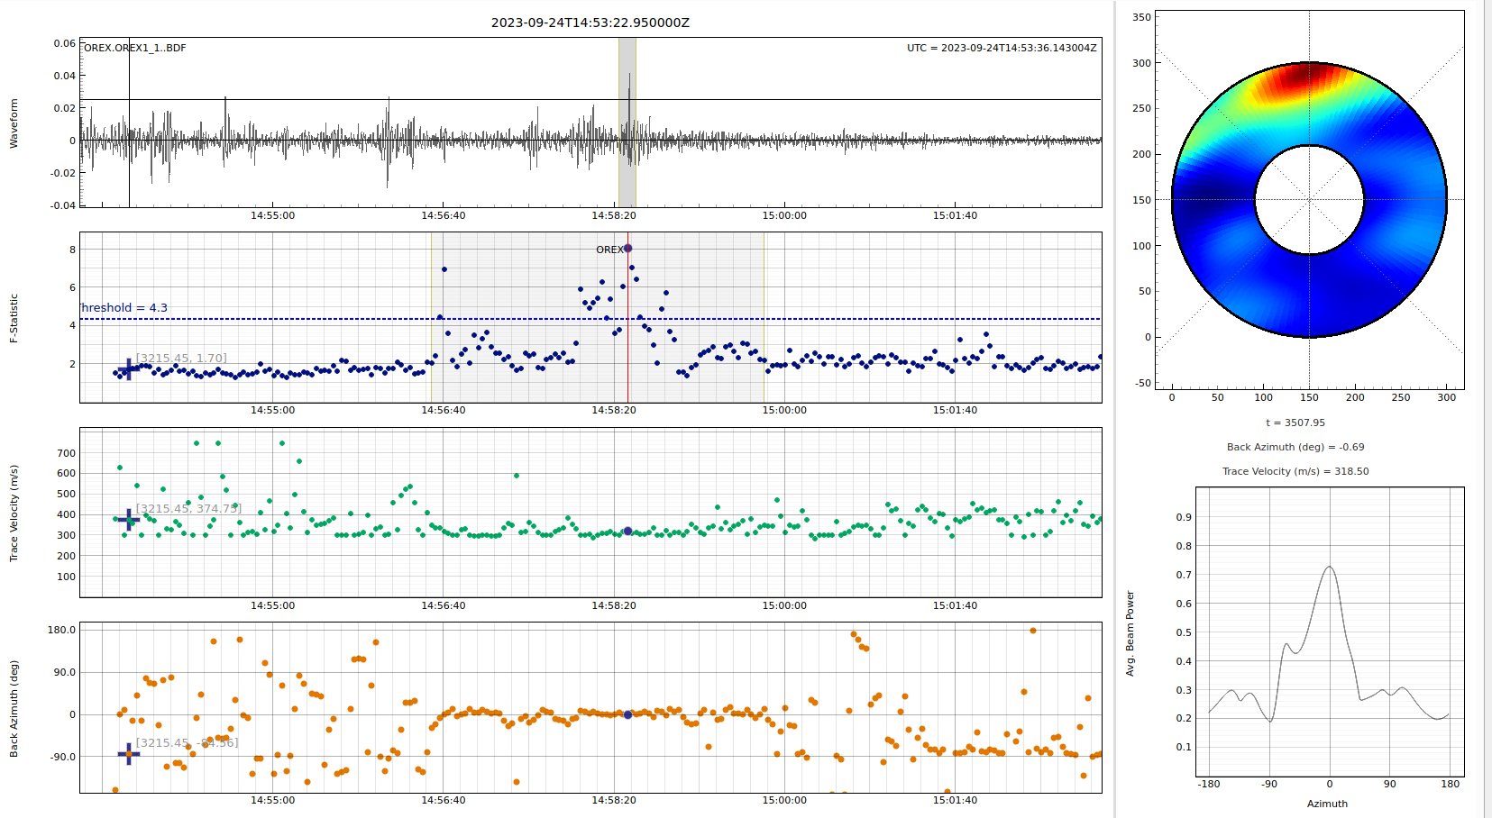
Beamforming results from NNSS array
Unclassified

Slide 9
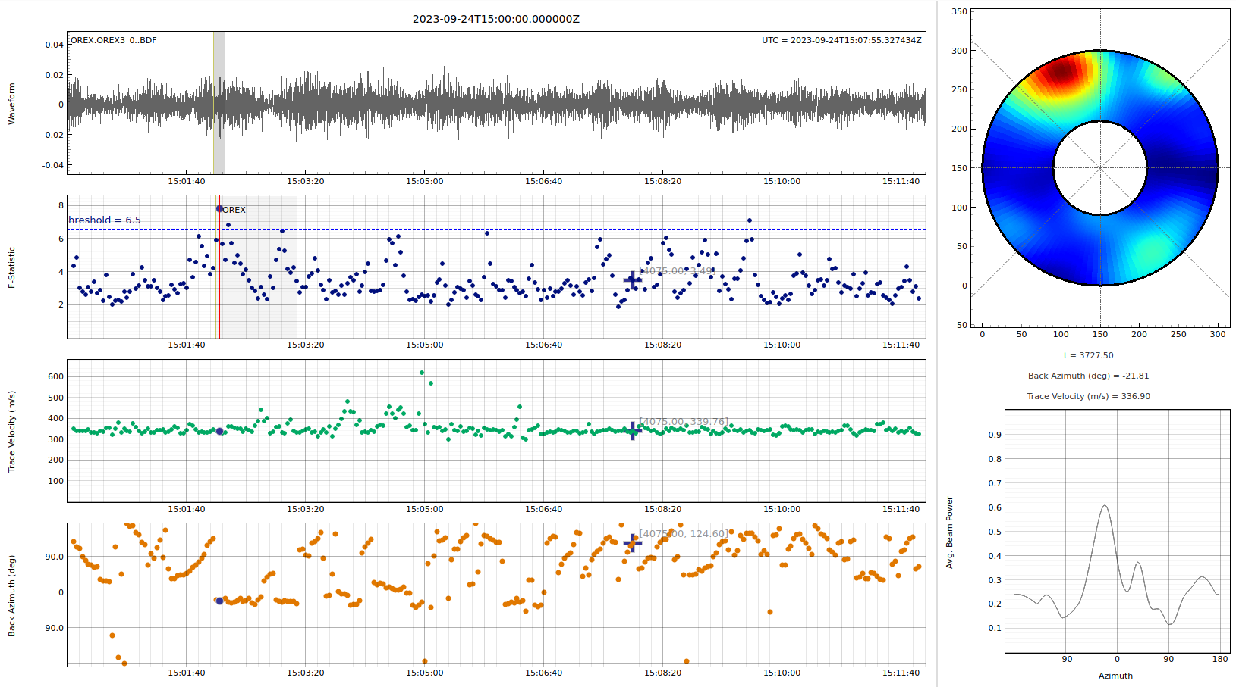
Beamforming results from St George array
Unclassified

Slide 10
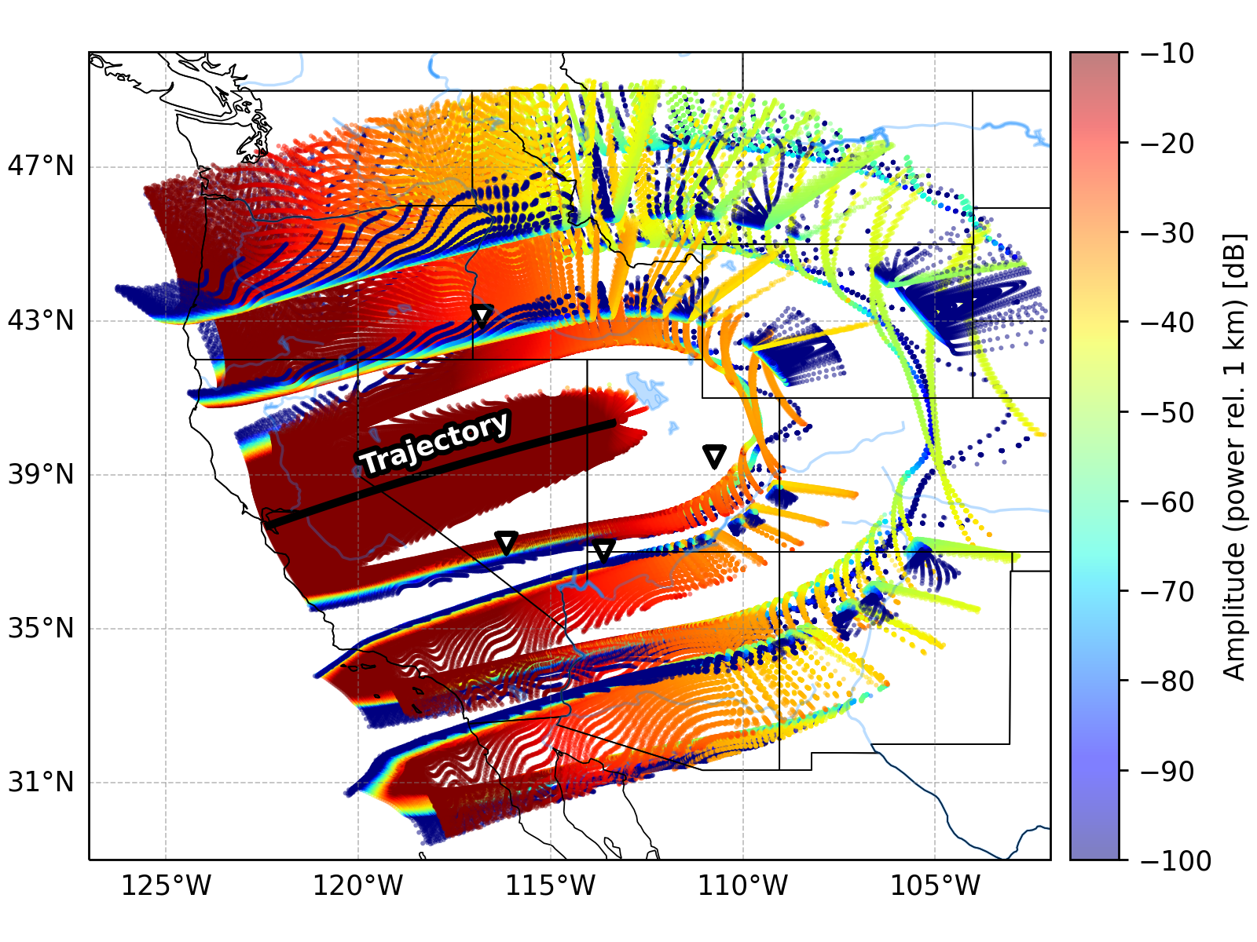
InfraGA predictions using expected trajectory from NASA and the atmosphere from 9/24/2023
Note that the Price Utah array is now is the shadow zone.
Unclassified

Slide 11
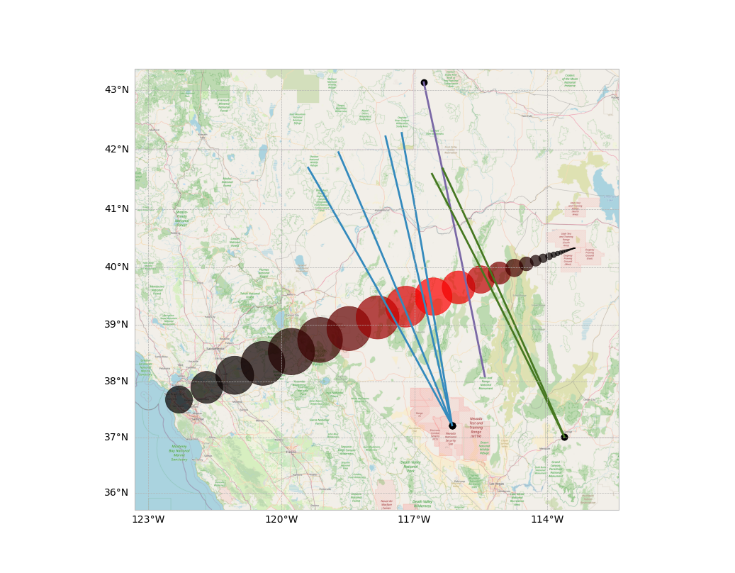
Beam Analysis
Blue: NNSS
Green: St George
Purple: Boise St
Unclassified

Slide 12
CONCLUSIONS
We were able to detect the acoustic signal from a hypersonic object with size < 1^3 m at an altitude of 60 km and an over-ground distance > 300 km.
InfraGA’s mach cone propagation estimates seems to work.
Unclassified

Slide 13
ACKNOWLEGEMENTS
This work gratefully acknowledges support from LDRD DR iNDD (2020188DR) and LDRD DR DIIComms (20230120DR).
Infrasound data from arrays JDSA and JDNB was provided by a team lead by Dr. Jacob Anderson at Boise State University.
Unclassified

