Slide 1
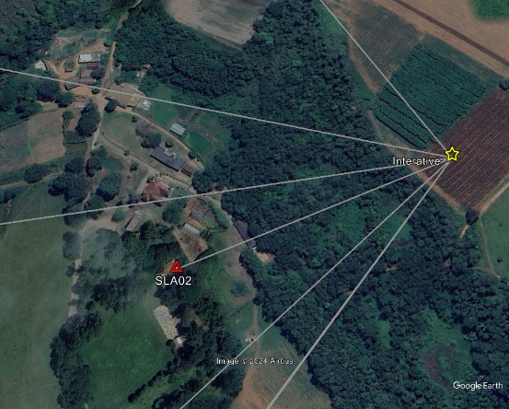
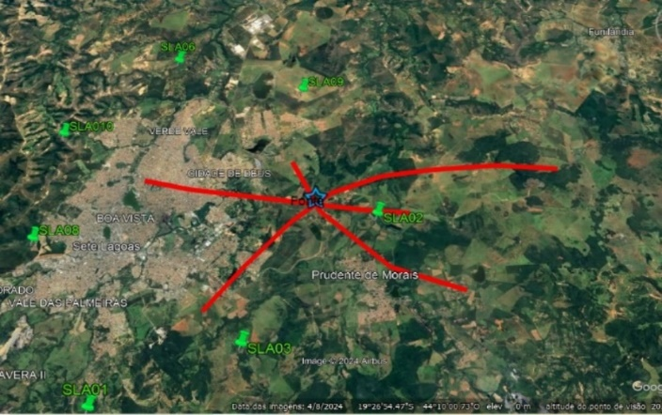
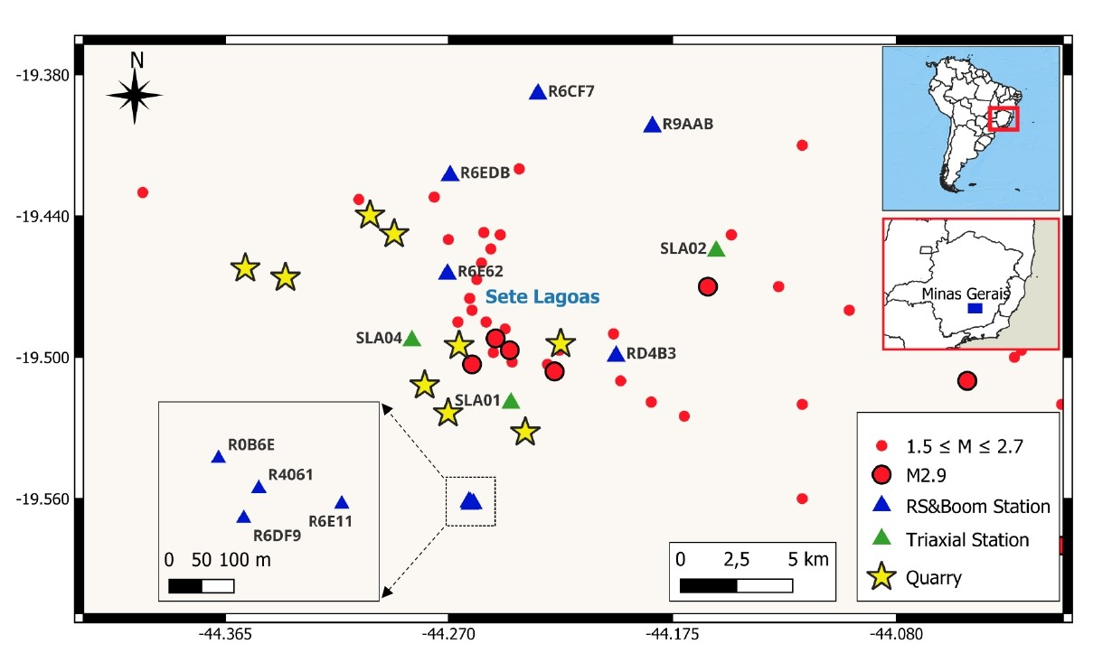
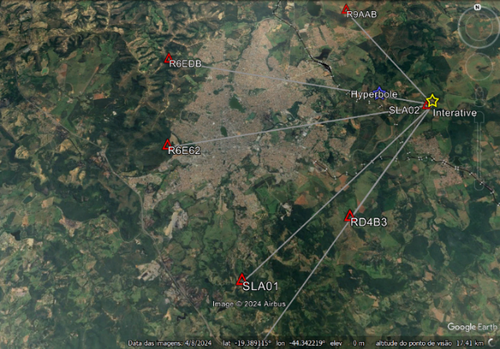
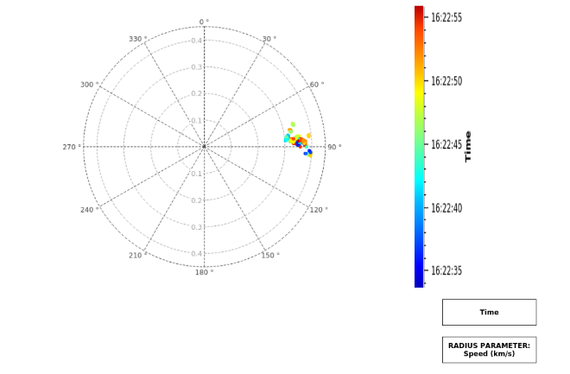
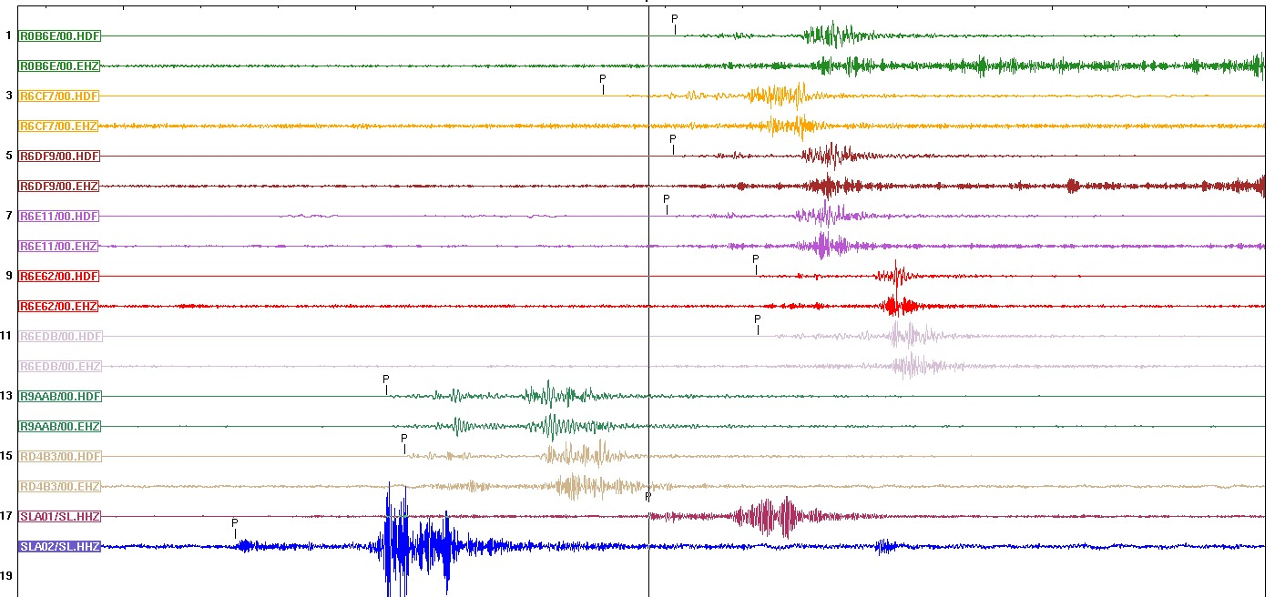
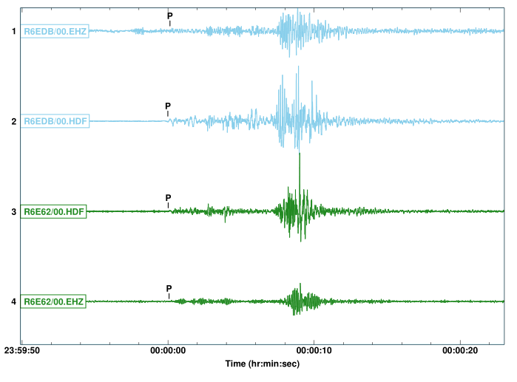
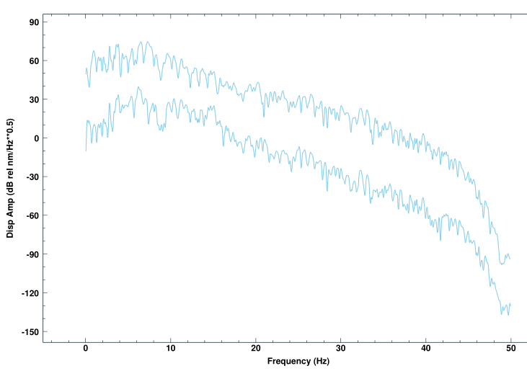
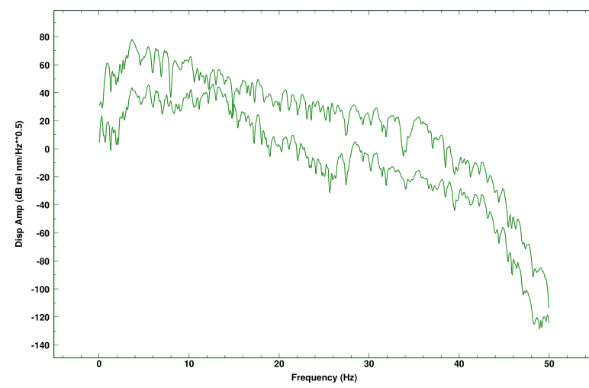
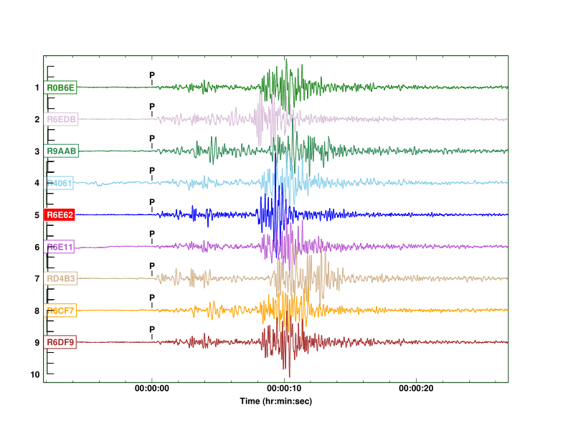
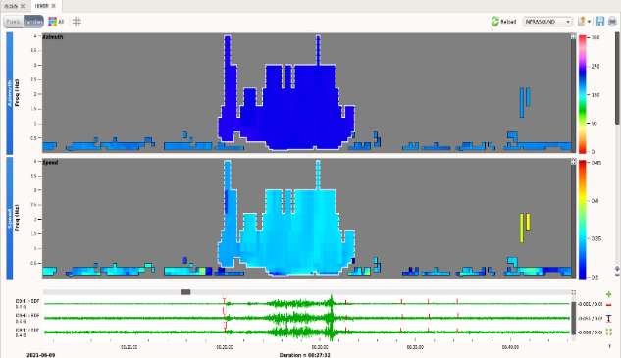
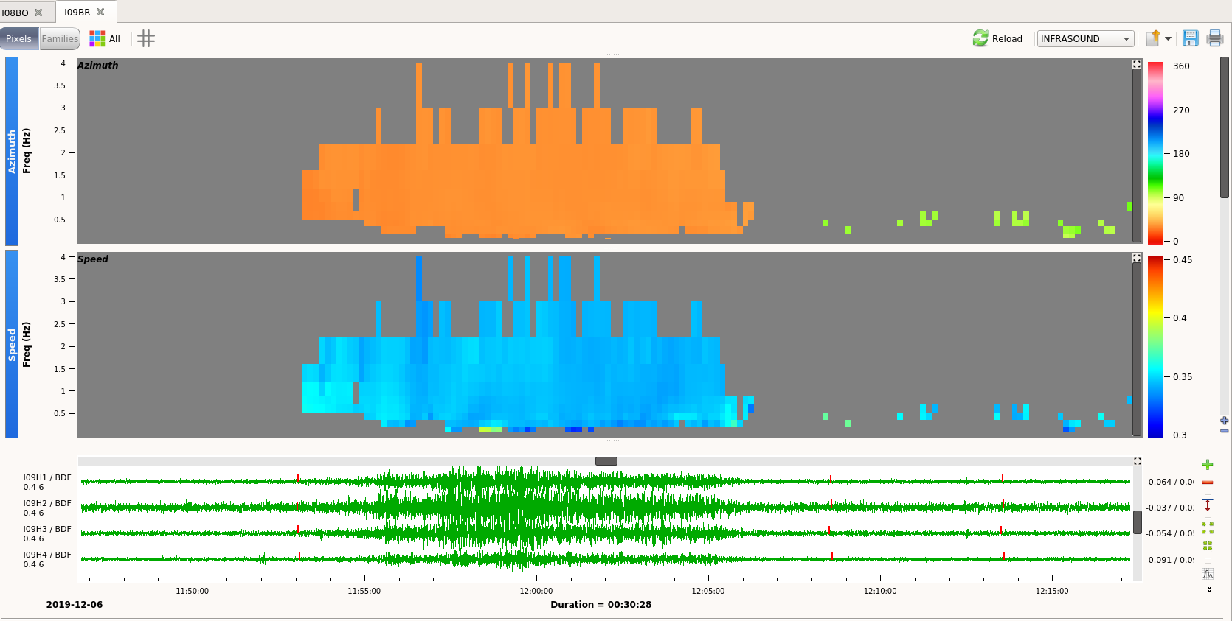
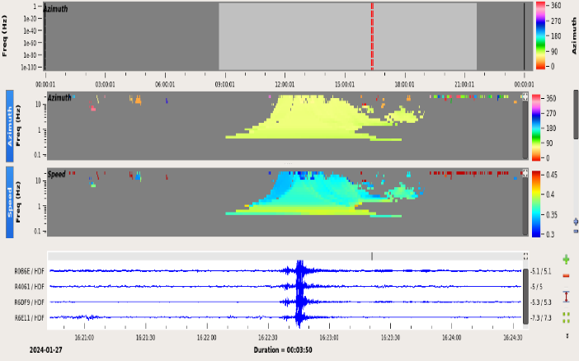
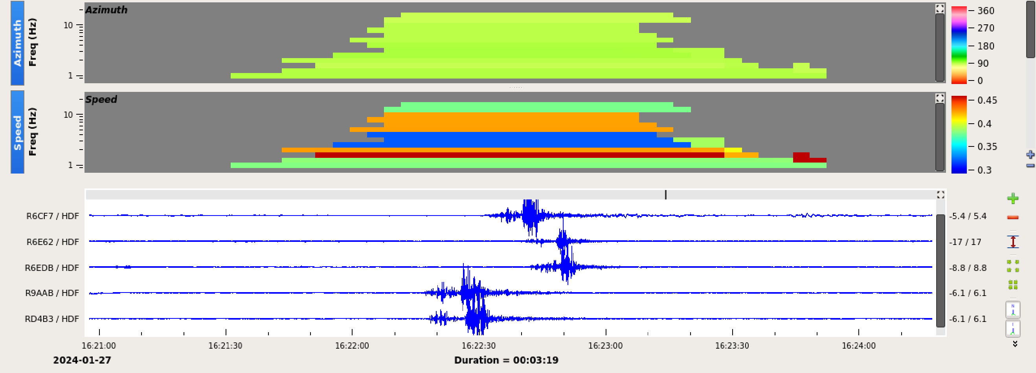
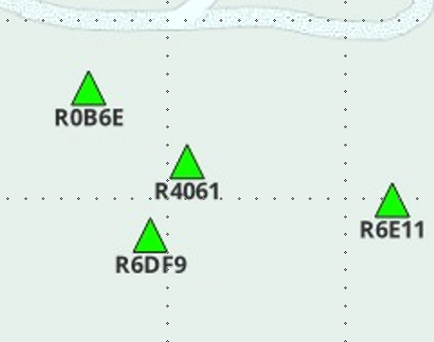
ITW 2024
Infrasound Technology Workshop
#162
Identifying infrasound sources using nearby and co-located infrasound and seismic sensors
Lucas Vieira Barros ¹, Darlan Portela Fontenele ¹ , Juraci Mario de Carvalho ¹ and Leticia Guedes ¹
1.Observatory Seismological of University of Brasília (SIS-UnB).
Abstract
2. Hyperbolic localization method
This method is used when there is only information about the arrival time of the P-wave at different stations, with at least three arrivals. In this study, the arrival time of the P-wave was replaced by the first arrival time of the acoustic wave. The method approach used here is based on (Pujol 2004; Bormann, Klinge, & Wendt, 2014) (Fig 5).
We deployed an eight-stations seismic network and a four-elements infrasound array to monitor an ongoing seismic sequency and discriminate tectonic from anthropogenic events in the city of Sete Lagoas, Minas Gerais State, Southeastern Brazil. In the area there are nine quarries that systematically, without any warning carry out explosions just to remove limestone, and in the cave of these mines it were already detect events not known its origin; if tectonics, probably induced by stress release due to the large amount of material being removed; if anthropogenic, explosion carry out in the queries (Fig. 1). However, no earthquakes or explosions were detected in the first month of operation of the instrument; instead, one uncategorized event was recorded on 1/27/2024.
In this work, we carried out a study on the nature, origin and characteristics of the signals detected by the seismic and infrasonic stations and concluded that the event is related to the bolide explosion that occurred between the cities of Sete Lagoas and Prudente de Morais.
Fig.4: Event location using the interactive method with hypocenter software and data from 7 stations (yellow star). Fig. 5: Hyperbola location method. The differences in arrival times at three stations of the array were used and, from these, three hyperbolas were drawn, the intersection point of the three is the location of the source (blue star).
Fig.1: Seismicity map (red circles), the eight-station seismic network (blue triangles: RSBoom station, and green triangle, broadband triaxial station) and the four-element infrasound array (blue triangles). Stars denote quarries in the region.
Introduction
The Sete Lagoas/MG region has been experiencing recurring seismicity (M3) since 2022, which has frightened the local population and neighboring cities. The earthquakes are shallow and very close to populated areas.
The seismic network and infrasound array are made up of RSBoom instruments, which are composed of uniaxial seismic sensors (1 – 44Hz) and broadband triaxial sensors (120 s – 100 Hz), microbarometers (1 - 44 Hz). All the signals were sampled at 100 s.p.s.
On 01/27/2024, an uncategorized event, of unknown origin and nature, was recorded by all sensors (infrasonic and seismic), except for the BB triaxial station (SLA04), the only one installed on an outcrop. The signals do not have a defined signature (Fig. 2).
The event was recorded simultaneously by collocated seismic and infrasonic sensors, but it was not detected by the Brazilian Meteor Observation Network (BRAMON), a national network dedicated to monitoring and studying meteors and fireballs in Brazil. It was also not detected by the Geostationary Lightning Mapper (GLM) sensor. But the event was perceived/felt by 32 residents of the cities of Sete Lagoas and Prudente de Morais.
This study aims to identify the origin and nature of this event, determine its location and discuss the contradiction of why this event was felt by some people if no seismic signal was recorded at any station.
Fig.6: Location of the event: yellow (interactive location) and blue (hyperbola method) stars. The Rosette, on the right, shows a diagram with temporal variation of the azimuth and velocity obtained from the array. The velocities vary with the arrival times of the waves from 0.3 km/s to 0.4 km/s. As expected, the lower velocities arrive later.
Discussion
An initially intriguing fact in the characterization of the event is that some people felt the ground shake, although the seismographic stations did not register any seismic signal. This was proven by the determination of wave propagation speeds of only 0.34 km/s.
Infrasound and seismic coupling
Seismic stations with high sensitivity, wide dynamic range and wide frequency response band, although designed to detect seismic waves, can also detect infrasonic signals, due to infrasonic coupling, since infrasonic waves generate small vibrations in the ground that can be detected locally by sensitive seismometers, but are not strong enough to generate seismic waves. Shock waves excite seismic sensors only locally.
Most likely source associated to January 27 infrasound event
1. Breaking of the sound barrier by a supersonic aircraft ; 2. Bolide hitting lower layers of the atmosphere.
Both can generate a bang, with a sudden displacement of air mass.
First case: almost always perceived visually, which did not occur.
1. The propagation speed of the resulting wave front is also not constant and varies greatly when the aircraft approaches or moves away from the station, which was not observed.
2. The azimuth can also vary; in our case it was very stable.
3. According to statements from some observers, a sudden movement of air was perceived, which caused doors and windows to vibrate. This can be observed in both cases.
4 Due to the unfavorable weather conditions on the day, clouds may have covered the light trail of a possible bolide, preventing the BRAMON cameras, the GLM sensor and the from viewing the phenomenon.
5. Comparing the infrasonic signal generated by the event of January 27 (Fig. 3), with two infrasonic signals from confirmed bolides, it is possible to verify the similarity between both signals (Fig. 7 and 8).
A)
B)
Fig.6A : Signals detected by seismic (EHZ) and infrasonic sensors (HDF) in two stations; Observe the simultaneous arrival of both signals.B) spectrum of both signals (blue traces), upper trace (seismic) and lower trace (infrasound). C) The same for thr green signal.
Fig 2A: Signals detected by infrasound (HDF traces) and seismic (EHZ traces) sensors on nine Raspberry instruments. Signals with traces of the same color refer to co-located sensors. The first two traces are related to the vertical components of two BB 3C stations. P indicates the first arrival time of the acoustic signal at the sensors. It is not a P- wave; 2B) Onset time of the infrasonic waves adjusted.
Methodology
The signals from the infrasound array and the seismic network were analyzed with the DTK-GPMCC software (Cansi, 1995) and Geotool (Ref), respectively. The event location was made using the Geiger (1912) iterative method (Hypocenter – Lienert & Haskov, 1995) and the ellipses method (Pujol 2004; Bormann, Klinge, & Wendt, 2014). The results were plotted with Google Earth and Qgis.
Data Analysis and Results
Fig. 3 shows PMCC families, sets of similar pixels that have the same attributes (azimuth, velocity and frequency). On the y-axis, the frequency (Hz) and on the x-axis, the time (UTC). The two-color scales on the right represent, respectively, the mean azimuth and the mean velocity of the wave front reaching the station. The green traces are the infrasonic signals detected in the four elements of the array on the left and five elements network on the right. The mean velocity, approximately 0.35 km/s, is compatible with the sound speed propagation in the atmosphere, which leads us to conclude that the event generated acoustic signals.
Fig. 3A: Infrasound signal detected by the array. Time is represented on the horizontal axis and frequency on the vertical axis. In upper and down, PMCC families with information on backazimuth (+-85 degres) and infrasonic wave front speed (350 m/s); Below, green lines, infrasonic signals detected in each of the four elements array; B : Infrasound signal detected by the array and infrasound network.
Fig.7: Infrasonic signal recorded at station I09BR (Brasília) referring to the bolide of 09/06/2021, whose maximum brightness was detected at 5:43 UTC in the north of Mato Grosso do Sul (Azimuth = 250.8 degrees, Speed ​​= 0.347 km/s, duration = 440 seconds and frequency = 1.025 Hz).
Fig. 8: Infrasonic signal related to the 12/06/2019 bolide, detected at station I09BR (Brazil). The maximum brightness was observed by the GLM sensor at 10:28 A.M on the coast of Ceará State Brazil, 2000 km away from the station.
Event Location
Conclusion
Normally, infrasonic event location is done using at least three infrasonic arrays, with the source located at the intersection of the three azimuthal beams. However, we only have one array. That is why other methods were used.
The infrasonic signals detected on 01/27/2024 were generated by a bolide that exploded in the lower atmosphere over the cities of Prudente de Morais and Sete Lagoas (19,454 W and 44,154 S).
The vibrations felt by some residents were caused locally by the ground impact of the shock waves in their vicinities and not by seismic waves itself, because these shock waves were not strong enough to propagate seismic waves, as no seismic station recorded seismic signals.
The use of cheap instruments, ~4,000,00 U$ per four-element array, will increase substantially the number of researchers working with the infrasound technology. In Brazil for the first time we have installed an experimental infrasound array.
Iterative Method
The Geiger (1812) method was used for event location, replacing the arrival times of P- waves by the first arrivals of acoustic signals. The velocity model was adapted to the case of acoustic waves traveling in the atmosphere at 340 m/s and negative depth. The event was located outside the network, with an azimuthal gap of 320 degrees (Fig. 4).

