Slide 1
Studying infrasound propagation in the middle atmosphere with ICON and UA-ICON: comparison with the IFS and ground-based remote sensing
Samuel Kristoffersen¹, Constantino Listowski¹, Robin Wing², Gerd Baumgarten², Sergey Khaykin³, Alain Hauchecorne³, Julien Vergoz¹, and Alexis Le Pichon¹
¹CEA, DAM, DIF, F-91297 Arpajon, France ²Leibniz Institute for Atmospheric Physics, Kühlungsborn, Germany ³Latmos, Guyancourt, France

Slide 2
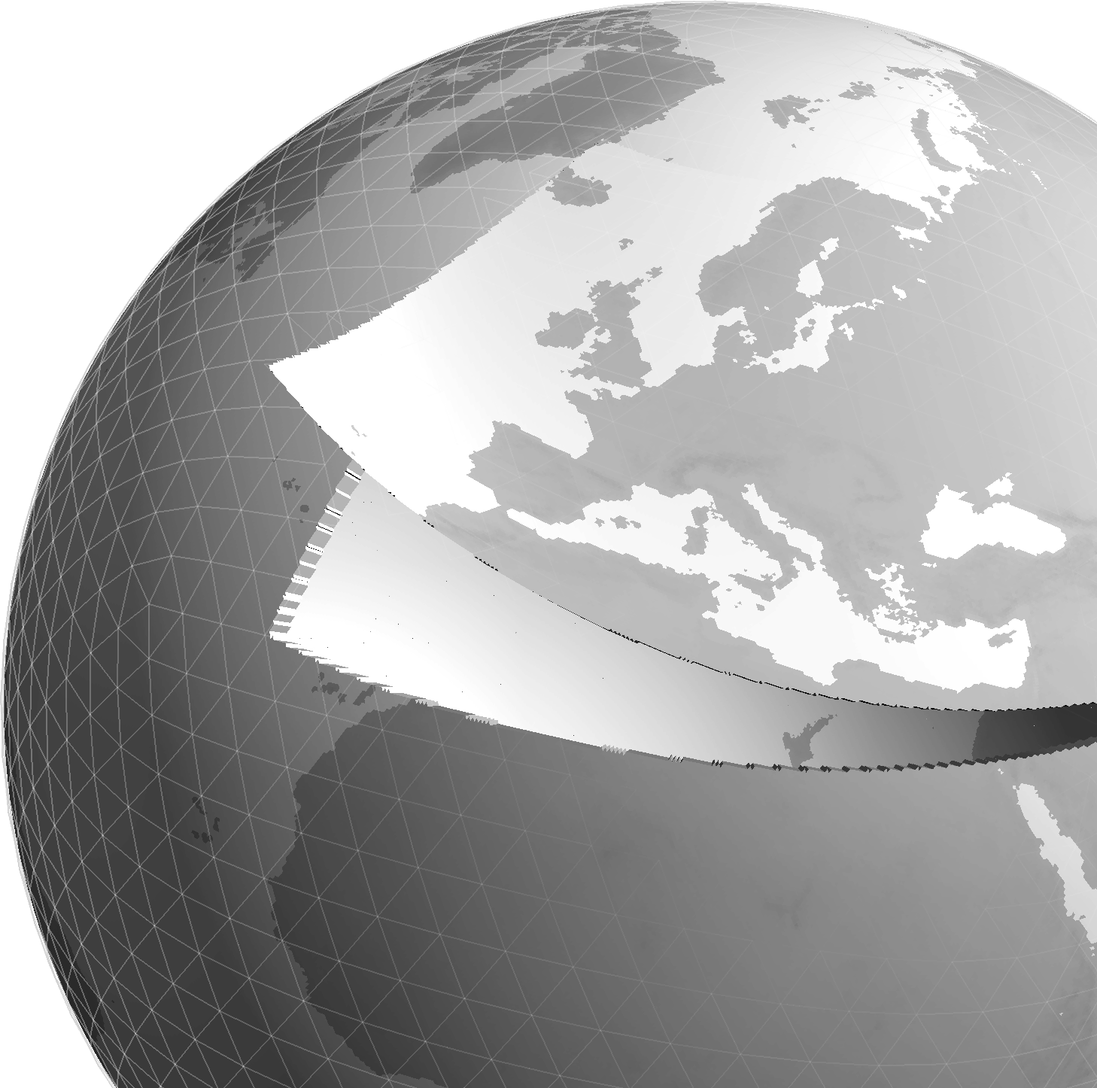
Atmospheric models (IFS and ICON)
Integrated Forecast System (IFS)
6-hourly forecast
80 km model top/137 levels
~9 km resolution
CEA has access to degraded version (~50 km resolution), once per day.
ICOsahedral Non-hydrostatic (ICON)
6-hourly forecast
75 km model top/120 levels
~13 km resolution
Non-hydrostatic model
Upper Atmosphere (UA) – ICON
150 km model top/240 levels
Sponge layer above 110 km
UA-ICON provides much better resolution of waves (e.g. GWs) through use of the non-hydrostatic atmosphere, and higher model top.
Borchert, S. et al. (2019) https://doi.org/10.5194/gmd-12-3541-2019, 2019.

Slide 3
UA-ICON parameters
Upper Atmosphere ICON height profile
Atmosphere top = 150 km (240 ML)
Sponge layer = 110 km
Operational ICON height profile
Atmosphere top = 75 km (120 ML)
Sponge layer = 35 km
Time step – 40 s
Horizontal resolution = 13 km
Nested domains are possible, which can increase the resolution 2/4 times.
Default settings for UA-ICON

Slide 4
Gravity wave parameterisation -> C*
Standard UA-ICON GW parameterisations were used save for C*.
C* regulates the height at which GW momentum and energy are deposited into the mean flow.
GW momentum that is greater than the C* saturation level is deposited into the atmosphere at that level.
Larger C* values increase the height at which momentum is deposited.
The default C* value (1) and a value of 20 were tested.
C*=20 was chosen based on the work of McLandress and Scinocca (2005) and results presented by Kunze et al. (2023) from IAP at the last ICCARUS meeting.
McLandress, C., and J. F. Scinocca, (2005) https://doi.org/10.1175/JAS3483.1

Slide 5
IFS and ICON comparisons
Wind and temperature comparisons

Slide 6
Global Maps at 60 km altitude – March 29, 2023
ICON
IFS
UA-ICON
U
V
T

Slide 7
March 2023 zonal-mean zonal wind
Large zonal wind jet is apparent in IFS around 60 km.
The URAP zonal-mean zonal winds do not show this feature.
ICON, both the operationa (above) and UA (not shown) provide zonal-mean zonal winds in better agreement with observations during the spring and fall.
Swinbank, R. and D. A. Ortland (2003), doi:10.1029/2002JD003135.

Slide 8
Differences between IFS and ICON
C-effective ratio (April, 2023)
Blue – ICON
Red – IFS
Dashed line - surface
C-effective is the speed of sound given the current wind conditions.
If the ratio of the effective speed of sound in the stratosphere and the surface is greater than 1, then a waveguide is formed.
ICON (blue) shows both easterly and westerly waveguide at IS32 (Kenya) in March, 2023.
IFS shows very strong westerly waveguide, but no easterly waveguide.
This will result in significantly different IS trajectories near the tropics/equator.

Slide 9
Lidar Comparisons
Investigation of C*

Slide 10
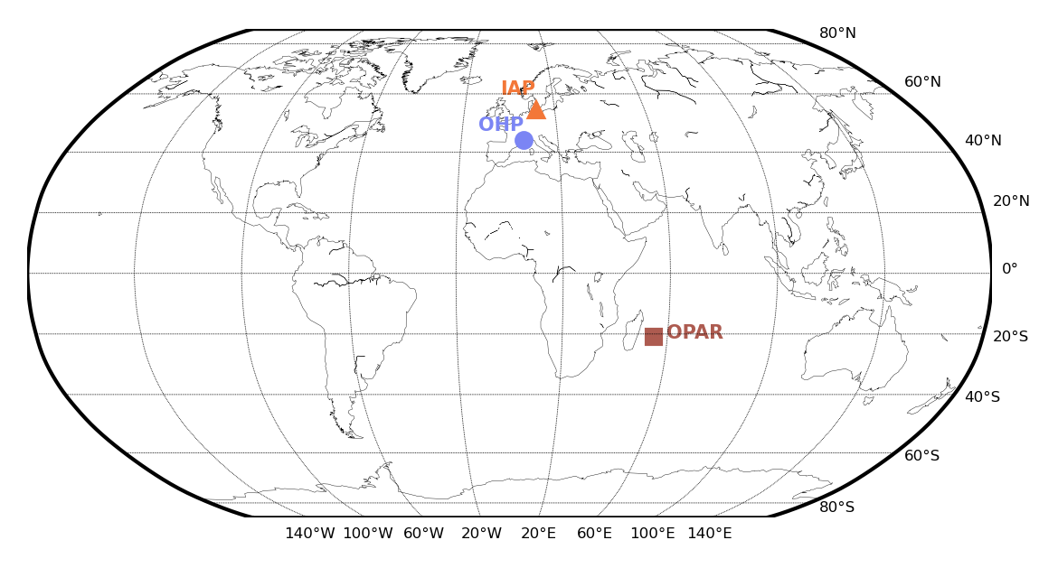
Lidar Atmospheric profiles
Rayleigh/Mie/Raman Lidars measure wind and temperature profiles in the middle atmosphere (30-100 km).
High vertical resolution allows for model validation, and resolution of atmospheric gravity waves.
These four locations provide high latitude, mid-latitude, and tropical comparisons.
https://www.iap-kborn.de/en/research/department-optical-soundings-and-sounding-rockets/instruments-and-models/alomar-rmr-lidar/

Slide 11
Model comparisons with Lidar at Kühlungsborn, Germany
June 2 to June 15, 2023
Models provide similar profiles up to about 50-60 km.
Notable deviations from temperature are observed using IFS and operational ICON products.
Increasing C* to 20 provides a much better fit to temperature (low mesopause temperature).
Meridional and zonal wind results are less clear.

Slide 12
Infrasound Results
Hukkakero

Slide 13
Infrasound measurements – Hukkakero, Finland
At Hukkakero Finland munitions are destroyed every August.
These ground-truth events provide an excellent reference for infrasound calibration.
IS37 (69.1N 18.6E) is located approximately 320 km from this site.
Signal and arrival time predictions were made using several different atmospheric model configurations (notably UA-ICON).
Different C* values were tested to see which provided the closest results to the observations.
Blixt et al. 2019 https://doi.org/10.1121/1.5120183
Google Earth

Slide 14
Waveform from parabolic equations
NCPAProp calculates attenuation for a range dependent atmosphere as a function of frequency. (Waxler et al., 2020, 10.5281/zenodo.4477089)
Complex gain can be determined at station for all the frequencies of interest.
Waveform is created by convolving the gain at the station with a source signal
A simple sinusoidal impulse was used, but other more complicated sources could be chosen.

Slide 15
Infrasound observations with different atmospheres
ICON
IFS
Simulations
Observations
Mesosphere
Stratosphere
Thermosphere

Slide 16
Effects of C* on IS signal propagation
UA-ICON – C*=1
IUA-CON – C*=20
Simulations
Observations
Mesosphere
Stratosphere
Thermosphere

Slide 17
ICON C*=1 – Ray tracing

Slide 18
ICON C*=20, 13 km resolution – Ray tracing

Slide 19
ICON C*=20, 3 km resolution – Ray tracing

Slide 20
IS25 - Kourou
MCML analysis
Poste et al. 2023, , https://doi.org/10.1093/gji/ggac377
Signal duration – 10 minutes
$φ=$ $140.2±3.0°$ (direct – 142°)
$v=366±8$ m/s
Celerity -> 267 to 300 m/s consistent with stratospheric and mesospheric returns

Slide 21
Kourou – 3D ray tracing
Notable mesospheric waveguide in UA-ICON
Only thermospheric returns with IFS
UA-ICON could explain later returns observed with low celerity (267 m/s)
Ray tracing fails to predict stratospheric observations.
IFS
UA-ICON
C*=20

Slide 22
Waveforms from parabolic equations
Predicted waveforms shown in pressure relative to 1 Pa at 1 km from the source.
UA-ICON waveform amplitude is considerably larger than that of IFS.
Arrival time, and signal duration using UA-ICON are consistent with MCML analysis.
Predicted celerities are consistent with stratospheric and mesospheric returns observed with UA-ICON.

Slide 23
Summary/Conclusions
Infrasound propagation is highly dependent on atmospheric conditions (temperature, wind etc.) in the middle atmosphere.
Currently at CEA, operational (IFS) model is used with a climatology for the Mesosphere and Lower Thermosphere (MLT).
UA-ICON provides these atmospheric parameters up to the MLT.
There remains the need to fully calibrate the UA-ICON
Current GW parameterisations (e.g. C*) do not properly estimate MLT winds and temperatures.
Lidar comparisons during the summer of 2023 show good agreement with UA-ICON – C*=20
The Hukkakero reference event further demonstrates the importance of correct MLT model predictions
With C*=20 again providing the best results, especially at very high (3 km) horizontal resolution.
Kourou event consistent with UA-ICON results, in particular due to the large mesospheric winds not observed in IFS/climatology and the increased vertical resolution of UA-ICON.
Further Lidar comparisons are necessary to better tune GW parameterisations

Slide 24
Thank you for your attention
References
Borchert, S., Zhou, G., Baldauf, M., Schmidt, H., Zängl, G., and Reinert, D.: The upper-atmosphere extension of the ICON general circulation model (version: ua-icon-1.0), Geosci. Model Dev., 12, 3541–3569, https://doi.org/10.5194/gmd-12-3541-2019, 2019.
McLandress, C., and J. F. Scinocca, 2005: The GCM Response to Current Parameterizations of Nonorographic Gravity Wave Drag. J. Atmos. Sci., 62, 2394–2413, https://doi.org/10.1175/JAS3483.1.
Swinbank, R. and D. A. Ortland (2003), Compilation of wind data for the (UARS) Reference Atmosphere Project, J. Geophys. Res., 108, D19, 4615, doi:10.1029/2002JD003135.
B Poste, M Charbit, A Le Pichon, C Listowski, F Roueff, J Vergoz, The multichannel maximum-likelihood (MCML) method: a new approach for infrasound detection and wave parameter estimation, Geophysical Journal International, Volume 232, Issue 2, February 2023, Pages 1099–1112, https://doi.org/10.1093/gji/ggac377
Waxler, Roger & Hetzer, Claus & Assink, Jelle & Velea, Doru. (2020). ncpaprop: a software package for infrasound propagation modeling. 10.5281/zenodo.4477089.
Erik Mårten Blixt, Sven Peter Näsholm, Steven J. Gibbons, Läslo G. Evers, Andrew J. Charlton-Perez, Yvan J. Orsolini, Tormod Kværna; Estimating tropospheric and stratospheric winds using infrasound from explosions. J. Acoust. Soc. Am. 1 August 2019; 146 (2): 973–982. https://doi.org/10.1121/1.5120183
Kristoffersen, Samuel, Listowski, Constantino, Wing, Robin, Baumgarten, Gerd, Khaykin, Sergey, Hauchecorne, Alain, Vergoz, Julien, Le Pichon, Alexis. (2024). Studying infrasound propagation in the middle atmosphere with ICON and UA-ICON: comparison with the IFS and ground-based remote sensing. INTER-NOISE and NOISE-CON Congress and Conference Proceedings. 270. 3756-3764. 10.3397/IN_2024_3366.

Slide 25
Backup slides

Slide 26
Waveforms from parabolic equations
Predicted waveforms shown in pressure relative to 1 Pa at 1 km from the source.
UA-ICON C*=20 waveform amplitude is considerably larger than that of IFS and C*=1.
Both UA-ICON models better predict arrival times than IFS
Predicted celerities are consistent with stratospheric and mesospheric returns observed with UA-ICON.

