Slide 1
Quantifying atmospheric uncertainty and detection quality impacts on infrasound localization
Infrasound Technology Workshop (ITW2024)
Philip Blom¹, Jordan Bishop¹, & W. Garth Frazier²
¹Los Alamos National Laboratory
²NCPA, University of Mississippi
LA-UR-24-31074
This Ground-based Nuclear Detonation Detection (GNDD) research was funded by the National Nuclear Security Administration, Defense Nuclear Nonproliferation Research and Development (NNSA DNN R&D). This work was supported by the U.S. Department of Energy through the Los Alamos National Laboratory.

Slide 2
Outline
Back Projection Localization
Examples
  Multi-phase single-station localization
  Regional multi-station localization
Localization Confidence Trends
Summary and Ongoing R&D

Slide 3
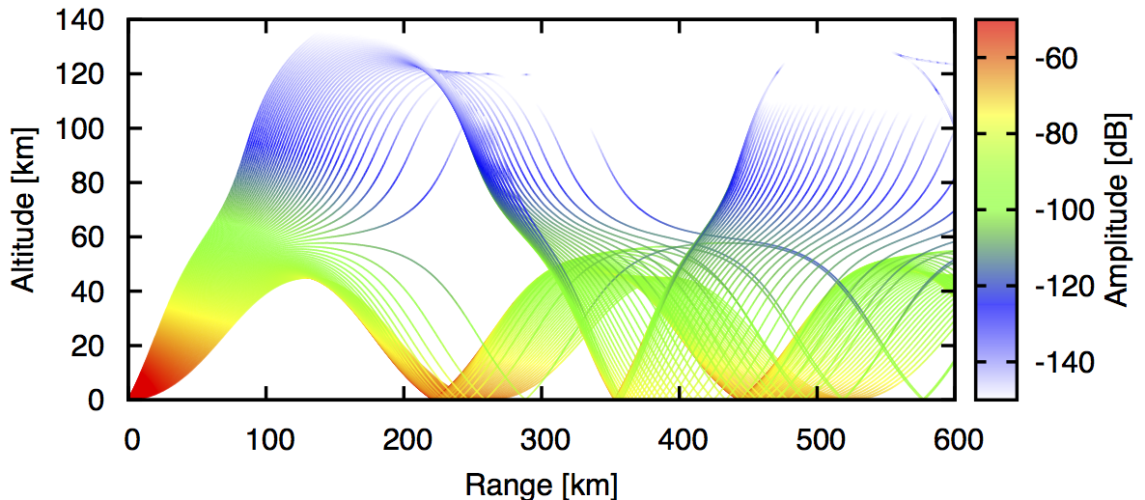
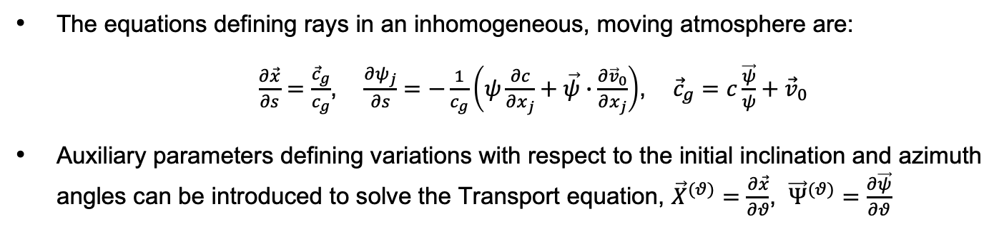
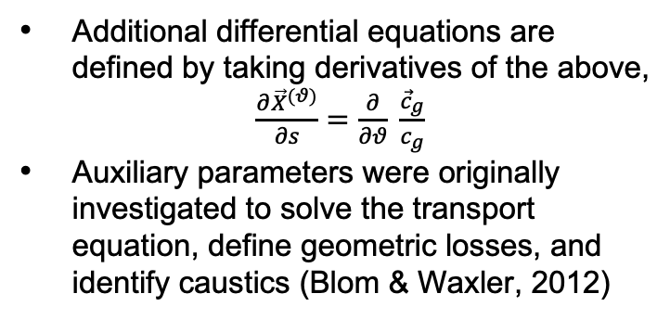
Background – Auxiliary Parameters
The equations defining rays in an inhomogeneous, moving atmosphere are:
  $\frac{∂\vec{x}}{∂s}=$ $\frac{{\vec{c}}_{g}}{c_{g}}$, $\frac{∂ψ_{j}}{∂s}=−\frac{1}{c_{g}}\left(ψ\frac{∂c}{∂x_{j}}+\vec{ψ}∙\frac{∂{\vec{v}}_{0}}{∂x_{j}}\right)$, ${\vec{c}}_{g}=c\frac{\vec{ψ}}{ψ}+{\vec{v}}_{0}$
Auxiliary parameters defining variations with respect to the initial inclination and azimuth angles can be introduced to solve the Transport equation, ${\vec{X}}^{(θ)}=\frac{∂\vec{x}}{∂θ}$, ${\vec{Ψ}}^{(θ)}=\frac{∂\vec{ψ}}{∂θ}$
Additional differential equations are defined by taking derivatives of the above,
$\frac{∂{\vec{X}}^{(θ)}}{∂s}=$ $\frac{∂}{∂θ} \frac{{\vec{c}}_{g}}{c_{g}}$
Auxiliary parameters were originally investigated to solve the transport equation, define geometric losses, and identify caustics (Blom & Waxler, 2012)

Slide 4
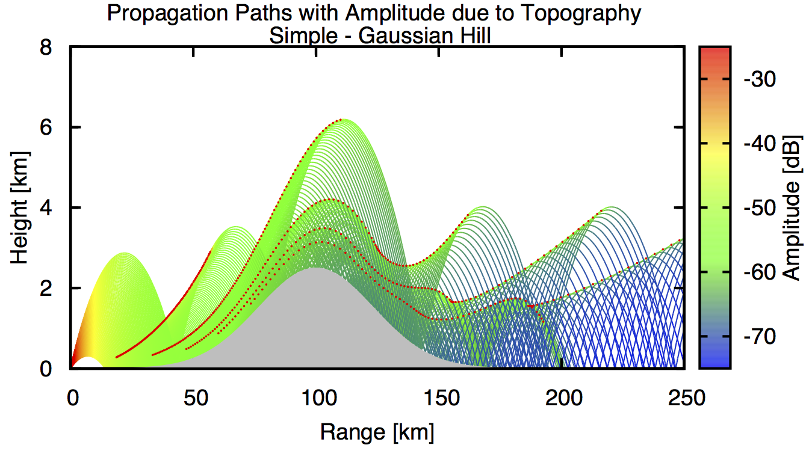
Background – Auxiliary Parameters
The equations defining rays in an inhomogeneous, moving atmosphere are:
  $\frac{∂\vec{x}}{∂s}=$ $\frac{{\vec{c}}_{g}}{c_{g}}$, $\frac{∂ψ_{j}}{∂s}=−\frac{1}{c_{g}}\left(ψ\frac{∂c}{∂x_{j}}+\vec{ψ}∙\frac{∂{\vec{v}}_{0}}{∂x_{j}}\right)$, ${\vec{c}}_{g}=c\frac{\vec{ψ}}{ψ}+{\vec{v}}_{0}$
Auxiliary parameters defining variations with respect to the initial inclination and azimuth angles can be introduced to solve the Transport equation, ${\vec{X}}^{(θ)}=\frac{∂\vec{x}}{∂θ}$, ${\vec{Ψ}}^{(θ)}=\frac{∂\vec{ψ}}{∂θ}$
Additional differential equations are defined by taking derivatives of the above,
$\frac{∂{\vec{X}}^{(θ)}}{∂s}=$ $\frac{∂}{∂θ} \frac{{\vec{c}}_{g}}{c_{g}}$
Auxiliary parameters were originally investigated to solve the transport equation, define geometric losses, and identify caustics (Blom & Waxler, 2012)

Slide 5
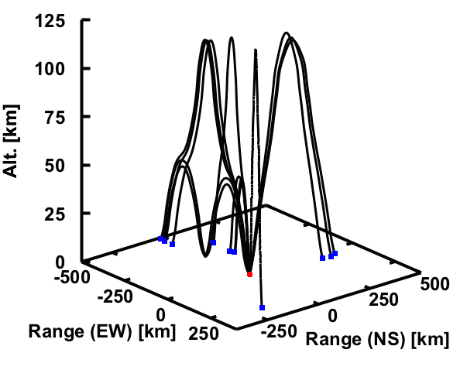
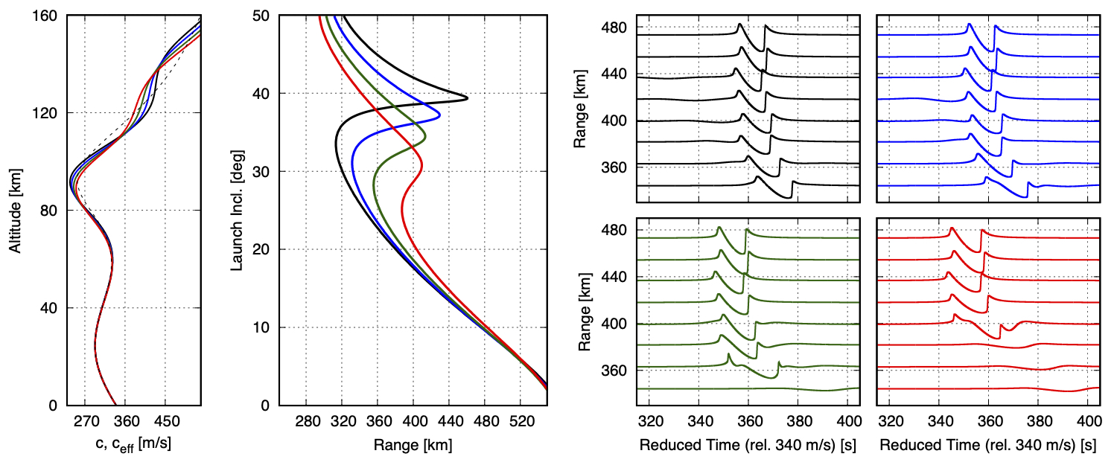
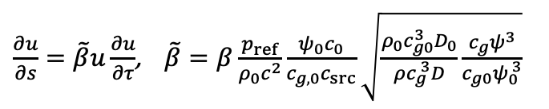

Background – Auxiliary Parameters
Auxiliary parameters were subsequently leveraged as part of a Levenberg-Marquardt eigenray algorithm
The Jacobian determinant is used in weakly non-linear waveform evolution computations
$$Δ\vec{Ω}={\left(D_{0}+λ diag(D_{0})\right)}^{−1}Δ{\vec{x}}_{0},$$
$D_{0}=\left(\begin{matrix}\frac{∂x_{0}}{∂θ} & \frac{∂x_{0}}{∂φ} \\ \frac{∂y_{0}}{∂θ} & \frac{∂y_{0}}{∂φ}\end{matrix}\right)$
$\frac{∂u}{∂s}=\tilde{β}u\frac{∂u}{∂τ}$, $\tilde{β}=β\frac{p_{ref}}{ρ_{0}c^{2}}\frac{ψ_{0}c_{0}}{c_{g,0}c_{src}}\sqrt{\frac{ρ_{0}{c_{g0}^{3}D}_{0}}{ρc_{g}^{ 3}D}\frac{c_{g}ψ^{3}}{c_{g0}ψ_{0}^{ 3}}}$

Slide 6
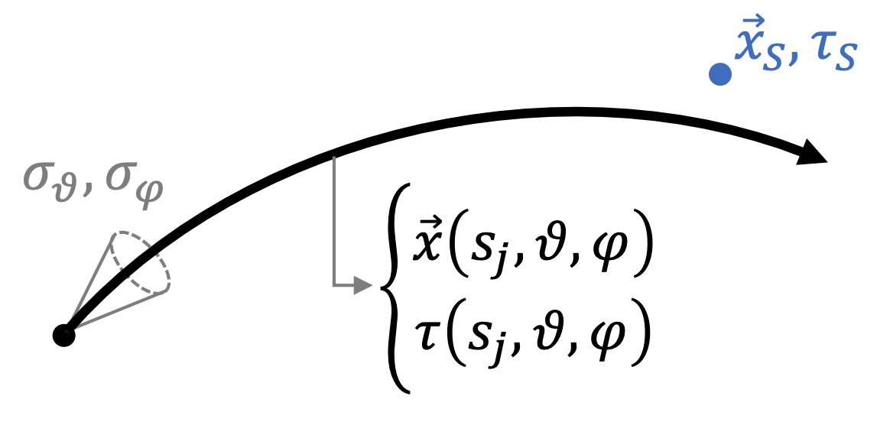
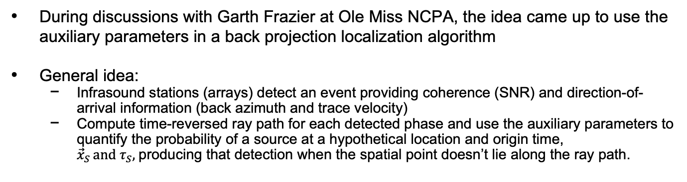
Back Projection Localization
During discussions with Garth Frazier at Ole Miss NCPA, the idea came up to use the auxiliary parameters in a back projection localization algorithm
General idea:
  Infrasound stations (arrays) detect an event providing coherence (SNR) and direction-of-arrival information (back azimuth and trace velocity)
  Compute time-reversed ray path for each detected phase and use the auxiliary parameters to quantify the probability of a source at a hypothetical location and origin time, ${\vec{x}}_{S }and τ_{S},$producing that detection when the spatial point doesn’t lie along the ray path.

Slide 7
Back Projection Localization
During discussions with Garth Frazier at Ole Miss NCPA, the idea came up to use the auxiliary parameters in a back projection localization algorithm
General idea:
  Infrasound stations (arrays) detect an event providing coherence (SNR) and direction-of-arrival information (back azimuth and trace velocity)
  Compute time-reversed ray path for each detected phase and use the auxiliary parameters to quantify the probability of a source at a hypothetical location and origin time, ${\vec{x}}_{S }and τ_{S},$producing that detection when the spatial point doesn’t lie along the ray path.
Considerations:
  Implemented auxiliary parameters are only spatial. Can we define variation of propagation time along the ray path? (not included here, see manuscript)
  How can we quantify uncertainty/confidence in detection direction-of-arrival estimates?
  Localization should include uncertainty in the atmospheric state, but avoid introducing many parameters (e,g., EOF coefficients)?

Slide 8
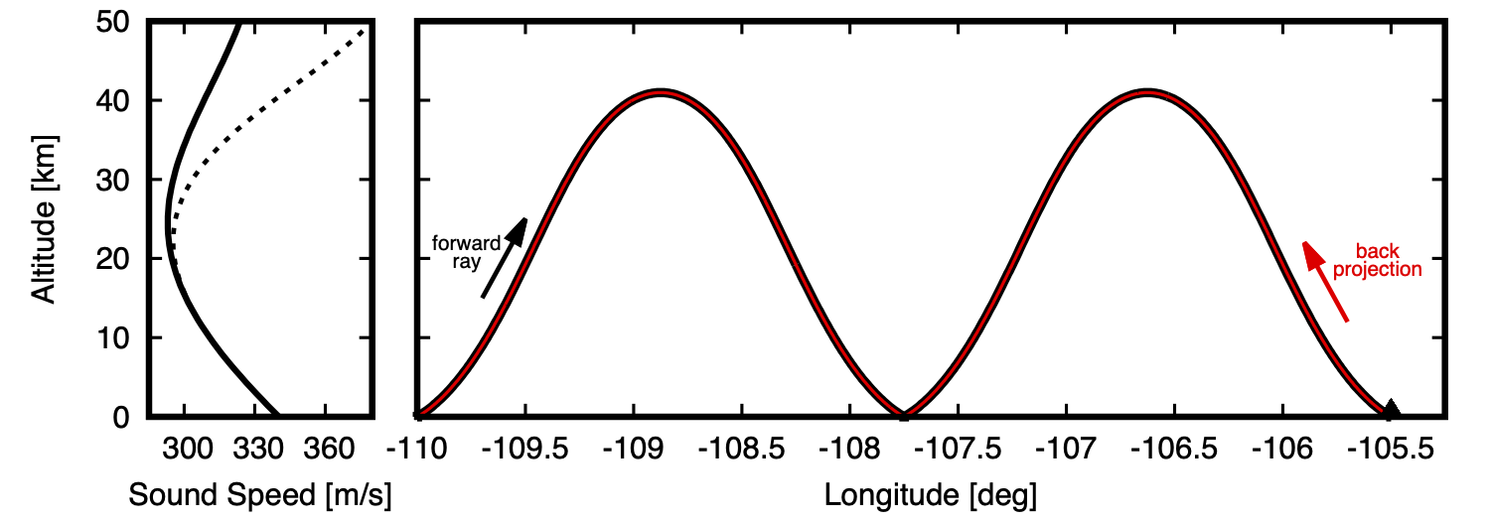
Back Projection Localization – Ray Tracing
Time-reversed ray tracing requires swapping the wind flow direction (east ⬌ west, north ⬌ south)
In spherical geometry, the inclination angles at launch and arrival are different, so reciprocity is a bit more complicated (but still valid)
 | Eigenray | Time-Reversed Projection
Starting Location | 30°, -110° | 30°, -105.5°
Arrival Location | 30°, -105.4998° | 29.9999°, -110.0002°
Launch Inclination | 9.32190589° | 9.3168453°
Arrival Inclination | 9.3168453° | 9.32190589°
Launch Azimuth | 88.893277° | -88.85578°
Arrival Back Azimuth | -88.85578° | 88.893263°
Propagation Time | 1484.417 sec | 1484.425 sec
Transport Coefficient (rel. 1 km) | -43.1139 dB | -43.1138 dB

Slide 9
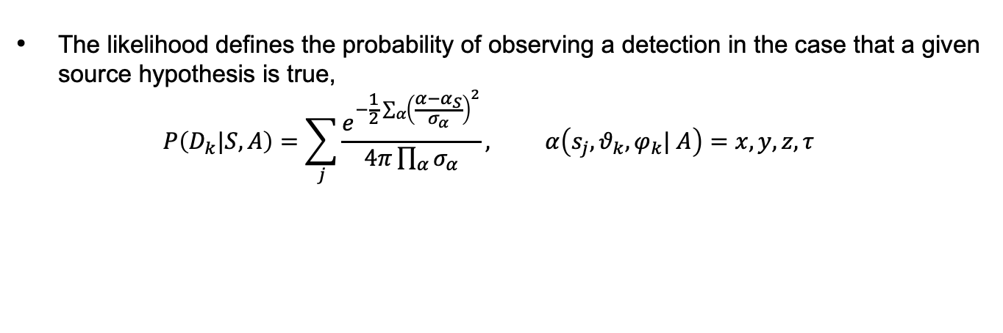
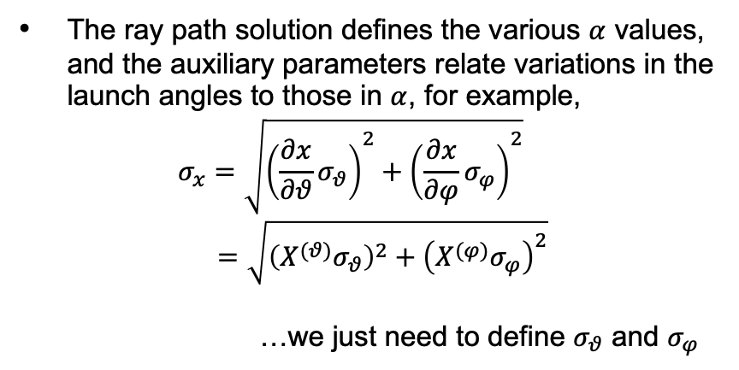
Back Projection Localization – Likelihood
The likelihood defines the probability of observing a detection in the case that a given source hypothesis is true,
$$P\left(D_{k}|S, A\right)=\sum_{j}{\frac{e^{−\frac{1}{2}\sum_{α}{{\left(\frac{α−α_{S}}{σ_{α}}\right)}^{2}}}}{4π\prod_{α}{σ_{α}}}}, α\left(s_{j},θ_{k},φ_{k}| A\right)=x, y, z, τ$$
The ray path solution defines the various $α$ values, and the auxiliary parameters relate variations in the launch angles to those in $α$, for example,
$$σ_{x}=\sqrt{{\left(\frac{∂x}{∂θ}σ_{θ}\right)}^{2}+{\left(\frac{∂x}{∂φ}σ_{φ}\right)}^{2}}$$
$=\sqrt{{\left(X^{(θ)}σ_{θ}\right)}^{2}+{\left(X^{(φ)}σ_{φ}\right)}^{2}}$
…we just need to define $σ_{θ}$ and $σ_{φ}$

Slide 10
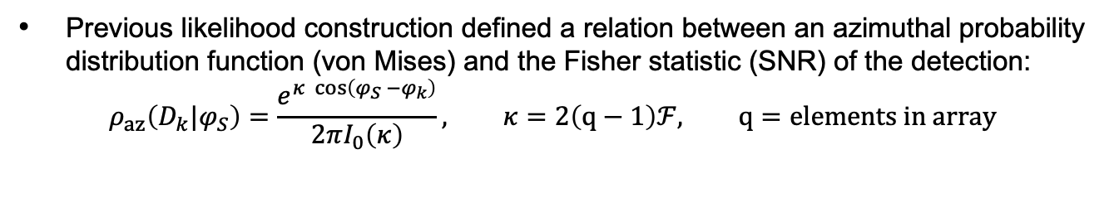
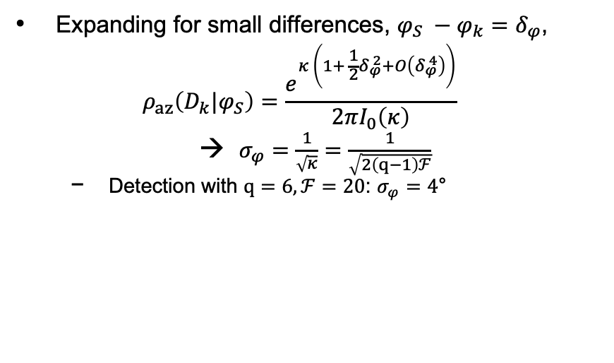
Back Projection Localization – Uncertainty
Previous likelihood construction defined a relation between an azimuthal probability distribution function (von Mises) and the Fisher statistic (SNR) of the detection:
$$ρ_{az}\left(D_{k}|φ_{S}\right)=\frac{e^{κ \cos\left(φ_{S} −φ_{k}\right)}}{2πI_{0}\left(κ\right)}, κ=2\left(q−1\right)ℱ, q=elements in array$$
Expanding for small differences, $φ_{S} −φ_{k}=δ_{φ}$,
$$ρ_{az}\left(D_{k}|φ_{S}\right)=\frac{e^{κ \left(1+ \frac{1}{2}δ_{φ}^{ 2}+O\left(δ_{φ}^{ 4}\right)\right)}}{2πI_{0}\left(κ\right)}$$
$σ_{φ}=\frac{1}{\sqrt{κ}}=\frac{1}{\sqrt{2\left(q−1\right)ℱ}}$
  Detection with $q=6, ℱ=20$: $σ_{φ}=4$°

Slide 11
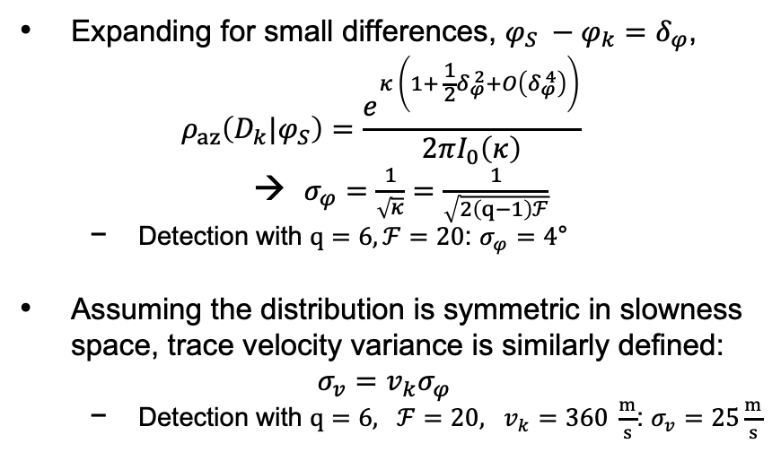
Back Projection Localization – Uncertainty
Previous likelihood construction defined a relation between an azimuthal probability distribution function (von Mises) and the Fisher statistic (SNR) of the detection:
$$ρ_{az}\left(D_{k}|φ_{S}\right)=\frac{e^{κ \cos\left(φ_{S} −φ_{k}\right)}}{2πI_{0}\left(κ\right)}, κ=2\left(q−1\right)ℱ, q=elements in array$$
Expanding for small differences, $φ_{S} −φ_{k}=δ_{φ}$,
$$ρ_{az}\left(D_{k}|φ_{S}\right)=\frac{e^{κ \left(1+ \frac{1}{2}δ_{φ}^{ 2}+O\left(δ_{φ}^{ 4}\right)\right)}}{2πI_{0}\left(κ\right)}$$
$σ_{φ}=\frac{1}{\sqrt{κ}}=\frac{1}{\sqrt{2\left(q−1\right)ℱ}}$
  Detection with $q=6, ℱ=20$: $σ_{φ}=4$°
Assuming the distribution is symmetric in slowness space, trace velocity variance is similarly defined:
$$σ_{v}=v_{k}σ_{φ}$$
  Detection with $q=6, ℱ=20, v_{k}=360 \frac{m}{s}$: $σ_{v}=25\frac{m}{s}$

Slide 12

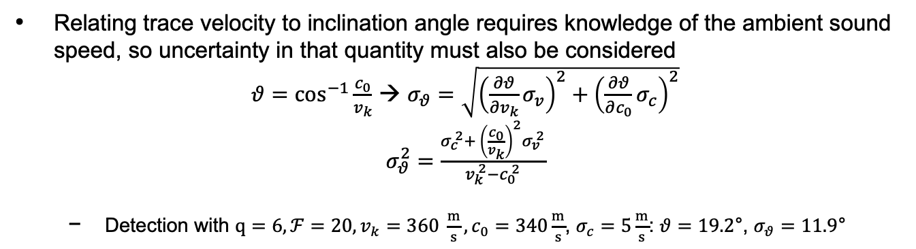
Back Projection Localization – Uncertainty
Relating trace velocity to inclination angle requires knowledge of the ambient sound speed, so uncertainty in that quantity must also be considered
$θ{=\cos^{−1}\frac{c_{0}}{v_{k}}}$ → $σ_{θ}=\sqrt{{\left(\frac{∂θ}{∂v_{k}}σ_{v}\right)}^{2}+{\left(\frac{∂θ}{∂c_{0}}σ_{c}\right)}^{2}}$
$σ_{θ}^{2}=\frac{σ_{c}^{ 2}+ {\left(\frac{c_{0}}{v_{k}}\right)}^{2}σ_{v}^{ 2}}{v_{k}^{ 2}−c_{0}^{ 2}}$
  Detection with $q=6, ℱ=20, v_{k}=360 \frac{m}{s},c_{0}=340\frac{m}{s}$, $σ_{c}=5\frac{m}{s}$: $θ=19.2\text{°}\text{, }σ_{θ}=11.\text{9}\text{°}$
Some complications at shallow angles when the denominator grows large, but the physical constraint of $θ≥\text{0}\text{°}$ can be used to limit $σ_{θ}$

Slide 13
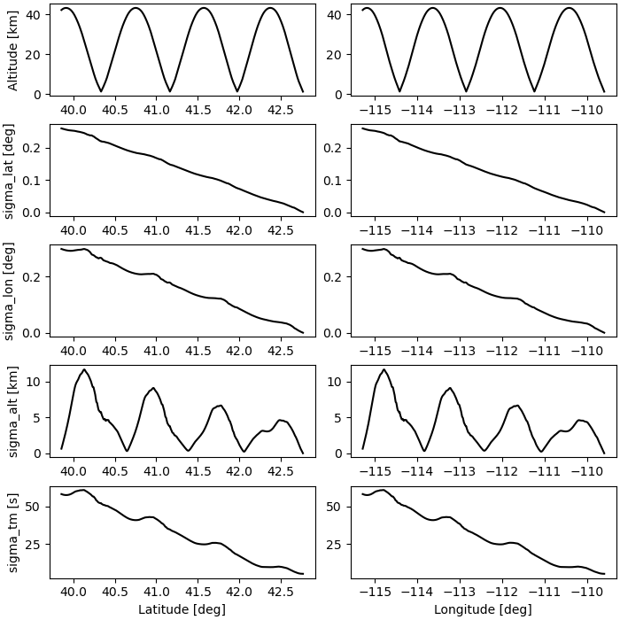
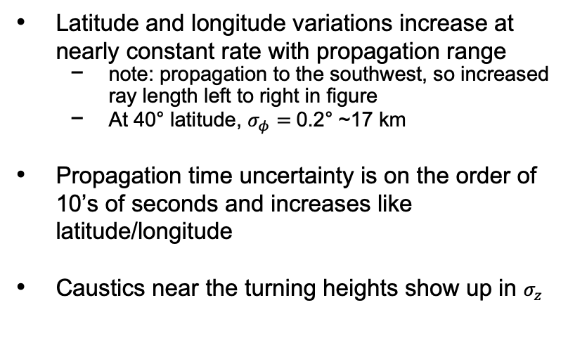
Back Projection Localization – Uncertainty
A synthetic event has been constructed to evaluate the back projection method
Standard deviations along the time-reversed paths exhibit reasonable behavior
Latitude and longitude variations increase at nearly constant rate with propagation range
  note: propagation to the southwest, so increased ray length left to right in figure
  At 40° latitude, $σ_{φ}=$0.2° ~17 km
Propagation time uncertainty is on the order of 10’s of seconds and increases like latitude/longitude
Caustics near the turning heights show up in $σ_{z}$

Slide 14
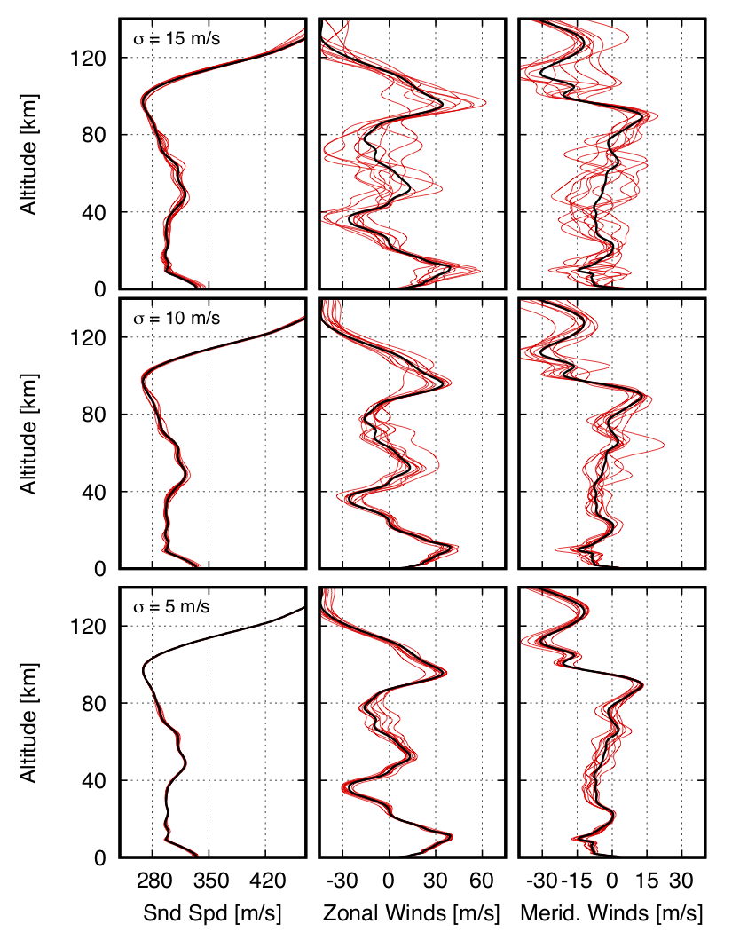
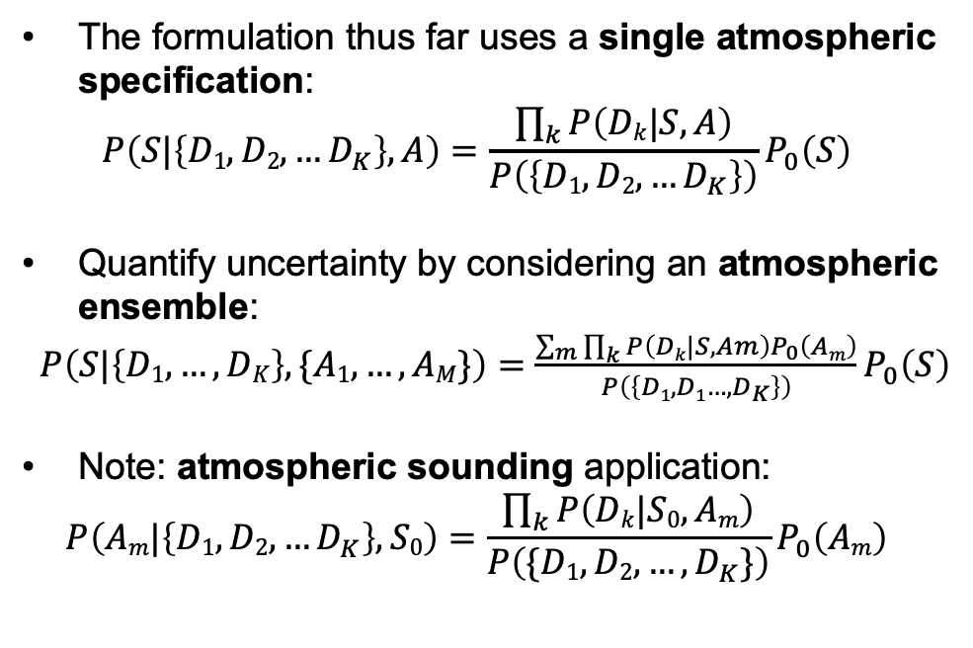
Back Projection Localization – Atmo Uncertainty
The formulation thus far uses a single atmospheric specification:
$$P\left(S|\left\{D1,D2, …D_{K}\right\},A\right)=\frac{\prod_{k}{P\left(Dk|S,A\right)}}{P\left(\left\{D1,D2, …D_{K}\right\}\right)}P_{0}\left(S\right)$$
Quantify uncertainty by considering an atmospheric ensemble:
$P\left(S|\left\{D1, …,DK\right\}, \{A1,…,AM\}\right)=$ $\frac{\sum_{m}{\prod_{k}{P\left(Dk|S,Am\right)P_{0}\left(Am\right)}}}{P\left(\left\{D1,D1…,D_{K}\right\}\right)}P_{0}\left(S\right)$
Note: atmospheric sounding application:
$$P\left(Am|\left\{D1,D2, …D_{K}\right\},S0\right)=\frac{\prod_{k}{P\left(Dk|S0,Am\right)}}{P\left(\{D1,D2, …,D_{K}\}\right)}P_{0}\left(Am\right)$$
Atmospheric perturbation ensembles computed using stochprop software (see Blom et al., 2023)

Slide 15
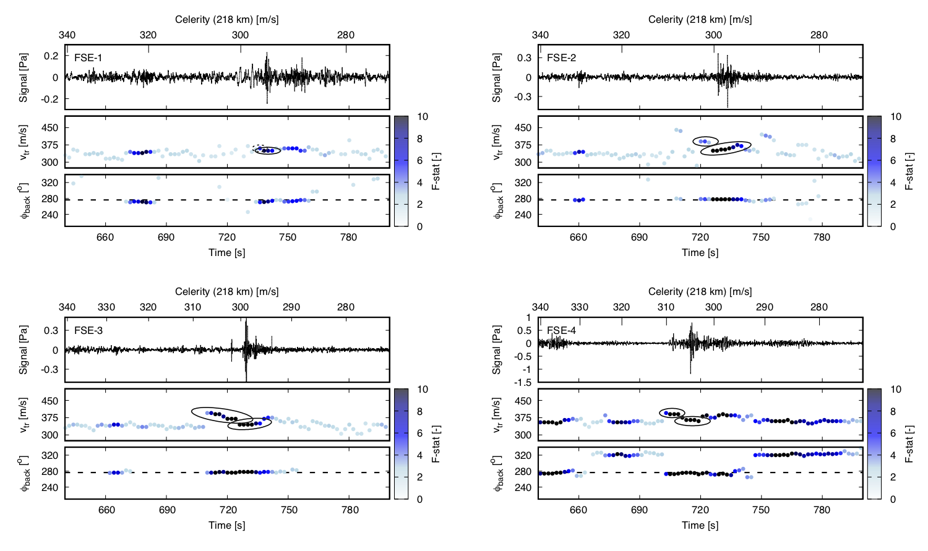
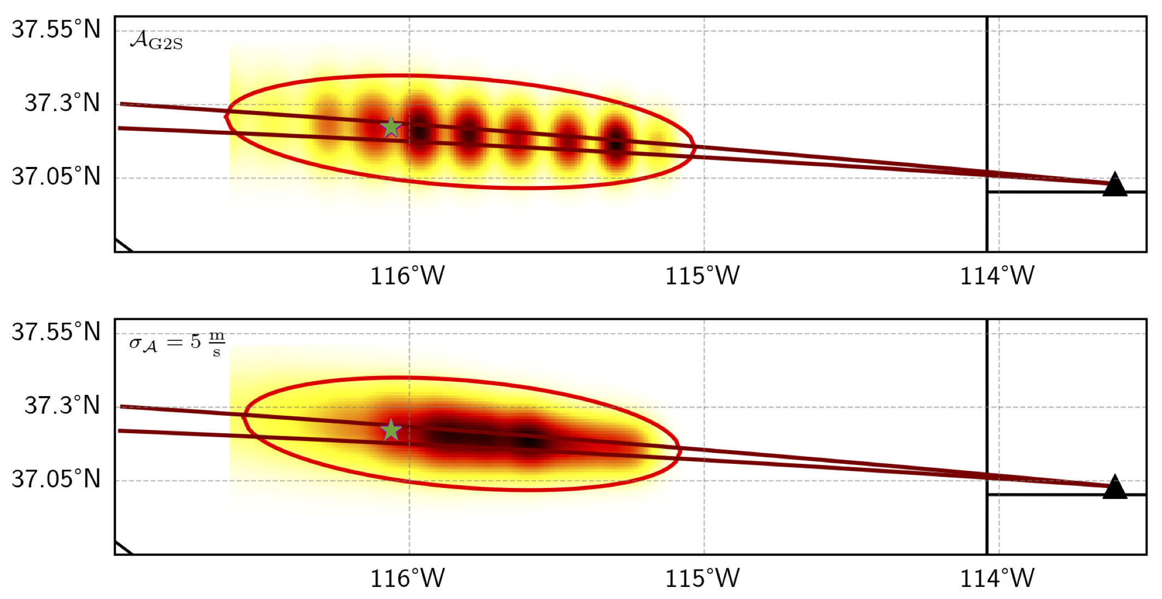
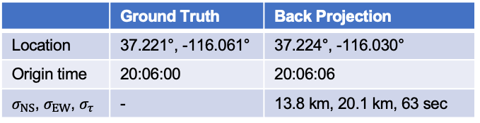
Example – Single-Station Multi-Phase Detections
Tropospheric and stratospheric phases were identified at St George during the FSE explosions
A localization estimate has been computed for FSE-2 using tropospheric and slow stratospheric phases
95% confidence region of 5400 km²
 | Ground Truth | Back Projection
Location | 37.221°, -116.061° | 37.224°, -116.030°
Origin time | 20:06:00 | 20:06:06
$σ_{NS}$, $σ_{EW}$, $σ_{τ}$ | - | 13.8 km, 20.1 km, 63 sec

Slide 16
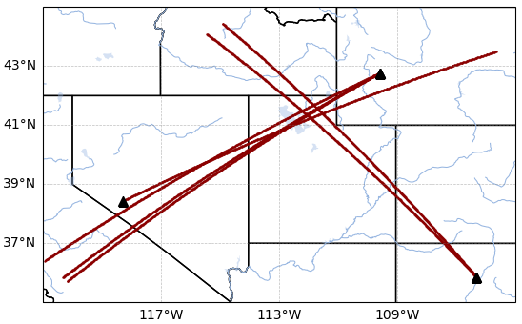
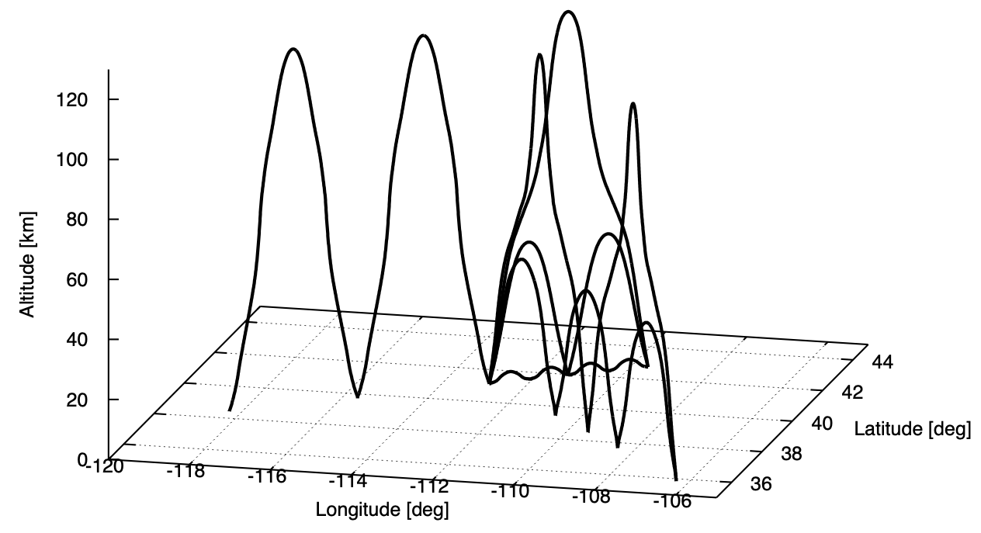
Example – Multi-Station Regional Detections
Synthetic event was constructed using a reference set of stations in the western US
  Source at Utah Test and Training Range (UTTR)
  Stations DLIAR (LANL), PDIAR (Pinedale, WY), and NVIAR (Mina, NV)
Propagation times and direction-of-arrival information computed using eigenray analysis
Detection JSON file constructed usable in InfraPy BISL and in-development back-projection localization methods
Notes:
Note: cropping dims:
convert Figure_1.png -crop 548x340+35+80 test.png

Slide 17
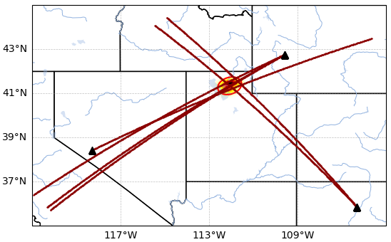
Example – Multi-Station Regional Detections
Synthetic event was constructed using a reference set of stations in the western US
  Source at Utah Test and Training Range (UTTR)
  Stations DLIAR (LANL), PDIAR (Pinedale, WY), and NVIAR (Mina, NV)
Propagation times and direction-of-arrival information computed using eigenray analysis
Detection JSON file constructed usable in InfraPy BISL and in-development back-projection localization methods
Notes:
Note: cropping dims:
convert Figure_1.png -crop 548x340+35+80 test.png

Slide 18

Example – Multi-Station Regional Detections
Synthetic event was constructed using a reference set of stations in the western US
  Source at Utah Test and Training Range (UTTR)
  Stations DLIAR (LANL), PDIAR (Pinedale, WY), and NVIAR (Mina, NV)
Propagation times and direction-of-arrival information computed using eigenray analysis
Detection JSON file constructed usable in InfraPy BISL and in-development back-projection localization methods
Notes:
Note: cropping dims:
convert Figure_1.png -crop 548x340+35+80 test.png

Slide 19
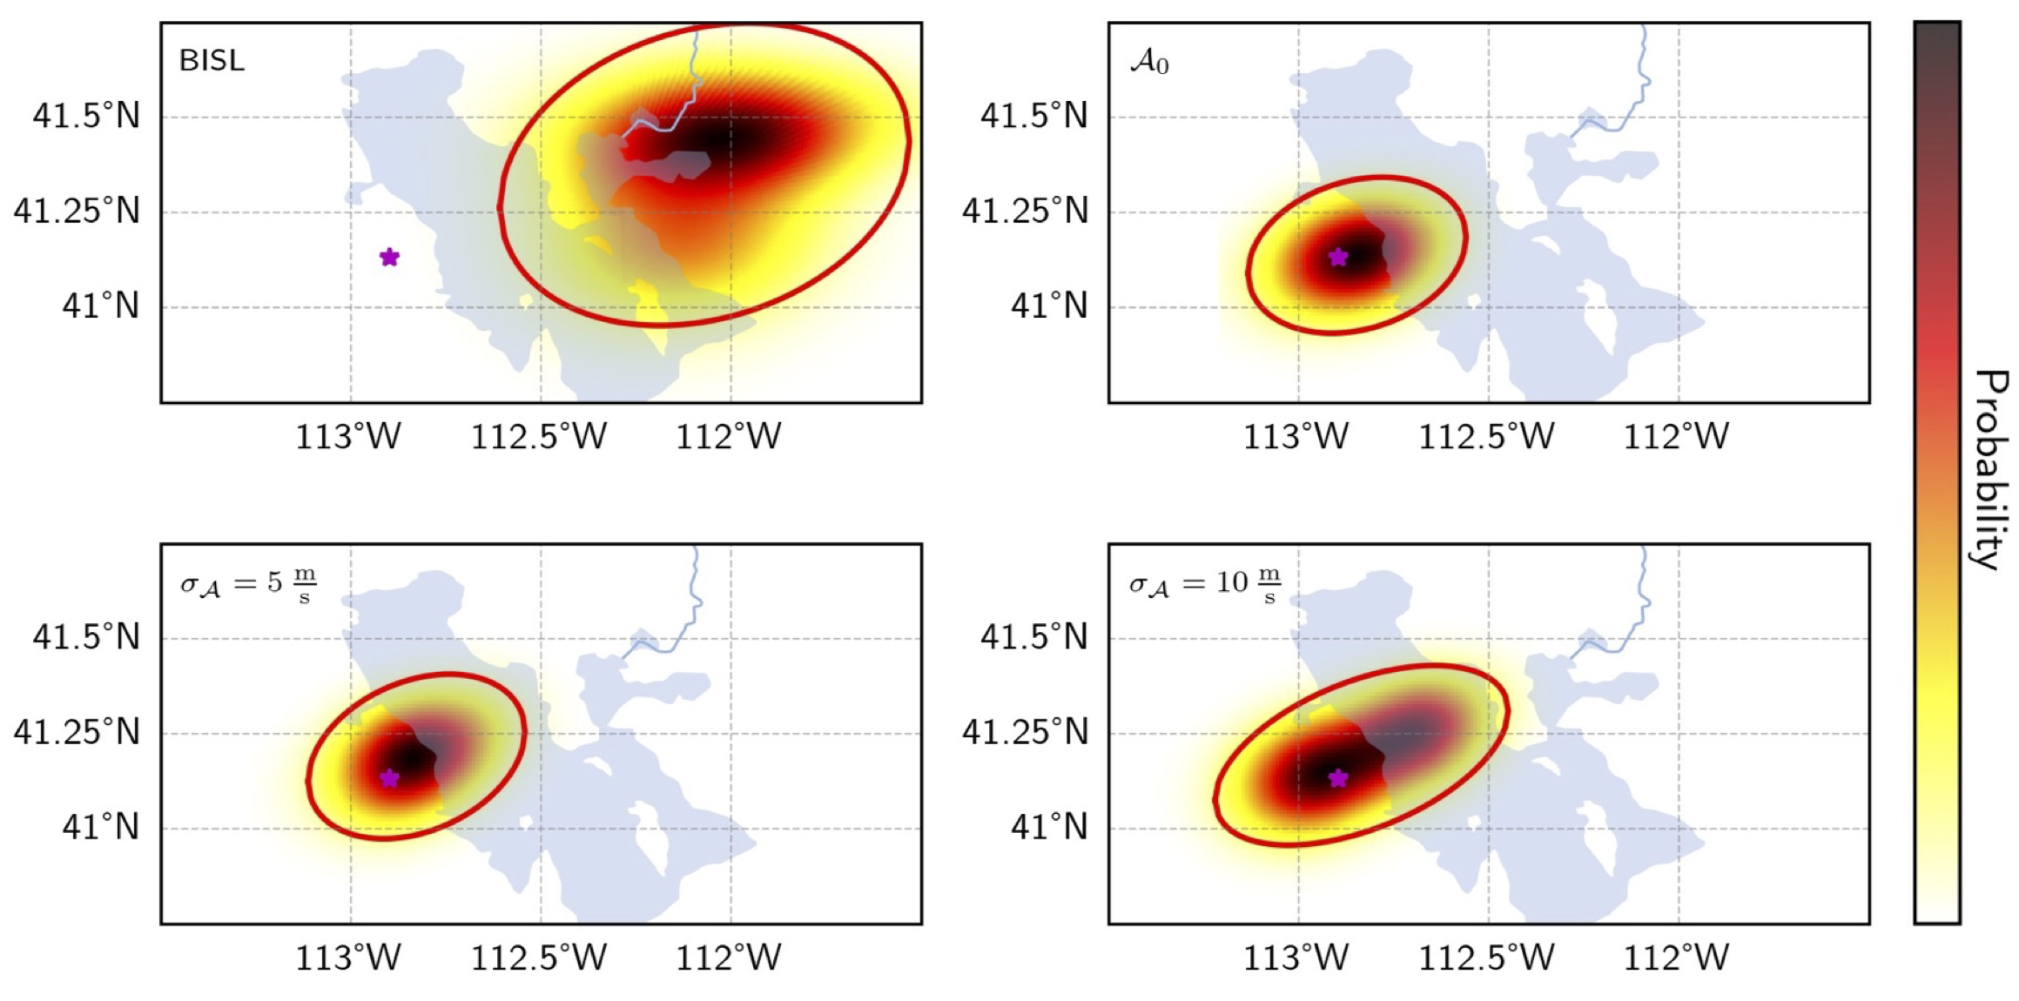
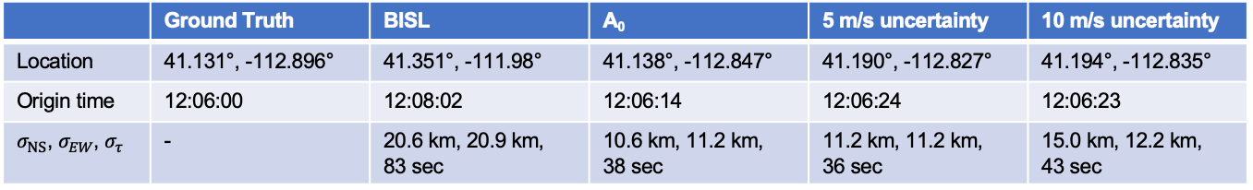
Example – Multi-Station Regional Detections
BISL lacks crosswind corrections, so the estimated source is displaced in the direction of the stratospheric winds (cross wind impact is underestimated)
Back projection methods produce a more accurate estimate and reduce area of the 95% confidence ellipse (2200 km² vs. 8100 km²)
 | Ground Truth | BISL | A₀ | 5 m/s uncertainty | 10 m/s uncertainty
Location | 41.131°, -112.896° | 41.351°, -111.98° | 41.138°, -112.847° | 41.190°, -112.827° | 41.194°, -112.835°
Origin time | 12:06:00 | 12:08:02 | 12:06:14 | 12:06:24 | 12:06:23
$σ_{NS}$, $σ_{EW}$, $σ_{τ}$ | - | 20.6 km, 20.9 km, 83 sec | 10.6 km, 11.2 km, 38 sec | 11.2 km, 11.2 km, 36 sec | 15.0 km, 12.2 km, 43 sec

Slide 20
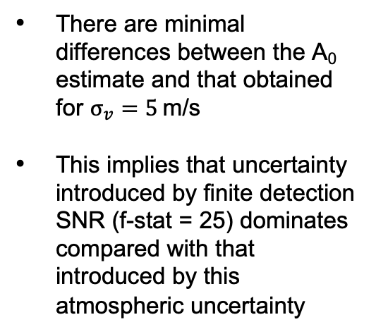
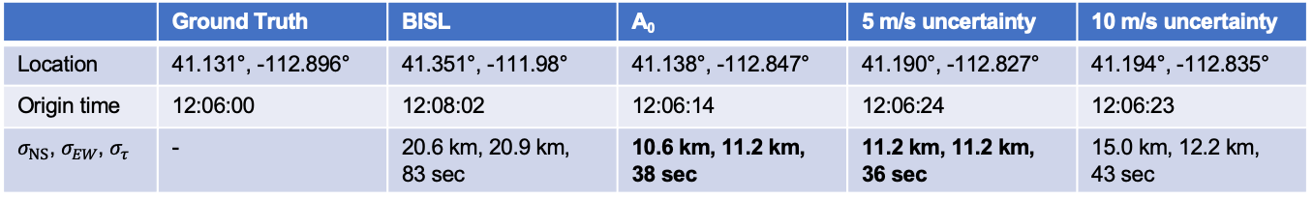
Localization Confidence Trends
There are minimal differences between the A₀ estimate and that obtained for $σ_{v}=5$ m/s
This implies that uncertainty introduced by finite detection SNR (f-stat = 25) dominates compared with that introduced by this atmospheric uncertainty
 | Ground Truth | BISL | A₀ | 5 m/s uncertainty | 10 m/s uncertainty
Location | 41.131°, -112.896° | 41.351°, -111.98° | 41.138°, -112.847° | 41.190°, -112.827° | 41.194°, -112.835°
Origin time | 12:06:00 | 12:08:02 | 12:06:14 | 12:06:24 | 12:06:23
$σ_{NS}$, $σ_{EW}$, $σ_{τ}$ | - | 20.6 km, 20.9 km, 83 sec | 10.6 km, 11.2 km, 38 sec | 11.2 km, 11.2 km, 36 sec | 15.0 km, 12.2 km, 43 sec

Slide 21
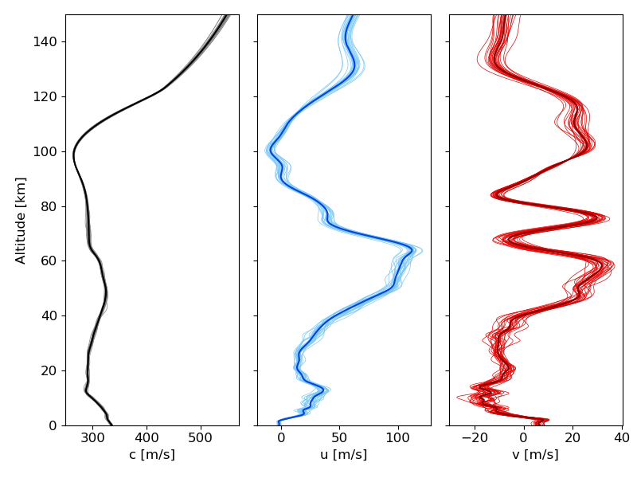
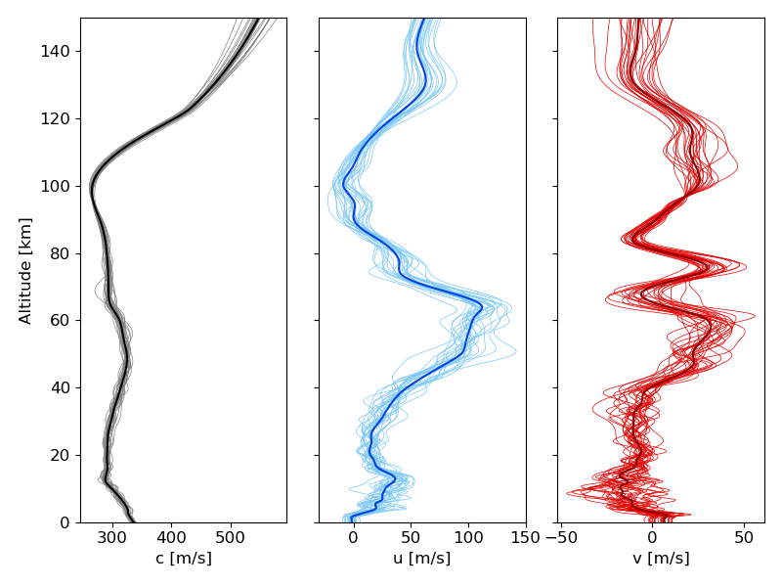
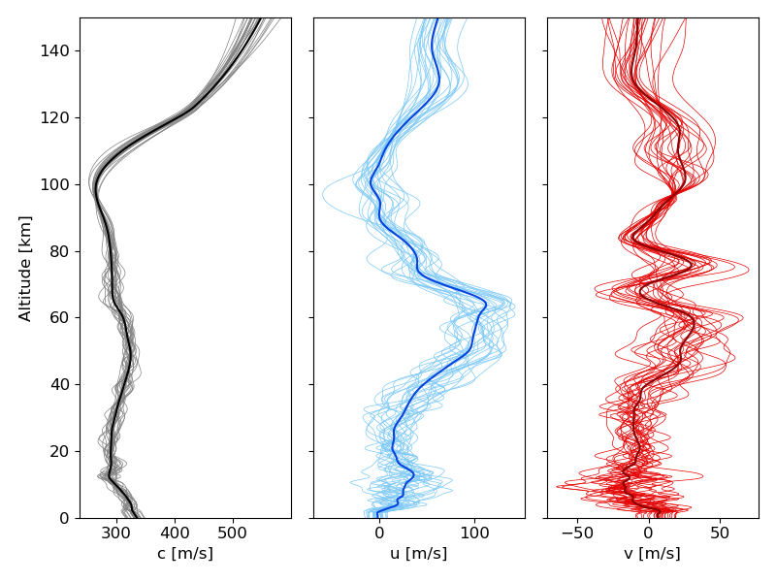

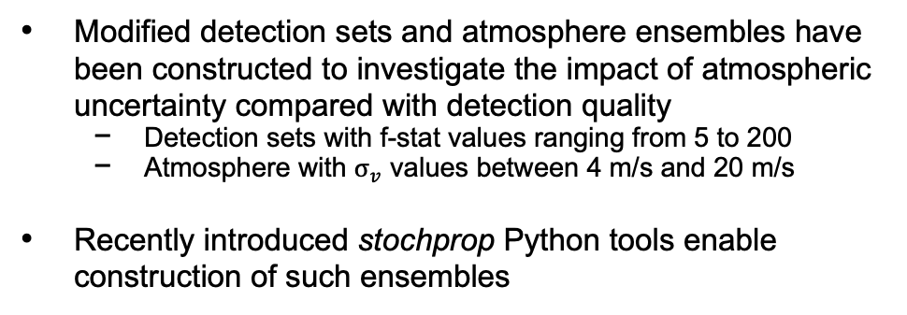
Localization Confidence Trends
Modified detection sets and atmosphere ensembles have been constructed to investigate the impact of atmospheric uncertainty compared with detection quality
  Detection sets with f-stat values ranging from 5 to 200
  Atmosphere with $σ_{v}$ values between 4 m/s and 20 m/s
Recently introduced stochprop Python tools enable construction of such ensembles
$σ_{v}$ = 4, 12, and 20 m/s ensembles

Slide 22
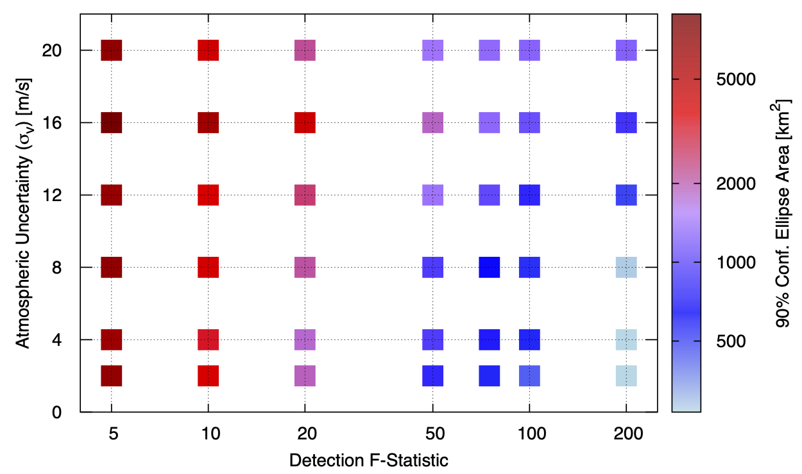
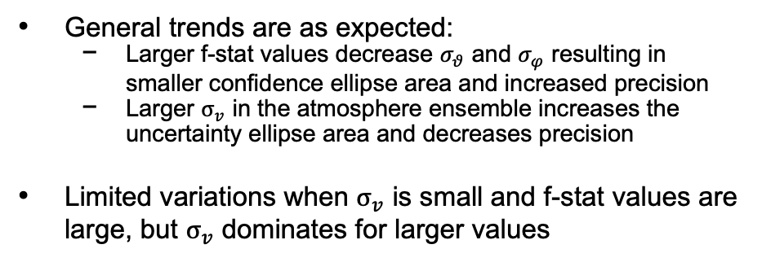
Localization Confidence Trends
General trends are as expected:
  Larger f-stat values decrease $σ_{θ}$ and $σ_{φ}$ resulting in smaller confidence ellipse area and increased precision
  Larger $σ_{v}$ in the atmosphere ensemble increases the uncertainty ellipse area and decreases precision
Limited variations when $σ_{v}$ is small and f-stat values are large, but $σ_{v}$ dominates for larger values
$σ_{v}$ = 4, 12, and 20 m/s ensembles

Slide 23
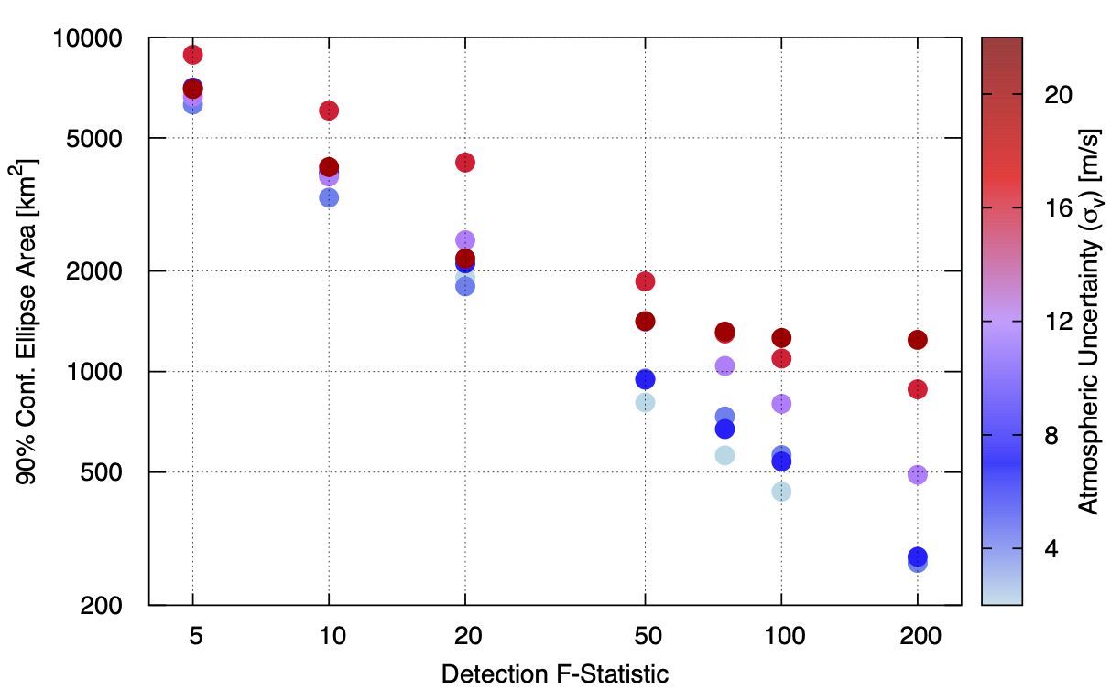
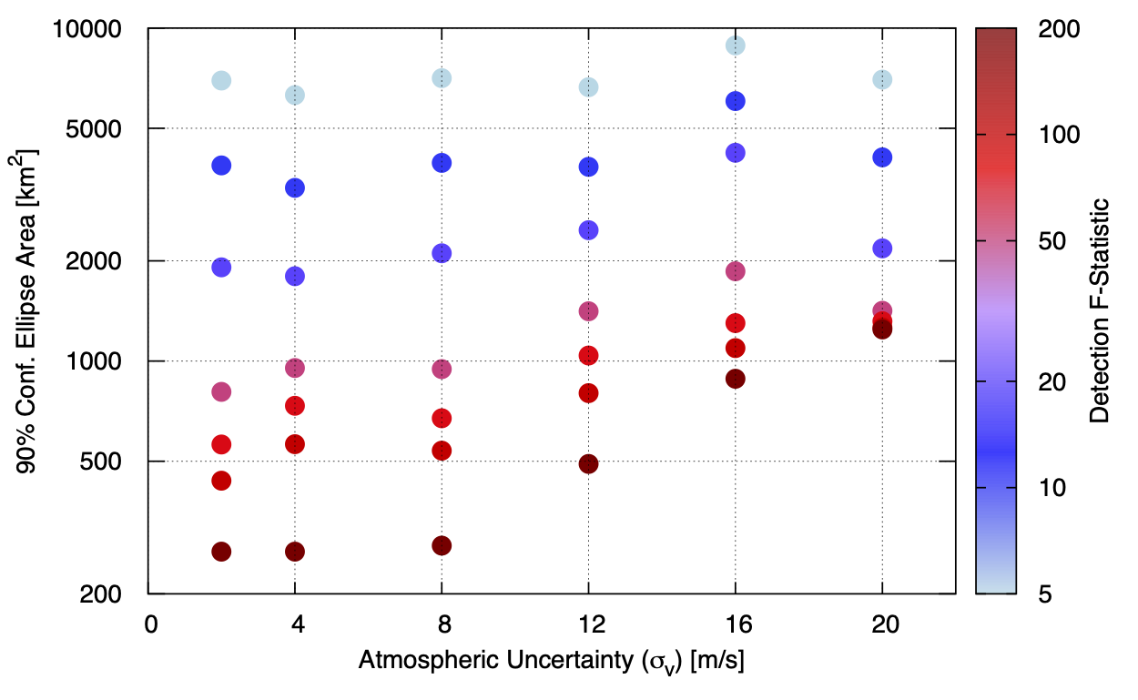
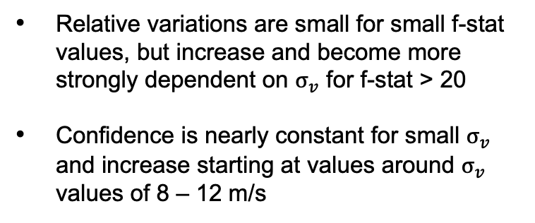
Localization Confidence Trends
Relative variations are small for small f-stat values, but increase and become more strongly dependent on $σ_{v}$ for f-stat > 20
Confidence is nearly constant for small $σ_{v}$ and increase starting at values around $σ_{v}$ values of 8 – 12 m/s

Slide 24
Localization Confidence Trends
Relative variations are small for small f-stat values, but increase and become more strongly dependent on $σ_{v}$ for f-stat > 20
Confidence is nearly constant for small $σ_{v}$ and increase starting at values around $σ_{v}$ values of 8 – 12 m/s
Atmospheric uncertainty dominates uncertainty
Poor detection quality dominates uncertainty

Slide 25
Summary and Ongoing R&D
Auxiliary parameters investigated for solving the Jacobian and computing geometric spreading can also be utilized in eigenray identification, weakly non-linear waveform evolution, and in localization likelihood construction.
The detection SNR can be used to quantify uncertainty in back projection launch angles
Application of the localization method to a synthetic multi-station event as well as an actual single-station multi-phase analysis show promising results
Sensitivity analysis related to the detection quality (f-stat) and atmospheric uncertainty (via ensemble analysis) shows complicated behavior in the uncertainty budget → continued sensitivity analysis is needed

Slide 26
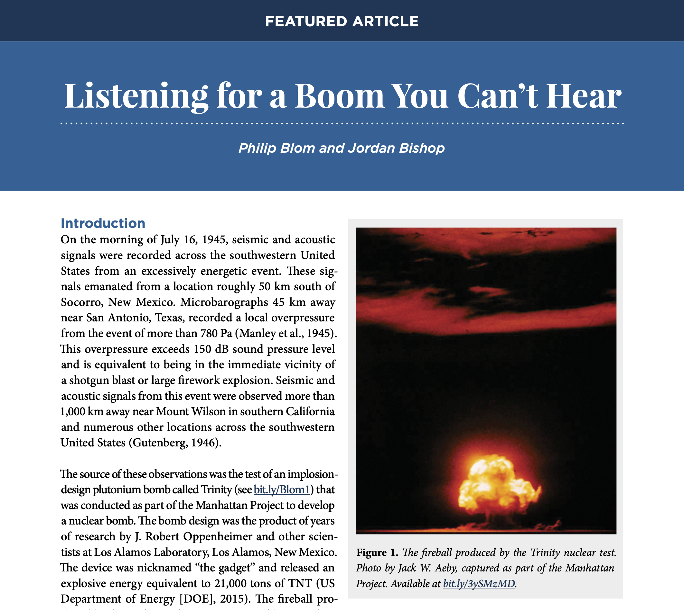

Shameless Promotion
LANL SMEs authored an article in a recent issue of Acoustics Today detailing the history and current landscape of infrasound R&D for Nuclear Non-Proliferation.
https://acousticstoday.org/listening-for-a-boom-you-cant-hear/

Slide 27
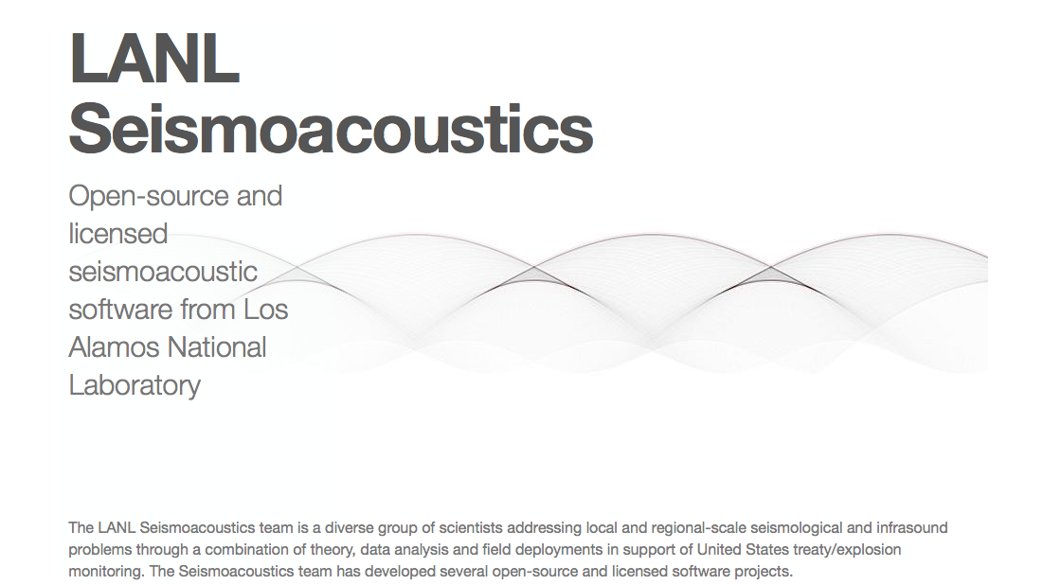
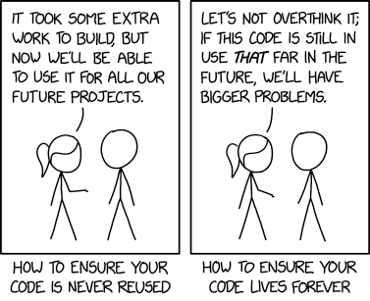

Questions?
https://github.com/LANL-Seismoacoustics

