Slide 1


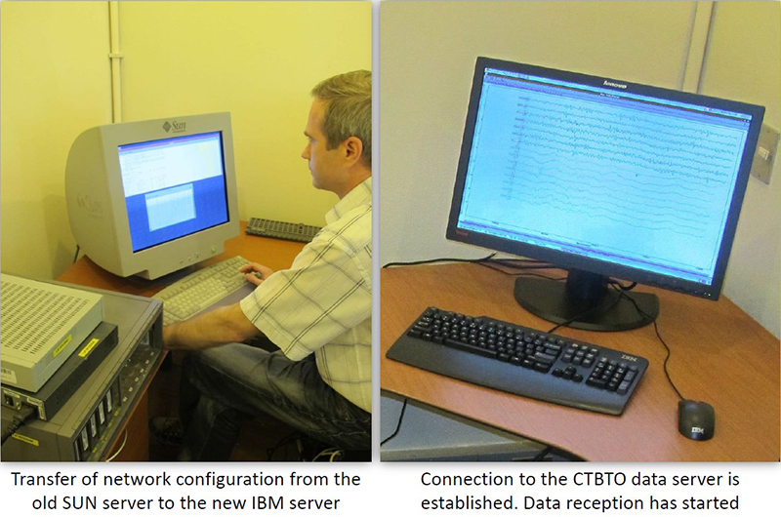
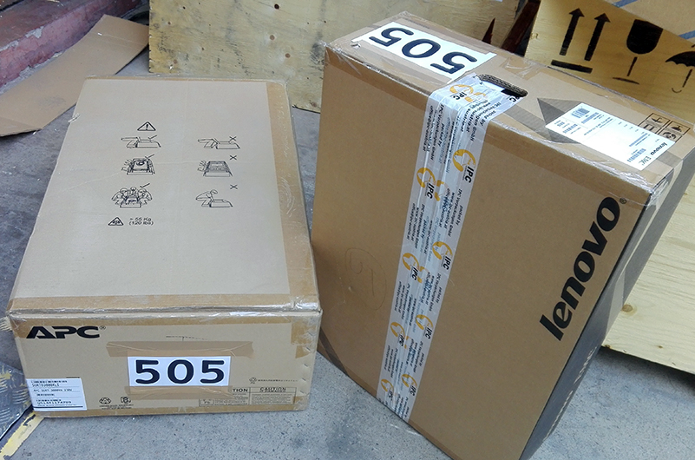
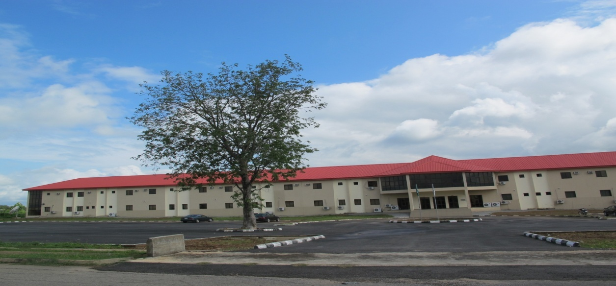
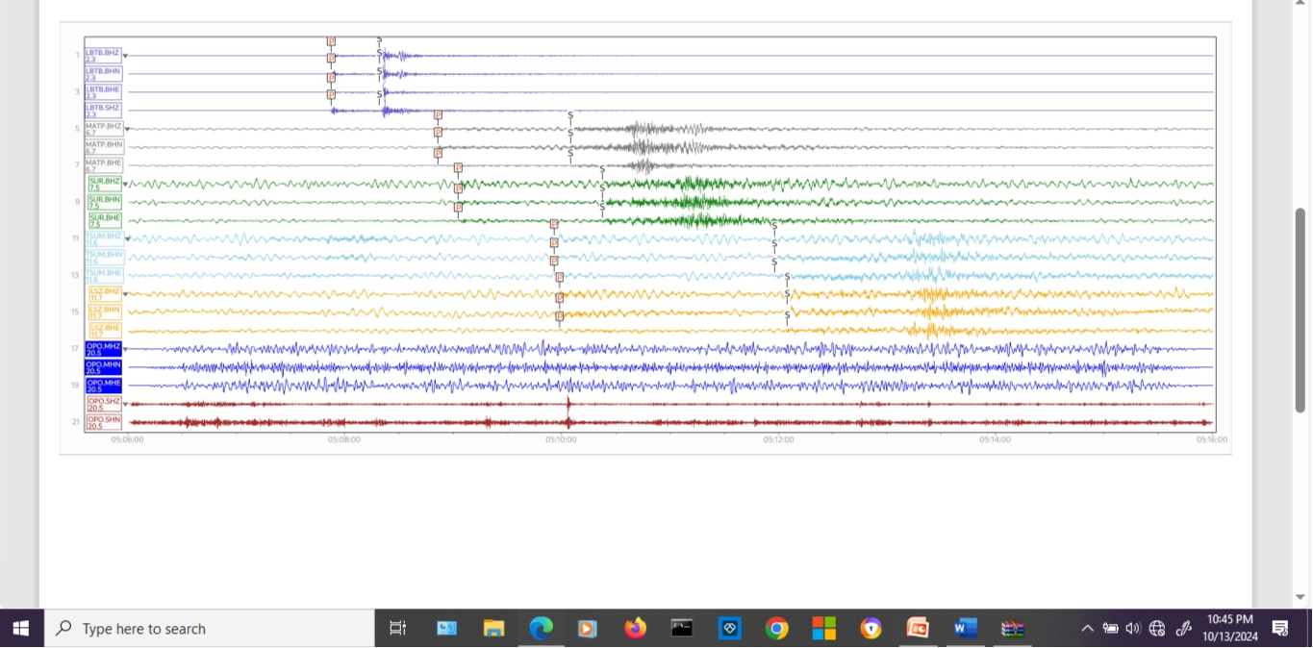
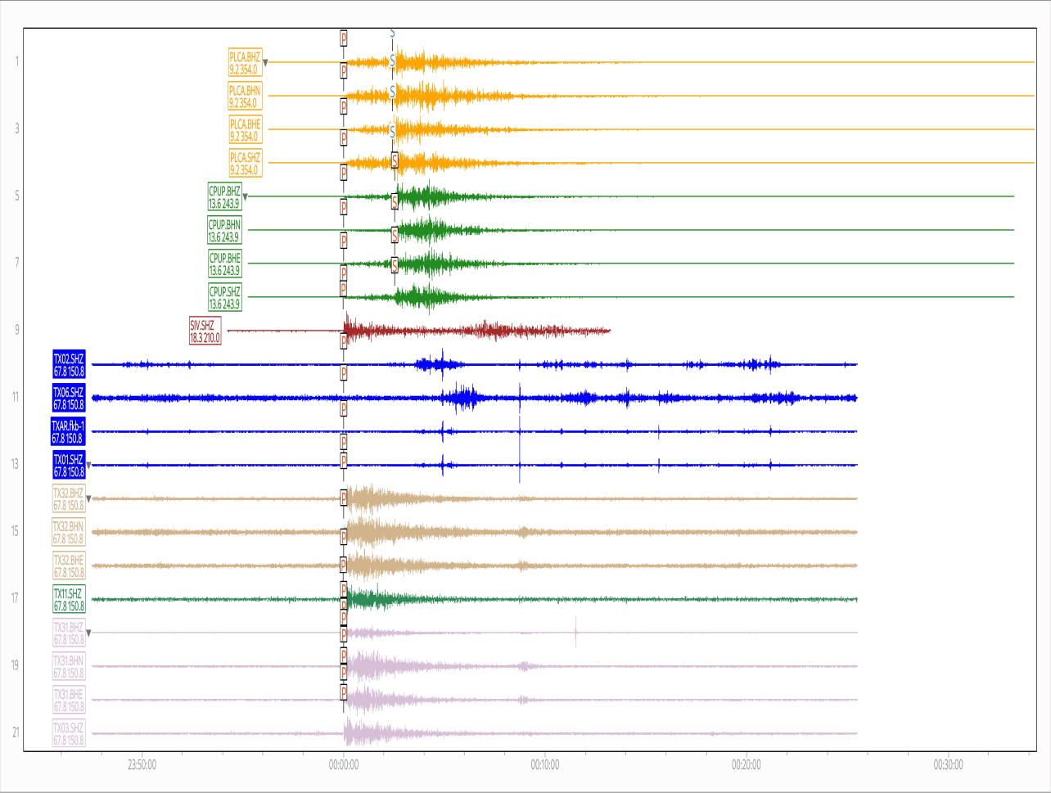
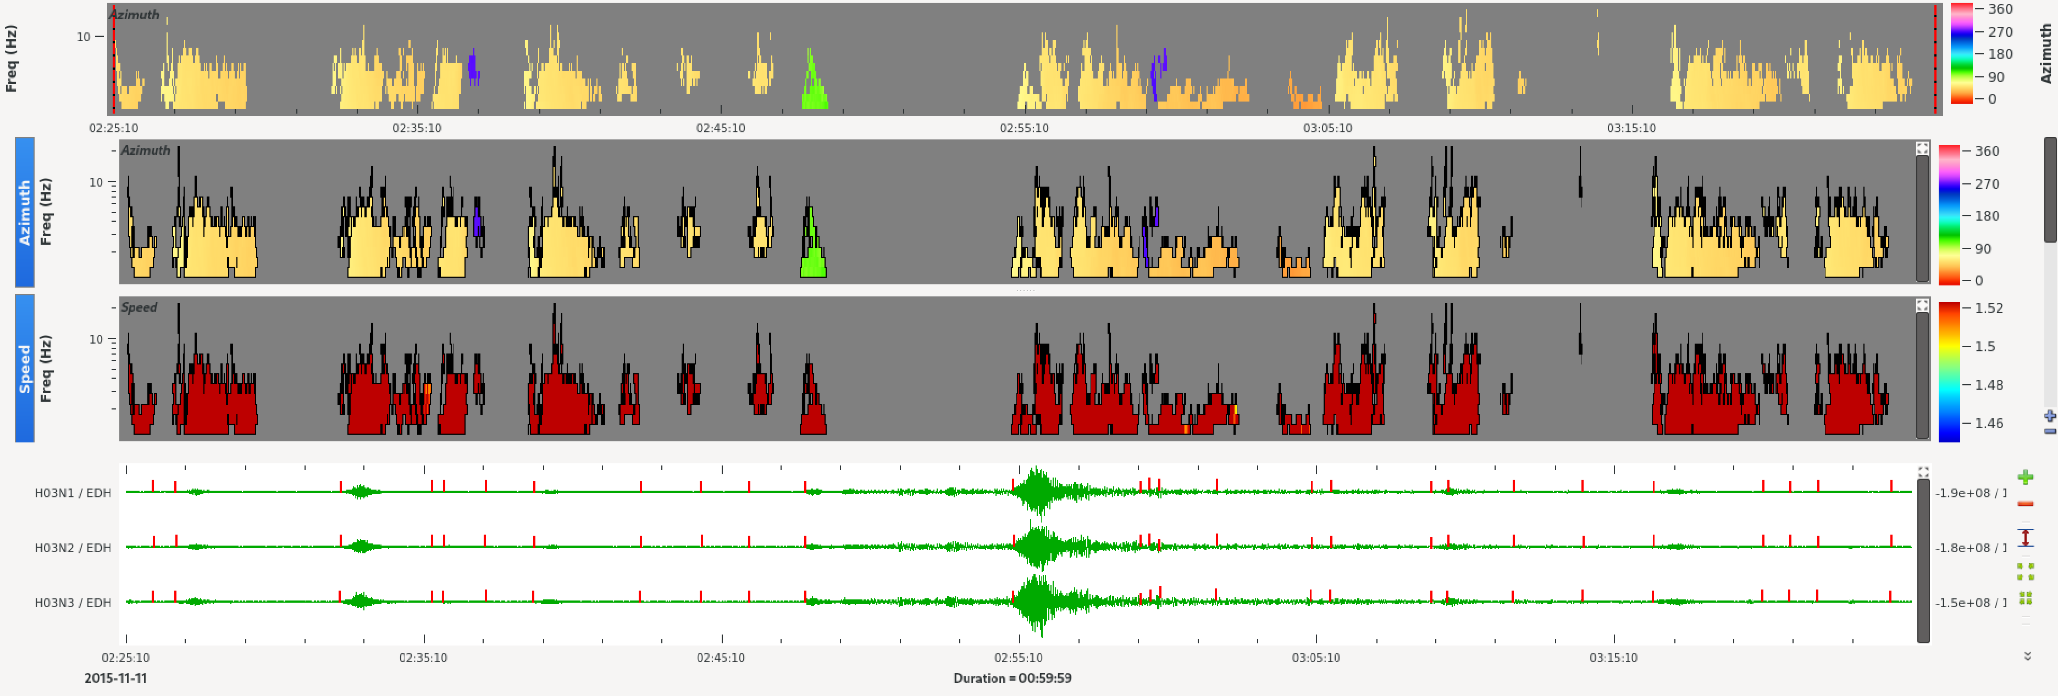
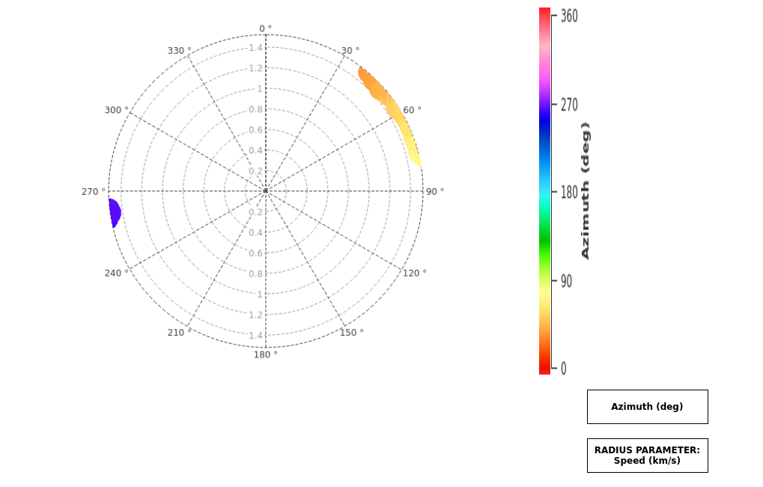
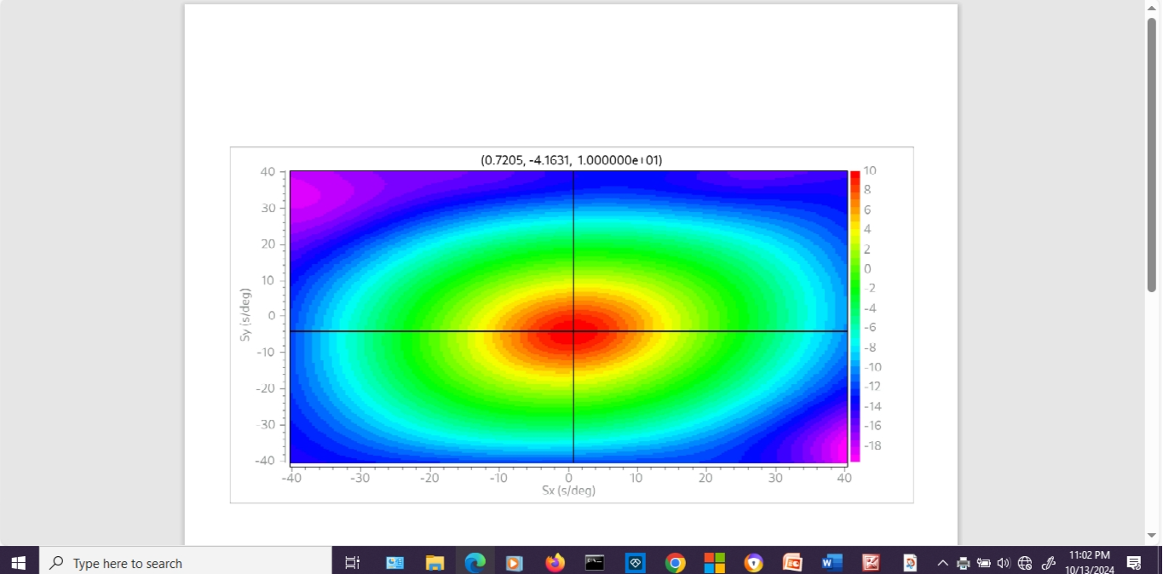
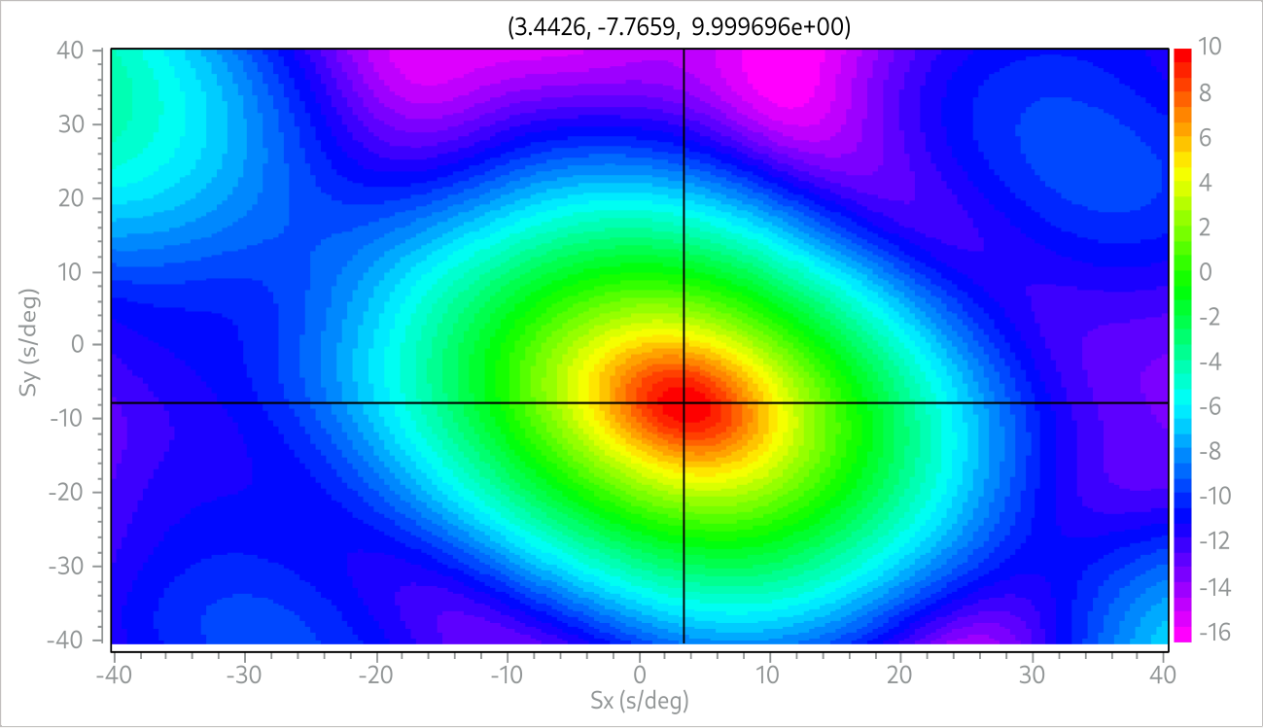
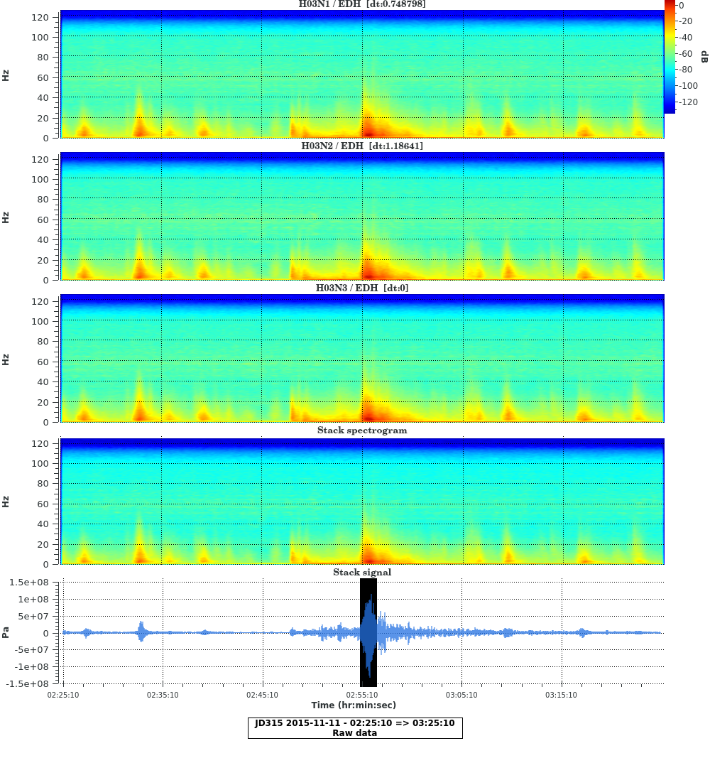
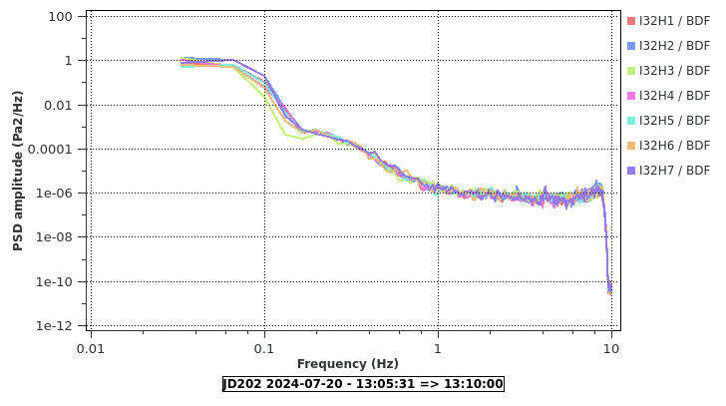
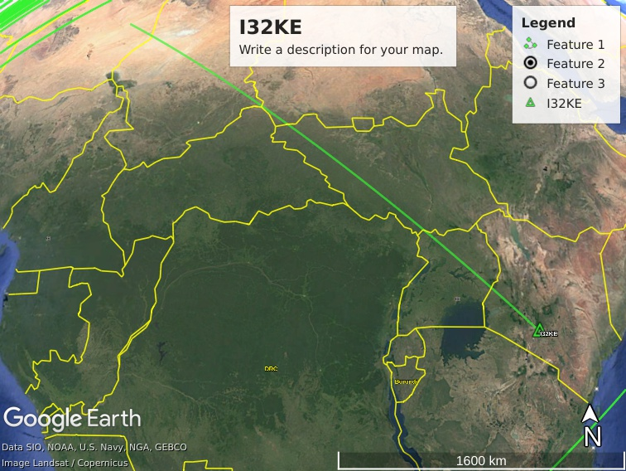
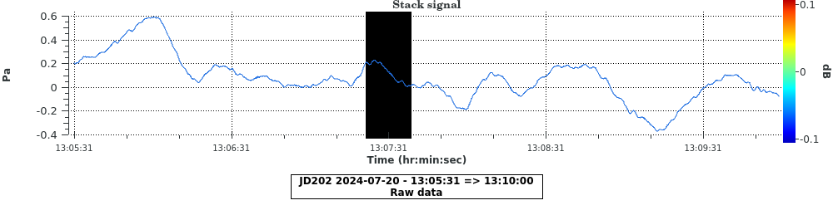
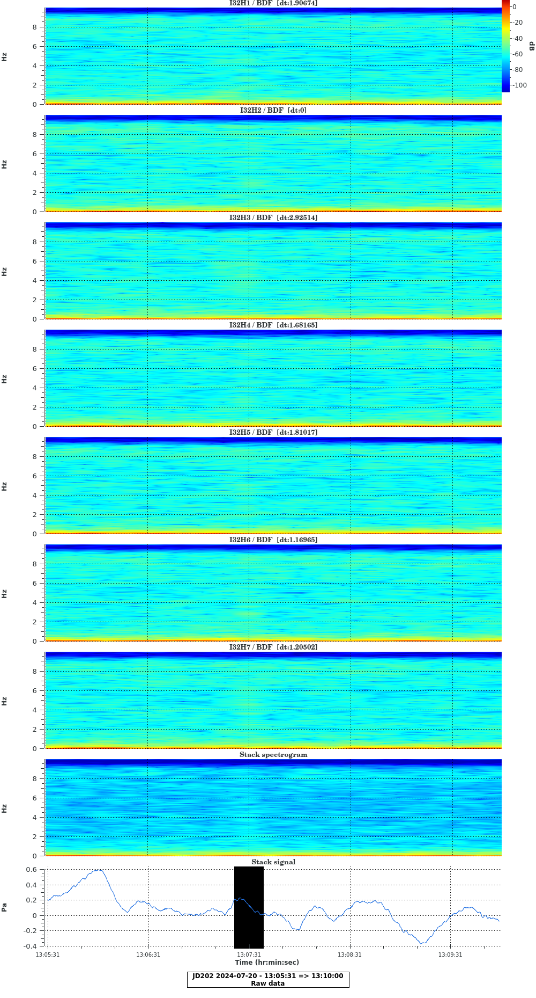
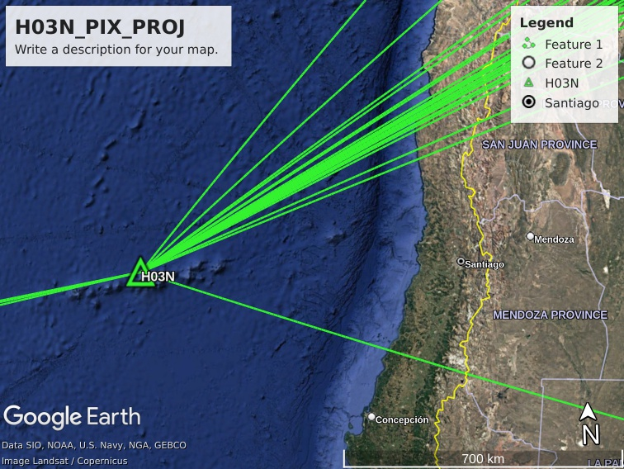
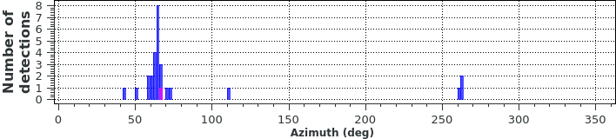
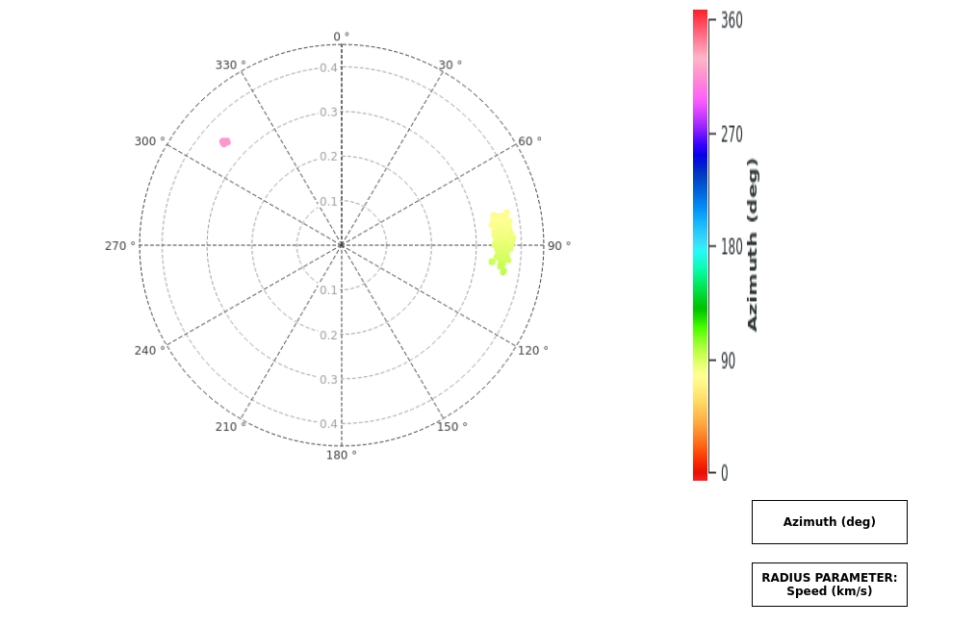
Enhanced NDC Capability for Nuclear Explosion Monitoring
#120
Dr. Umar Afegbua Kadiri
NDC-NG/CENTRE FOR GEODESY AND
GEODYNAMICS, NIGERIA
Email: iumakad@yahoo.com; uafegbua206@gmail.com, Phone: +2348037122784
Infrasound Technology Workshop, Vienna, Austria, 4 to 8 November 2024.
Introduction NDC-NG, Data Utilization, Capacity Building Support, Routine Activities and Challenges
Nigeria signed the Treaty in September 8, 2000 and deposited the article for its ratification on 27th September 2001; making Nigeria the 83rd State Signatory and 12th in Africa to have ratified the Treaty.
Between 2002-2004 and later, a number of users were registered; Much was not achieved due to lack of infrastructure and technical know how.
Data usage at the NDC-NG was very low in the past. This can be attributed to lack of adequate training and infrastructure to support data utilization.
This has improved significantly over the years with the installation of the CBS equipment, additional trainings and analysis capabilities.
NDC-NG is a beneficiary from Technical Assistance in training courses, workshops for NDC staff; donation of NDC basic equipment (CBS) and follow-up visits of experts from the CTBTO
Routine activities at NDC-NG include: Data download via GCI, Data requests/access from the IDC/CTBTO, Data analysis to determine the nature of events, Advice to government on events of interests, Support for R&D collaborations with other stakeholders, Preparation of bulletin for events within the region, Outreach and awareness campaign, conducting research in support of the CTBTO etc.
Major challenges at NDC-NG: Steady power supply, dearth of qualified manpower, adequate capacity building, joint research etc.
Computers
Methods & Materials Enhanced Capability at NDC-NG
With trainings received from PTS, the capacity of staff at NDC-NG to process and analyse data has improved significantly with respect to SHI data processing.
Data from SHI waveforms were acquired through the GCI and SWP. Earthquakes analyzed include Beirut, South Africa, Zaire, Haiti, Chile, Zimbabwe, etc. P and S phases were picked and associated regional phases (Pn, Lg, Sn, etc.), were identified sing the Geotool software. The magnitudes, locations, azimuth, and depths of selected events were determined. Array networks were processed using FK analysis to create P arrivals beams
Data acquired from the Hydroacoustic and Infrasound stations were processed using TDK PMCC to determine the type of phases associated with the hydroacoustic signals, back azimuth and the average speed associated with te infrasound signals . Stations used: H03N, H10N, H04S, H01W, HO8S; I48TN, I42PT, I32KE, I37NO, I26DE etc..
Building hosting NDC-NG
Results Spectrogram, polar plot, statistics, PSD of signals recorded by H03N and I32KE, seismic beams
Earthquake processed and analyzed
Results from Hydrocaustic data processing from H03N
Seismic arrays processed using FK analysis
EVENT -6 REPUBLIC OF SOUTH AFRICA
Date Time Err RMS Latitude Longitude Smaj Smin Az Depth Err Ndef Nsta Gap mdist Mdist Qual Author OrigID
2024/01/04 05:07:16.2 4.21 0.89 -26.9070 26.6993 81.7 31.1 115 156.1 66.6 5 5 207 2.13 11.66 m i uk - -6
Magnitude Err Nsta Author OrigID
Sta Dist EvAz Phase Time TRes Azim AzRes Slow SRes Def SNR Amp Per Qual Magnitude ArrID
LBTB 2.13 332.0 Pn 05:07:52.531 -0.8 152.5 -3.1 13.1 1.4 T__ 12.7 249.0 0.29 m__ ML 6.1 28061298
LBTB 2.13 332.0 Sn 05:08:19.207 -3.2 152.5 -1.0 19.3 -1.6 __S 4.2 2421.9 0.41 m__ 28061309
MATP 6.66 14.7 Pn 05:08:51.710 -0.2 194.0 -1.9 12.4 -0.9 T__ 46.6 108.4 0.49 m__ ML 6.6 28061300
MATP 6.66 14.7 Sn 05:10:04.859 -2.7 194.0 -175.0 21.8 -2.1 __S 2.9 100.9 0.34 m__ 28061306
SUR 7.48 221.8 Pn 05:09:02.645 -0.2 44.7 12.8 11.9 -1.5 T__ 21.5 22.8 0.38 m__ ML 5.7 28061302
SUR 7.48 221.8 Sn 05:10:22.575 -0.6 44.7 -175.0 16.9 -7.1 __S 2.0 34.0 0.51 m__ 28061307
TSUM 11.36 310.5 Pn 05:09:55.881 1.7 134.1 8.0 11.5 -1.6 T__ 3.5 4.1 0.32 m__ ML 4.9 28061303
TSUM 11.36 310.5 Sn 05:11:57.721 -2.9 134.1 28.1 18.4 -5.7 __S 3.0 6.6 0.48 m__ 28061308
LSZ 11.66 7.1 Pn 05:09:58.703 0.7 186.6 -6.5 12.9 -0.2 T__ 8.3 15.2 0.78 m__ ML 7.4 28061299
LSZ 11.66 7.1 Sn 05:12:04.979 -1.7 186.6 91.8 7.8 -16.3 __S 2.9 15.3 0.51 m__ 28061305
Conclusion
The accomplishment has shown the NDC-NG's improved ability to fulfill one of its regular responsibilities under its mandates, which is to assist in nuclear explosion monitoring.

