Slide 1
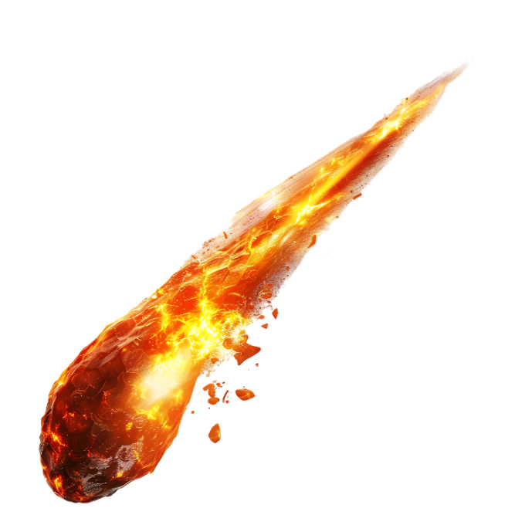
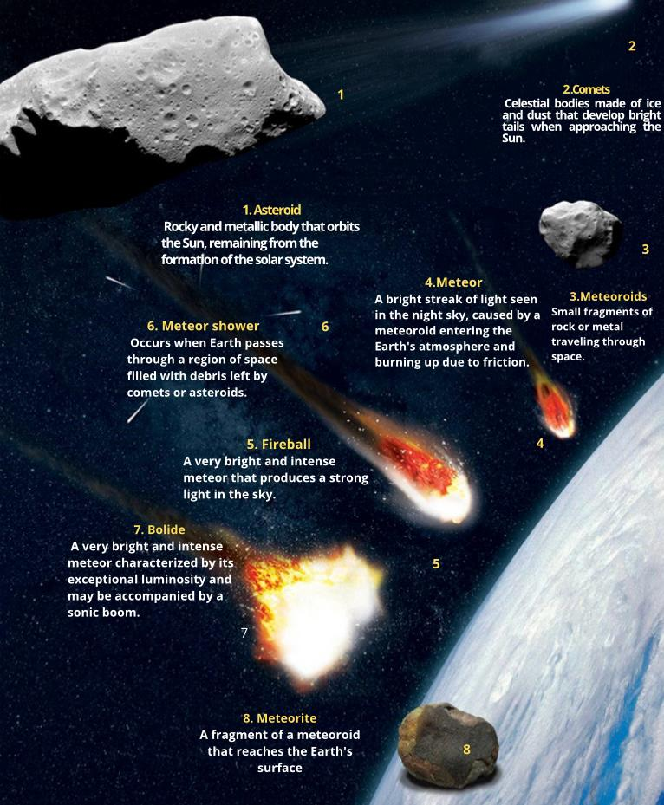
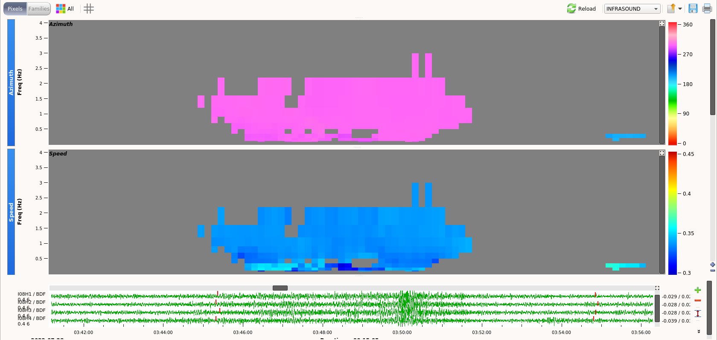
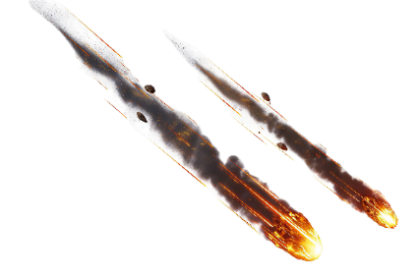
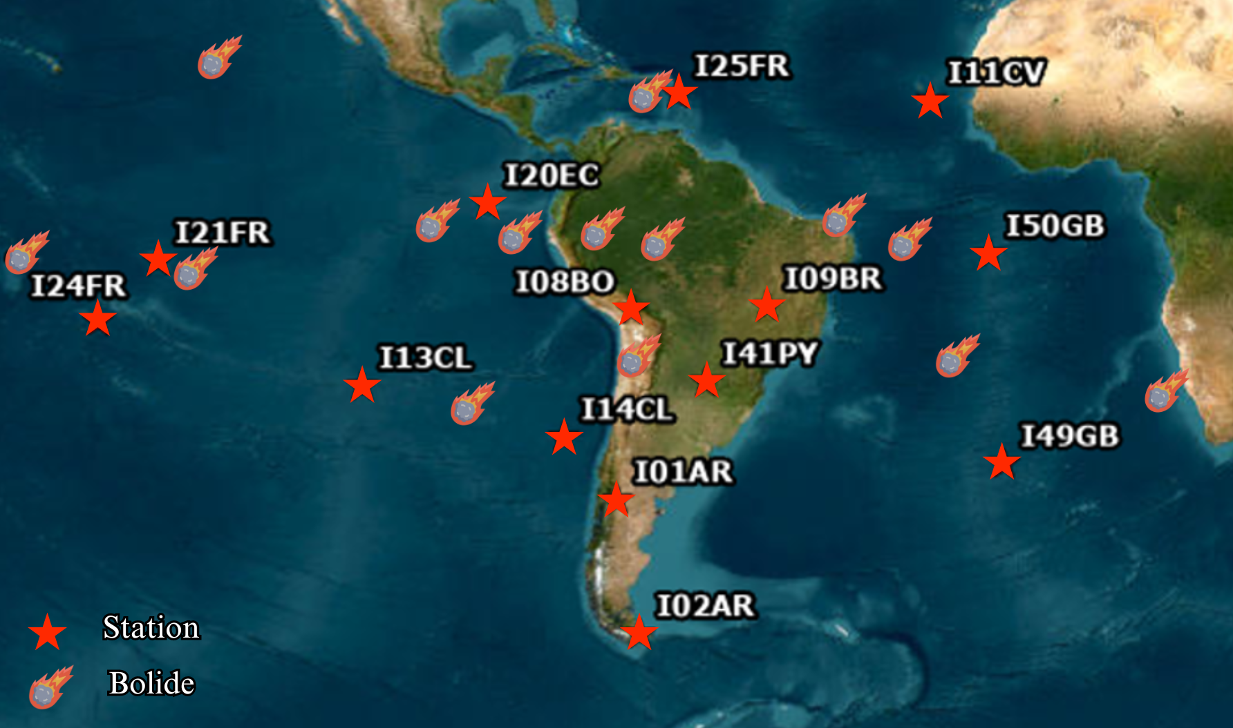
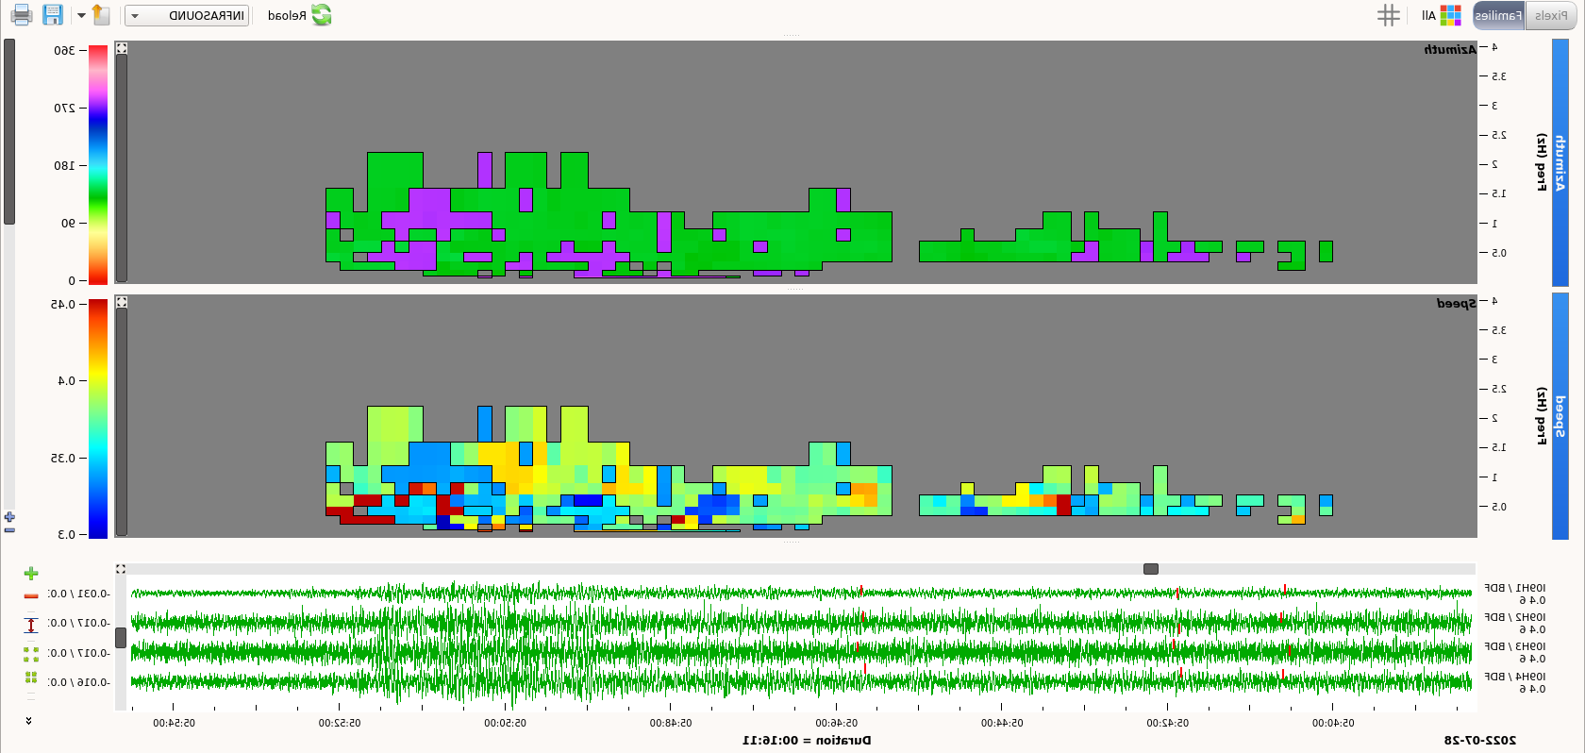
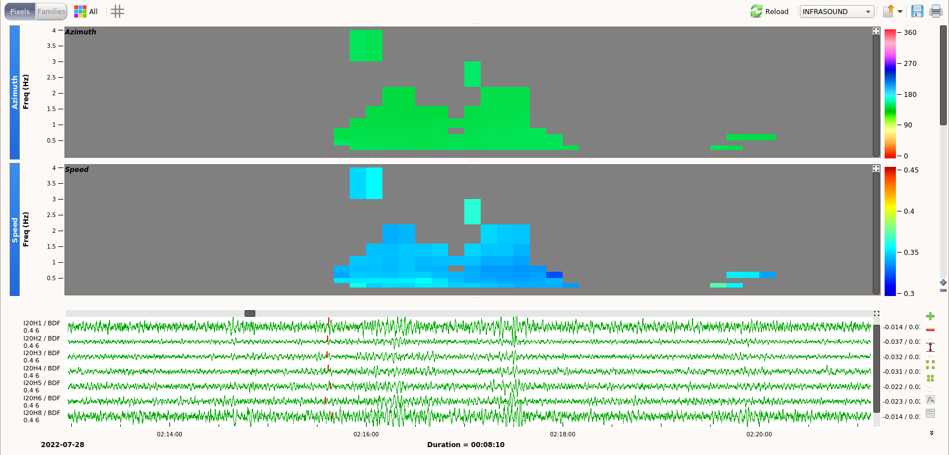
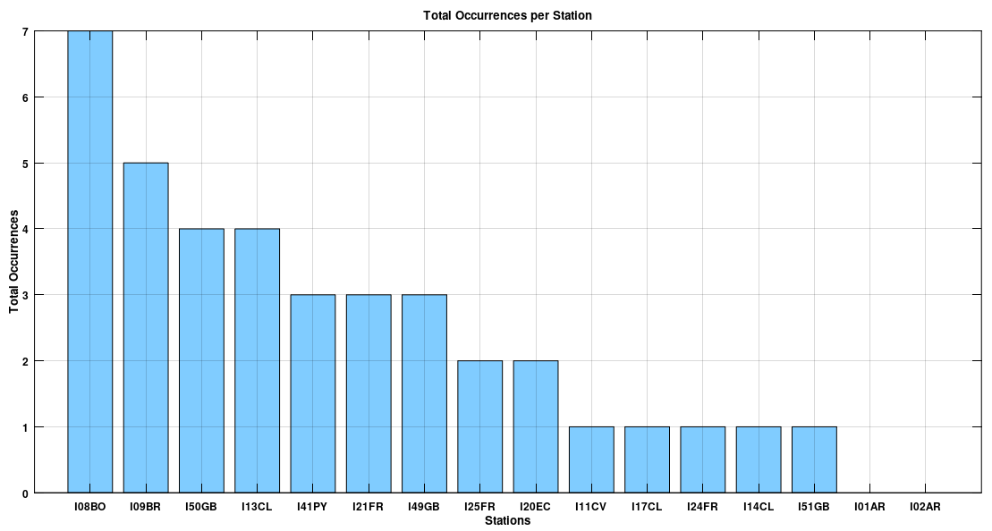
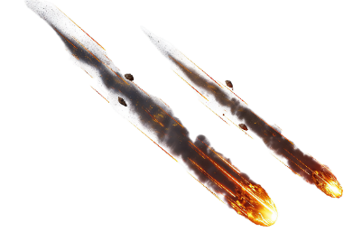
ITW 2024
Infrasound Technology Workshop
#128
Analysis and identification of meteor signals detected by the IMS infrasound
stations in South America
Letícia Guedes Assunção ¹, Lucas Vieira Barros ¹, Darlan Portela Fontenele ¹ , Juraci Mario de Carvalho ¹ and Vinícius de Miranda Pellussi ¹
1.Observatory Seismological of University of Brasília (SIS-UnB).
Introduction
EVENT N° | STATION | DATE | EVEN TIME | ARRIVAL TIME | LAT | LONG | DISTANCE KM | VELOCITY KM/S | BACK AZIMUTH | FREQUENCY HZ | DURATION
1 | I09BR | 16/10/2023 | 17:16 | 19:19 | -6,2647° | -65,6634° | 2174 | 0.352 | 297.4 | 1.017 | 160
 | I41PY | 16/10/2023 | 17:16 | 19:23 | -6,2647° | -65,6634° | 2413 | 0.368 | 334 | 0.800 | 660
2 | I21FR | 14/10/2023 | 22:55 | 01:13 | -9,1015° | -162,8784° | 2542 | 0.351 | 266.8 | 0.295 | 530
 | I24FR | 14/10/2023 | 22:55 | 00:31 | -9,1015° | -162,8784° | 1788 | 0.349 | 302.7 | 0.928 | 280
3 | I21FR | 05/08/2023 | 19:54 | 23:13 | 20,774° | -135,6956° | 3363 | 0,393 | 16,86 | 0,295 | 21
4 | I20EC | 28/07/2022 | 01:39 | 02:15 | -5,5829° | -87,4058° | 668,9 | 0,347 | 147,2 | 0,843 | 280
 | I08BO | 28/07/2022 | 01:39 | 03:45 | -5,5829° | -87,4058° | 2378 | 0,337 | 294,2 | 0,85 | 420
 | I09BR | 28/07/2022 | 01:39 | 05:45 | -5,5829° | -87,4058° | 4452 | 0,354 | 277,1 | 0,561 | 390
5 | I49GB | 22/07/2022 | 00:19 | 01:52 | -23,3627° | -19,1206° | 1698 | 0,337 | 337,4 | 1,236 | 160
 | I50GB | 22/07/2022 | 00:19 | 01:57 | -23,3627° | -19,1206° | 1767 | 0,353 | 197,7 | 0,843 | 160
6 | I20EC | 06/03/2022 | 15:05 | 16:09 | -3,6036° | -100,0169° | 1157 | 0,352 | 251,8 | 1,827 | 80
 | I13CL | 06/03/2022 | 15:05 | 17:40 | -3,6036° | -100,0169° | 2828 | 0,355 | 21,1 | 1,308 | 120
7 | I49GB | 07/02/2022 | 20:15 | 22:20 | -28,6011° | 8,6498° | 2182 | 0,352 | 66,18 | 1,041 | 90
 | I50GB | 07/02/2022 | 20:15 | 23:16 | -28,6011° | 8,6498° | 3333 | 0,354 | 135,4 | 0,95 | 1130
8 | I08BO | 28/01/2022 | 05:04 | 06:25 | -3,4909° | -75,4311° | 1627 | 0,339 | 332,9 | 0,548 | 72
 | I25FR | 28/01/2022 | 05:04 | 07:30 | -3,4909° | -75,4311° | 2601 | 0,351 | 215,2 | 1,036 | 890
 | I14CL | 28/01/2022 | 05:04 | 08:04 | -3,4909° | -75,4311° | 3408 | 0,357 | 6,2 | 0,569 | 400
 | I13CL | 28/01/2022 | 05:04 | 09:06 | -3,4909° | -75,4311° | 4555 | 0,354 | 63,16 | 1,158 | 590
9 | I08B0 | 21/10/2020 | 06:40 | 09:21 | -29,3282° | -93,6° | 2957 | 0,337 | 234,6 | 1,079 | 730
 | I41PY | 21/10/2020 | 06:40 | 09:21 | -29,3282° | -93,6° | 3583 | 0,344 | 255,1 | 1,14 | 240
10 | I21FR | 18/10/2020 | 10:56 | 11:23 | -11,0476° | -136,3876° | 485 | 0,349 | 121,2 | 0,851 | 300
11 | I08BO | 23/03/2020 | 16:54 | 17:42 | -23,9153° | -68,3924° | 936 | 0,346 | 177,3 | 0,698 | 390
 | I13CL | 23/03/2020 | 16:54 | 20:35 | -23,9153° | -68,3924° | 4157 | 0,354 | 92,44 | 1,098 | 1190
12 | I41PY | 06/12/2019 | 10:28 | 13:24 | -2,4799° | -38,8312° | 3299 | 0,349 | 39,63 | 1,023 | 710
 | I08BO | 06/12/2019 | 10:28 | 13:44 | -2,4799° | -38,8312° | 3556 | 0,341 | 68,6 | 0,818 | 370
 | I09BR | 06/12/2019 | 10:28 | 11:53 | -2,4799° | -38,8312° | 1788 | 0,346 | 38,61 | 1,046 | 800
13 | I51GB | 22/06/2019 | 21:30 | 23:18 | -14,7186° | -67,5034° | 1945 | 0,358 | 189 | 0,696 | 290
 | I08BO | 22/06/2019 | 21:30 | 00:38 | -14,7186° | -67,5034° | 3439 | 0,339 | 0,60 | 0,699 | 710
14 | I50GB | 17/09/2018 | 01:12 | 02:31 | -7,12510° | -27,39350° | 1428 | 0,352 | 277,7 | 1.660 | 190
 | I09BR | 17/09/2018 | 01:12 | 03:25 | -7,12510° | -27,39350° | 2449 | 0,360 | 66,37 | 0.490 | 340
 | I11CV | 17/09/2018 | 01:12 | 03:29 | -7,12510° | -27,39350° | 2497 | 0,351 | 190,4 | 0.668 | 460
 | I17CI | 17/09/2018 | 01:12 | 04:30 | -7,12510° | -27,39350° | 3665 | 0,340 | 338,8 | 0.944 | 560
 | I08BO | 17/09/2018 | 01:12 | 02:31 | -7,12510° | -27,39350° | 1428 | 0,352 | 277,7 | 1.661 | 190
Celestial bodies from space have sparked both curiosity and fear throughout the years. According to NASA, it is estimated that approximately 48.5 tons of meteoric material fall on Earth daily after penetrating the atmosphere at supersonic speeds. The Cretaceous-Paleogene extinction, caused by the Chicxulub asteroid impact 66 million years ago, wiped out 75% of species, including dinosaurs, and has spurred ongoing research on asteroids and comets to monitor future threats. The International Monitoring System (IMS), a global network designed to detect nuclear explosions in compliance with the Comprehensive Nuclear-Test-Ban Treaty (CTBT), can also study the generation of infrasound waves by meteors, bolides, fireballs (Fig. 1), and other meteorological and anthropogenic phenomena. The infrasound technology of the Comprehensive Nuclear-Test-Ban Treaty Organization (CTBTO), through the IMS, detects infrasound waves generated by these luminous phenomena associated with meteoroid interactions with the Earth's atmospheric layers. Upon entering at high velocities, meteoroids undergo fusion, vaporization, surface fragmentation, and ionization, creating ballistic shock waves that propagate as infrasound. Due to their low frequencies and long wavelengths, these waves can travel long distances with minimal attenuation. In addition to the meteoroid's disintegration, its trajectory and explosion can generate ballistic shock waves. Monitoring these waves by infrasound stations is crucial for detecting and analyzing meteoric events, contributing to the understanding and prevention of potential impacts on Earth. This study analyzes the capability of infrasound stations in South America and adjacent regions to detect these phenomena between 2018 and 2023, presenting a catalog of the detected signals.
Table 1 - Bolide and fireball events detected by IMS stations located in South America and nearby oceanic regions.
Fig.1:Terminologies of space rocks based on their composition, dimensions, and interactions with Earth's atmospheric layers. Modified by the American Meteor Society: American Meteor Society, 2024.
Methodology
In this study, data were obtained from the Center for Near-Earth Object Studies (CNEOS) database of NASA, which provides information on bolides and fireballs detected by the Geostationary Lightning Mapper (GLM) sensors aboard the GOES-16 and GOES-17 satellites. During the study period (2018-2023), the GLM recorded 228 events of these phenomena around the planet Earth. These events were investigated on the CTBTO website (CTBTO Web Portal) and in the products of the IDC (SEL-3: Standard Event List 3), to locate and identify those occurring in South America and nearby regions. A comprehensive analysis was conducted on all the studied infrasound stations, located in South America and adjacent oceanic regions. The objective of the analysis was on the detection of infrasonic events generated by bolides and fireballs. Specific scripts were developed to search for data in the IDC products, and the data were processed using the DTK-GPMCC software. At the end of the study, a complete catalog was compiled, tabulating all relevant parameters of the investigated events.
Fig.6: Infrasound signal generated by the bolide on July 28, 2022, detected by station I08BO (Bolivia), located approximately 2378 km from the source. The upper rectangle contains information on the average back-azimuth (294.2°), and the lower rectangle contains information on the average phase velocity (0.337 km/s)."
Fig.2: Infrasound stations of the IMS used in this study are represented by stars and detected bolides and fireballs.
Results
Among the 228 events analyzed, only 14 (Fig. 2 and Table 1) generated detectable infrasonic waves in South America and nearby regions. The infrasonic stations in Bolivia and Brazil recorded the most detections.
Fig.7 : Infrasound signal generated by the bolide on July 28, 2022, detected at station I09BR (Brazil), located in Brasília-DF, approximately 4452 km from the source. The upper rectangle contains information on the average back-azimuth (277°), and the lower rectangle contains information on the average phase velocity (0.354 km/s).
Fig.5 : Infrasound signal generated by the bolide on July 28, 2022, detected by station I20EC (Ecuador), located about 670 km away from the source. The upper rectangle shows the information of the average back-azimuth (147.2°), and the lower rectangle shows the information of the average phase velocity (0.347 km/s).
Fig.5: Total number of occurrences per station.
The 14 events were analyzed using the DTK-GPMCC software to extract data such as wavefront arrival, apparent velocity, frequency, azimuth, distance, and duration. Figures 5, 6, and 7 demonstrate one of the bolides detected by IMS infrasound stations.
Conclusion
This study demonstrated the efficiency of IMS infrasound stations in detecting atmospheric explosions generated by meteors, highlighting their importance for monitoring natural events and global security. In addition to contributing to the understanding of meteoroid impacts, the research reinforces the capability of these stations to detect clandestine explosions, which is essential for maintaining the reliability of the system.

