Slide 1

Infrasound signals likely to be excited by submarine volcanic activity around Tori-shima in the Izu-Bonin islands arc on 8th October 2023
ITW2024@VIC, Nov. 4-8, 2024
〇Nobuo ARAI, Takayuki OTSU, Makiko IWAKUNI and Masashi MOTOHASHI
NDC-1, JAPAN

Slide 2
Outline
A brief introduction to the events occurred in the Izu-Bonin island arc
Discussion of signals observed at I30JP
  Features of wave-train
  Back-azimuth
  Traveling time
Concluding remarks

Slide 3
A brief introduction to the events occurred in the Izu-Bonin island arc

Slide 4
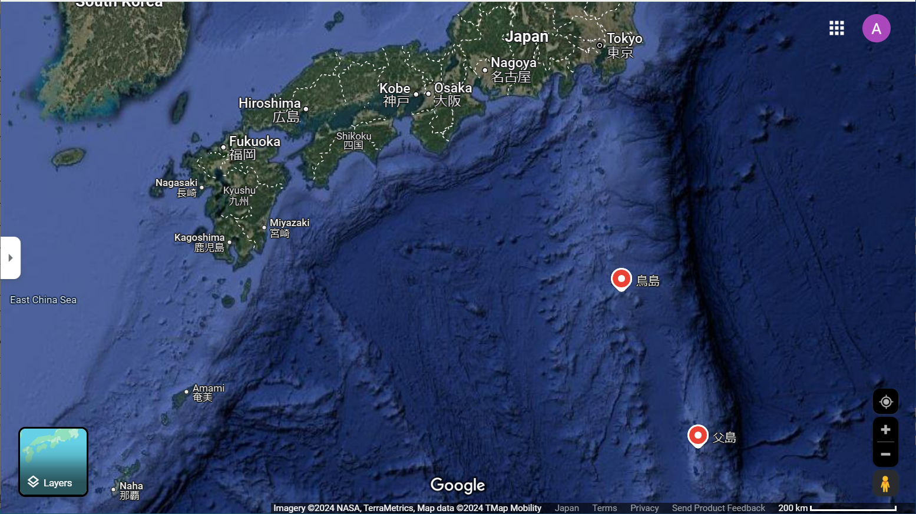
Location of events and observation site
I30JP
Volcanic chain
Tori-shima
Chichi-jima

Slide 5
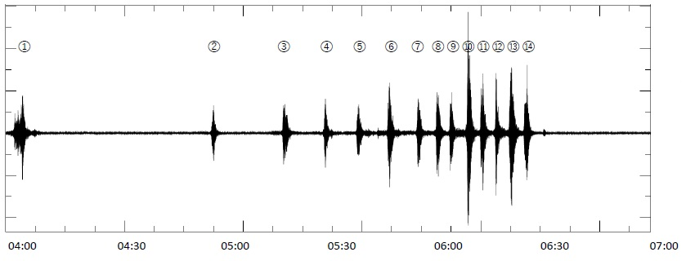
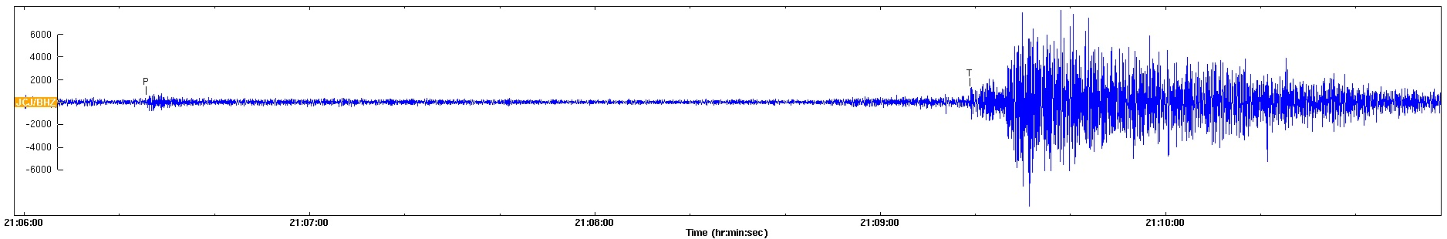
This story begins when strange signals were observed at Chichi-jima.
(cm/sec²)
(After press release of government)
0.5
Vertical comp. of strong motion seismoglaph at Chichi-jima deployed by JMA.
JMA announced that signals with a predominant T phase had been observed.
(JST)
PTS deployed auxiliary seismic station to Chichi-jima (JCJ).
Vertical component (4 Hz high-pass adapted) observed at JCJ
T
P
2023-10-08
Time(UTC)
1 min.

Slide 6
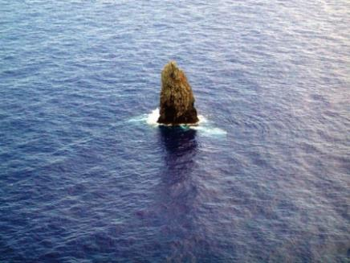
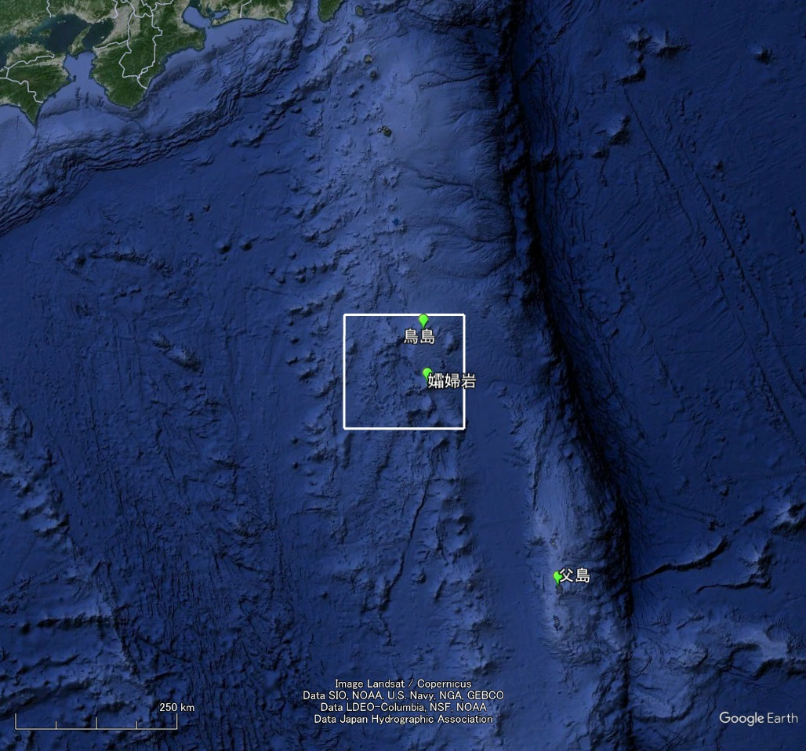
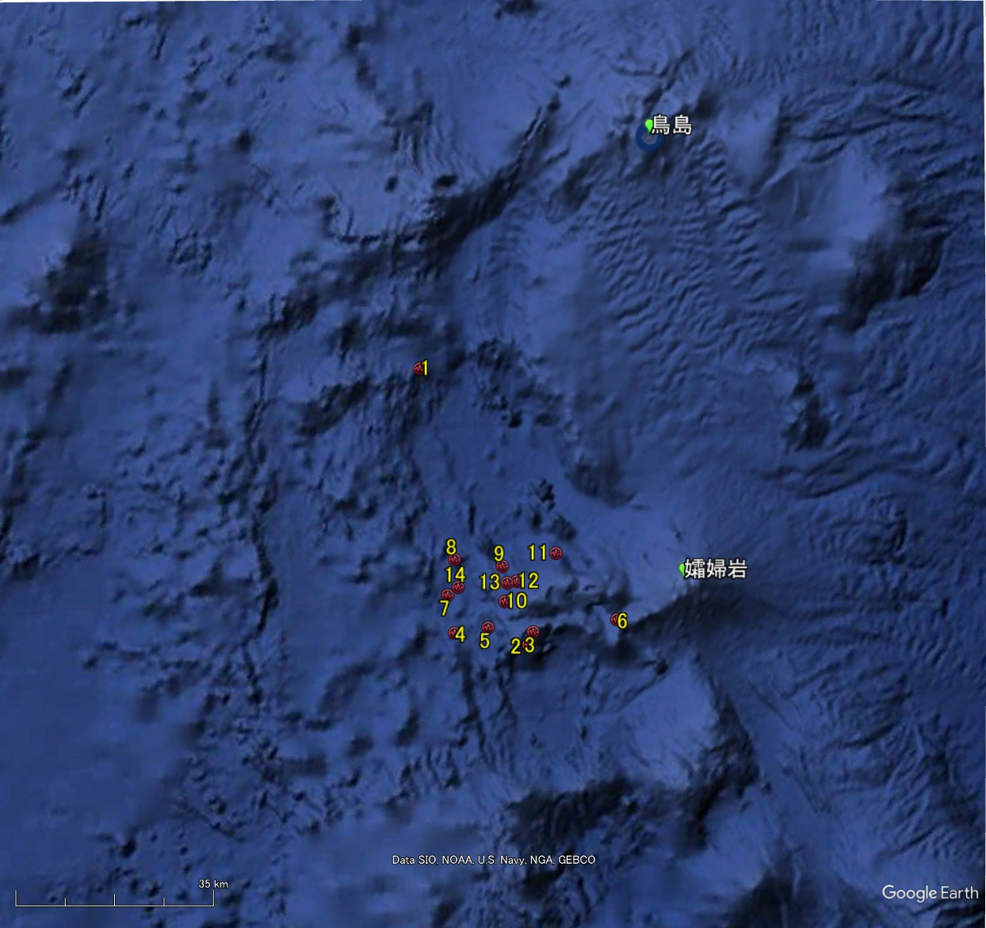
USGS estimated these event’s locations. (the date is Oct. 8th, 2023（UTC）)
No. | Time(UTC) | Lat. | Lon. | mb
1 | 18:58:10 | 30.122 | 139.878 | 4.3
2 | 19:53:46 | 29.690 | 140.061 | 4.5
3 | 20:13:51 | 29.688 | 140.089 | 4.7
4 | 20:25:22 | 29.712 | 139.926 | 4.9
5 | 20:34:32 | 29.718 | 139.990 | 4.7
6 | 20:43:09 | 29.726 | 140.220 | 4.8
7 | 20:51:25 | 29.770 | 139.919 | 4.7
8 | 20:56:48 | 29.825 | 139.933 | 4.9
9 | 21:00:41 | 29.742 | 140.050 | 5.0
10 | 21:05:33 | 29.764 | 139.966 | 5.3
11 | 21:09:16 | 29.831 | 140.114 | 4.9
12 | 21:13:28 | 29.799 | 140.028 | 5.1
13 | 21:17:29 | 29.770 | 140.074 | 5.4
14 | 21:21:42 | 29.637 | 139.813 | 4.9
Sofu-gan
Tori-shima
about 70 km
Tori-shima
Sofu-gan
Chichi-jima

Slide 7
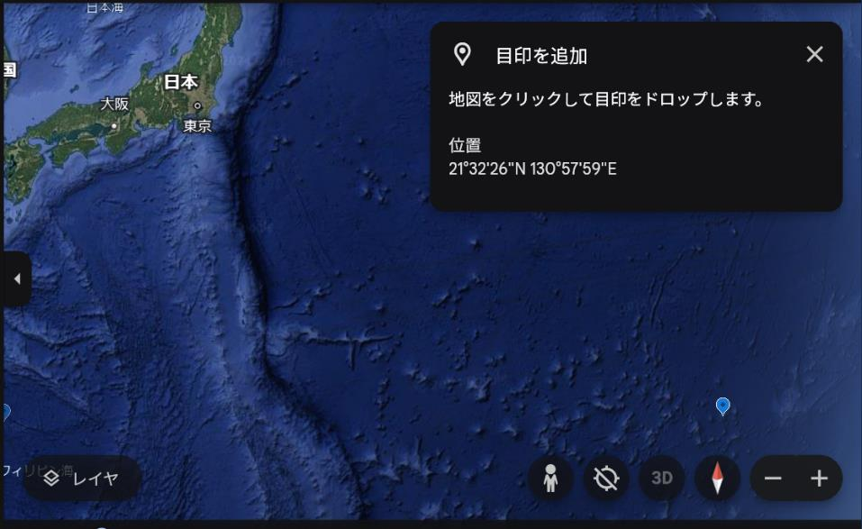
Hydroacoustic monitoring station is deployed at Wake island (H11).
There was nothing interrupting through the propagation path, so we tried to check the data observed at H11.
H11

Slide 8
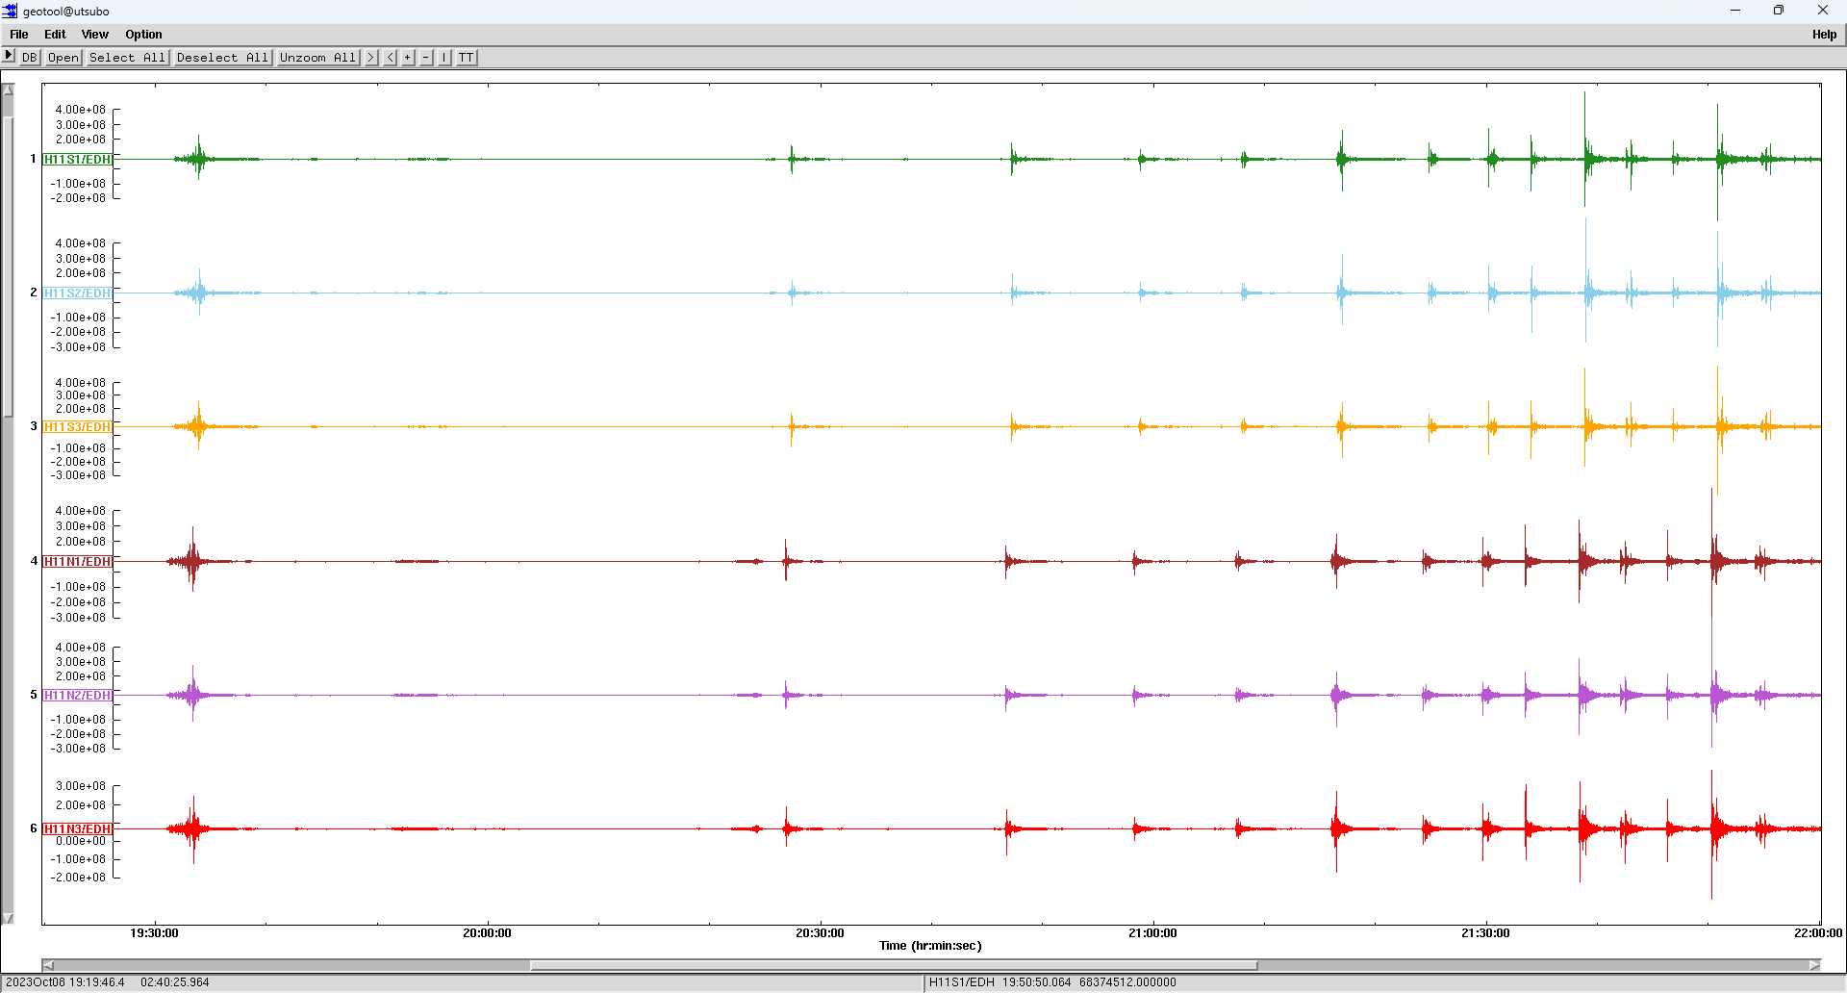
Hydro-acoustic signals observed at H11
Very clear signals have been identified!
Some kind of activities in the ocean might have occurred at that day in that area.

Slide 9
Signals observed at I30JP

Slide 10
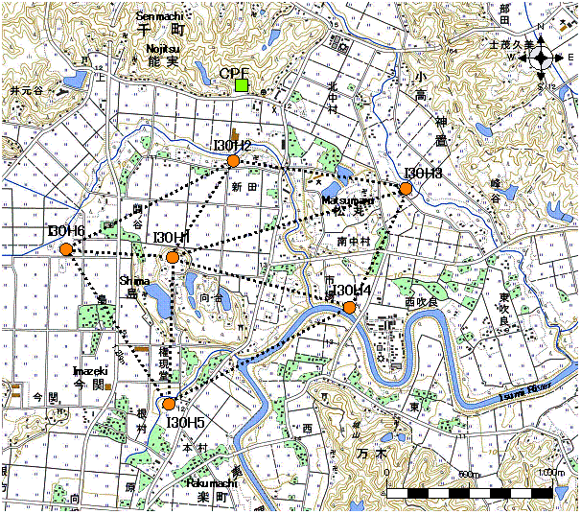
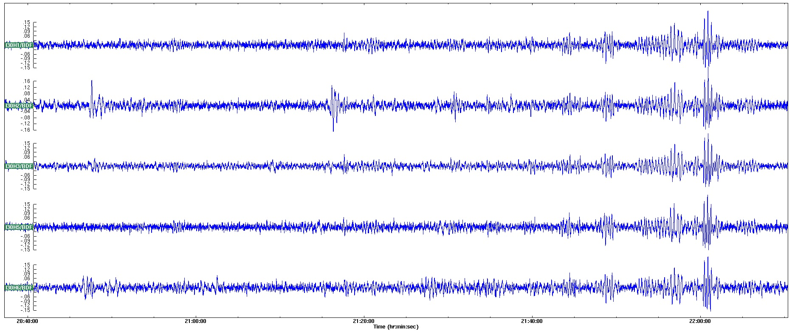
I30JP
The feature of intermittent signals is very similar to what was observed at Chichi-jima.
Now H4 site is not functioning.
H1
0.04 -0.5 Hz band-pass filter adapted
H2
H3
H5
0.1 Pa
H6
21:00:00
10 min.
22:00:00

Slide 11
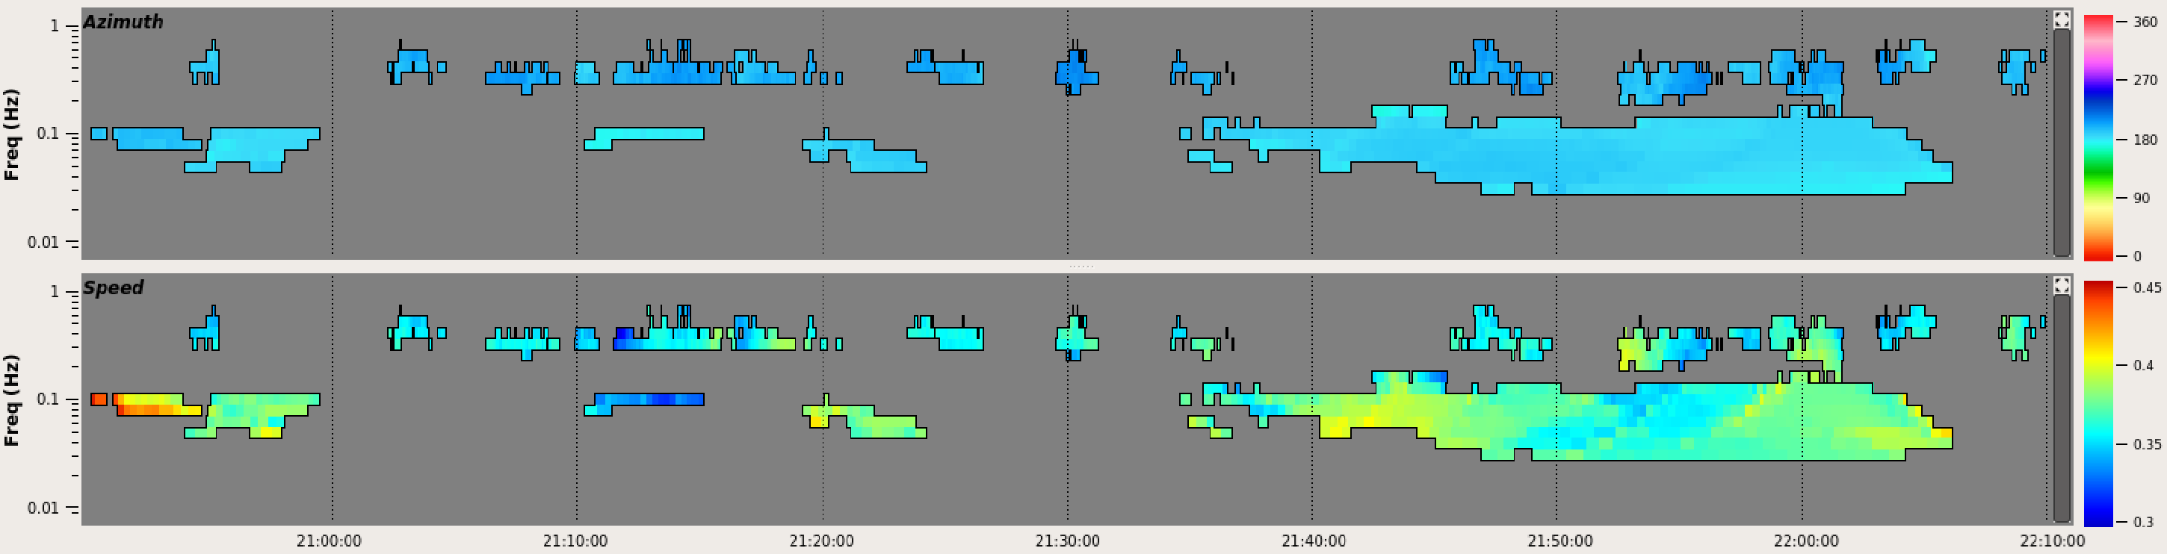
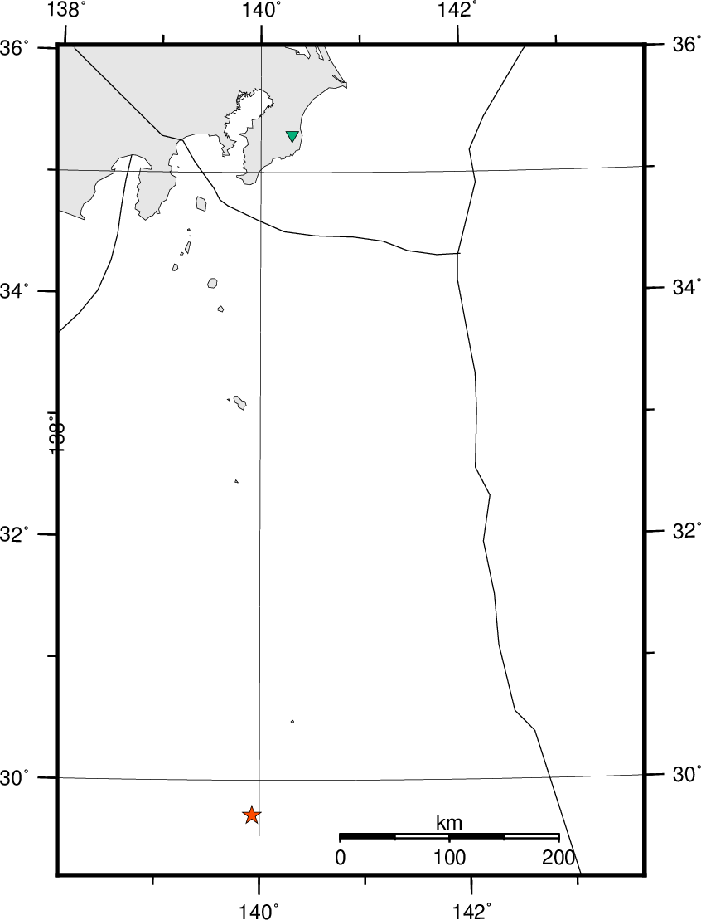
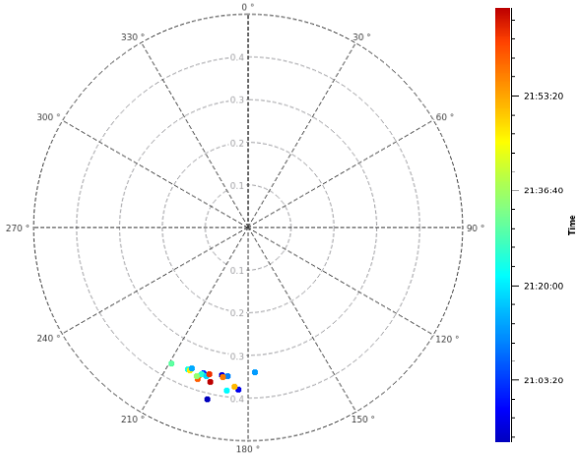
Back-azimuth and apparent velocity by PMCC
Back azimuth
Apparent velocity
21:00:00
22:00:00
Back azimuth and apparent velocity
Back-azimuth：181.6°
Distance: 612km

Slide 12
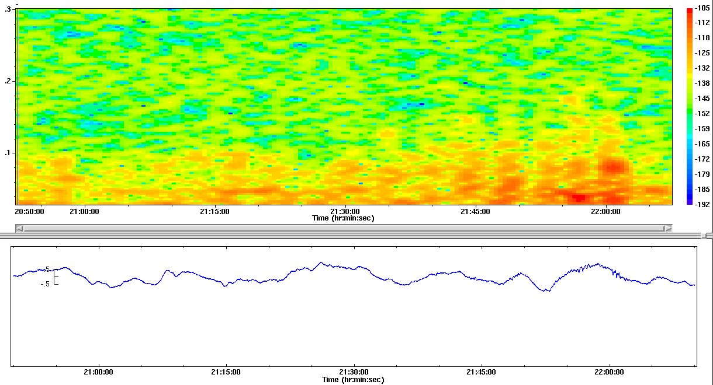
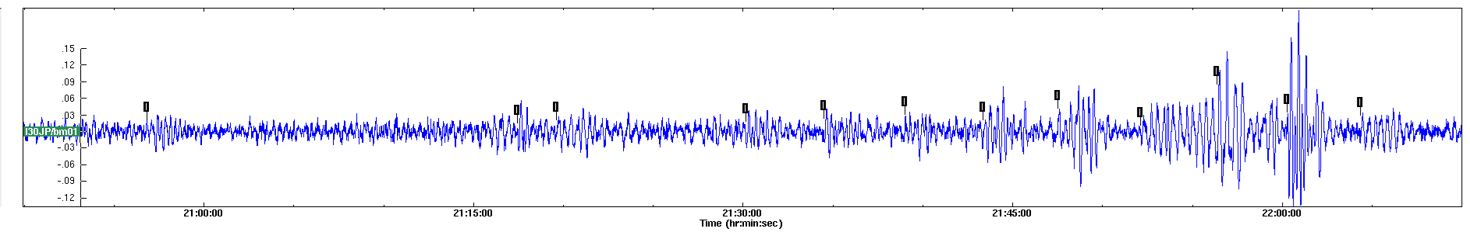
Stacked waveform and its spectrogram
Spectrogram
21:00:00
22:00:00
Waveform stacked (0.04 -0.5 Hz band-pass filter adapted)
Direction: 181.6°, apparent velocity: 0.365 km/sec.
Intermittent activity is more clearly visible.

Slide 13
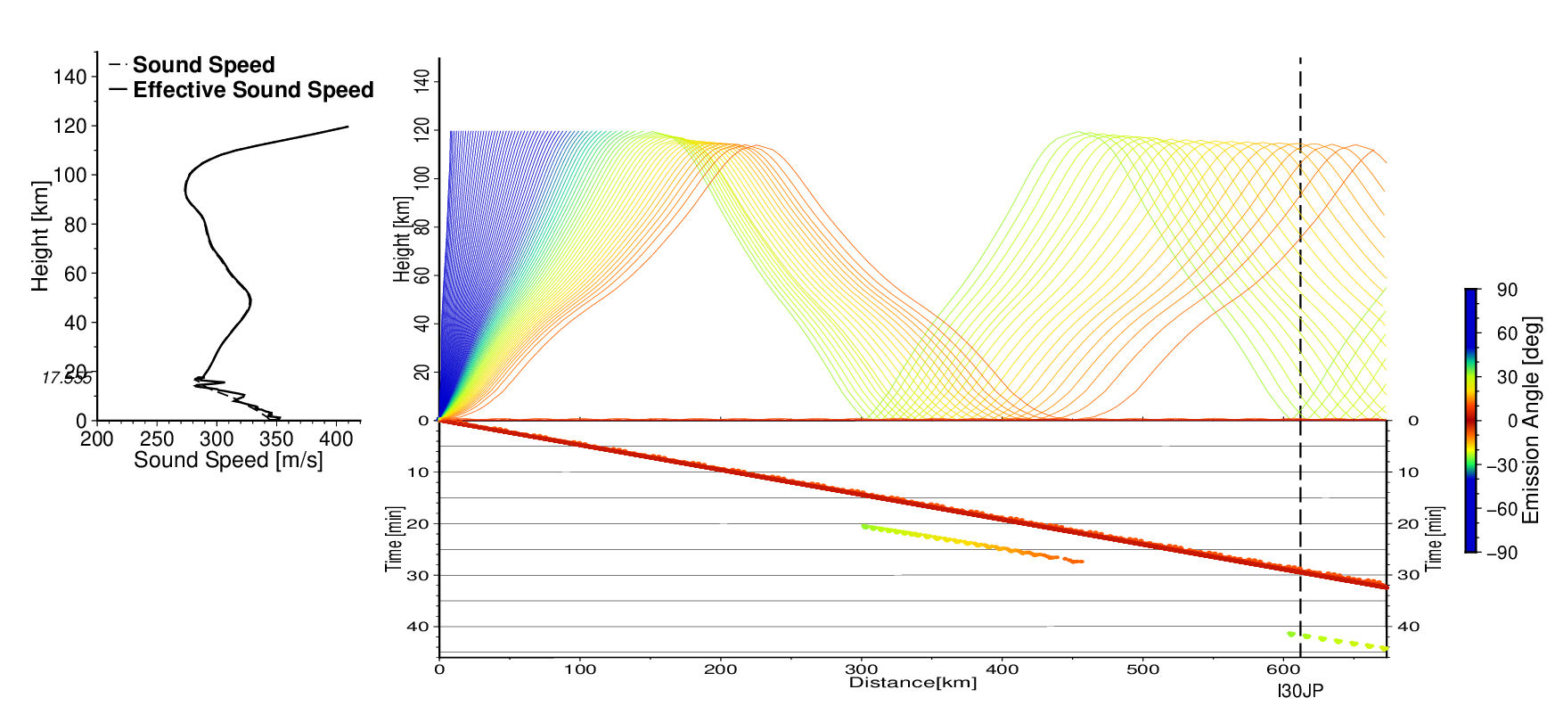
Travel time estimated by ray tracing
Analyzed propagation path
Distance : 612km
Refracting in the thermosphere
Traveling along the Earth’s surface
Travel time : 30 min
Travel time : 42 min
Estimated sound speed profile for ray tracing based on both sonde data observed at Chichi-jima and the standard atmospheric model (CIRA-86 ).
Traveling time when the signal reach the Earth’s surface
Travel time apparent velocity through the I30
Thermosphere 42 min. 0.38 – 0.40 km/sec.
Along the surface 30 min. 0.34 – 0.35 km/sec.

Slide 14
Arrival time of signals
Arrival time propagating through the thermosphere = origine time + 42 min.
Arrival time propagating along the earth’s surface = origine time + 30 min.
③
④
⑤
⑥
⑦
⑧
⑨
⑩
⑪
⑫
⑬
⑭
21:00:00
22:00:00
④
⑤
⑥
⑦
⑧
⑨
⑩
⑪
⑫
⑬
⑭
Arrival time of each signal might be coincide with the arrival time of each signal of the event estimated on its path propagating through the thermosphere.
Of course, there is a possibility that the observed waveform contains signals from two paths.

Slide 15
Comparison the apparent velocity
Back azimuth
Apparent velocity
21:00:00
22:00:00
The observed apparent velocity might be consistent with the velocity estimated for a path propagating through the thermosphere.
Back azimuth and apparent velocity

Slide 16
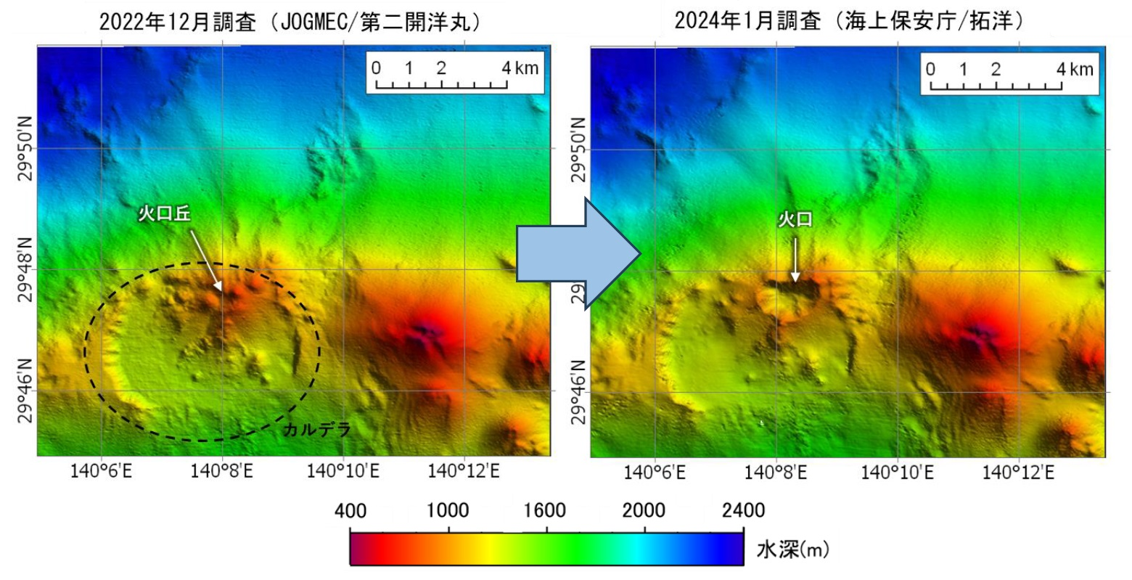
Other relating information
Seafloor topography surveyed by JOGMEC in Dec. 2022
Seafloor topography surveyed by JCD in Jan. 2024
Before the events
After the events
Tori-shima
Crater cone
New crater
The signals observed might be related to the formation of this new crater?
New crater
Caｌdera
Sofu-gan
Water depth (m)
Ocean depth (m)

Slide 17
Concluding remarks
Some kind of volcanic activities had occurred near Tori-shima (Sofu-gan) in the Izu-Bonin island arc.
Its activity was intermittent, and signals with similar characteristics were observed at I30JP.
Back-azimuth, apparent velocity propagating through the site and arrival time might indicate that origin of these signals was the activity occurred near Tori-shima.

Slide 18
Concluding remarks
We think that I30JP could capture the signals induced by the events occurred near Tori-shima, even though the events occurred underwater.
Infrasound array site deployed by PTS has high ability of detection and monitoring remote phenomena.
IMS data would be expected to use more actively for scientific research and disaster mitigation.

Slide 19
Thank you for your attention!

