Slide 1
Introduction to National Data Centres-for-All Initiative
NDCs4All
Ms. Loipa Sanchez Lorenzo
Senior Adviser, External Relations &
Chief of Protocol
Coordinator, Outreach activities, NDCs4All Initiative
Thursday, 22 June at 14:15

Slide 2
Introduction to the NDCs4All
25% of States Signatories do not have a Secure Signatory Account (SSA), nor have they established a National Data Centre (NDC) 25 years after the CTBT opened for signature.
Therefore, They are not accessing IMS data and IDC products
Some others who have established an SSA are not downloading CTBT data, and do not fully benefit from their Treaty membership.
These States are not in a position to determine and assess potential nuclear tests, as is their national prerogative, or use the wealth of data offered by the CTBT verification system.

Slide 3
Introduction to the NDCs4All
Status in 2022
43 States Signatories without Secure Signatory Accounts (SSAs)
8 States Signatories with an SSA but no National Data Centre (NDC)
66 States Signatories eligible for Capacity Building System (CBS) donations
34 States Signatories have SSA, but download zero or minimal IMS data

Slide 4
Introduction to the NDCs4All
Some remarks from the Treaty for you…
All States Signatories, “irrespective of their technical and financial capabilities, shall enjoy the equal right of verification.”
The PTS shall “make available all (IMS) data, both raw and processed, and any reporting products, to all” States Signatories, (…) and provide “equal, open, convenient and timely access to all stored data”.
“The International Data Centre shall, where required, provide technical assistance to individual States: … by assisting them to develop the capability to receive, process and analyse IMS data at a national data centre.”

Slide 5
Introduction to the NDCs4All
Ox.x-xxx
Executive Secretary Dr Robert Floyd launched the NDCs4All initiative on 27 June 2022 during the 58th session of the Preparatory Commission (PrepComp58).
OBJECTIVES
Increase the number of Secure Signatories Accounts (SSAs), Authorised Users, National Data Centres (NDCs), and Capacity Building Systems (CBSs)
Increase IMS data and IDC products downloaded by CTBT States Signatories

Slide 6
Introduction to the NDCs4All
Ox.x-xxx
The NDCs4All Task Force has increased outreach efforts and enhanced tailored assistance to reach States Signatories. It also encourages and supports them to create an SSA, while increasing the number of Authorised Users, and establishing NDCs so that they can enjoy the benefits of Treaty membership.
The establishment of an NDC is a national issue that should be handled by the National Authority (NA) of each State. To start the process, a State Signatory needs to send a formal request for assistance to the PTS. The PTS will then provide support to facilitate the process.
The initiative supports all CTBT States Signatories, in particular, Least Developing Countries (LDCs), Landlocked Developing Countries (LLDCs), and Small Island Developing States (SIDS) by providing them with Capacity Building Systems (CBSs).

Slide 7
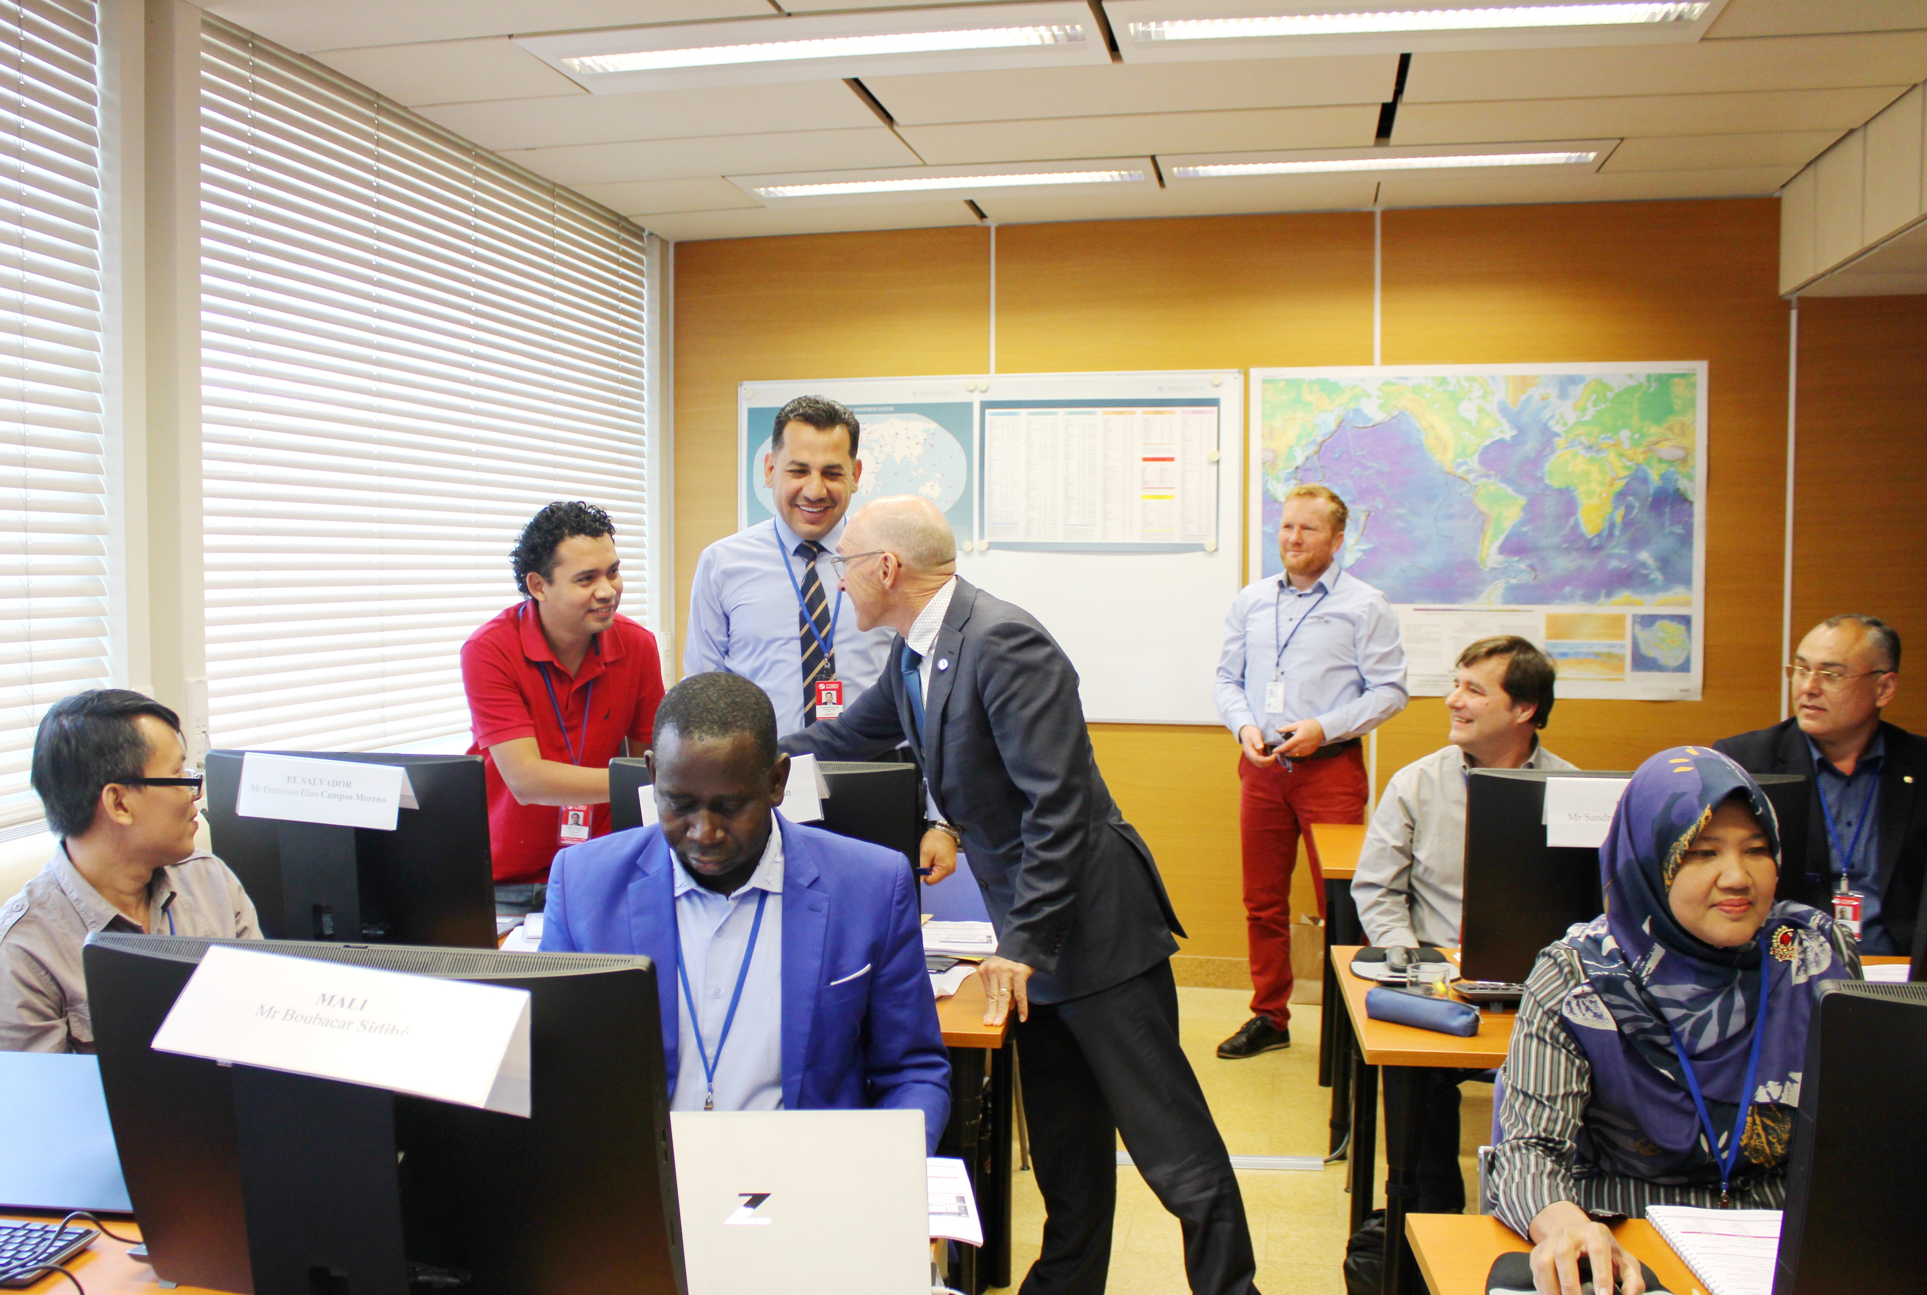
Introduction to the NDCs4All
Ox.x-xxx
The initiative promotes better understanding of CTBT:
Main objective: Detect/Ban nuclear explosions
On top of that, CTBT's data and products can
be put to a wide range of civil and scientific uses

Slide 8
Introduction to the NDCs4All
Ox.x-xxx
Examples of potential Civil and Scientific Uses of Detection
And Near-Real Time Warning of :
• Earthquakes and tsunamis
• Radiation dispersal from nuclear accidents
• Volcanic eruptions
• Meteors
Research on:
• The Earth’s core
• Climate change
• Meteorology
• Break-up of ice shelves
and the creation of icebergs
• Oceans and marine life
• Worldwide background radiation

Slide 9
Introduction to the NDCs4All
Ox.x-xxx
Medium-Term Strategy (MTS) Published in February 2023 sets four strategic objectives for the Provisional Technical Secretariat (PTS) for the next years, which are:
Universalisation & Entry Into Force (EIF)
A complete, robust & sustainable verification system is in place at EIF
All States Signatories benefit fully from Treaty Membership
Efficient, effective and agile PTS
The NDCs4All initiative is part of this objective

Slide 10
Introduction to the NDCs4All
Ox.x-xxx
Expected Impact of Initiative
Period 4Q 2022-2026
Verification data and products are more equitably accessed and used among
States Signatories
Reinforced sense of CTBT ownership among States Signatories
Enhanced States Signatories' capabilities and participation in CTBT verification
Enhanced States Signatories capability to use IMS data for civil and
scientific applications
Further support for CTBT and CTBTO

Slide 11
Introduction to the NDCs4All
Ox.x-xxx
Successes of NDCs4All
After one year of The NDCs4All initiative implementation, several States Signatories are already enjoying its benefits.
The PTS assisted five (5) States Signatories with the creation of their Secure Signatory Accounts (SSAs)
Tuvalu, Timor-Leste, Benin, Uruguay, Yemen
2. Eight (8) States Signatories established their National Data Centers (NDCs)
Mauritania, Brazil, Cambodia, Tuvalu, Timor-Leste, Benin, Uruguay, Yemen
3. Four (4) Capacity Building Systema (CBSs) were installed
Oman, Montenegro, Uzbekistan, Ukraine
The PTS is currently working with many more States Signatories, anticipating the creation of new SSAs, the increase of authorized users, the increase of data downloaded, and the establishment of more NDCs in the coming months.
The PTS has also received a large number of requests for CBSs within the scope of this Initiative as well as for the sustainment of CBS at existing NDCs, which require additional resources.

Slide 12
Introduction to the National Data Centers-for-All initiative
NDCs4All
Thank you!
Ms. Loipa Sanchez Lorenzo
Coordinator-Outreach activities NDCs4All Initiative
Senior Adviser External Relations
Chief of Protocol
Thursday 22 June at 14:15

