Slide 1
NPE2019 scenario: Italian and German National Data Centre
Antonietta Rizzo² , J. Ole Ross¹, Giuseppe Ottaviano² , Nicolai Gestermann¹, Barbara Ferrucci², Peter Gaebler¹,Antonio Guglielmelli², Christian Müller¹,Stefano Salvi², Chiara Telloli², Alberto Ubaldini²
¹ Federal Institute for Geosciences and Natural Resources, BGR
²Fusion and Technology for Nuclear Safety and Security Department
Presentation Date: 22 June 2023

Slide 2
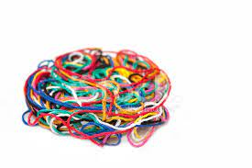
THE START…
We started to develop the scenario with these features:
To imagine a violation of the Treaty (UNE)
To use real seismic data
To add radionuclides particulate signatures to cover up
To make the scenario complex, mixing different sources for radioxenon and radioactive particulate.
La
Cs
I
Xe

Slide 3
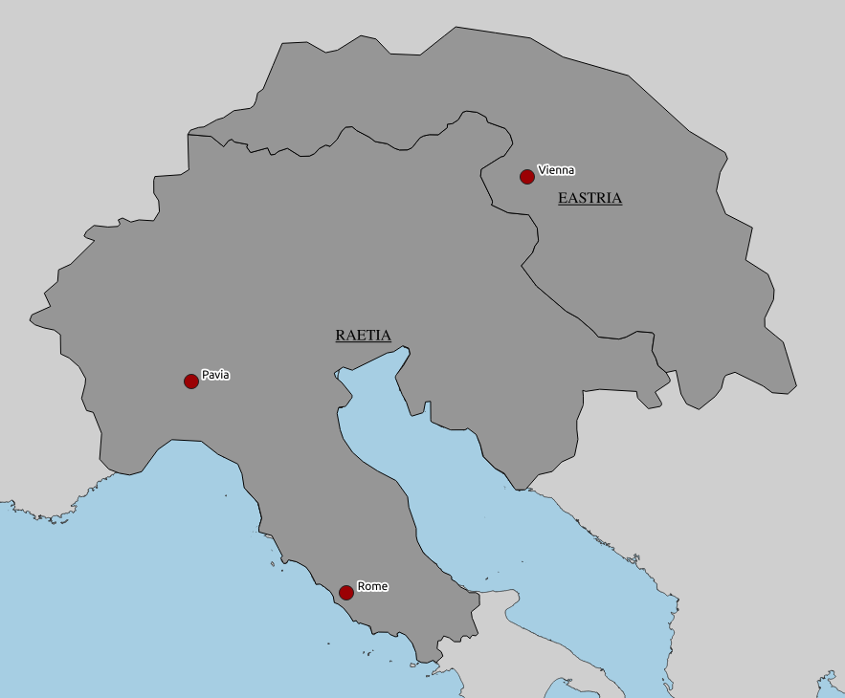
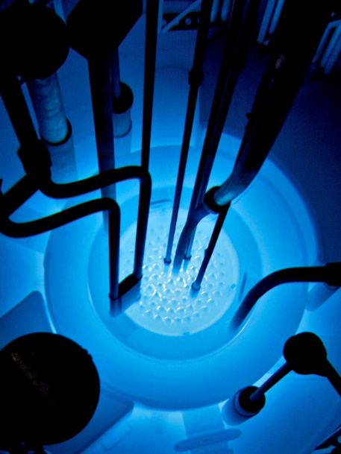
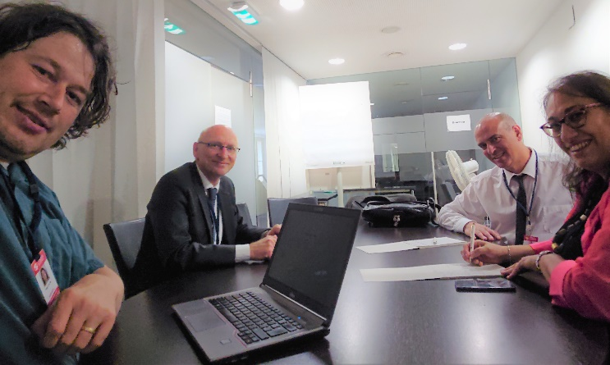
BASIC SCENARIO DESIGN OF NPE 2019
ENEA, Bologna:
Scenario Storyline
Radionuclide source terms
RRR design
BGR, Hannover, German NDC:
Seismic event selection
Forward ATM for RN concentrations
ETA request and additional seismic data
Organizational issues and website
Initial announcement by fictitious alpine state Raetia
Accident at TRIGA reactor, Pavia, morning of 30th July 2019
Small release of radioactive isotopes expected
Local monitoring in place, no hazardous level
No radiological protection measures required

Slide 4
Triggering event
The RAETIA country announces that a nuclear accident at the Pavia’s TRIGA-RR, happened with releases of particulate and noble gases: therefore the country states that the event is not relevant to the Treaty.
IMS detect seismic and radionuclide evidences and National Authorities ask for clarification.
Seismic signals
Seism at the Costanza Lake (Bodensee) at about 280 km from Pavia, on 29 July 2019, 23.17 UTC, 3,7 ML, 3 km deep.

Slide 5
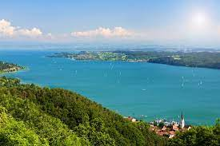
SCENARIO
We have imagined a test under the lake of Costanza… (very capable country…)
Costanza lake
…and intentional releases of radioactive particulate from Pavia research reactors (280 km far from the lake)

Slide 6
THE SCENARIO CORE BUILD UP
Scenario core
A release of radioxenon from the UNE (radionuclide signatures)
A release of radioactive particulate (radionuclide signatures)
A real seismic and infrasound signatures
Radioactive cover-up
The country simulates an accident at the Pavia’s TRIGA-RR simulated by a nuclear fuel-fire, occurring on 29 July 2019.
Particulate release
A controlled release of fission products and activation products is done through a controlled fuel-fire simulating a nuclear accident at the Pavia’s TRIGA-RR; the reactor is shutted-down about two months before 29 July 2019 to reprocess the nuclear fuel in order to separate the particulate source-term (should be about 1E+10 Bq) from the noble gases source-term (should be about 1E+15 Bq), making the radioxenon to be completed decayed.

Slide 7
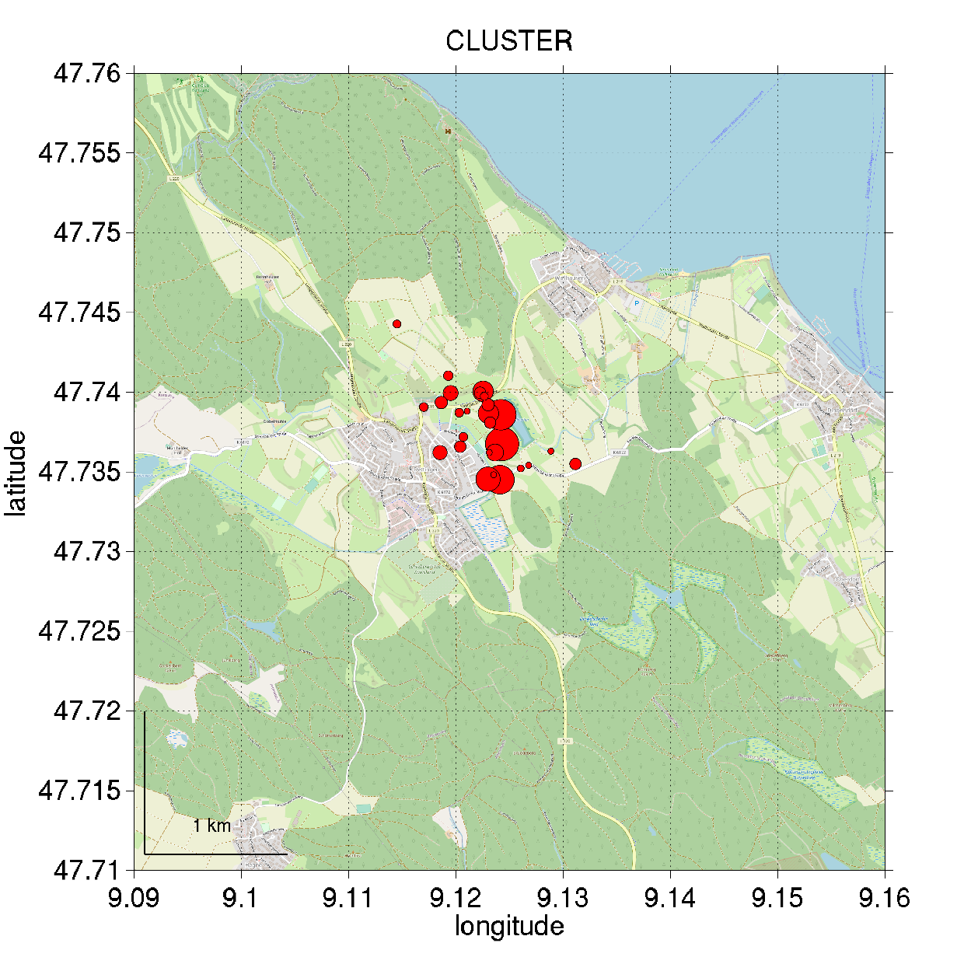
SEISMIC SCENARIO EVENT OF NPE 2019
Ox.x-xxx
A shallow ML 3.7 seismic event in northern RAETIA (actually southern Germany)
Parameter of scenario event Origin time 29 June 2019 23:17:47.9 UTC Epicentre 47.739N 9.108E Source depth 3 km Magnitude 3.7 ML Region Lake Constance
One Event of a Earthquake sequence
Number of events: > 47
Magnitude: 0.7 – 3.7 ML
Source depth: 2.3 – 3.6 km (results of relative localization)
Shallow source depth is unusual
The tectonic background is still unclear

Slide 8
Seismic event
Location of the source of the seismic signal and infrasound signal (red dot), location of the Pavia’s TRIGA-RR involved and possible region of the test (red ellipse).
280 km
TRIGA reactor

Slide 9
THE COUNTRY STRATEGY
We imagined the malevolent country had very smart experts
They want to cover up the UNE with an emission of real radionuclides
They decided to take some fuel, let it decay for 2 months and then fire it to release radionuclides in the atmosphere
They calculated the decay time in order to in order to separate the particulate source-term (about 1E+12 Bq) from the noble gases source-term (about 1E+15 Bq)
The government doesn’t care to much about fear of the population for radiation
The government does not care at all about emission of radioactivity in the environment

Slide 10
THE COUNTRY FACTS
The country did an UNE under the Lake of Costanza on 29 July 2019 (FACT)
The release of radioxenon was totally due to the UNE (FACT)
The country took irradiated fuel and did reprocessing in order to have an inventory of radionuclides (FACT)
The country lighted a big fire with radioactive materials to spread them in the atmosphere (FACT)

Slide 11
THE COUNTRY DECLARATIONS
The country announced an accident at the TRIGA Nuclear Research Reactor in Pavia, occurring on 29 July 2019 (FAKE)
The country stated that some radionuclide releases have been occurred cause to the nuclear accident at the TRIGA reactor in Pavia. They are particulate and radioxenon. They’re not relevant to the Treaty (FAKE)
The country stated that both radioxenon and particulate are coming from the same source (incident) (FAKE)

Slide 12
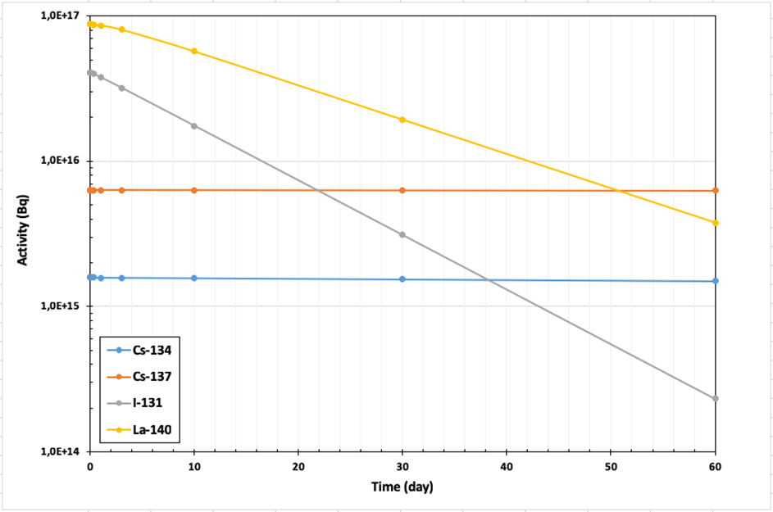
RADIONUCLIDE INVENTORY
We run simulation of decay of specific radionuclides from real fuel composition of TRIGA Reactor
We obtain the source term for several radionuclides
We select Cs137, Cs134, La140, Ba140 products
We hypothesized 24 hours of delay for the radioxenon release
We hypothesized that the fire was lighted 2 hours after the UNE and it lasted 8 hours (continuous release)
We need to fix quite high initial activity concentrations to obtain ATM data suitable to be detected at the IMS stations (difficult balance between low yield explosion and activity concentration released)

Slide 13
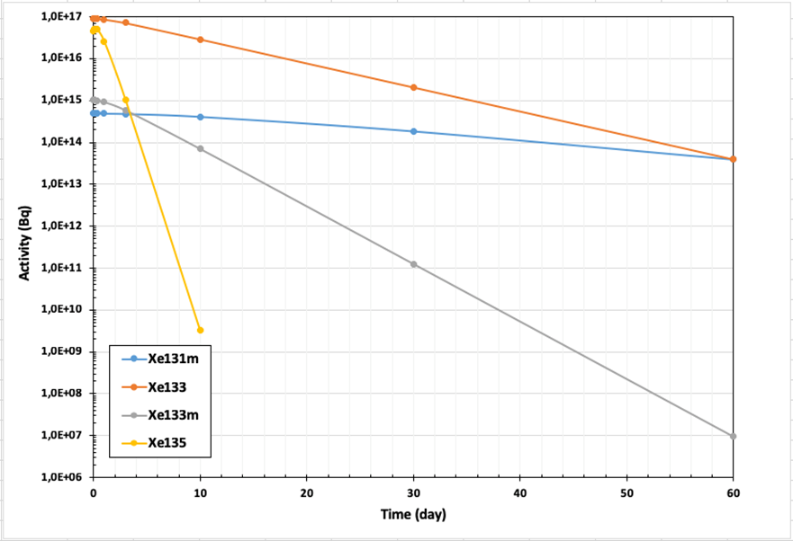
RADIONUCLIDE INVENTORY
We consider a prompt relase of particulates and a 6h release of radioxenon, after 1 day of delay

Slide 14
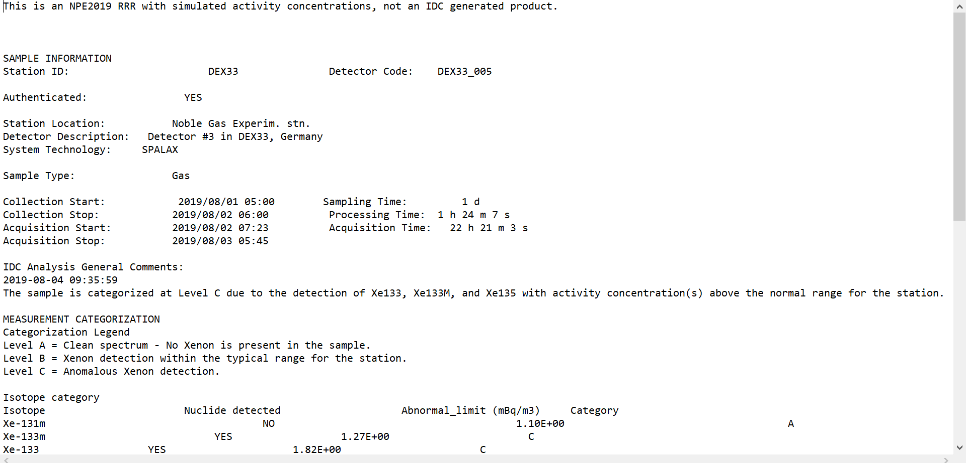
ATM TRANSPORT
German NDC run ATM modelling to obtain activity concentration at selected IMS stations
We produced RRR with the calculated ATM data (deleting some sections, pasting the data) !!!!!!
We accept some artificialities, but we decided to not pointed clearly at them…we leave the work to the participants!

Slide 15
THE LAUNCH OF THE EXERCISE

Slide 16
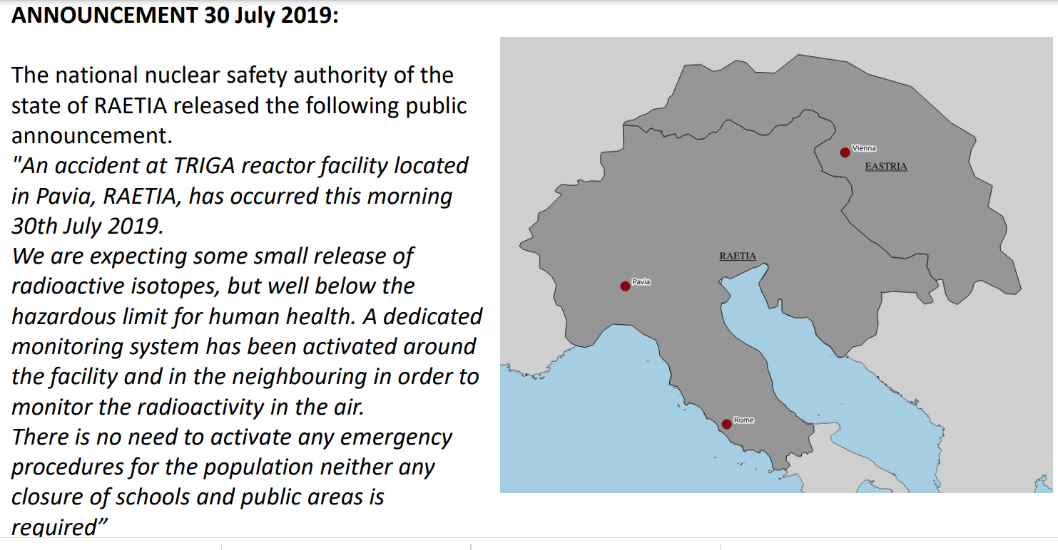

Slide 17
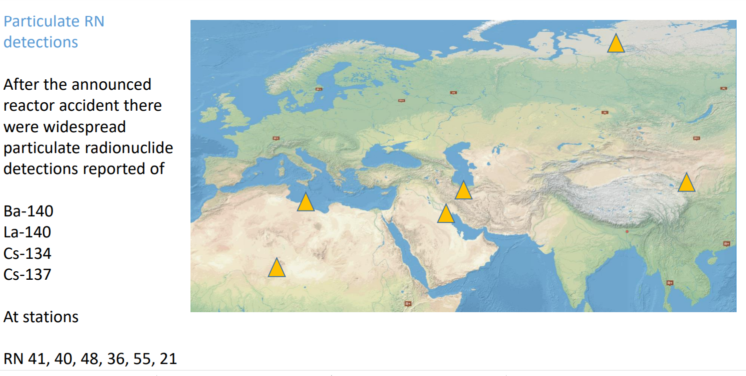
IMS DETECTIONS
NG Detections
Few noble gas measurements at DEX33 Schauinsland of Xe-133 Xe-135 Xe-131m
And a tiny fraction of Xe-133 at RN 48

Slide 18
NDCs TASKS
NDC was asked to:
Describe what will they comunicate to the National Authority
Study the isotopic ratios at the date of the IMS detections to run discrimination analysis
Discuss the request of an Expert Technical Analysis and try to figure out a procedure for the request
Speculate about a request for an OSI

Slide 19
FIRST ETA REQUEST EVER DURING NPE 2019
Ox.x-xxx
Content of ETA request
IDC results on ETA request
Quick response (within 14 days) with an „Exercise State Requested Methods Report“
Sticked closely to the specific questions given in the request
Performed suitable ATM for the additonal radionuclide data from Vienna
Radionuclide analysis difficult, potential connection of Xe at DEX33 and Vienna recognized
Considered only waveform events listed in IDC products
Identified small earthquake at Lake Constance 30 July, 5:32 UTC, ML 2.9
Eastria has provided national NPE 2019 radionuclide measurements to the IDC and requests assistance with Expert Technical Analysis to identify potential sources.
Backward Atmospheric transport modelling for the given samples
Search for (real) waveform events in the region of potential origin including events not yet included in IDC SEL/REB products.
Characterization of the isotopic composition and assessment of possible connection to other scenario samples

Slide 20
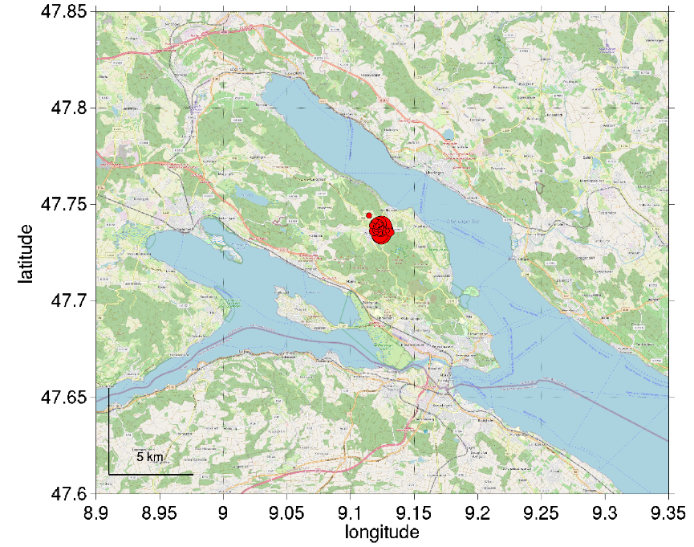
LAST STAGE OF NPE2019 – ADDITIONAL (FAKE) SEISMIC DATA
NPE 2019 Seismic event
Original Waveform Data
Modified NPE-data
Parameter of scenario event Origin time 29 June 2019 23:17:47.9 UTC Epicentre 47.739N 9.108E Source depth 3 km Magnitude 3.7 ML Region Lake Constance
Seismic data of regional stations for two days (29/30 July 2019) were provided. Within the data the signature of the NPE 2019 event was manipulated to show explosive characteristics.

Slide 21
LESSON LEARNED
Check and check again the data
… some errors occurred during copy and paste………thanks to the NDCs for pointed out them!
FAQ section on the NPE portal will be beneficial
The best way to communicate and to share experiences among NDCs is to have meetings and discuss
NDC Forum

Slide 22
IDEAS FOR THE FUTURE
Technical questionnaire in order to know the various approaches, methods that the NDC teams used to face the exercise, step-by-step
Real “modified” RRR (able to be analyzed by software tools)
Description of Modus Operandi by the NDCs
Photos and screenshots of the calculation, discussion, interaction
Interactive polls launched by the organizers to the NDCs
Push notification
NDCs collaborative work (let’s work together)

Slide 23
Ox.x-xxx
THANKS

