Slide 1
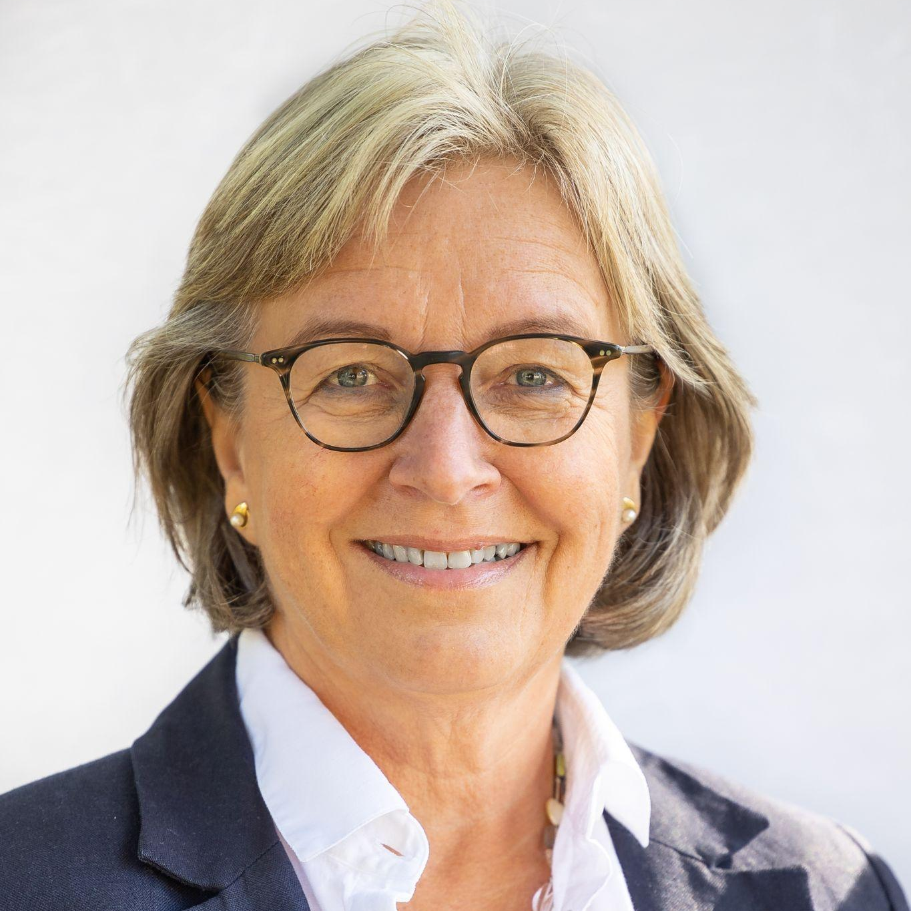
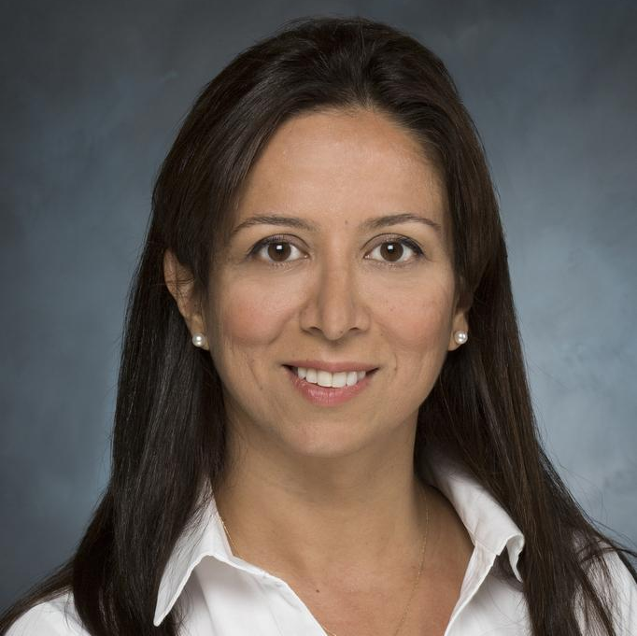
Introduction of Professional Networks Promoting Female & Young Experts in STEM and Cooperation With CTBTO
PANELLISTS:
Anne Strømmen Lycke
Founder, Young Professionals Network (YPN)
Rengin Gok
Former Manager, Seismic Cooperation Program
MODERATOR: Sanam Shantyaei
Information Officer, CTBTO
Gabriele Voigt
Past President, Women in Nuclear (WiN)
Marius Jano
Task Force, CTBTO Youth Group (CYG)

