Slide 1
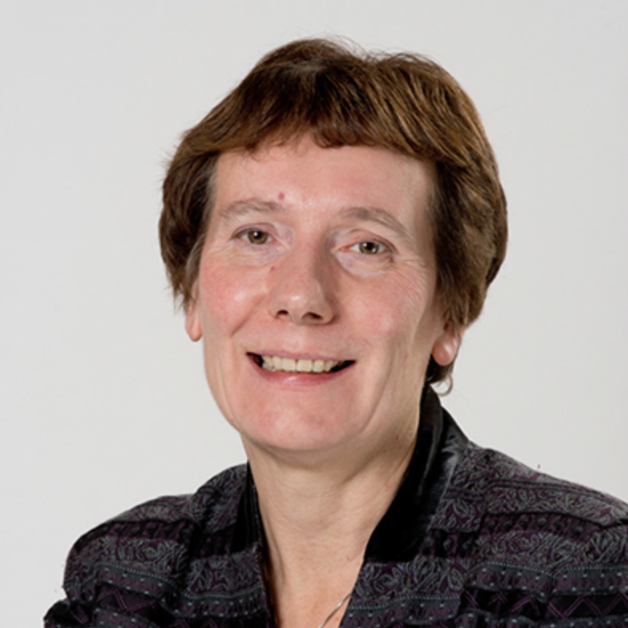
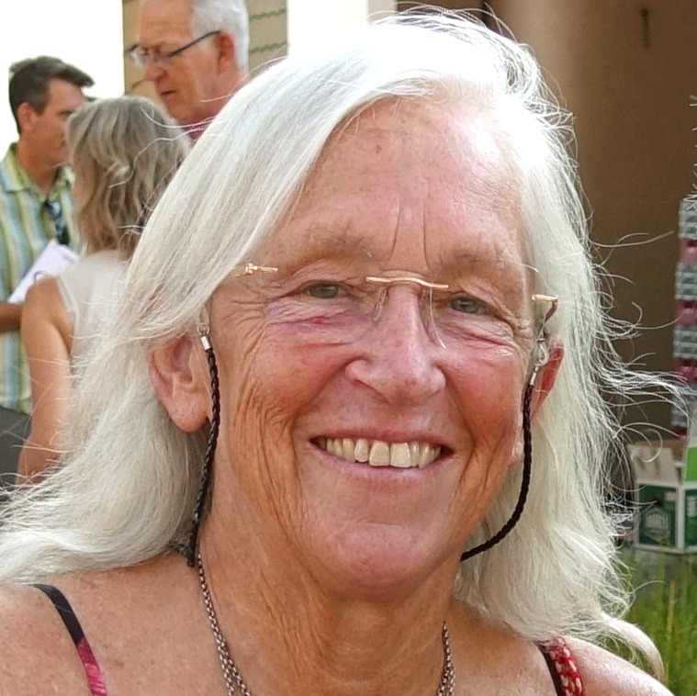
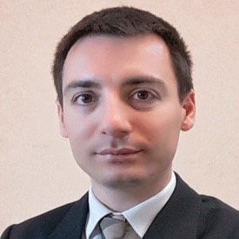
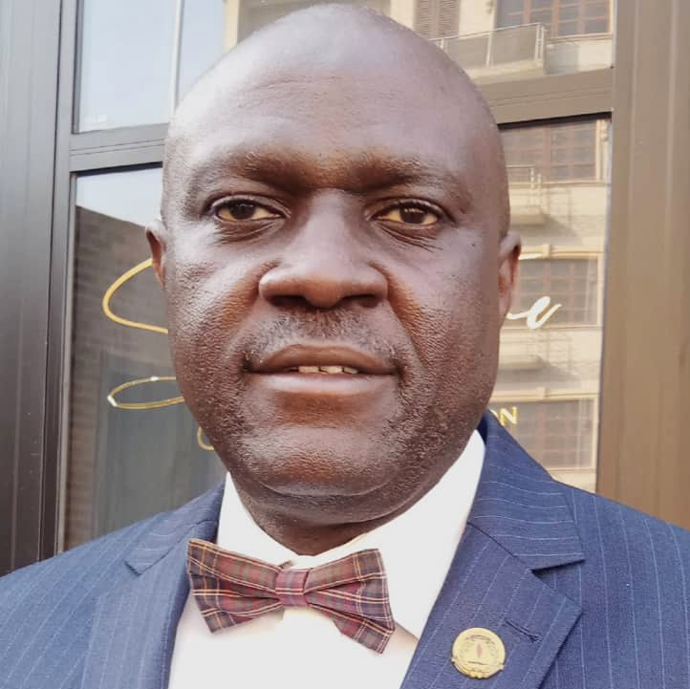
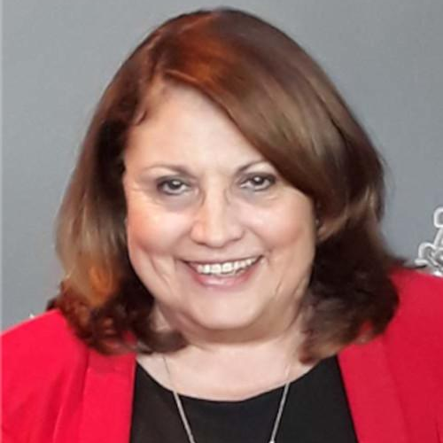
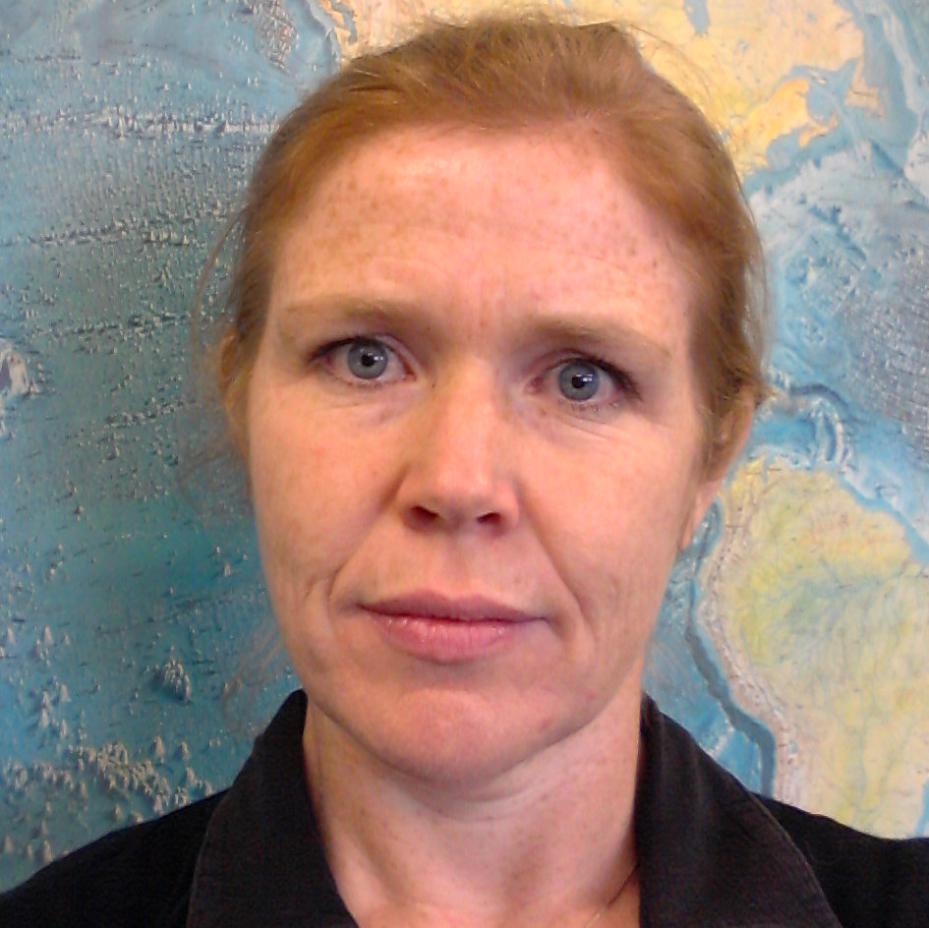
Introduction of Synergies Between Professional Societies & CTBTO
PANELLISTS & SOCIETIES:
MODERATOR:
Sanam Shantyaei
Information Officer, CTBTO
Atalay Ayele Wondem
Founding President,
The African Seismological Commission (AfSC)
Kathy Whaler
President, The International Union of Geodesy and Geophysics (IUGG)
Marino Protti
Former President, Latin American and Caribbean Seismological Commission (LACSC)
Peggy Hellweg
Past-President,
Seismological Society of America (SSA)
Massimo Pellegrino
European Public Policy Manager, The Institute of Electrical and Electronics Engineers (IEEE)
Oladoyin Odubanjo
Chairman, The Africa Chapter of the Intl.
Network for Government Science Advice (INGSA)
Silvia Blanc
Past Member, Executive Committee, The Intl. Association for the Physical Sciences of the Oceans (IAPSO)
Michelle Grobbelaar
First Vice-President, Intl. Association of
Seismology & Physics of the Earth's Interior (IASPEI)

