Slide 1
Panel Discussion:
Operating the IMS in the framework of the International System of Units (SI)
Moderator: Richard Barham
Director, Acoustic Sensor Networks
Pa2.8-908
20 June 2023

Slide 2
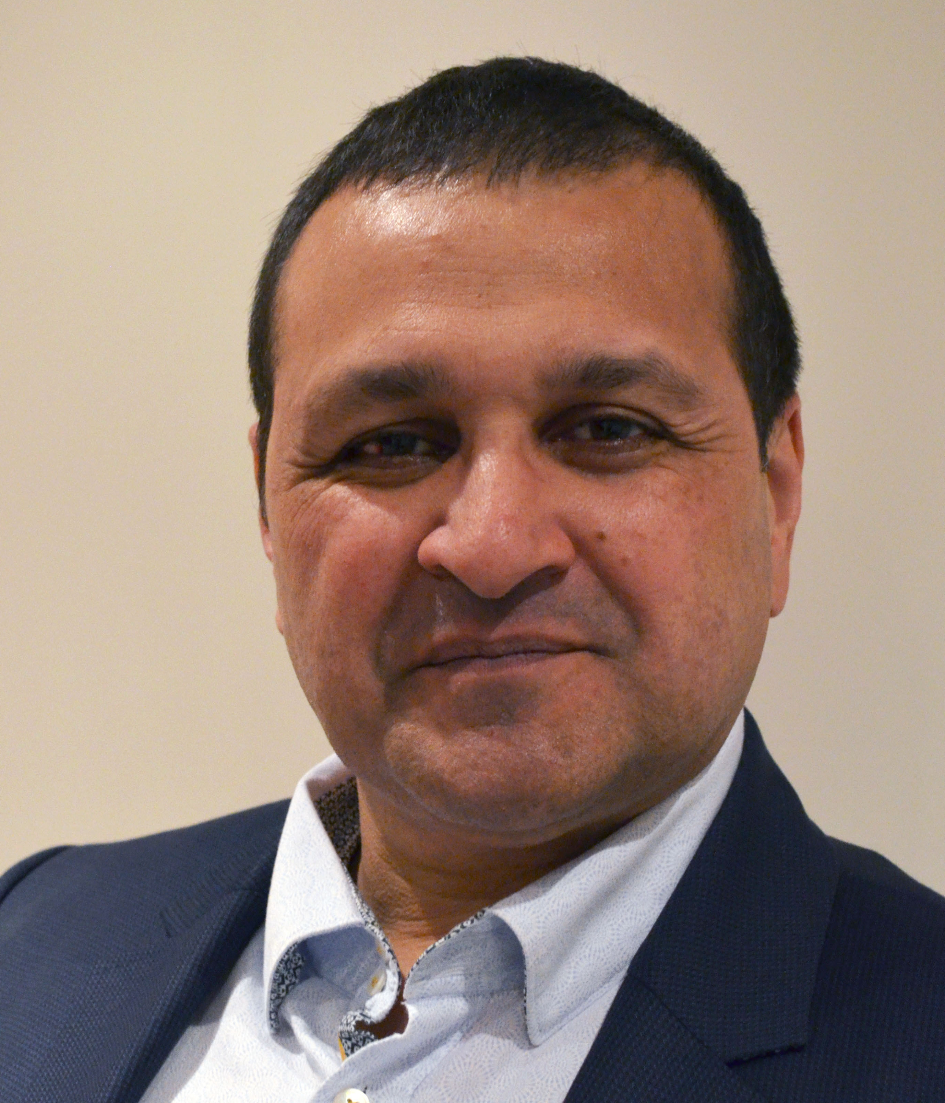
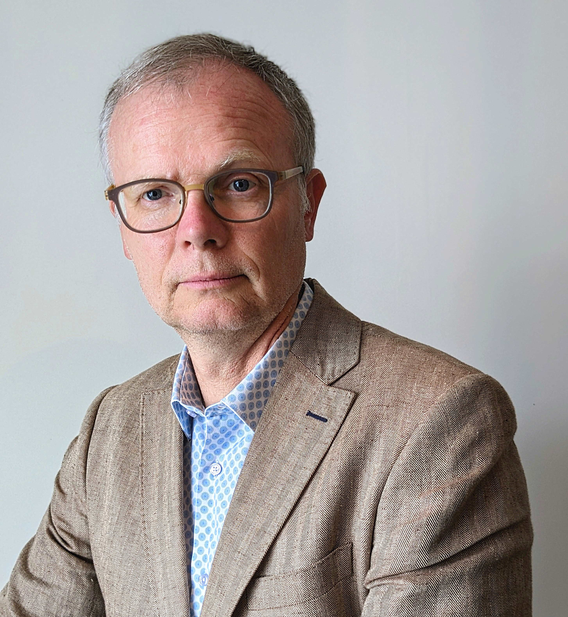
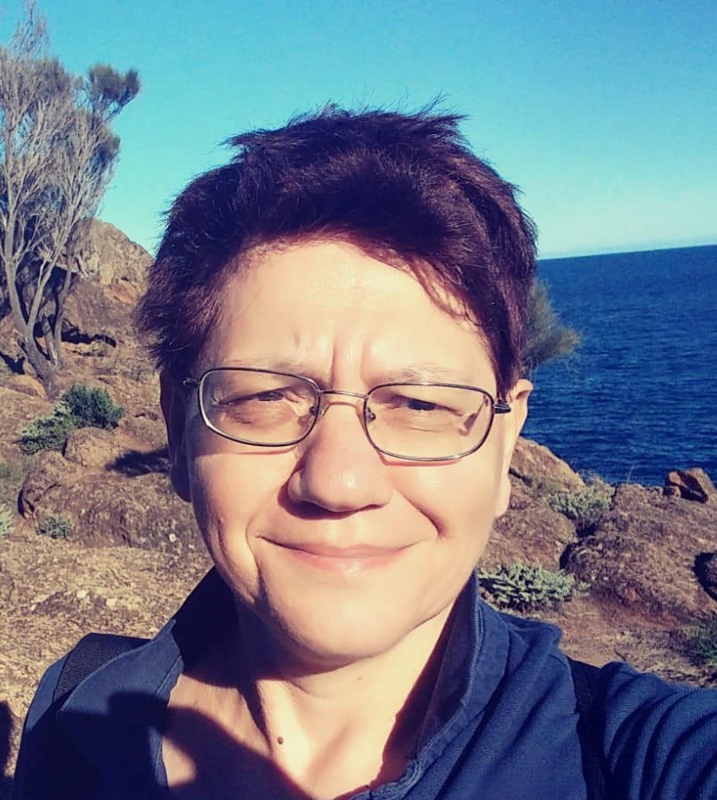
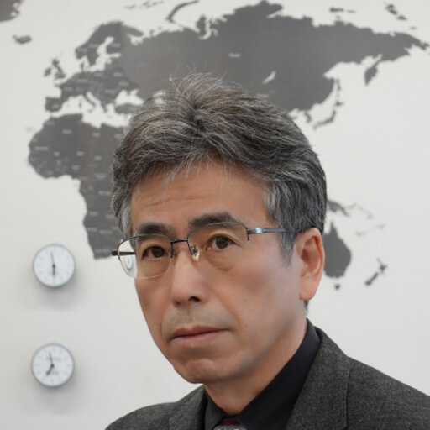
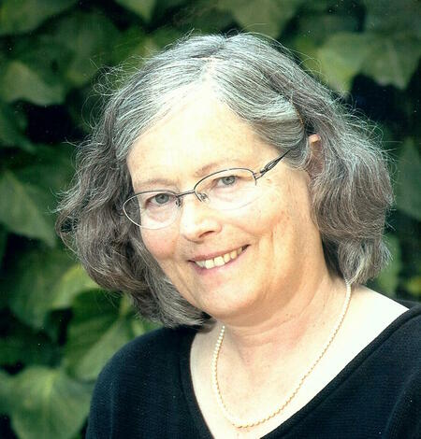
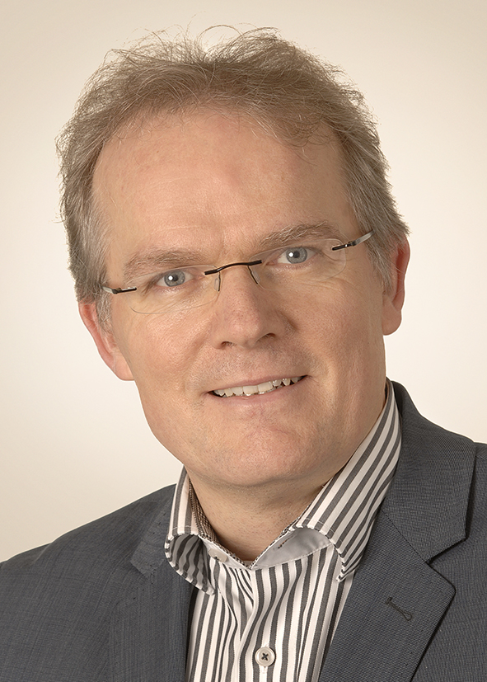
Panel discussion:
Operating the IMS within the framework of the International System of Units (SI)

Slide 3
Dr Takashi Usuda
Director General at National Institute of Advanced Industrial Science and Technology, Japan
Secretary of the International Committee for Weights and Measures (CIPM)
Former President of the BIPM Consultative Committee for Acoustics, Ultrasound and Vibration (CCAUV)

Slide 4
Dr Lind Gee
United States Geological Survey (USGS), Retired

Slide 5
Dr Svetlana Nikolova
Seismologist, Nuclear Monitoring Section, Geoscience Australia.
Formerly,
Unit Head, Monitoring Facilities Operations, Operations Section IDC, CTBTO
Senior Scientist, National Institute of Geophysics, Geodesy and Geography, Bulgarian Academy of Sciences

Slide 6
Dr Franck Larsonnier
Quality and metrology in geoscience manager at the Commissariat à l’énergie atomique et aux énergies alternatives (CEA), France
Member of EMPIR Project Infra-AUV – Metrology for low-frequency sound and vibration

Slide 7
Dr Thomas Bruns
Head of Acoustics and Dynamics Department at the Physikalisch-Technische Bundesanstalt (PTB), Germany
Convenor of: EURAMET/TC-AUV/SC-Vibration
ISO/TC 108/WG 34
Delegate to the Consultative Committee for AUV (CCAUV) at the BIPM
Co-ordinator of EMPIR Project Infra-AUV – Metrology for low-frequency sound and vibration
Personal Interest in dynamic measurement of mechanical quantities

