Slide 1
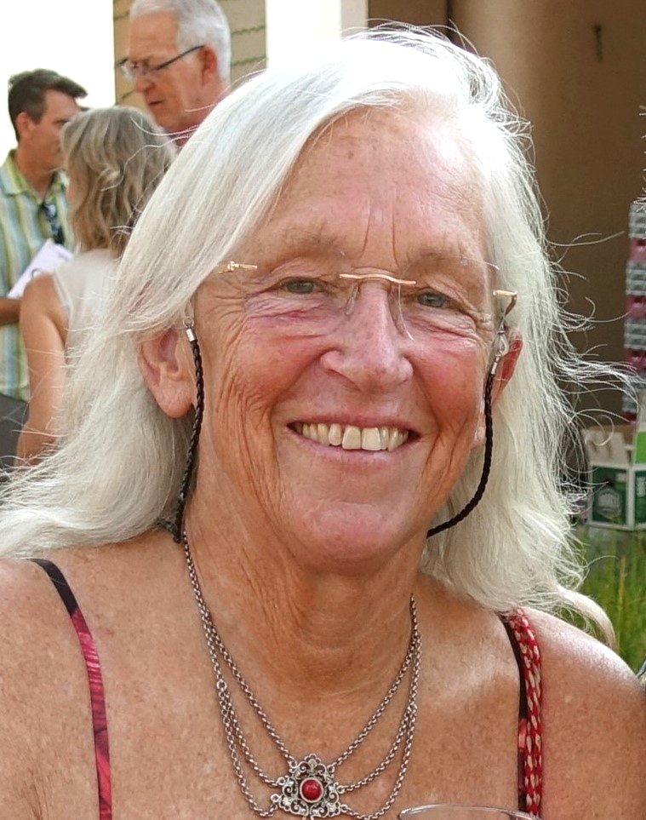
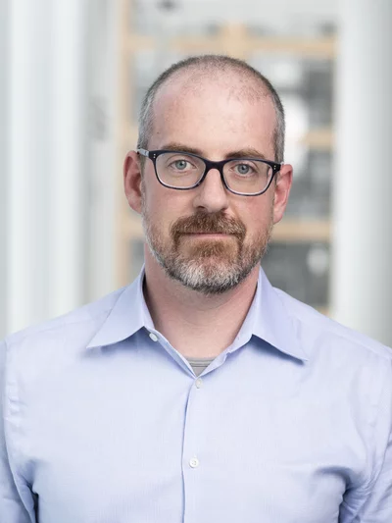
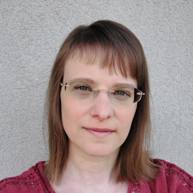
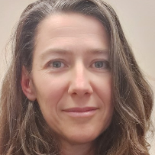
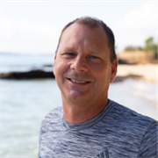
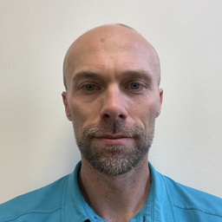
Public event on large seismoacoustic events
Hunga Tonga-Hunga Ha’apai Eruption and Tsunami: a multi-phenomenon event
PANELLISTS
Peggy Hellweg
Seismological Society of America (SSA)
MODERATOR
Stefanie Donner
Federal Institute for Geosciences and Natural Resources (BGR)
Geoff Brumfiel
National Public Radio
Sara Barsotti
Icelandic Meteorological Office (IMO)
Shane Cronin
University of Auckland
David Fee
University of Alaska Fairbanks

Slide 2
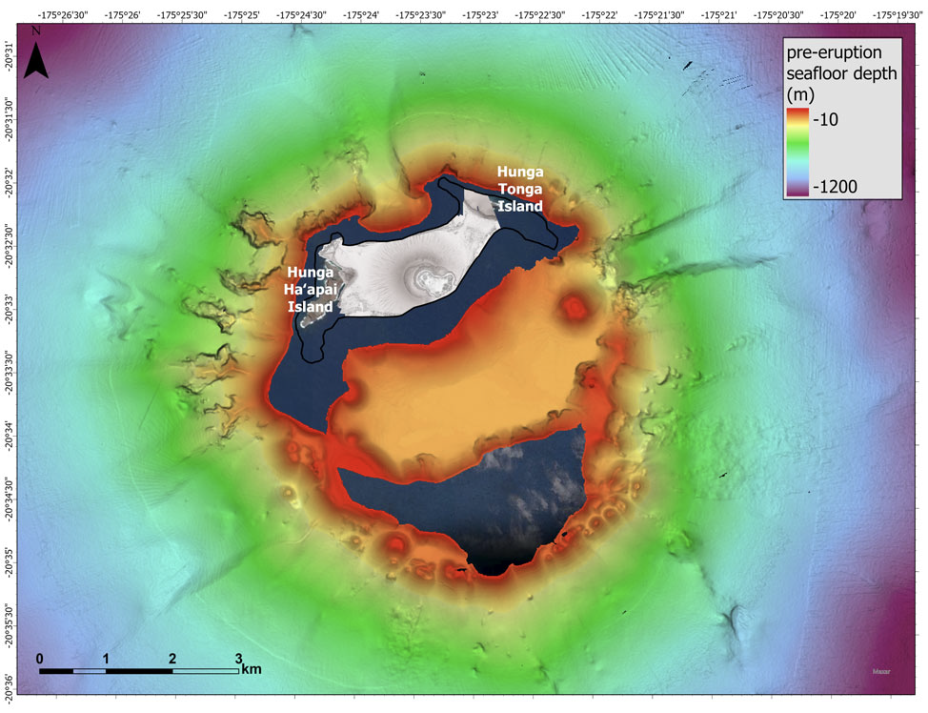

Slide 3
