Slide 1
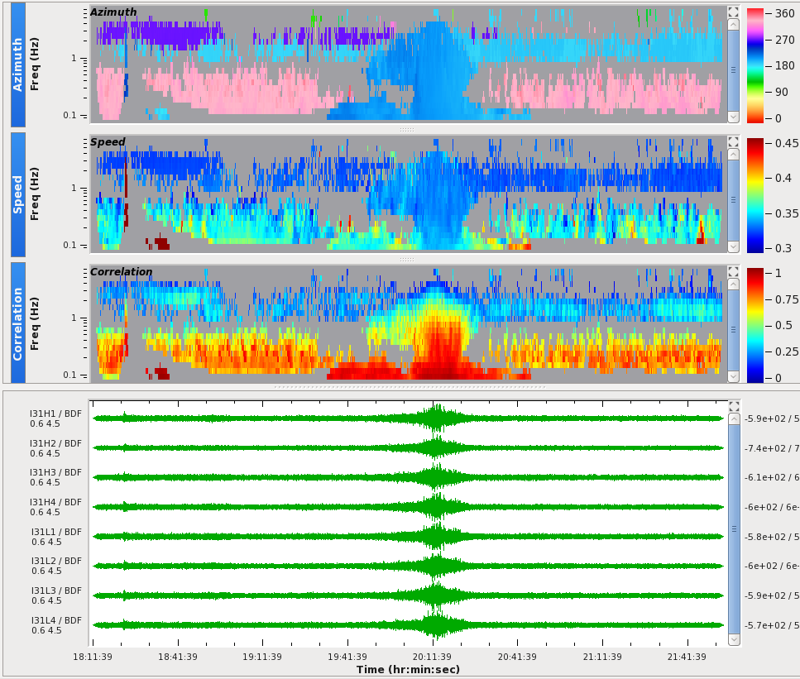
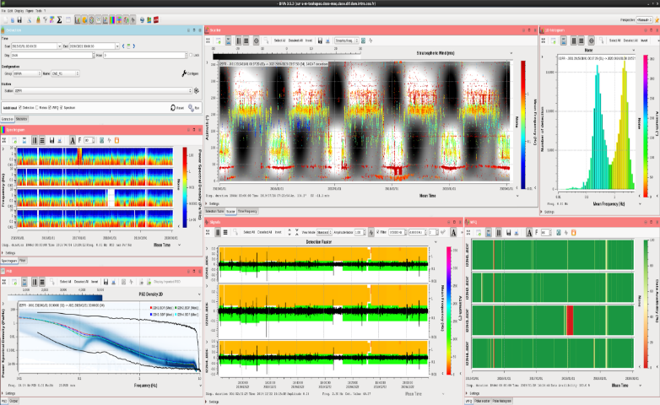
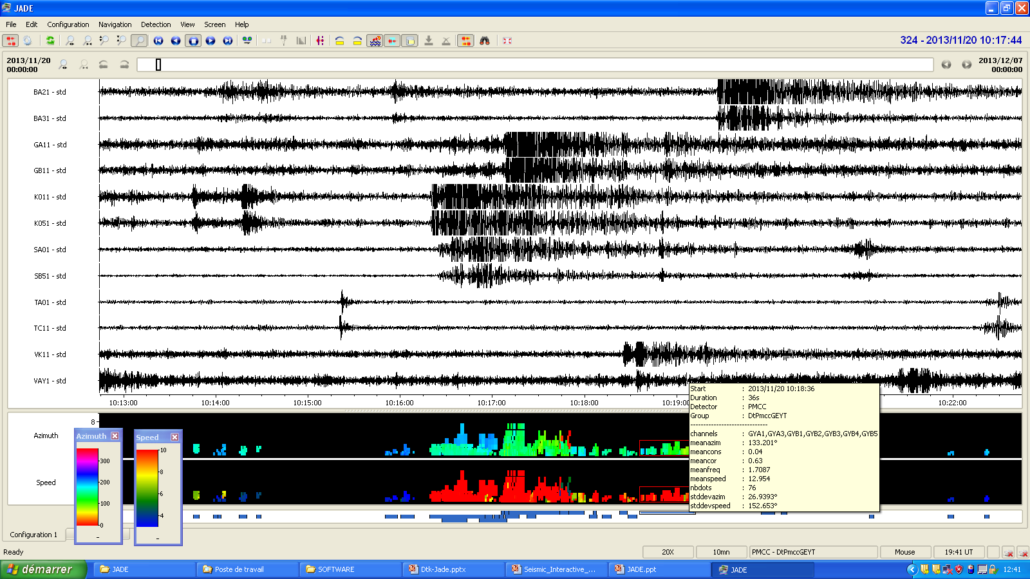
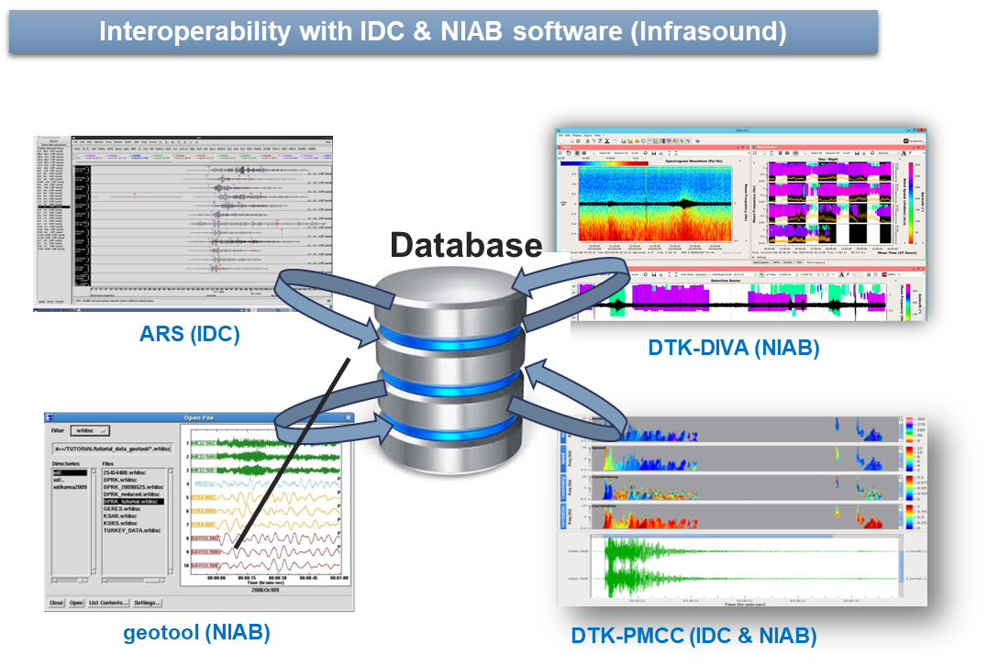
NDC in-a-Box
Improve the NDCs processing capabilities, in particular give new capability to process seismic, infrasound and hydroacoustic data
Array detector based on PMCC algorithm
Analyze the detection background of seismo-acoustic arrays over long period of time
Monitoring tool to scrutinize waveform signals and detections

