Slide 1
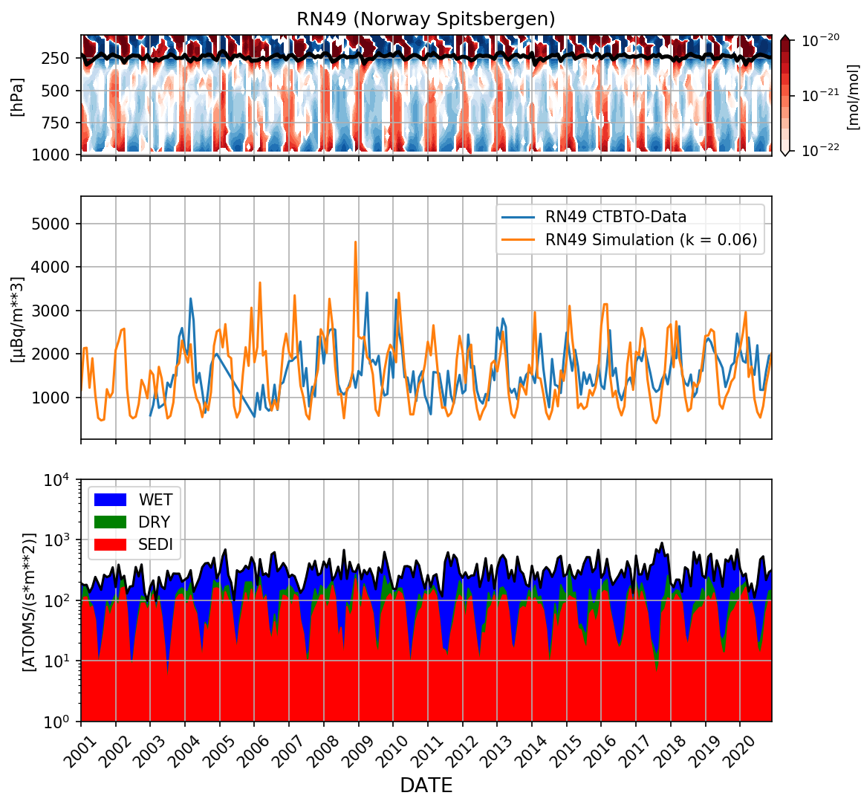
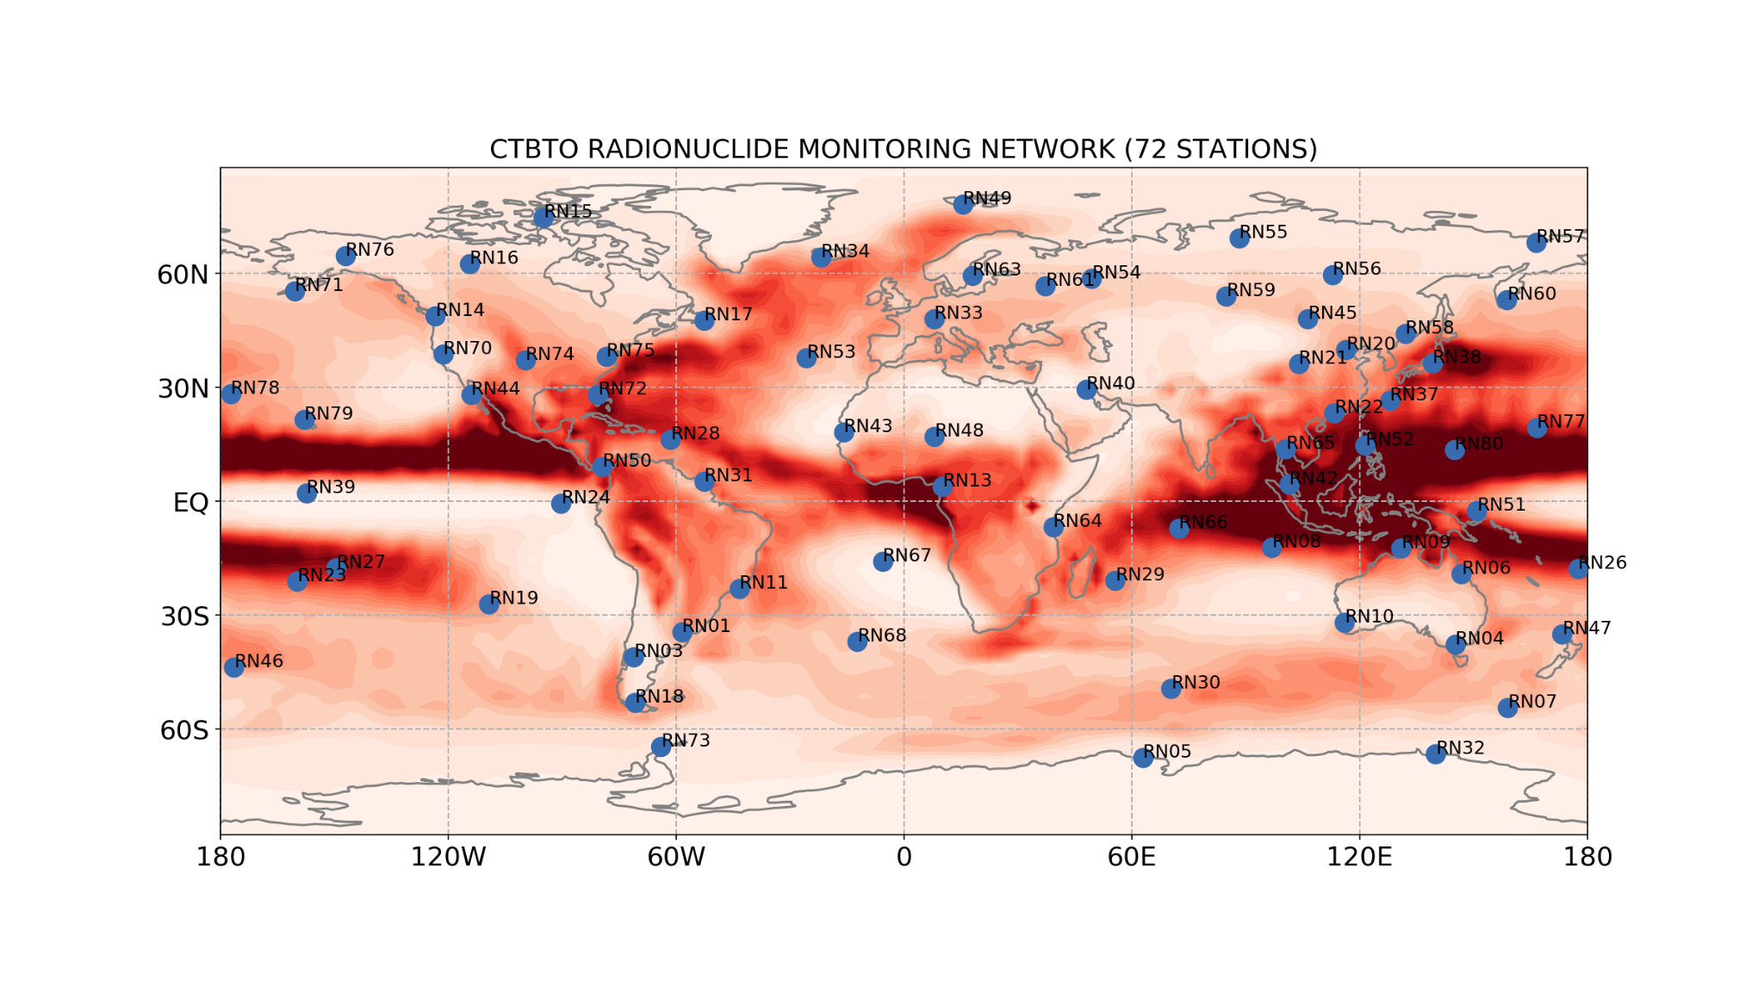
Simulation of the Atmospheric Transport of Beryllium-7 with an Earth System Model and Comparison to CTBTO Radionuclide Monitoring Network Data
KONSTANTIN SCHAAR, TOBIAS SPIEGL, ULRIKE LANGEMATZ
Freie Universität Berlin // Institut für Meteorologie
P1.1-158
ECHAM5/MESSy SIMULATION
TRANSIENT SIMULATIONS
1850-2100 (SSP3.7) WITH Be-7
FROM GALACTIC COSMIC RAY
COMPARED TO RADIONUCLIDE MONITORING DATA OF NEAR-GROUND Be-7
CTBTO DATA OF NEAR GROUND Be-7 HAS BEEN INVESTIGATED E.G. BY TERZI ET AL. 2017 SHOWING Be-7 CAN BE A PROXY FOR LARGE-SCALE ATMOSPHERIC CIRCULATION DYNAMICS → MODELING TRANSPORT AND DEPOSITION OF Be-7 FROM GALACTIC COSMIC RAYS (GCR)
FIRST STEP: COMPARE SIMULATIONS TO CTBTO RADIONUCLIDE MONITORING NETWORK DATA TO EVALUATE MODELING APPROACH → LEARN ABOUT THE TRANSPORT AND DEPOSITION OF Be-7 AND BETTER UNDERSTAND THE DATA
RESULT: GOOD AGREEMENT BETWEEN SIMULATIONS AND THE CTBTO RADIONUCLIDE MONITORING NETWORK DATA DEMONSTRATES THAT MODELING APPROACH IS REASONABLE → CONTINUE SIMULATIONS AND ANALYSIS OF THE MODEL OUTPUT

