Slide 1
Simulation of the Atmospheric Transport of Beryllium-7 with an Earth System Model and Comparison to CTBTO Radionuclide Monitoring Network Data
Konstantin Schaar, Tobias Spiegl, Ulrike Langematz
Freie Universität Berlin // Institut für Meteorologie
We model the atmospheric transport and deposition of Be-7 with EMAC and compare the results to CTBTO radionuclide monitoring network data for near ground Be-7 to validate our simulations and extend the understanding of the data.
Simulations were carried out with EMAC, a climate chemistry model (CCM) based on ECHAM5 with the “Modular Earth Submodel System” (MESSy) interface. Tracers are described as aerosols with different size distributions. GCR-production rates for Be-7 were provided by Dr. Tatsuhiko Sato.
The comparison of our simulations with the CTBTO radionuclide monitoring network data shows a good qualitative agreement. Depending on the respective station of the network compared to our results, differences, especially due to the impact of wet deposition, can be found.
The good agreement between the data and the results of our simulations shows that our modeling approach is capable of reproducing the complex atmospheric transport and deposition of Be-7 and thus is a valid starting point for further simulations and analysis e.g. to evaluate the potential of Be-7 radionuclide data as a proxy for large scale atmospheric circulation dynamics under changing conditions.
Please do not use this space, a QR code will be automatically overlayed
P1.1-158

Slide 2
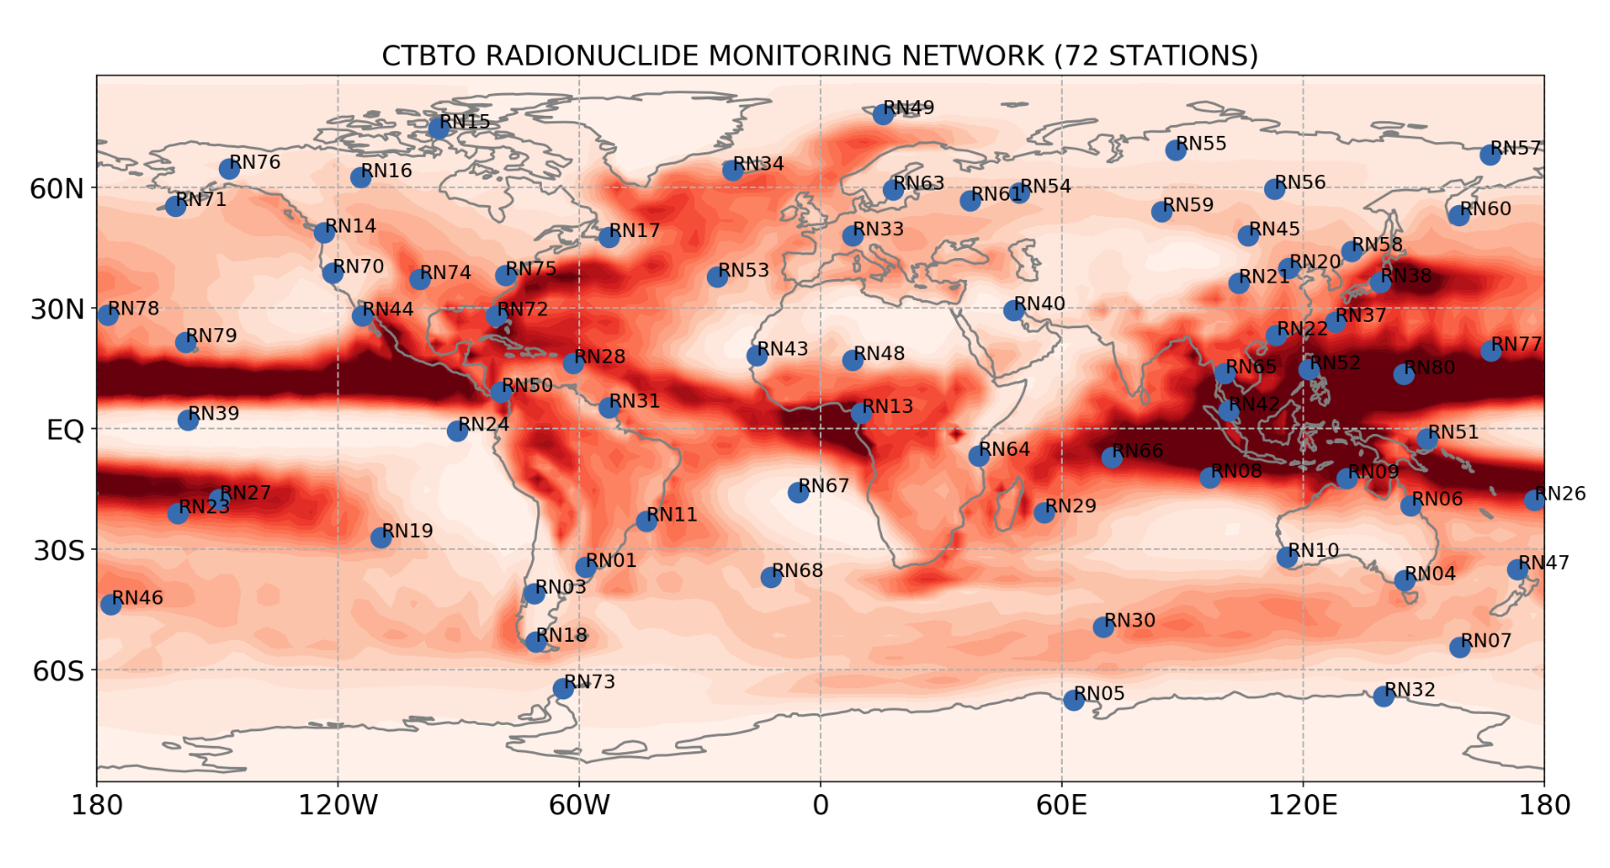
INTRODUCTION
CTBTO RADIONUCLIDE MONITORING NETWORK MEASURES NEAR GROUND Be-7 CONCENTRATION
DATA OF THIS KIND HAS BEEN INVESTIGATED E.G. BY TERZI ET AL. 2017 SHOWING Be-7 CAN BE A PROXY FOR LARGE-SCALE ATMOSPHERIC CIRCULATION DYNAMICS [1]
MODELING THE DATA WITHIN COPROX - COSMOGENIC ISOTOPES AS PROXIES OF SOLAR ACTIVITY AND ATMOSPHERIC DYNAMICS
Please do not use this space, a QR code will be automatically overlayed
[1] see e.g. L. Terzi, M. Kalinowski “World-wide seasonal variation of Be-7 related to large-scale atmospheric circulation dynamics” (2017) or L. Terzi et al. “Radioisotopes demonstrate changes in global atmospheric circulation possibly caused by global warming” (2020)
P1.1-158

Slide 3
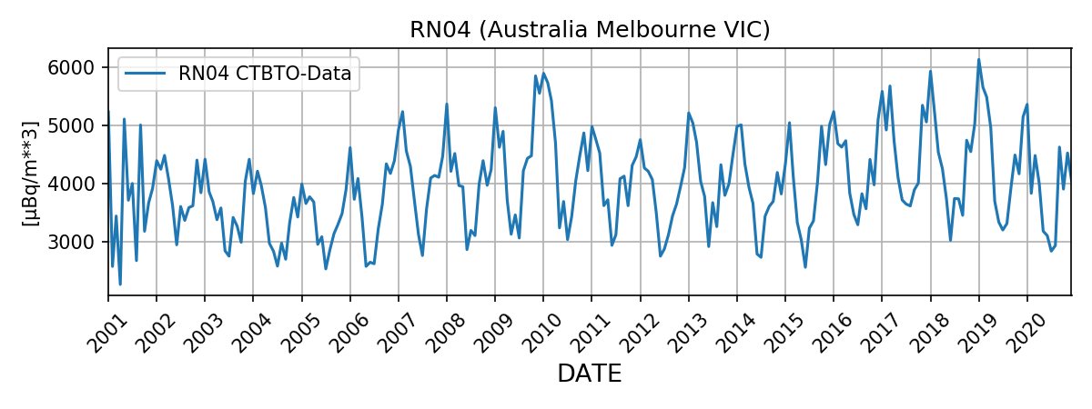
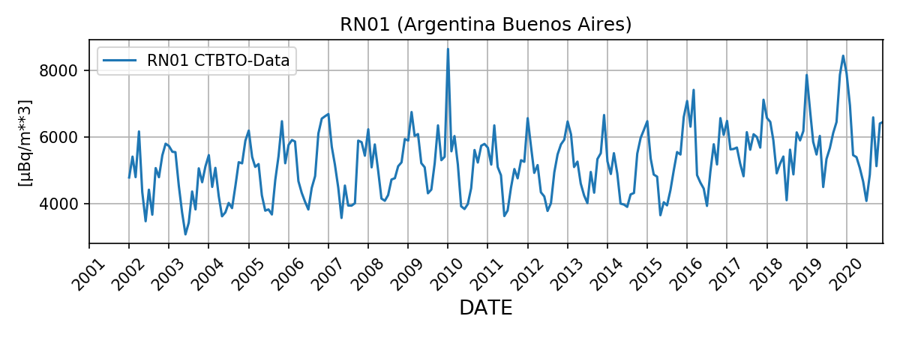
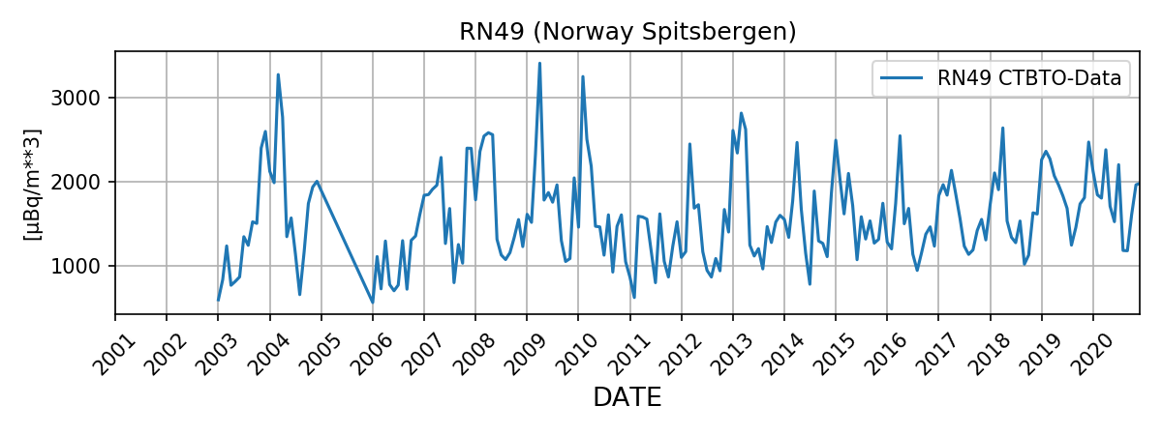
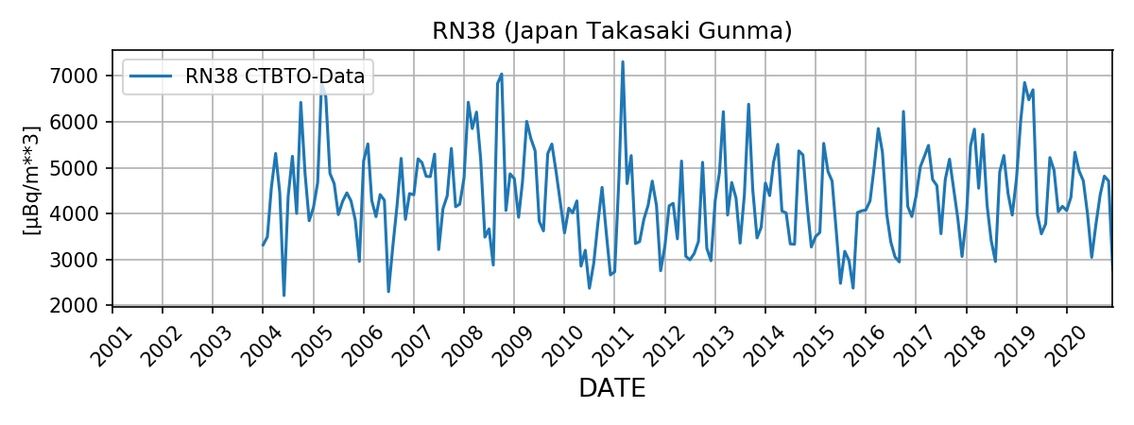
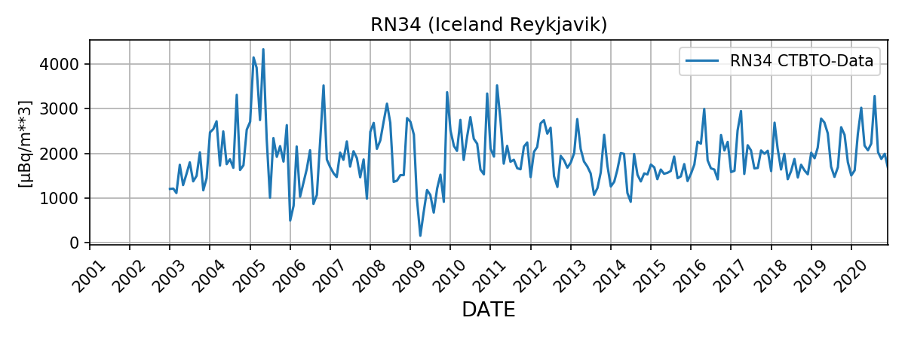
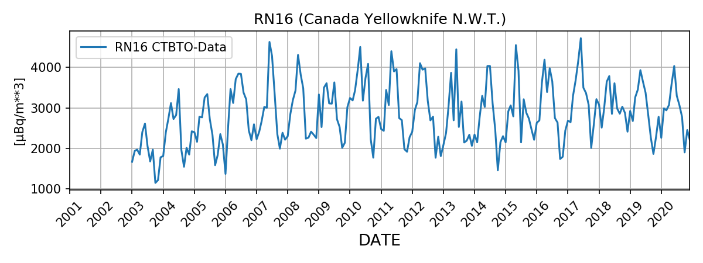
OBJECTIVES
CTBTO RADIONUCLIDE MONITORING NETWORK DATA OF NEAR-GROUND Be-7 FROM DIFFERENT STATIONS
COMPARE SIMULATIONS TO CTBTO RADIONUCLIDE MONITORING NETWORK DATA TO EVALUATE MODELING APPROACH
LEARN ABOUT THE TRANSPORT AND DEPOSITION OF Be-7 AND BETTER UNDERSTAND THE DATA
PERSPECTIVE: INVESTIGATE THE FULL POTENTIAL OF Be-7 AS PROXY FOR LARGE-SCALE ATMOSPHERIC CIRCULATION DYNAMICS E.G. UNDER THE ASPECT OF CLIMATE CHANGE
Please do not use this space, a QR code will be automatically overlayed
P1.1-158

Slide 4
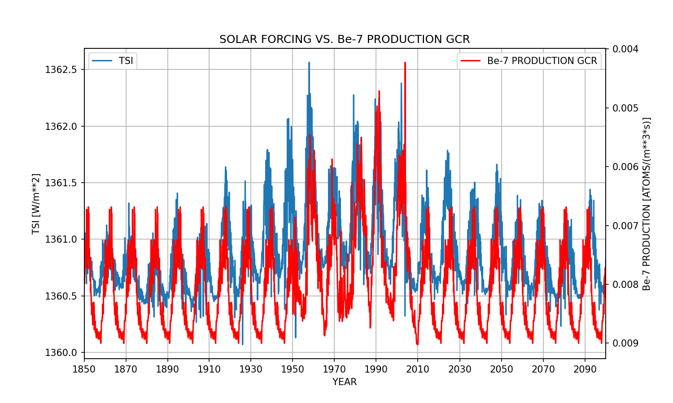
METHODS/DATA
TRANSIENT SIMULATIONS FOR PERIOD 1850-2100 (SSP3.7) WITH EMAC A CCM BASED ON ECHAM5 WITH THE “MODULAR EARTH SUBMODEL SYSTEM” (MESSy)
Be-7 PRODUCTION FROM GCR VARIES IN TIME DUE TO SCHWABE CYCLE [2]
TRACER Be-7 IS DESCRIBED AS AEROSOLS OF DIFFERENT SIZE DISTRIBUTIONS IN STRATOSPHERE AND TROPOSPHERE [3]
R_{S} = 0.1 μm S_{S} = 1.4
R_{T} = (0.1-1.0) μm S_{T} = 2.0
Please do not use this space, a QR code will be automatically overlayed
[2] GCR productions rates calculated by Dr. Tatsuhiko Sato using the Particle and Heavy Ion Transport code System (PHITS) based Analytical Radiation Model in the Atmosphere (PARMA) (see https://phits.jaea.go.jp/expacs/ and https://phits.jaea.go.jp/ for further information)
[3] E.Malinina et al. “Aerosol particle size distribution in the stratosphere retrieved from
SCIAMACHY limb measurements” (2018)
P1.1-158

Slide 5
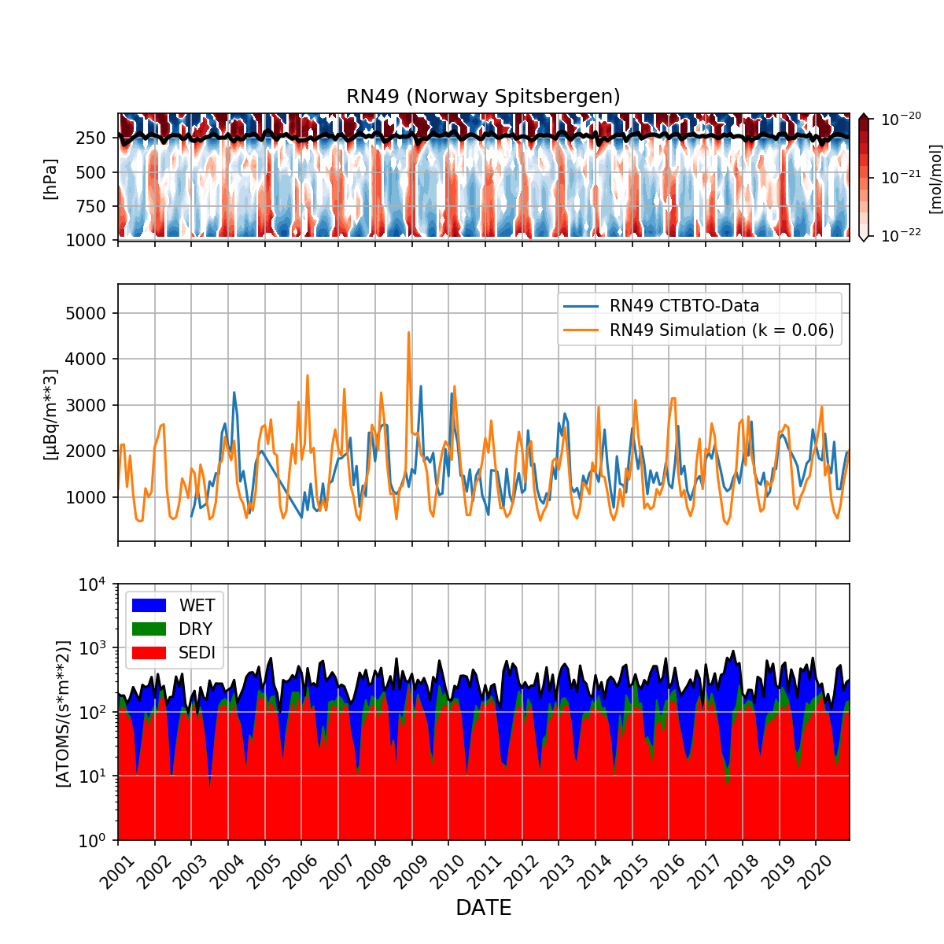
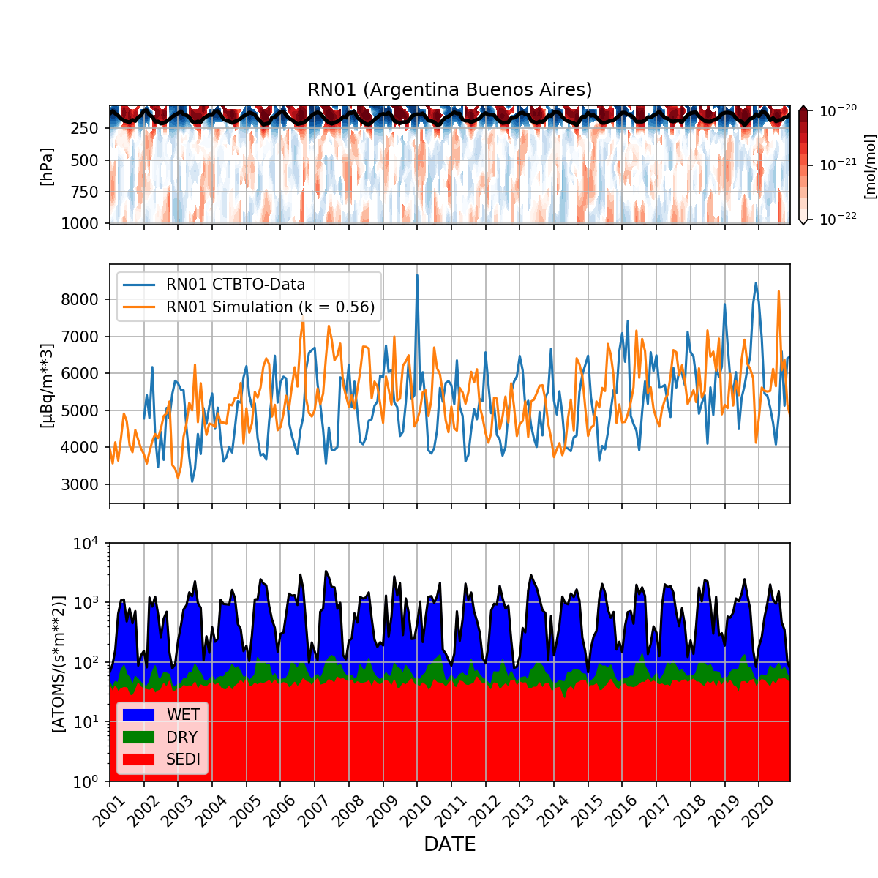
RESULTS
COMPARISON OF SIMULATIONS AND CTBTO RADIONUCLIDE MONITORING NETWORK DATA FOR RN49 (NH) and RN01 (SH).
TOP: AMOUNT FRACTION Be-7 OVER HEIGHT. MIDDLE: COMPARISON OF DATA TIME SERIES TO SIMULATION. BOTTOM: SURFACE FLUX FOR WET AND DRY DEPOSITION AND SEDIMENTATION AT THE STATION.
Please do not use this space, a QR code will be automatically overlayed
P1.1-158

Slide 6
CONCLUSION
GOOD AGREEMENT BETWEEN SIMULATIONS AND THE CTBTO RADIONUCLIDE MONITORING NETWORK DATA DEMONSTRATES THAT MODELING APPROACH IS REASONABLE
WET DEPOSITION CAN HAVE AN ESSENTIAL IMPACT ON THE Be-7 MEASUREMENT BY WASHING OUT TRACERS, LEADING TO MINIMA IN THE TIME SERIES
NON-WET DEPOSITION (DRY DEPOSITION, SEDIMENTATION) CAN BE PROXIED BY THE DATA WHEN WET DEPOSITION IS LOW
FURTHER ANALYSIS IS REQUIRED TO DEEPEN THE UNDERSTANDING OF THE MODEL OUTPUT AS WELL AS THE DATA E.G. TO EVALUATE THE IMPACT OF CLIMATE CHANGE ON THE DEPOSITION AND TRANSPORT OF Be-7
Please do not use this space, a QR code will be automatically overlayed
Disclaimer: The views expressed in this study are those of the authors and do not necessarily represent the views of the CTBTO Preparatory Commission. The IMS radionuclide data are available directly from the CTBTO upon request and signing a confidentiality agreement to access the virtual Data Exploitation Centre (vDEC, https://www.ctbto.org/resources/for-researchers-experts/vdec).
P1.1-158

