Slide 1
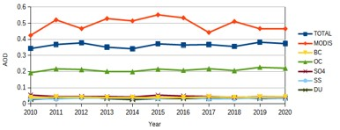
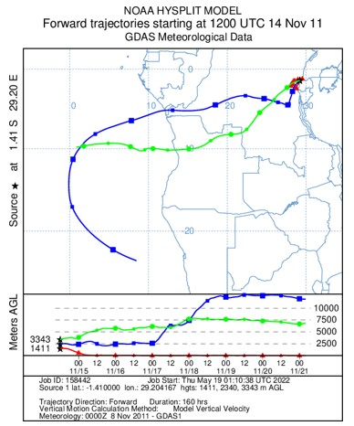
Assessment of aerosols over five cities of Angola based on MERRA–2 reanalysis data
Pascoal M. D. Campos¹, José C.M. Pires, Anabela A. Leitão
1- National Center for Scientific Research (CNIC), Luanda, Angola (micolo.campos@gmail.com)
P1.1-767
1. INTRODUCTION
2. RESULTS
3. CONCLUSION
The use of Aerosol Optical Depth (AOD) has been proven as a feasible alternative to the traditional ground-level monitoring of air quality in many countries across the world. Consequently this study based on MERRA-2 data aims to:
(i) to characterise the spatiotemporal and vertical variations of aerosols in the atmosphere over the capital cities of the five most densely populated provinces of Angola; (ii) to analyse the relationship between the monthly mean variation of the total AOD and the meteorological parameters (precipitation, temperature, wind speed, and relative humidity) in the five cities chosen for this research; (iii) to study the possible influence of emissions from the Nyamuragira volcano, located in the Democratic Republic of Congo, on the air quality in the five selected cities.
In all the cities, organic carbon was the major source of the total amount of AOD, with Luanda having the highest levels.
This study made it possible to draw the conclusion that the variability of AOD loading varies on seasons and places, adding some more knowledge to the issue.
This study contributed to the increment in the knowledge of aerosol's behaviours in several cities of Angola, which information is relevant for the definition of future national air quality policies.

