Slide 1
Assessment of aerosols over five cities of Angola based on MERRA–2 reanalysis data
Pascoal M. D. Campos¹, José C.M. Pires, Anabela A. Leitão
1- National Center for Scientific Research (CNIC), Luanda, Angola (micolo.campos@gmail.com)
The control of the aerosols is essential to eliminate or mitigate the negative impacts on the environment and humans.
The use of Aerosol Optical Depth (AOD) has been proven as a feasible way to monitor the air quality.
The different aerosol species over the period of 2010-2020 in the capital cities of the five most densely populated provinces in Angola were analysed.
NASA's Earth science data sets (MERRA-2 Reanalysis and CALIPSO), and NOAA (HYSPLIT) were used.
The time-series of yearly average of the total AOD for the period 2010-2020, had the highest value in Luanda, among all the cities studied.
In November 2011, air masses from Nyamuragira volcano reached Luanda and Sumbe.
The most significant contribution to the total AOD, in all the cities, was derived from organic carbon.
This study may contribute to a better understanding of the aerosols in the country and the use of such knowledge by all stakeholders related to environmental issues.
Please do not use this space, a QR code will be automatically overlayed
P1.1-767

Slide 2
Introduction
Aerosols are defined as solid or liquid particles suspended in the atmosphere by natural origin, such as desert dust and sea salts, or anthropogenic causes through vehicular and industrial emissions, bushfires, and agricultural practices.
These particles can have sizes from the nanometer to a millimetre scale. The scattering and absorption of solar radiation by the aerosols impact the climate, and these particles can also influence negatively human health.
Therefore, the control of the aerosols is essential to eliminate or mitigate the negative impacts on the environment and humans; however, many developing countries lack air quality monitoring networks.
The use of Aerosol Optical Depth (AOD) has been proven as a feasible and cheap alternative to the traditional ground-level monitoring of air quality and assessment of potential health risks in many countries across the world, as stated by several studies.
Please do not use this space, a QR code will be automatically overlayed
P1.1-767

Slide 3
Objectives
The study aims:
to study a 10 year MERRA-2 AOD product aerosol (black carbon, dust, sea-salt, sulphates and organic carbon) profile data to characterize the spatio-temporal and vertical variations of aerosol in the atmosphere over the capital cities of the five most densely populated provinces of Angola;
to analyse the relationship between the monthly mean variation of the total AOD and the meteorological parameters (precipitation, temperature, wind speed, and relative humidity) in the five cities chosen for this research;
to study the possible influence of emissions from the Nyamuragira volcano, located in the Democratic Republic of Congo, on the air quality in the five selected cities.
As far as it is known, this may be the first study on this subject in Angola; therefore, this research contributes to the knowledge and understanding of the aerosols over cities in this country.
Please do not use this space, a QR code will be automatically overlayed
P1.1-767

Slide 4
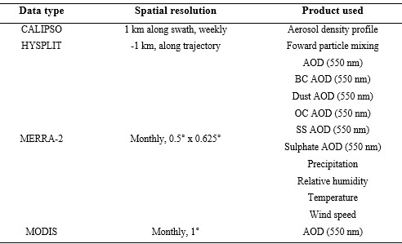
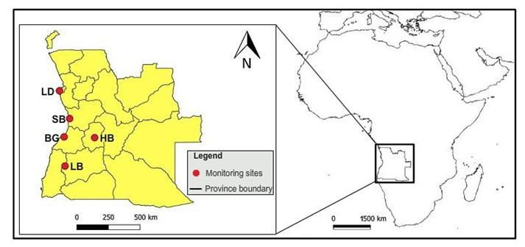
Methods/data
Study area
Summary of datasets used in this study
Angola is located in southwestern Africa, covering an area of 1 246 700 km². Luanda is the capital province of Angola and has a population number of 6.9 million, which represents 27% of the country´s population.
AOD: aerosol optical depth; BC: black carbon; OC: organic carbon; SS: sea salt; HYSPLIT: Hybrid Particle Lagrangian Dispersion Model; MERRA-2: Modern-Era Retrospective Analysis for Research and Applications, Version 2; MODIS: Moderate Resolution Imaging Spectroradiometer; CALIPSO: Cloud-Aerosol Lidar and Infrared Pathﬁnder Satellite Observation.
Please do not use this space, a QR code will be automatically overlayed
Fig. 1. A map of Angola showing the location of the five cities (BG - Benguela, HB - Huambo, LB - Lubango, LD - Luanda, SB -Sumbe) investigated in the present study.
P1.1-767

Slide 5
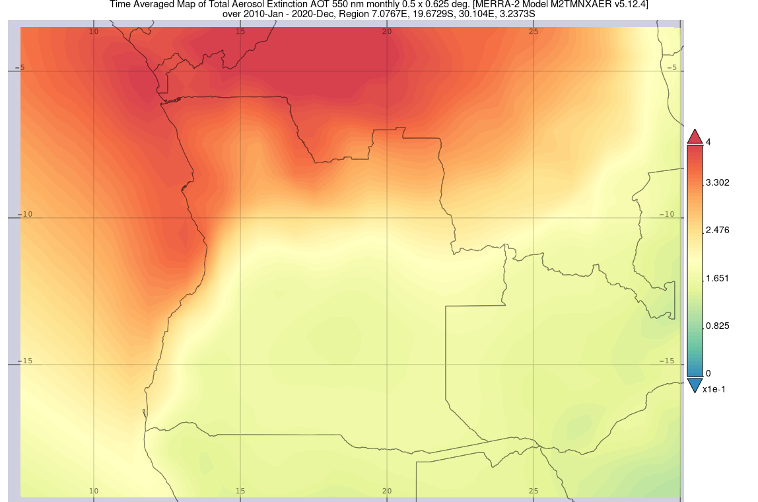
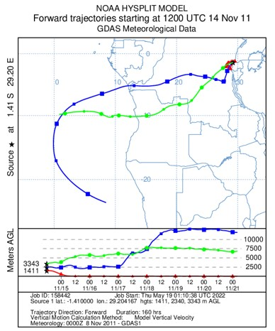
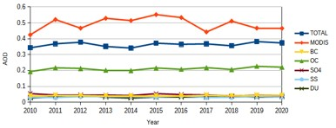
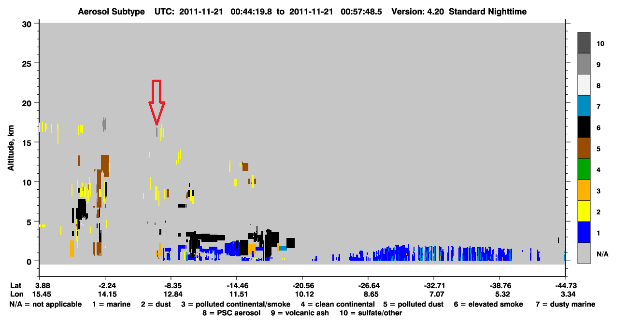
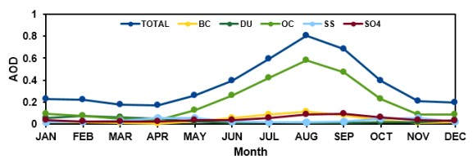
Results
An eruption of the volcano Nyamuragira started on November 6, 2011 and stopped approximately on March 12, 2012. In that month there was an increase in sulphate in all the cities studied, where Luanda registered the highest loading (0.091).
Fig. 2. Time-average map of a region encompassing Angola showing total aerosol extinction, aerosol optical depth (AOD) at 550 nm, monthly 0.5◦ × 0.625◦, MERRA-2 Model, over January 2010–December 2020.
A seven day forward HYSPLIT model confirmed that within 140 h from the emissions on November 14, 2011, air masses at an altitude of 5000 m from the Nyamuragira volcano crossed Luanda and Sumbe.
Vertical feature mask and aerosols subtypes profile obtained on the November 21, 2011 in Luanda. On that date, volcanic aerosols near the city was visible, at altitudes between 15 and 20 km, which could have been originated from the Nyamuragira volcanic eruption.
Please do not use this space, a QR code will be automatically overlayed
Fig. 3. Time series of the (a) yearly and (b) monthly averaged aerosol optical depth AOD of black carbon, dust, organic carbon, sea salt, sulfates and total AOD from 2010 to 2020 for the city of Luanda retrieved by MERRA-2.
P1.1-767

Slide 6
Conclusion
In all the cities, organic carbon was the major source of the total amount of AOD, with Luanda having the highest levels (0.19–0.23). The data from the emissions inventory showed that sulphate ranges were higher in coastal cities than in interior areas. All the cities had an increase in AOD value, which peaked during the dry season.
Sea salt aerosol loading decreases as we approach south, maybe due to wind speed and direction from the sea to the land.
In November 2011, air masses from Nyamuragira reached Luanda and Sumbe at varied heights, according to the HYSPLIT model, and CALIPSO was able to corroborate the presence of volcanic aerosols during this time.
This study made it possible to draw the conclusion that the variability of AOD loading varies on seasons and places, adding some more knowledge to the issue.
This study contributed to the increment in the knowledge of aerosol's behaviours in several cities of Angola, which information is relevant for the definition of future national air quality policies.
Please do not use this space, a QR code will be automatically overlayed
P1.1-767

