Slide 1
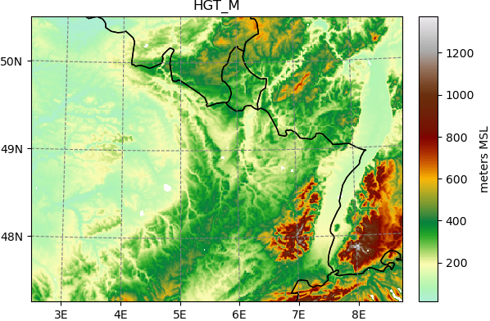
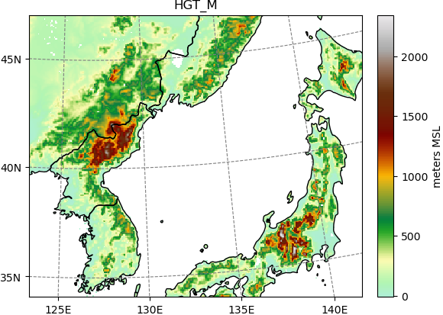
On the Importance of High-Resolution Atmospheric Transport Modelling in the case
of Receptor Stations Being Close to the Source in Complex Terrain
Anne Tipka, Robin Schoemaker, Jolanta Kusmierczyk-Michulec, Martin Kalinowski
CTBTO Preparatory Commission / International Data Centre
P1.1-506
Problem:
Hitting a receptor or missing a source with Atmospheric Transport Modelling
Reason:
Small scale meteorological features become important in complex terrain
IRE
Come see me during e-poster session 1.1 on Thursday 22nd to learn more.
Or access it online on the SnT2023 Conference platform!
DEX33
RN58
DPRK

