Slide 1
On the Importance of High-Resolution Atmospheric Transport Modelling in the case of Receptor Stations Being Close to the Source in Complex Terrain
Anne Tipka, Robin Schoemaker, Jolanta Kusmierczyk-Michulec, Martin Kalinowski
CTBTO Preparatory Commission / International Data Centre
Transport pathways of emissions from source locations in complex terrain are, among other things, strongly influenced by small-scale features.
Comparing the use of a variation of meteorological input data (different spatial resolution and met models) and atmospheric transport models to demonstrate the influence of small-scale meteorological features.
Two case studies demonstrate the improved value of using mesoscale ATM with higher spatial resolution over complex terrain.
Using higher resolution meteorological input data, especially in complex terrain, improves the accuracy of transport pathways.
Please do not use this space, a QR code will be automatically overlayed
P1.1-506

Slide 2
Introduction
The Preparatory Commission for the Comprehensive Nuclear-Test-Ban Treaty Organization (CTBTO) identifies possible source regions of nuclear explosions with relevant radioactive substances measured from samples taken at International Monitoring Stations (IMS). These possible source regions also identify IMS stations as a potential receptor of a possible nuclear explosion.
Atmospheric transport modelling (ATM) is used to track the movement of radioactive substances in the atmosphere and serves as the essential tool to link sources and receptors.
Transport pathways (TP) and dispersion of such emitted substances strongly depends on surrounding conditions, such as wind patterns and any kind of local atmospheric dynamics.
Global ATM simulations using reasonable coarse resolutions (0.5°) from numerical weather models are usually capable of reproducing observations quite well for flat terrain, e.g. frontal systems.
P1.1-506
Please do not use this space, a QR code will be automatically overlayed

Slide 3
Objectives
However, meteorological smaller scale becomes important when complex topography and its local wind patterns, which are superimposed on large-scale winds, are considered.
This requires higher resolution modelling to improve the localization of transported quantities by considering effects of convective vertical transport, turbulent phenomena and special effects due to elevations, coastlines, textures as forests and cities, etc., and the fact that e.g. mountains are smoothed on coarser grids causing pathways to be distorted.
This case study demonstrates the higher quality of high-resolution ATM and how using meteorological data of higher resolution improves the accuracy of transport pathways.
P1.1-506
Please do not use this space, a QR code will be automatically overlayed

Slide 4
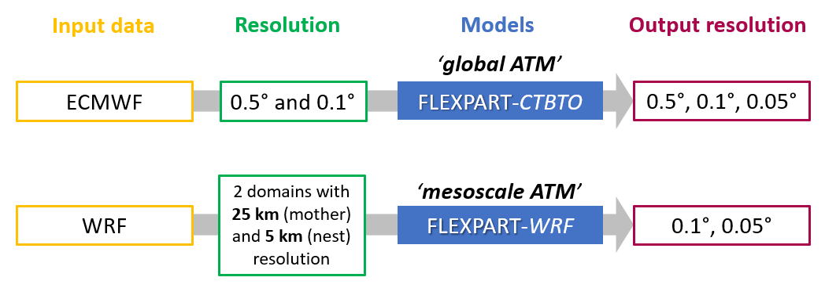
Methods 1/3
Investigate different weather models (ECMWF, NCEP, WRF) as meteorological input for the atmospheric transport model FLEXPART.
Conduct case studies on combinations of input and output spatial resolutions for FLEXPART.
Compare results from different versions of the ATM Flexpart model, e.g., FLEXPART and FLEXPART-WRF.
Compare IMS detections with simulated concentrations.
P1.1-506
Please do not use this space, a QR code will be automatically overlayed

Slide 5
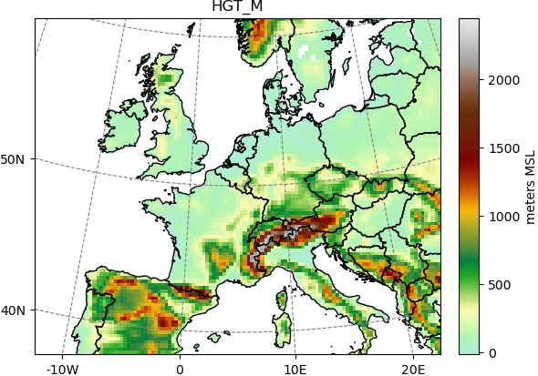
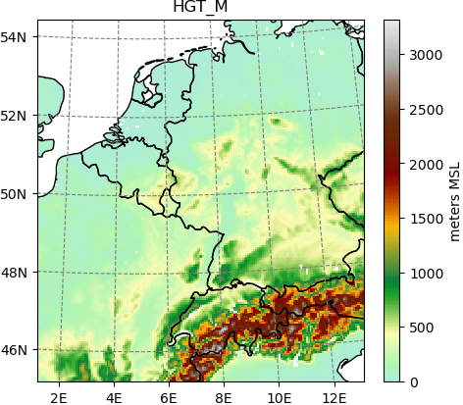
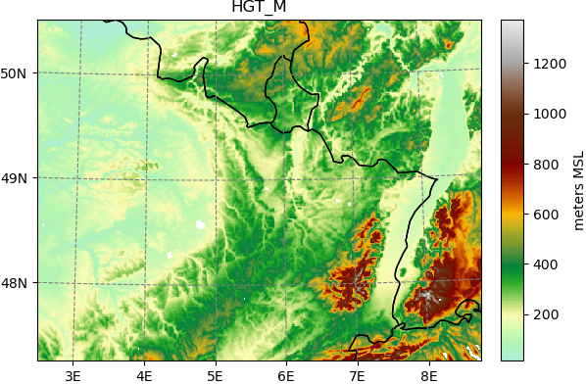
Methods 2/3
Case Study 1 –
IRE/DEX33
For the IRE/DEX33 study, a mother domain with two nested domains was defined for WRF (i.e., D01 = 50 km, D02 = 5 km and D03 = 1 km)
IRE
DEX33
The setup of the first ATM challenge is used for a comparison of past coarse global ATM results with higher resolution.
Emissions from the isotope production facility (IPF) in Belgium (IRE) and measurements at the IMS station (DEX33) close to Freiburg, Germany during Nov/Dec 2013 were collected, and ATM was used to link emissions with measurements.
P1.1-506
Please do not use this space, a QR code will be automatically overlayed

Slide 6
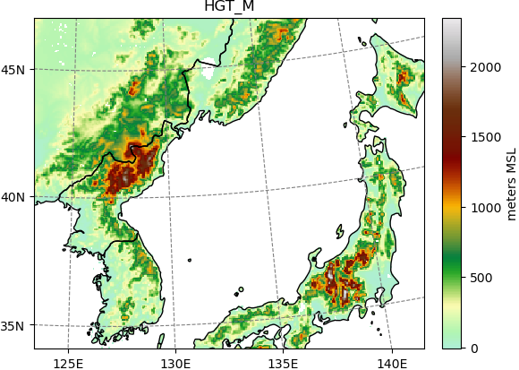
Methods 3/3
The Democratic People’s Republic of Korea (DPRK) executed 6 announced nuclear tests at the Punggye-ri Nuclear Test Site. These tests are of high importance to the CTBTO as case studies for evaluating the ability of localization.
The Test Site is in a complex, mountainous area as indicated in in the right figure. Accounting for local atmospheric dynamics in the lower planetary boundary layer by using higher resolution modelling can have a reasonable effect on the results.
Case Study 2 - DPRK
RN58
DPRK
P1.1-506
Please do not use this space, a QR code will be automatically overlayed

Slide 7
Results 1/2
Case Study 1 - IRE/DEX33
 |  | NCEP |  |  |  |  |  | ECMWF
DATE | OBS DEX33 | Global ATM Input: 0.5° Output: 0.5° |  |  | Mesoscale ATM Input: ~9km Output: ~9km |  |  | Mesoscale ATM Input: ~10km Output: 0.1° |  |  | Mesoscale ATM Input: ~1km Output: 0.01°
 | [mBq] | other | stack release | sum | other | stack release | sum | other | stack release | sum | other | stack release | sum
27-Nov | 0.16 | 0.30 | 0.00 | 0.30 | 0.02 | 0.00 | 0.02 | 0.02 | 0.00 | 0.02 | 0.04 | 0 | 0.04
28-Nov | 0.09 | 1.95 | 0.00 | 1.95 | 0.00 | 0.00 | 0.00 | 0.06 | 8.27 | 8.33 | 0 | 0 | 0
29-Nov | 26.80 | 1.52 | 52.62 | 54.14 | 0.01 | 0.55 | 0.56 | 0.15 | 1.22 | 1.37 | 0.13 | 21.76 | 21.89
30-Nov | 5.28 | 0.28 | 18.76 | 19.04 | 0.01 | 0.50 | 0.51 | 0.1 | 1.21 | 1.31 | 0.25 | 9.61 | 9.86
01-Dec | 4.18 | 0.54 | 3.69 | 4.23 | 0.00 | 0.37 | 0.37 | 0.07 | 0.23 | 0.30 | 0.09 | 2.77 | 2.77
02-Dec | 1.11 | 0.35 | 1.42 | 1.77 | 0.04 | 0.02 | 0.06 | 0.08 | 1.35 | 1.43 | 0.01 | 0.29 | 0.30
P1.1-506
The table shows a selected set of results for different spatial resolutions of meteorological input data.
The selected period coincide with a higher release at IRE.
Stack data come from IRE
Other data are from any other source in the domain
Activity concentrations are in mBq
Please do not use this space, a QR code will be automatically overlayed

Slide 8
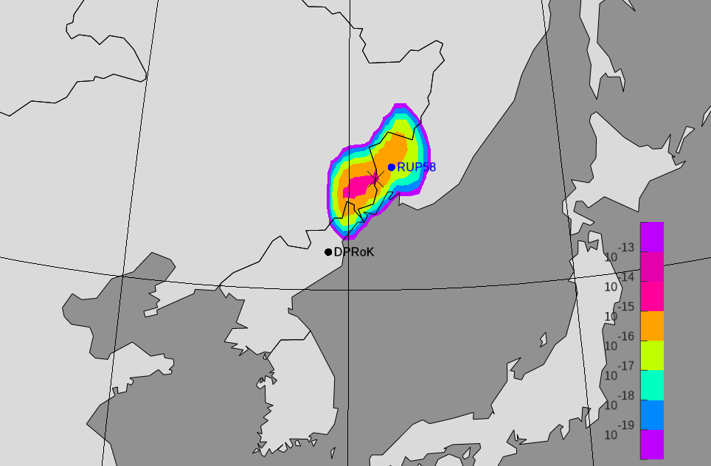
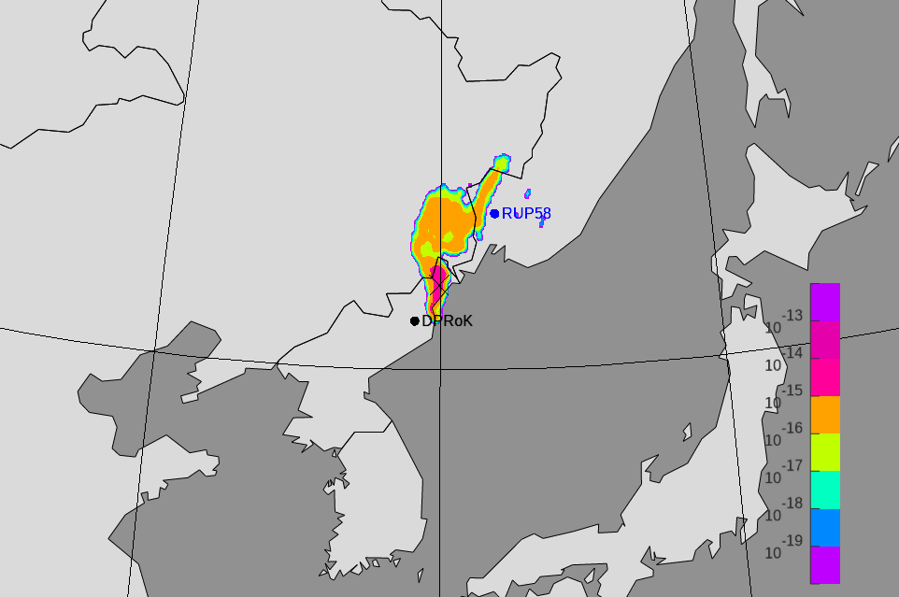
Results 2/2
Case Study 2 – DPRK
Hit or no hit
0.5° input/output resolution
0.1° input/output resolution
Global ATM simulation with ECMWF input data for the announced DPRK nuclear test in September 2017. Simulations run forward with a release from the test site and a snapshot was taken for the same time for a low resolution with 0.5° (left panel) and a high-resolution with 0.1° input and output resolution (right panel). The snapshots demonstrate the effect a complex area may have on the transport pathway and reflecting local meteorological effects.
P1.1-506
Please do not use this space, a QR code will be automatically overlayed

Slide 9
Conclusion
Using higher spatial resolution of meteorological input data has a positive impact on the transport pathway, and hence for the determination of activity concentration.
Further investigations will cover:
Further exploration of sensitivities due to physical parameterizations in WRF setups. (Mesoscale ATM fine tuning)
Additional case studies and different time periods of the Schauinsland study (seasonal variations).
P1.1-506
Please do not use this space, a QR code will be automatically overlayed

Slide 10
References
P. Eslinger, et al., “International Challenge to Predict the Impact of Radioxenon Releases from Medical Isotope Production on a Comprehensive Nuclear Test Ban Treaty Sampling Station”, J. Env. Rad. (2016)
P1.1-506
Please do not use this space, a QR code will be automatically overlayed

