Slide 1
Flights and Pandemic Influence on Chilean Infrasound stations I13CL and I14CL
Christopher Celis Huaiquilaf
Chilean Nuclear Energy Commission
During the COVID-19 pandemic, the air traffic activity was significantly reduced. This is a comparison between data from I13CL and I14CL before and during this event.
The fight log was requested from the General Directorate of Civil Aeronautics of Chile (DGAC). Using the IMS data on DTK-GPMCC for the months with less flights are compared.
Data from 2019 shows higher levels of noise compared to years with restrictions and increase again when restrictions were lifted.
Human activity has an influence on the noise levels for these stations, due to factors like tourism the air traffic was significantly less for Easter Island (I13CL) compared to Robinson Crusoe Island (I14CL). This favors the identification of flights through data available on the stations
Please do not use this space, a QR code will be automatically overlayed
P1.1-244

Slide 2
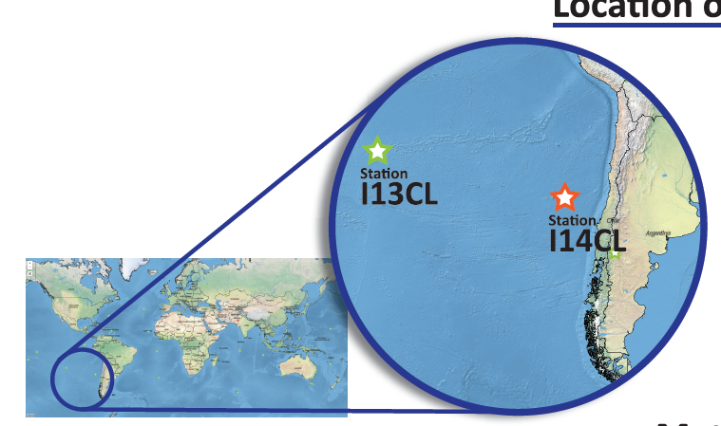
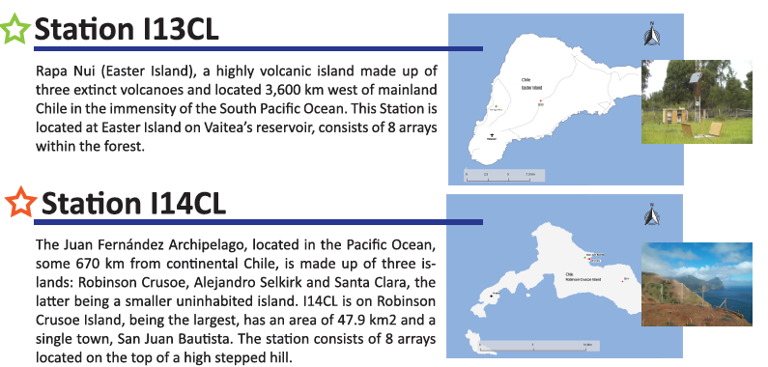
INTRODUCTION
In Chile there is 7 IMS stations, 2 of them are located West from the Continent on the Pacific Ocean.
During the COVID-19 pandemic, the air traffic activity was significantly reduced. This is considered an opportunity to perform a comparison between data from I13CL and I14CL before and during period of time when restrictions to travel to the islands were limited and health emergency procesures entry into force
Please do not use this space, a QR code will be automatically overlayed
P1.1-244
Notes:
During the COVID-19 pandemic, the air traffic activity was significantly reduced. This is considered an opportunity to perform a comparison between data from I13CL and I14CL before and during period of time when restrictions to travel to the islands were limited and health emergency procesures entry into force

Slide 3
OBJETIVES
Compare data from Rapa Nui Station I13CL and Robinson Crusoe Station I14CL before and during the health restrictions were force from 2020 to 2022, and after were lifted.
Identify the signals from the airplane's arrivals and departures from the islands.
Stablish if influence from anthropogenic lifestyle shows differences in the noise ratios.
Please do not use this space, a QR code will be automatically overlayed
P1.1-244

Slide 4
METHODOLOGY
To know the number of flights made to and from the islands during the pandemic period, the flight log for years 2019, 2020,2021 and from January to September of 2022 was kindly acquired through the General Directorate of Civil Aeronautics of Chile (DGAC).
Year | SCIP |  | Total SCIP | SCIR |  | Total SCIR | TOTAL
 | arrivals | departures |  | arrivals | departures
2019 | 747 | 746 | 1493 | 521 | 521 | 1042 | 2535
2020 | 273 | 274 | 547 | 257 | 257 | 514 | 1061
2021 | 131 | 131 | 262 | 216 | 216 | 432 | 694
2022* | 94 | 94 | 188 | 168 | 168 | 336 | 524
TOTAL | 1245 | 1245 | 2490 | 1162 | 1162 | 2324 | 4814
Table 1. Operations at Easter Island (SCIP) and Robinson Crusoe Island (SCIR). * (Jan-Sept)
It can be observed among the log that there is a clear decrease in air traffic between 2019 and the rest of the years, after reviewing this log, the flights from March-April best for the purposed of this study because in these months there were fewer flights to the islands for the years 2020, 2021 and 2022, this would make it possible to distinguish the signals of the airlines that made flights to and from the islands using the stations data on DTK-GPMCC.
Please do not use this space, a QR code will be automatically overlayed
P1.1-244
Notes:
It can be observed among the log that there is a clear decrease in air traffic between 2019 and the rest of the years, after reviewing this log, the flights from March-April best for the purposed of this study because in these months there were fewer flights to the islands for the years 2020, 2021 and 2022, this would make it possible to distinguish the signals of the airlines that made flights to and from the islands using the stations data on DTK-GPMCC.

Slide 5
RESULTS
When comparing the signals from 2019 to those years with restrictions, noise decreases and when reviewing the flight operations log, noise increases at hours when flights were conducted.
2019
2019
Station I13CL
Station I14CL
2020
2020
2021
2021
2019
Easter island is high-demand for tourist, due to restriction decrees, movement on the island on weekends was lesser than 2019.
Station I13CL on weekends
2021
Please do not use this space, a QR code will be automatically overlayed
2022
P1.1-244
Notes:
When comparing the signals from 2019 to those years with restrictions, noise decreases (Figures 3 for Rapa Nui and Figure 4 for Robinson Crusoe Island) and when reviewing the flight operations log, noise increases at hours when flights were conducted.

Slide 6
RESULTS
For Robinson Crusoe Island a progressive decrease on arrivals and departures from 2020 to 2021, the signals on these years shows less noise, but when restrictions were lifted in 2022, noise started to increase again.
On weekends the signals of the airplanes can by identify
Days with flights I13CL
2020
2019
2021
Station I14CL
Days without flights I13CL
2020
2020
2021
Please do not use this space, a QR code will be automatically overlayed
2021
2022
P1.1-244
Notes:
Easter island is high-demand for tourist, due to restriction decrees, movement on the island on weekends was lesser than 2019.

Slide 7
CONCLUSION
Human activity has an influence on the noise detected for the IMS monitoring stations, and its decrease has an impact on the noise density detected by it. After 2019, due to sanitary restrictions, the flights made were exclusively for supplies and emergencies, and considering that Easter Island is a place of high tourist demand, so by 2020 there is a 63% decrease in flights and in the year 2021 of 82%. For this reason, a decrease in noise is observed during working hours in years of sanitary restrictions. On the other hand, Robinson Crusoe has less demand, and presents a smaller decrease in flights due to restrictions and compared to 2019, 49% of flights were made in 2020, dropping to 41% in 2021.
All these factors favor the identification of landings and takeoffs through the data available thanks to these stations.
Departures and landings information from the flight logs on the islands can be useful to identify some of the sources of noise for these stations.
Please do not use this space, a QR code will be automatically overlayed
P1.1-244
Notes:
Human activity has an influence on the noise detected for the IMS monitoring stations, and its decrease has an impact on the noise density detected by it. After 2019, due to sanitary restrictions, the flights made were exclusively for supplies and emergencies, and considering that Easter Island is a place of high tourist demand, so by 2020 there is a 63% decrease in flights and in the year 2021 of 82%. For this reason, a decrease in noise is observed during working hours in years of sanitary restrictions. On the other hand, Robinson Crusoe has less demand, and presents a smaller decrease in flights due to restrictions and compared to 2019, 49% of flights were made in 2020, dropping to 41% in 2021.
All these factors favor the identification of landings and takeoffs through the data available thanks to these stations.
Departures and landings information from the flight logs on the islands can be useful to identify some of the sources of noise for these stations.

