Slide 1
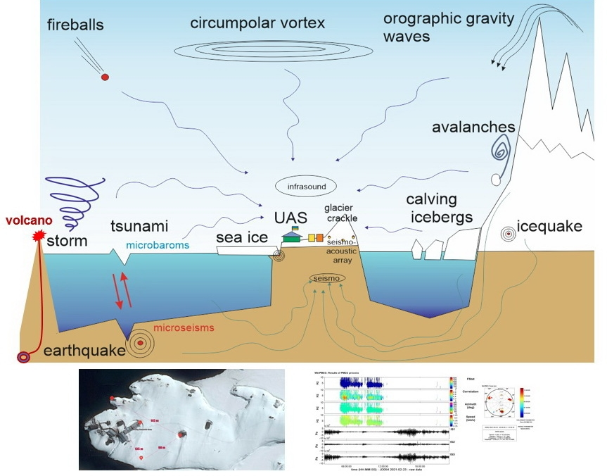
Experience of Year-Round Infrasound Observations at the Vernadsky Station, Antarctica
Oleksandr LIASHCHUK, Leonid KOLESNYKOV, Yuriy ANDRUSHCHENKO, Yuriy OTRUBA
P1.1-826
We present the small-aperture infrasound array and the result of its year-round operation in the region of the Antarctic Peninsula at the Ukrainian Antarctic Vernadsky Station (UAS Vernadsky).
Acoustic signals of various scales and energies from various sources of disturbances, including events from avalanches and iceberg calving to volcanic eruptions, were detected.
Small-aperture stations can be a promising direction of research in the Antarctic region.

