Slide 1
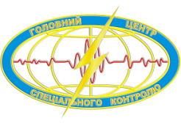


Experience of Year-Round Infrasound Observations at the Vernadsky Station, Antarctica
Oleksandr LIASHCHUK¹, Leonid KOLESNYKOV², Yuriy ANDRUSHCHENKO¹, Yuriy OTRUBA³
¹Main Centre of Special Monitoring, State Space Agency of Ukraine
²CTBTO Preparatory Commission
³State Institution National Antarctic Scientific Center
Please do not use this space, a QR code will be automatically overlayed
P1.1-826

Slide 2

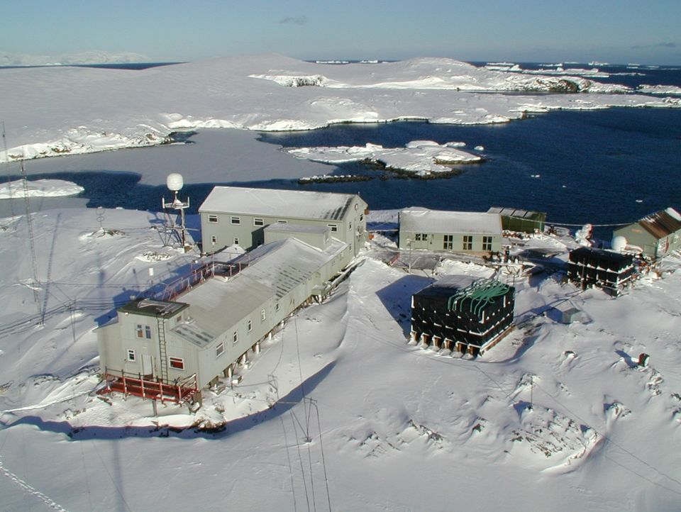
Introduction
The Ukrainian Antarctic station "Akademik Vernadsky" is equipped with a modern complex of geophysical measurements, the basis of which is continuous ozonometric, meteorological, hydrological and geomagnetic observations.
Since 2000, seismic and infrasound equipment has been located at the station, the composition of which has gradually changed. The data was provided for processing after the completion of the expedition.
However, in 2020, an extremely important event took place - permanent high-speed satellite Internet appeared, which changed the approach to measurements.
In 2021, an additional Guralp CMG-40TDE seismic station and a deployed infrasound array consisting of 4 microbarometers were placed at the Vernadsky station. Real-time data is sent to the National Data Center for processing.
Please do not use this space, a QR code will be automatically overlayed
P1.1-826

Slide 3
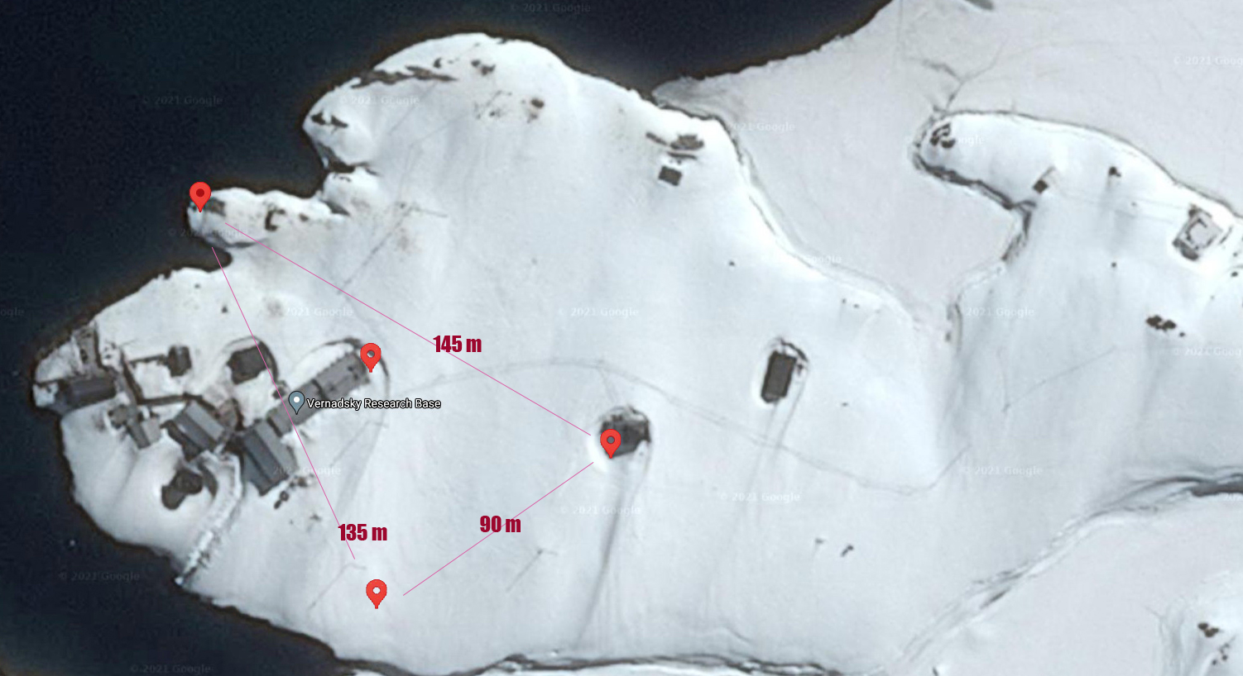
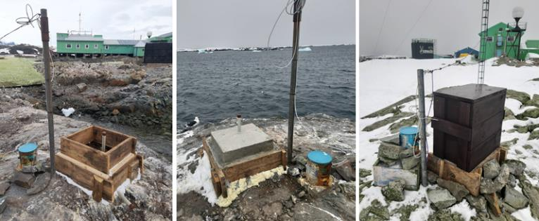
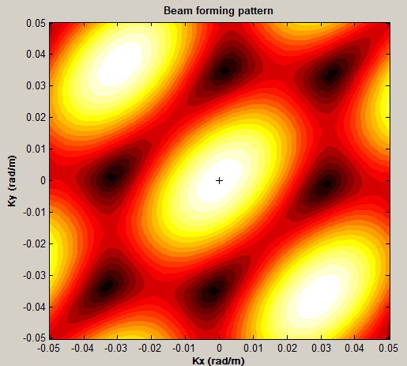
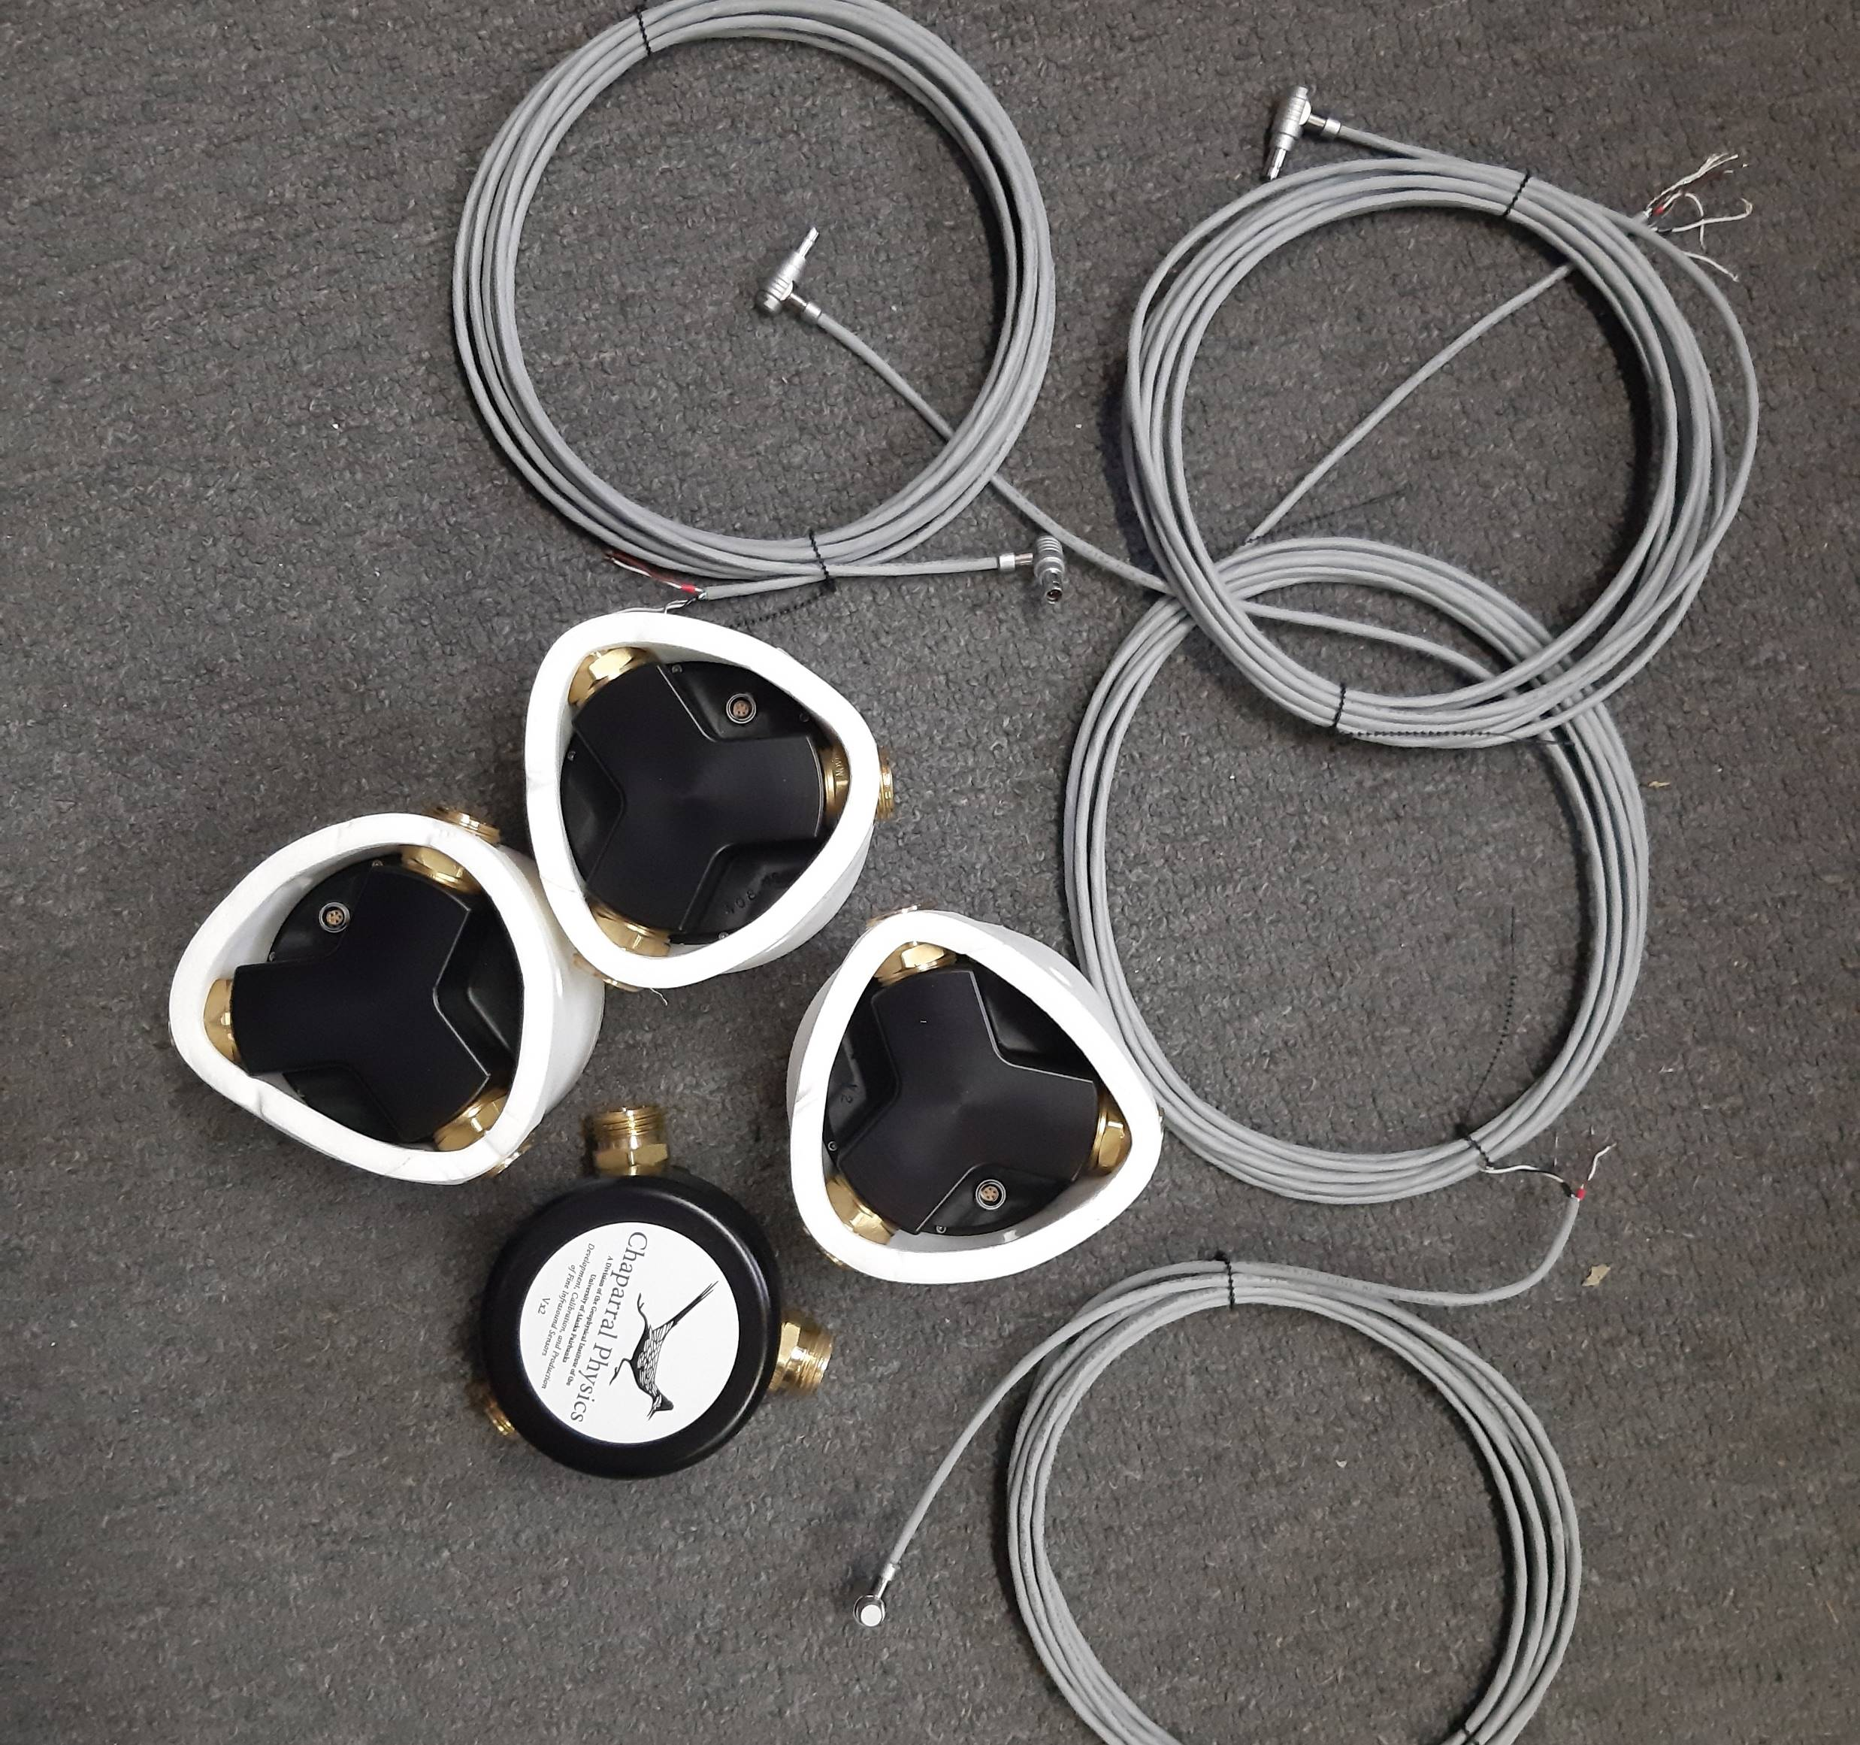
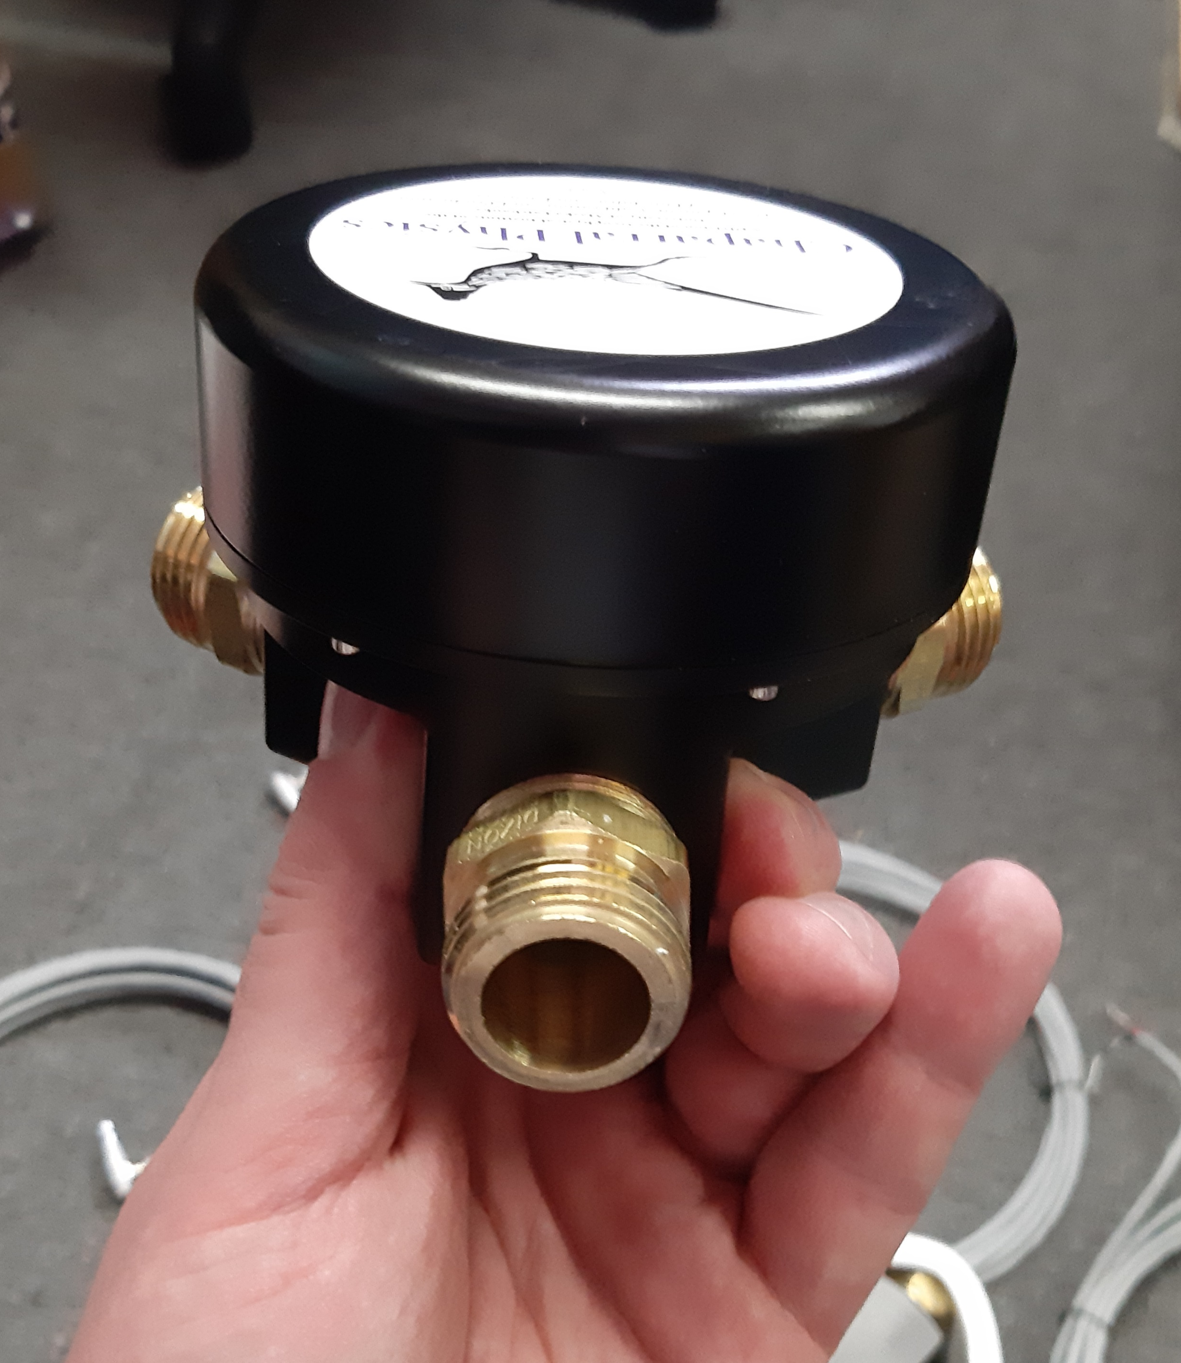
Configuration of the infrasound array of the Vernadsky Station
The infrasound array allowed us to estimate the direction of arrival of the acoustic wave and the speed of its propagation. Today, it is not possible to reach the typical sizes used by IMS STBTO. We expect to change the configuration and increase the dimensions of the array, the necessary materials are already at the station. However, at the time of installation, we were limited by the data cable, the dimensions of which were 90-145 meters. Due to the lengthening of the acoustic antenna, the directional pattern received two side lobes in the meridional direction. As wind noise reduction systems, we used containers covered with plastic from the middle for thermal insulation. The microbarograph is located directly in the container. We used 3 Chaparral Physics M64 microbarometers and one K-304 microbarometer. Power was supplied from the station. The data is fed to a 4-channel 24-bit ADC, where it is converted to digital form. Then the data is sent via the SeedLink protocol to the station's server and to the National Center in Ukraine. Data is stored in miniSEED format. The sampling rate is 40 Hz. Control system based on Linux SUSE.
Please do not use this space, a QR code will be automatically overlayed
P1.1-826

Slide 4
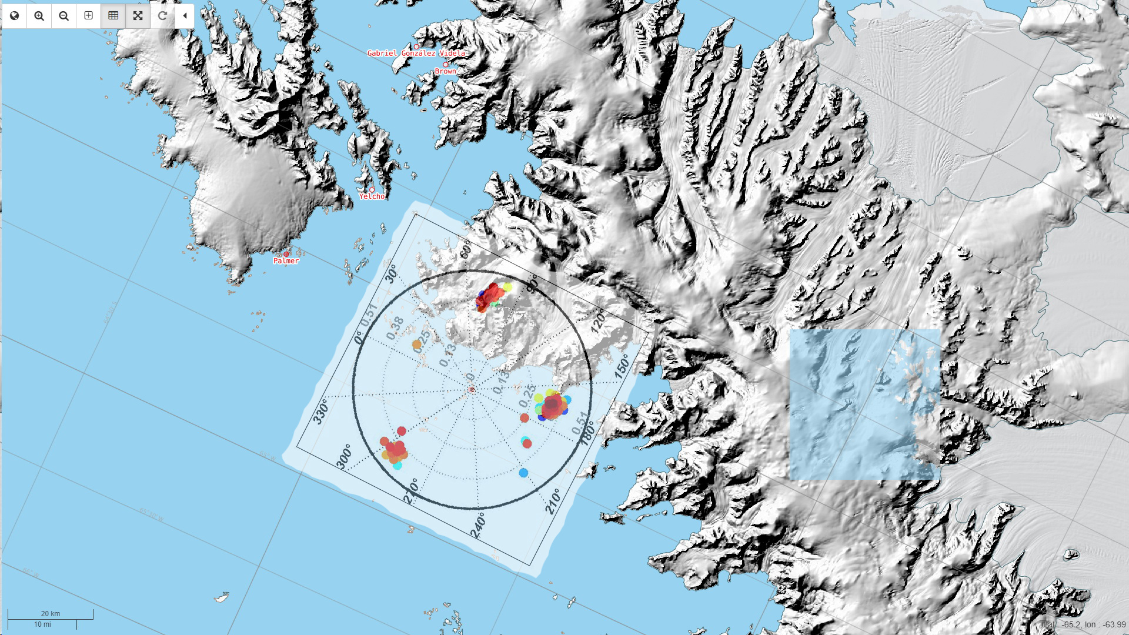
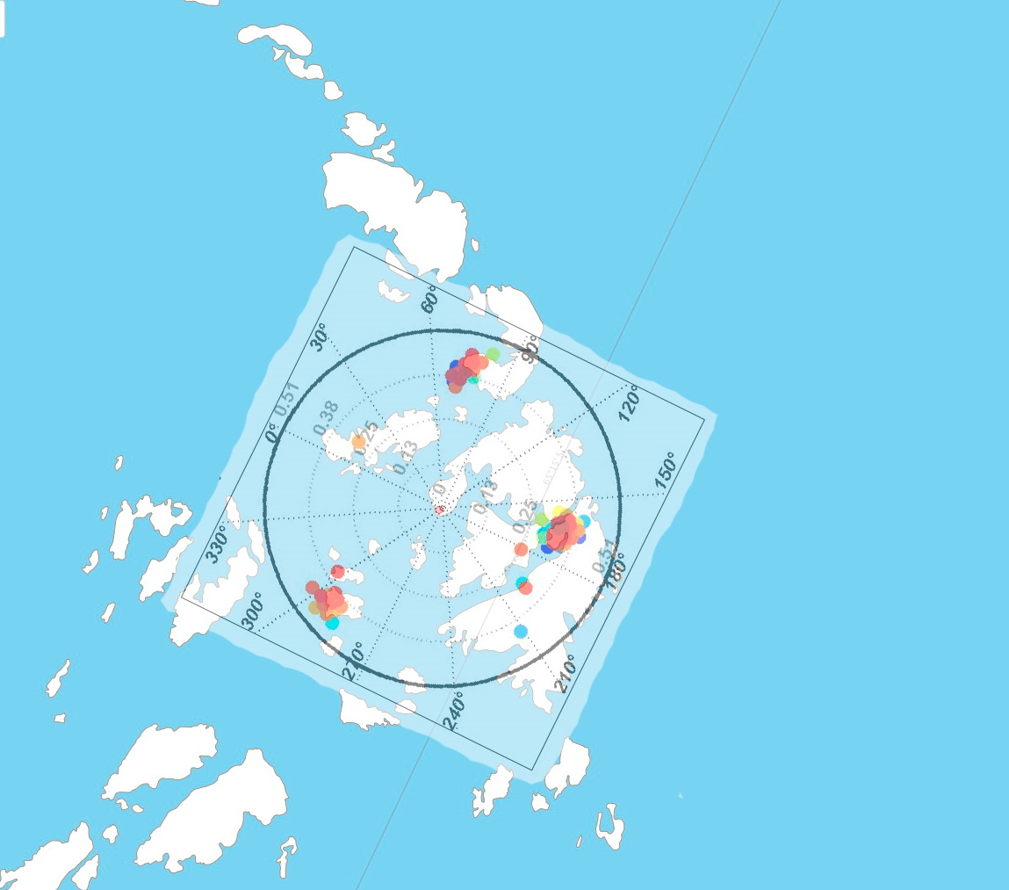
Association of sources of registered signals
Please do not use this space, a QR code will be automatically overlayed
P1.1-826

Slide 5
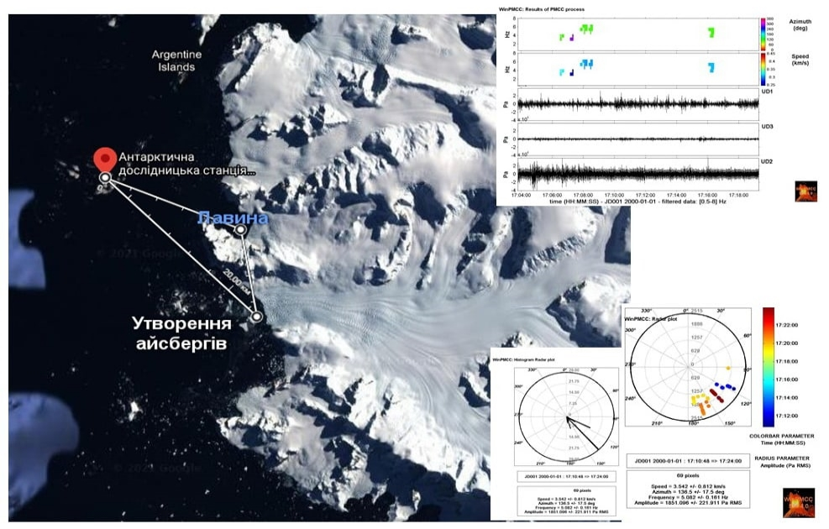
Registration of avalanches (mt DeMaria) and the calving of icebergs (Trooz glacier)
Avalanche
Iceberg calving
Please do not use this space, a QR code will be automatically overlayed
P1.1-826

Slide 6
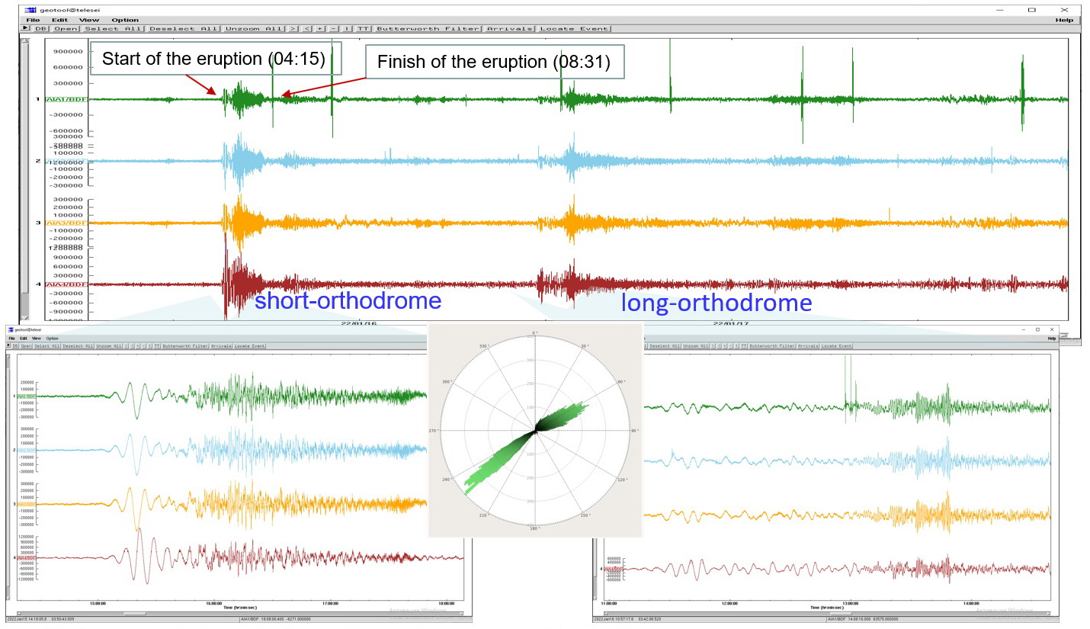
Registration volcano eruption Hunga, Tonga
Waveforms of infrasound signals from the volcano eruption Hunga, Tonga
The top picture is the wave pattern for January 15-17, 2022.
More detailed parts are shown below, showing signals from the volcano coming in a short way (left) and a long way (right). The difference in the arrivals is 20 hours.
Please do not use this space, a QR code will be automatically overlayed
P1.1-826

Slide 7
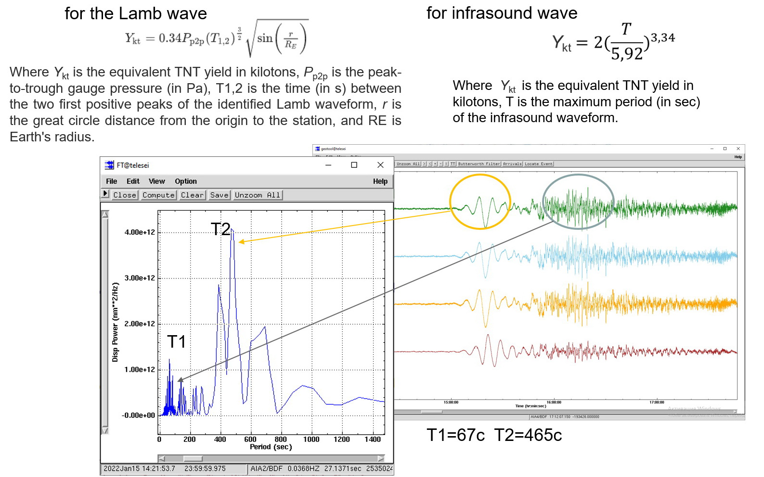
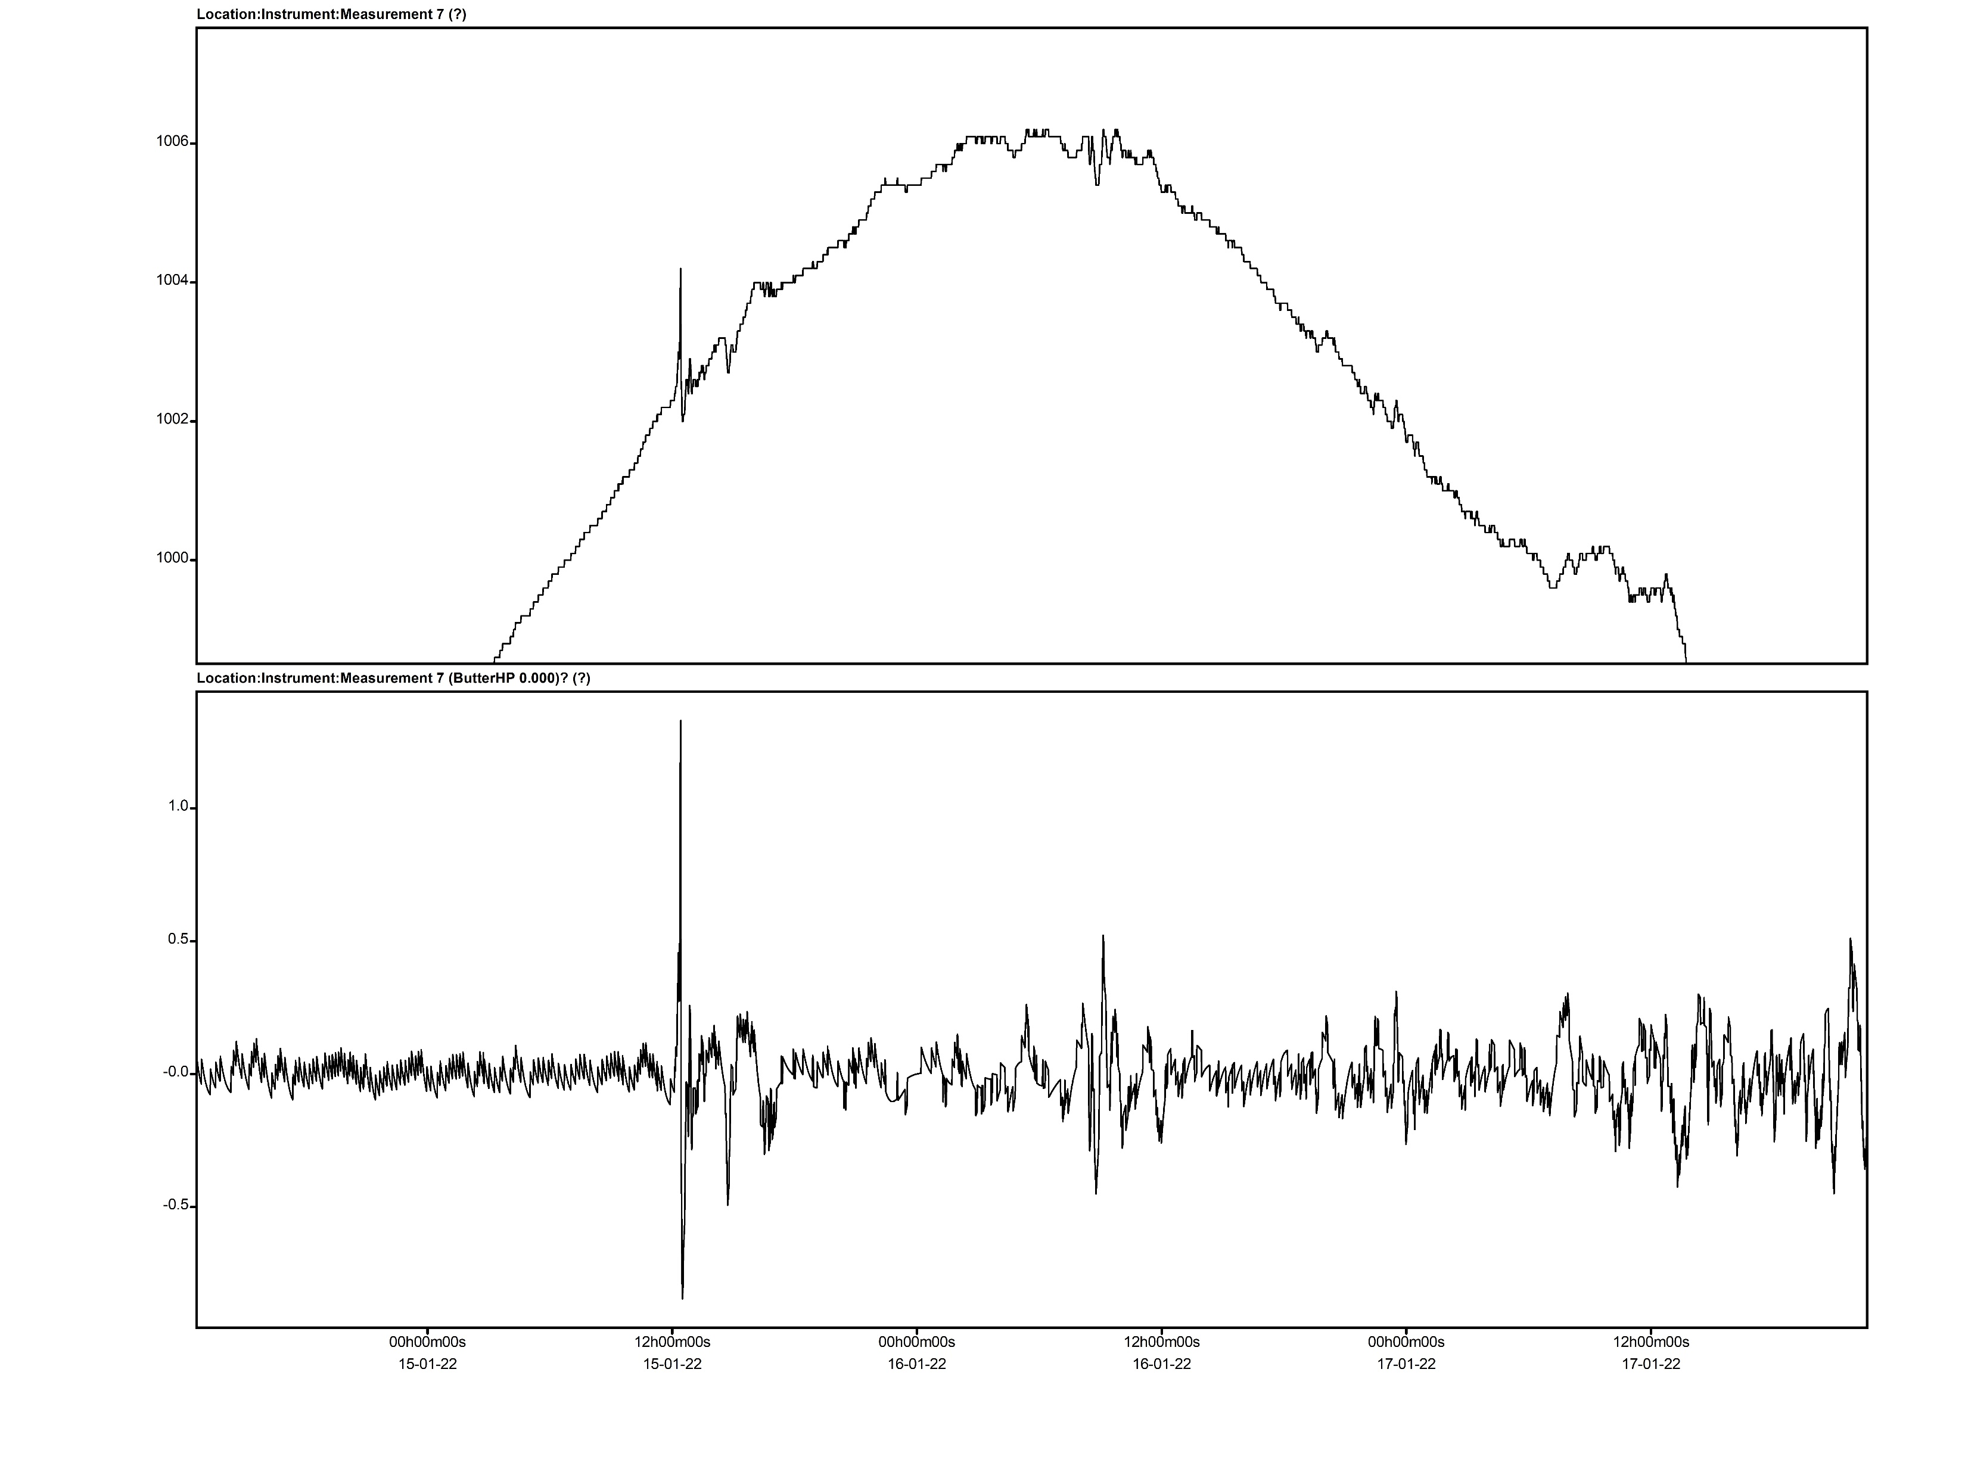
Calculation of the energy of a volcano explosion
P_{p2p}=220 Pa
A_{th}=32 sm
The result of registration of an acoustic wave by Vaisala
weather station (Above), tsunami wave according to the tide gauge (Bottom)
Please do not use this space, a QR code will be automatically overlayed
P1.1-826

Slide 8
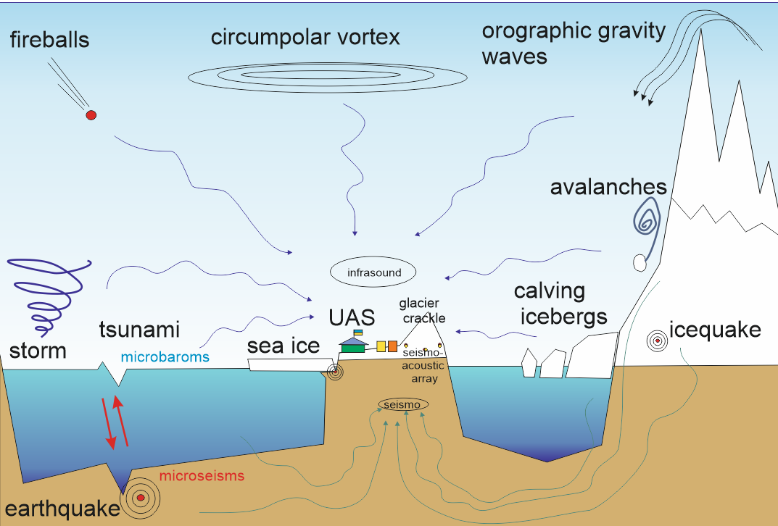
Conclusions
We managed to build the first working version of the infrasonic array in Antarctica and get a stable record of raw data.
Signals of various frequencies, durations and amplitudes were recorded. Oceanic microbaroms predominate among long-period sources. Microbaroms varied both in amplitude and frequency content over the short observation period at AIA. These variations appear to correspond to atmospheric conditions, which are related to the prevailing weather conditions in the vicinity.
It is necessary to make a comparison with seismic data in future analysis so as to clarify the physical interaction mechanisms among the atmosphere–ocean–cryosphere system in the Antarctic and surrounding oceans.
volcano
Local high-frequency events are filled with cryospheric events. These kinds of cryoseismic sources are likely to reflect short-term variations in surrounding environmental conditions, and their temporal change may provide indirect evidence of climate change at the area.
Volcano eruption. Publications report the released energy in the range of 5-50 and even 200 Mt of TNT. Our calculations give a value of 5-30 Mt of TNT, which is less than most claims. A direct wave and one that went around the Earth from the other side were recorded.
Such a wide range of recorded events gives hope for an interesting continuation of observations, but it is necessary to carry out work on increasing the aperture to at least 300-700 meters, local conditions allow it.
Please do not use this space, a QR code will be automatically overlayed
P1.1-826

