Slide 1
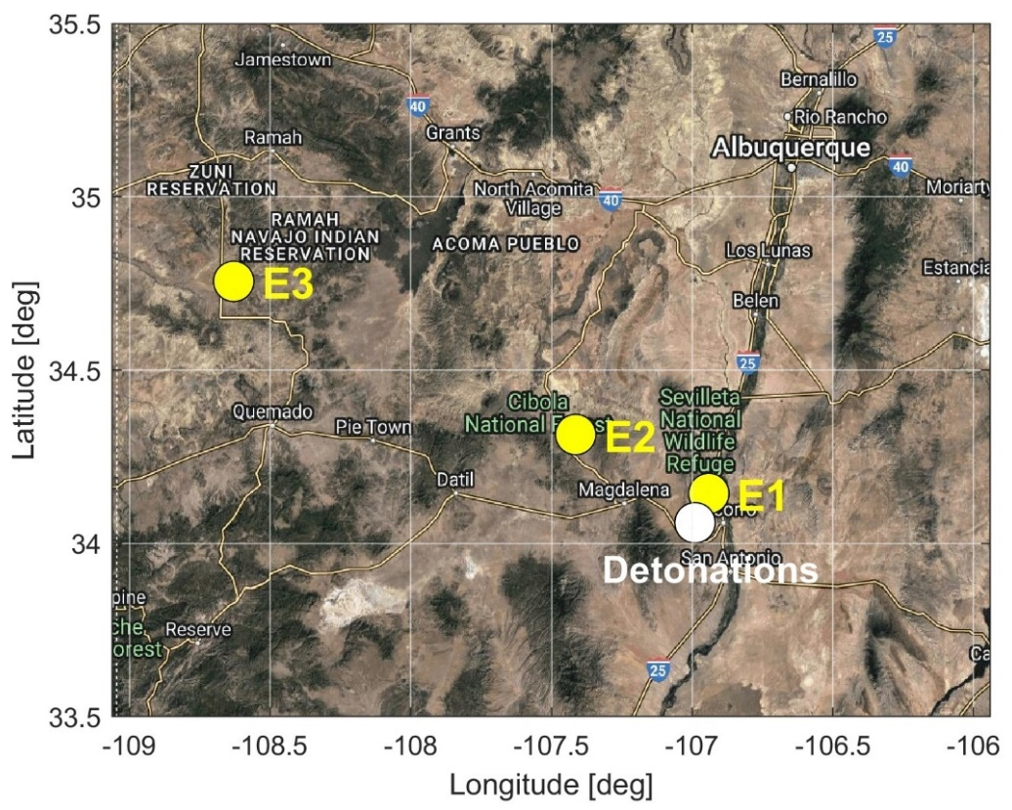
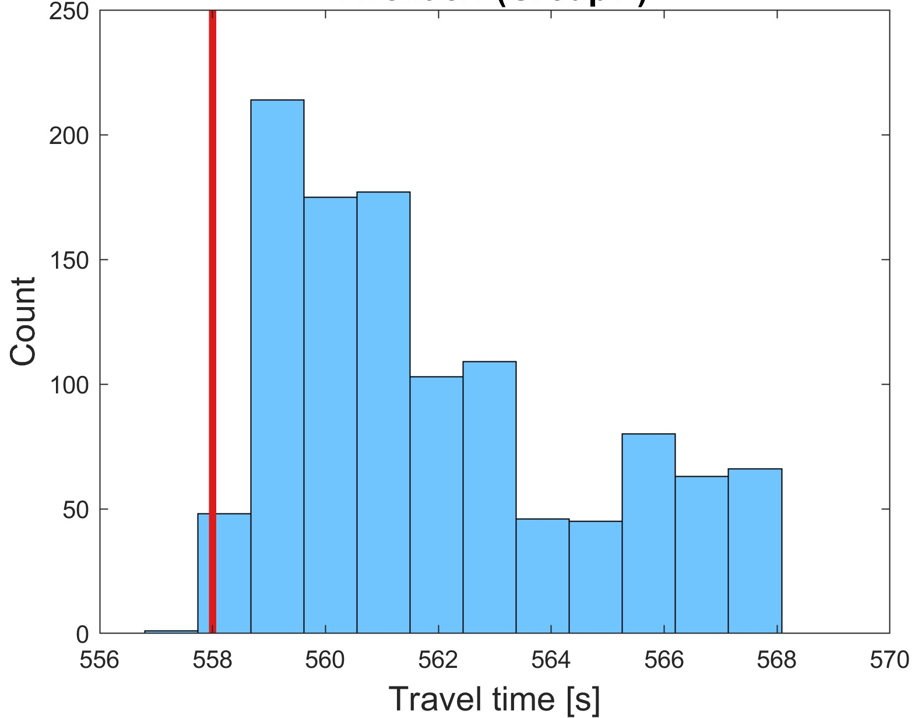
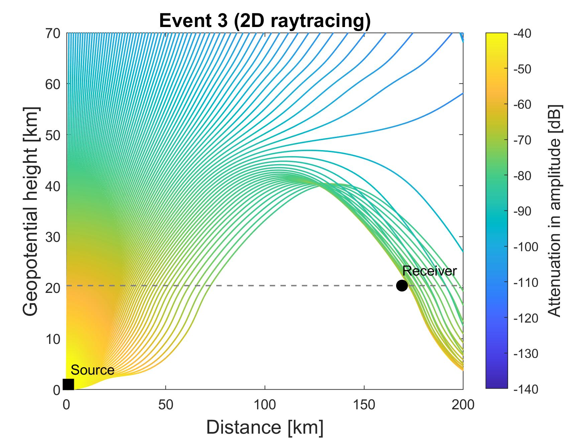
Effect of gravity wave induced small-scale perturbations in the atmosphere on infrasound arrival times at a high-altitude floating sensor system
E. A. Silber¹, D. C. Bowman¹, S. Krishnamoorthy²
¹Sandia National Laboratories, Albuquerque, NM, 87123, USA, ²Jet Propulsion Laboratory, California Institute of Technology, Pasadena, CA, 91109
SAND2023-04754C
P1.1-541
Implementation of GW perturbations to the stratospheric wind field explained the signal detection in the stratosphere and correctly predicted infrasound travel times.
Map showing the balloon location when each pair of detonations (or event) was detected (Events 1-3 are denoted with E1-E3)
One of the signal arrivals detected while the balloon was in the predicted acoustic shadow zone.
The count represents the number of perturbed atmospheric profiles for which raytracing resulted in eigenrays. Red line represents the observed signal travel time.
Zonal wind component:
Example of perturbation realizations (grey lines) plotted with a model atmosphere (red line).
A high-altitude helium-filled balloon carrying a sensor was launched with the aim to capture infrasound generated by three pairs of controlled ground explosions in New Mexico, USA (Jul 2020).
Raytracing results for the third set of detonations (Event 3). The signal was detected in the acoustic shadow zone.
The influence of GW-induced stratospheric perturbations can be substantial for a floating receiver in the stratosphere, even at regional distances. Our results demonstrate the importance of accounting for GW structures in modeling efforts.
We examined the role of gravity wave (GW) induced perturbations on infrasound propagation from the surface to an elevated receiver.
SNL is managed and operated by NTESS under DOE NNSA contract DE-NA0003525

