Slide 1
Rapid Automated infrasonic Detection and Source Location of Explosive Volcanic Eruptions Using Empirical Climatologies
R. De Negri^{1,2} and R. S. Matoza¹
¹University of California, Santa Barbara, USA
²NDC principal user, Chile
The IMS infrasound network has the potential to automatically detect, locate and characterize volcanic explosive events in the Earth [0]. We developed a robust methodology to generate sets of corrections to reduce the source location bias caused by the atmospheric winds [1]. In this poster we show our insights after using this methodology on different eruption cases.
The base methodology combines empirical climatologies [2,3] and a 3D ray tracing algorithm [4] to obtain first-order estimations of the azimuth deviation at the IMS stations.
We have used this method to investigate volcanoes like Mount Michael (South Sandwich islands) [5], Puyehue (Chile), Calbuco (Chile) [1], and the Vanuatu archipelago.
We find that: (1) our approach approach can significantly reduce the source location misfit for Puyehue and Calbuco [1]; (2) year-long predictions helped to distinguish volcanic infrasound from Mount Michael [5]; and (3) preliminary results are in good agreement with year-long models for Yasur and Lopevi/Ambrym volcanoes in the Vanuatu archipelago.
Our first-order methodology can significantly improve the source location of explosive events. Additionally, it can provide a valuable set of arrival parameters that are suitable for global and multi-year studies. We see this could be used to improve near real-time monitoring of volcanic eruptions.
Please do not use this space, a QR code will be automatically overlayed
P1.1-808

Slide 2
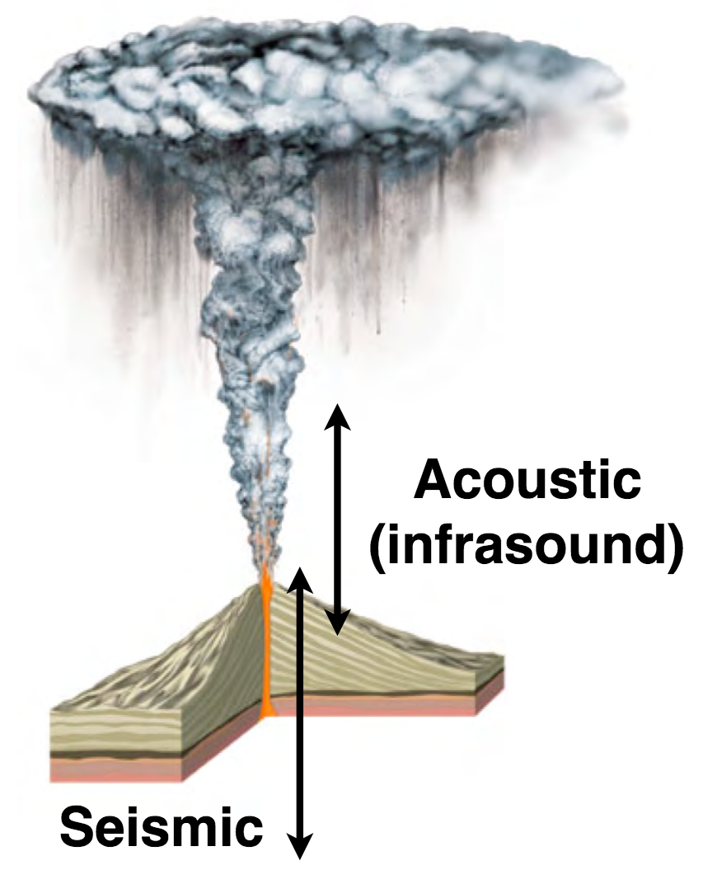
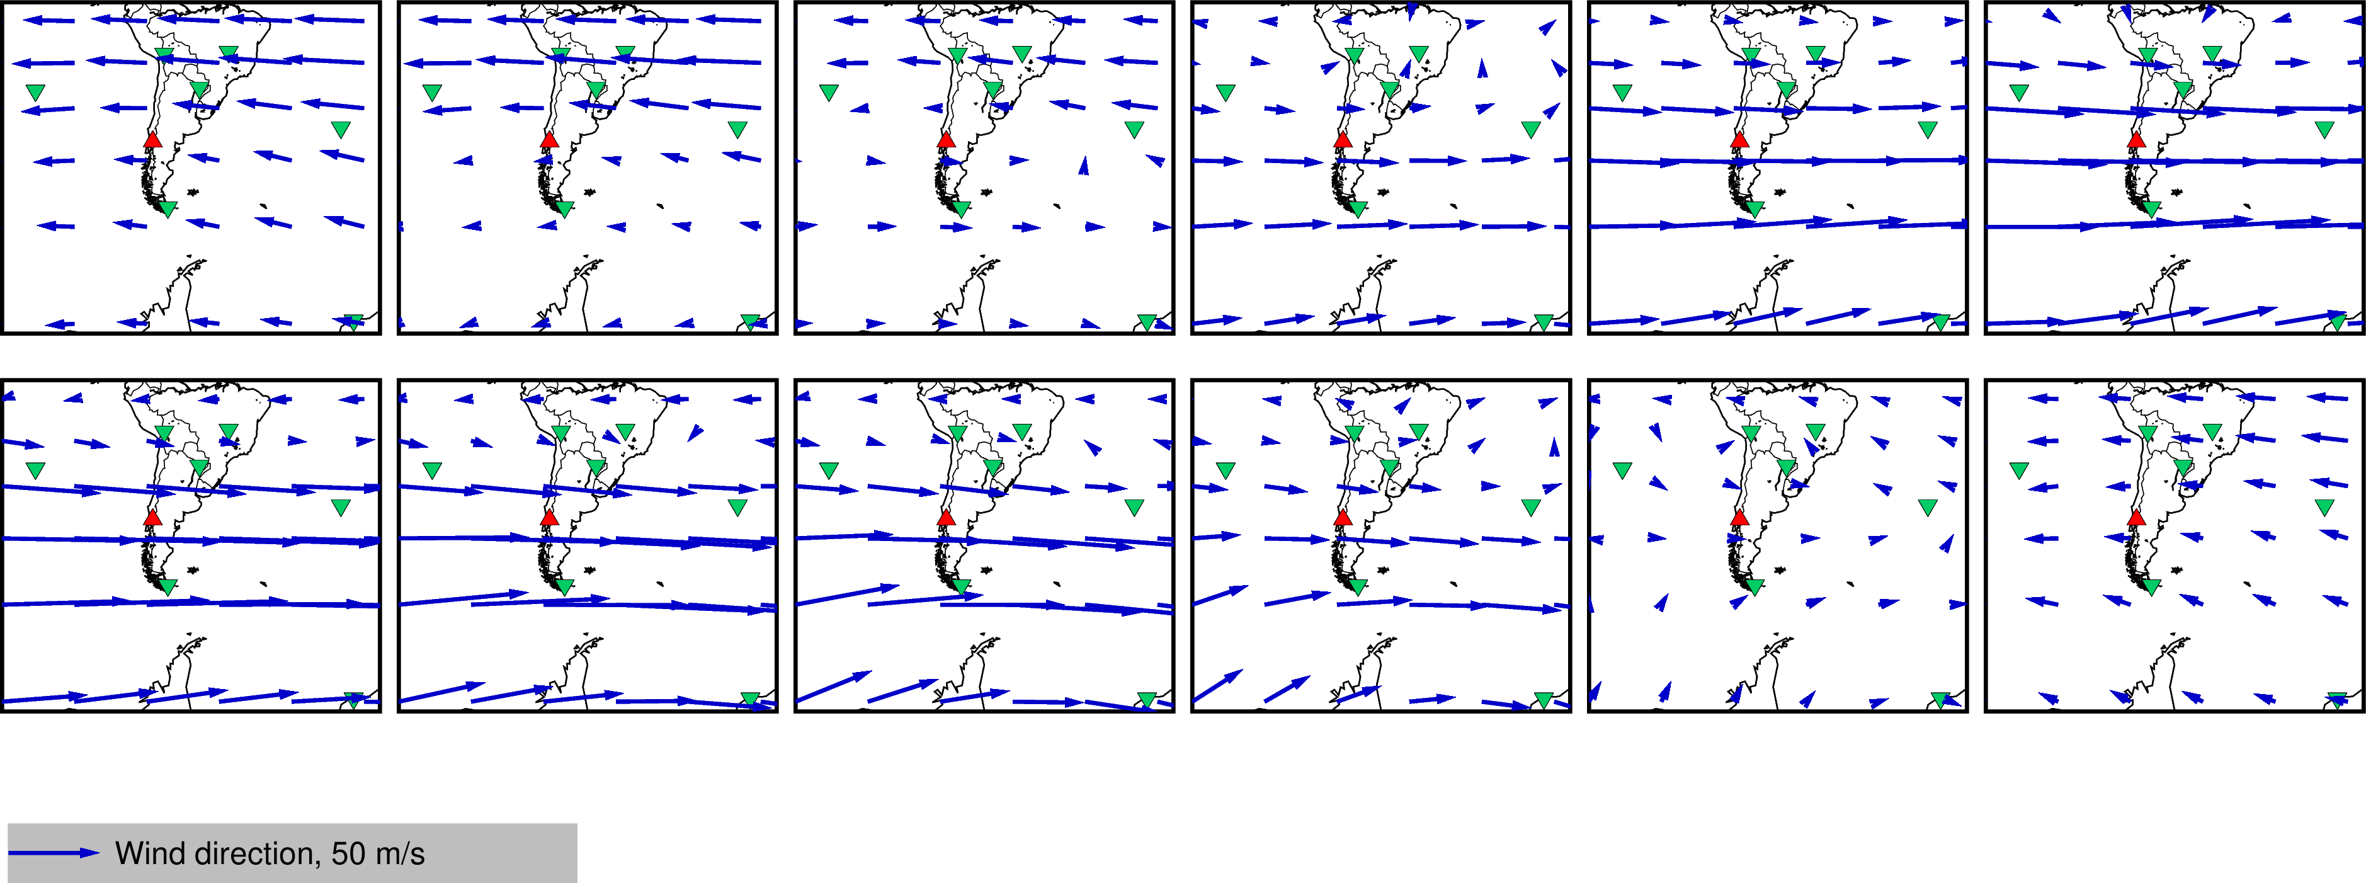
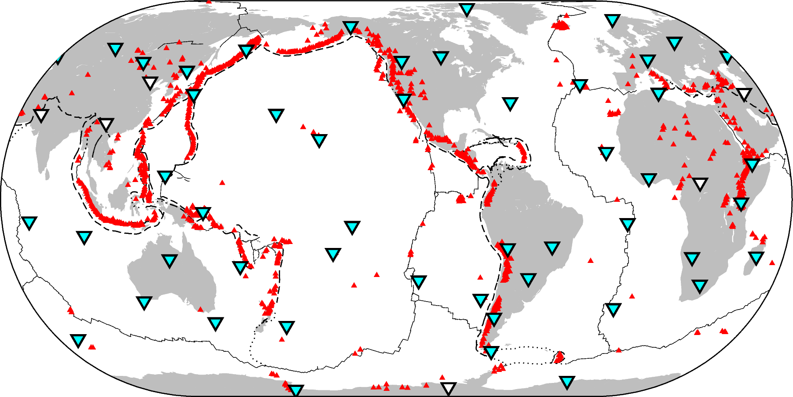
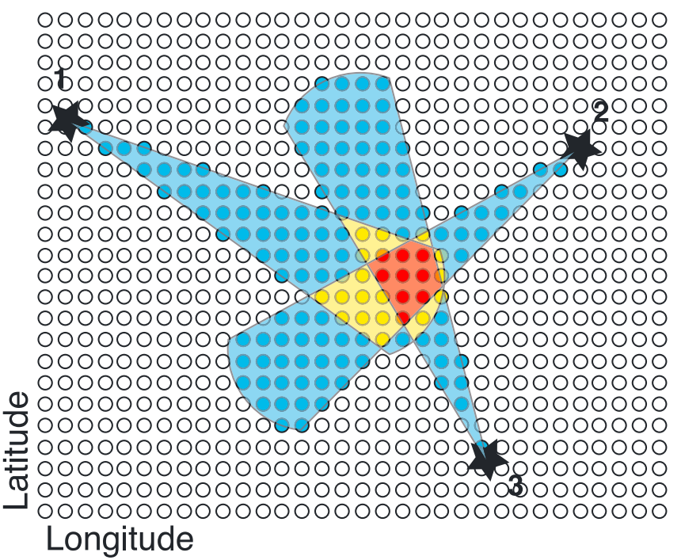
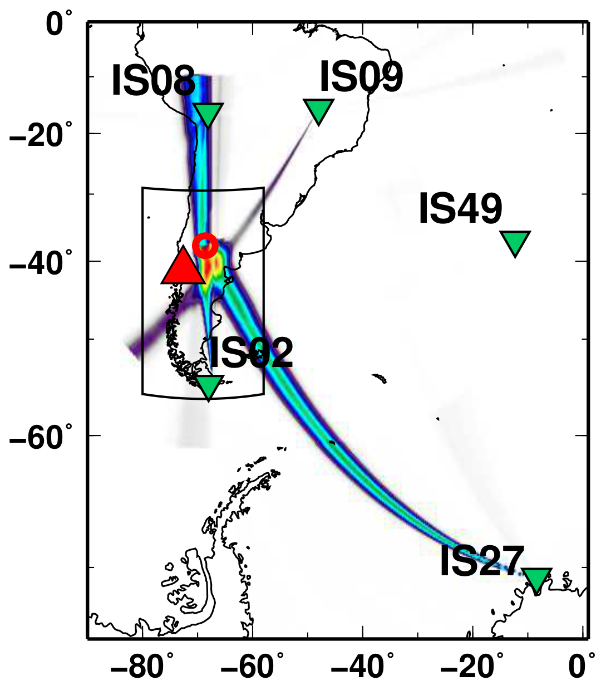
Introduction: volcanoes, infrasound, and the atmosphere
When volcanoes erupt, a considerable part of the energy released consists of sound waves (see Figure 1)
At long distances (hundreds of km), the atmosphere filters out the audible frequencies (>20 Hz), leaving only the infrasound waves (<20 Hz) that can be detected with the IMS infrasound stations (see Figure 2)
Jan 1st
Dec 1
Figure 5. Average of horizontal winds from 30 to 50 km for the first day of if the month from January to December. In a red box: April 1st, which corresponds to the month of Calbuco eruption (see Figure 6). Red triangle: Calbuco volcano, Chile. Green triangles: the IMS stations.
Figure 1. During an eruption, seismic and acoustic signals are produced.
Seasonal Zonal (E-W direction) and Meridional winds (N-S direction) can produce a significant deviation on the path of propagating waves which biases the detected azimuth at the IMS stations (see Figures 5 and 6)
Figure 2. The IMS infrasound network. In cyan triangles, current (53/60) certified stations. In white triangles, planned/incomplete stations. In red triangles Holocene active volcanoes. Dashed and dotted lines depict plate boundaries.
We developed and tested a method [1,5] that can significantly reduce the source offset obtained with IMS_vASC by combining empirical climatologies (HWM/MSISE) [2,3] and 3D ray tracing (infraGA) [4] to predict the azimuth deviation.
For the June 4, 2011, eruption of the Puyehue-Cordón Caulle volcanic complex, Chile, the source offset by ~89.6% (~242 to 37 km), while for the April 22, 2015, eruption of Calbuco volcano, Chile, by ~66% (~480 to 211 km).
The IMS infrasound network is designed to detect explosions down to 1 kT of TNT equivalent globally
The Progressive Multi-channel Correlation algorithm (PMCC) [6] is used at the International Data Centre (IDC) to detect infrasound sources
Figure 3. Trial-source nodes (white circles) are selected as possible sources (colored circles, where red is the highest probability) using detection lists from each station (black stars). Cartoon from Matoza et al., 2017.
P1.1-808
Figure 6. IMS_vASC source location map using available stations for the Calbuco eruption in 2015. The source was mislocated by 522 km from true. Figure from Matoza et al., 2018.
Please do not use this space, a QR code will be automatically overlayed
Matoza et al. (2017) [0], introduced a tool that uses the IMS infrasound network of arrays to globally detect and locate volcanic eruptions. A brute-force, cross-bearings, grid-search algorithm (IMS_vASC) was implemented and tested in a multi-decadal IMS global dataset of bulletin files (see Figures 3 and 6).
We summarize our findings after applying this method to Puyehue 2011 and Calbuco 2015 (Chile) eruptions, Mount Michael (2003-2020) eruptive activity, and Vanuatu archipelago ongoing research
The repository codes are in https://github.com/rodrum/arcade for research and collaboration

Slide 3
Objectives
Enable rapid and robust, first-order, estimations of arrival infrasound parameters (i.e., azimuth) considering the atmospheric propagation effects to help improve source location for cross-bearings methods using the IMS infrasound network like Matoza et al. (2017) [0]
Assess source improvement on real shorter (several days) eruption cases (e.g., Puyehue-Cordón Caulle eruption, 2011 (Chile); Calbuco eruption, 2015 (Chile) [1])
Use for year-long time windows in multi-year case studies to assess global studies in large time windows (e.g., Mount Michael 2003 to 2020 activity [5]; and current developments on Vanuatu volcanoes)
The method itself has two main design goals:
Modularity. For example, to allow the use of more realistic atmospheric models like the European Centre for Medium-Range Weather Forecasts (ECMWF) ERA 5 data (<80 km) instead of empirical climatologies only.
Open-access for research. We want the method to be reproducible and simple enough to be used by other scientists and facilitate collaboration.
P1.1-808
Please do not use this space, a QR code will be automatically overlayed

Slide 4
Methods and Data
ARCADE
General methodology
Infrasound waveforms
Climatologies
We have developed a method that automates the calculation of expected azimuth deviations for any day of the year, and any set of sources and stations, by combining empirical climatologies (HWM14/MSIS2.0) [2,3] with 3D ray tracing (infraGA) [4]. We call this method Automated Rapid Climatologic Azimuth Deviation Estimation (ARCADE).
Currently, the implementation of this method is available at https://github.com/rodrum/arcade
ARCADE aims to rapidly estimate, in a first-order, the expected azimuth deviation for models that involve multiple sets of sources, stations, and long-range calculations. We also introduce a Gaussian wind perturbation that enhances the along-path component of the winds by 30% at 40 km altitude with a standard deviation of 10 km, which aims to account for infrasound arrivals produced by atmospheric phenomena that are not visible on smooth climatological descriptions (e.g., gravity waves).
ARCADE also allows the use of hybrid atmospheric descriptions, that is, combining the European Centre Medium-Range Weather Forecasts (ECMWF) ERA 5 profiles (up to ~78 km) with empirical climatologies (above ~78 km) and the use of range-independent or range-dependent propagation schemes, provided by infraGA.
The expected azimuth deviations are stored in a look-up table which is used by IMS_vASC to correct the first-order offset that atmospheric crosswinds produced on long-range infrasound propagation. In Figure 12 we summarize the general scheme of how we integrate the IMS data, ARCADE, and IMS_vASC.
Profiles
PMCC
infraGA/GeoAC
3D ray tracing
Detections
Look-up table
IMS_vASC
Corrected source location
Figure 7. General scheme of IMS data, ARCADE, and IMS_vASC integration towards correcting the offset of volcanic infrasound source location.
Data
This work uses IMS data for three different test cases:
For the eruptions of Puyehue-Cordón Caulle, 2011 (Chile) and Calbuco, 2015 (Chile), we used data from the nearest eight stations (IS02, IS08, IS09, IS13, IS14, IS27, IS41, and IS49) considering a time window of about 10 days that starts one day before each eruption [1].
For Mount Michael (Saunders Island, South Sandwich Islands), we considered the available data from 2003 to 2020 of the stations IS02, IS49 and IS27, to later only use IS27 as it was the only station with apparent volcanic detections from Mount Michael [5].
For the Vanuatu archipelago volcanoes, we have considered the available data from IS22 only (2003-2023).
For each study case, we used our methodology to suit our needs:
For Puyehue and Calbuco cases, we modeled the expected azimuths of the arrivals for the day of the start of each eruption from all stations.
For Mount Michael, we modeled a year-long set of predictions arriving at IS27 from the theoretical location of the volcano.
For Vanuatu, we modeled year-long predictions for IS22 coming from Yasur and Lopevi/Ambrym directions.
P1.1-808
Please do not use this space, a QR code will be automatically overlayed

Slide 5
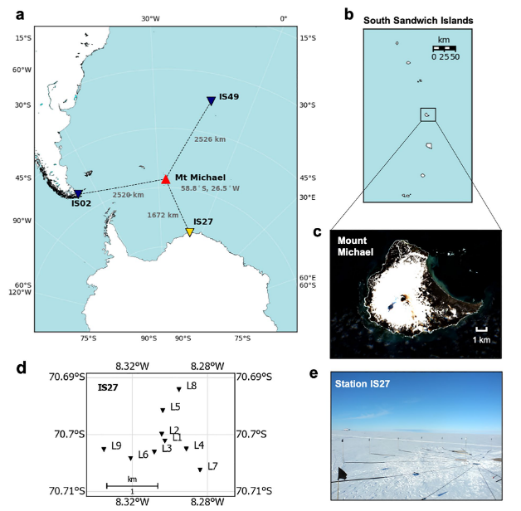
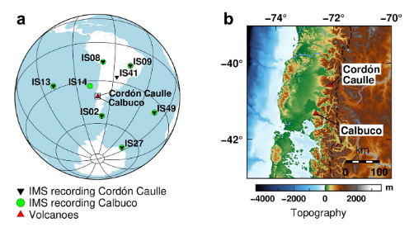
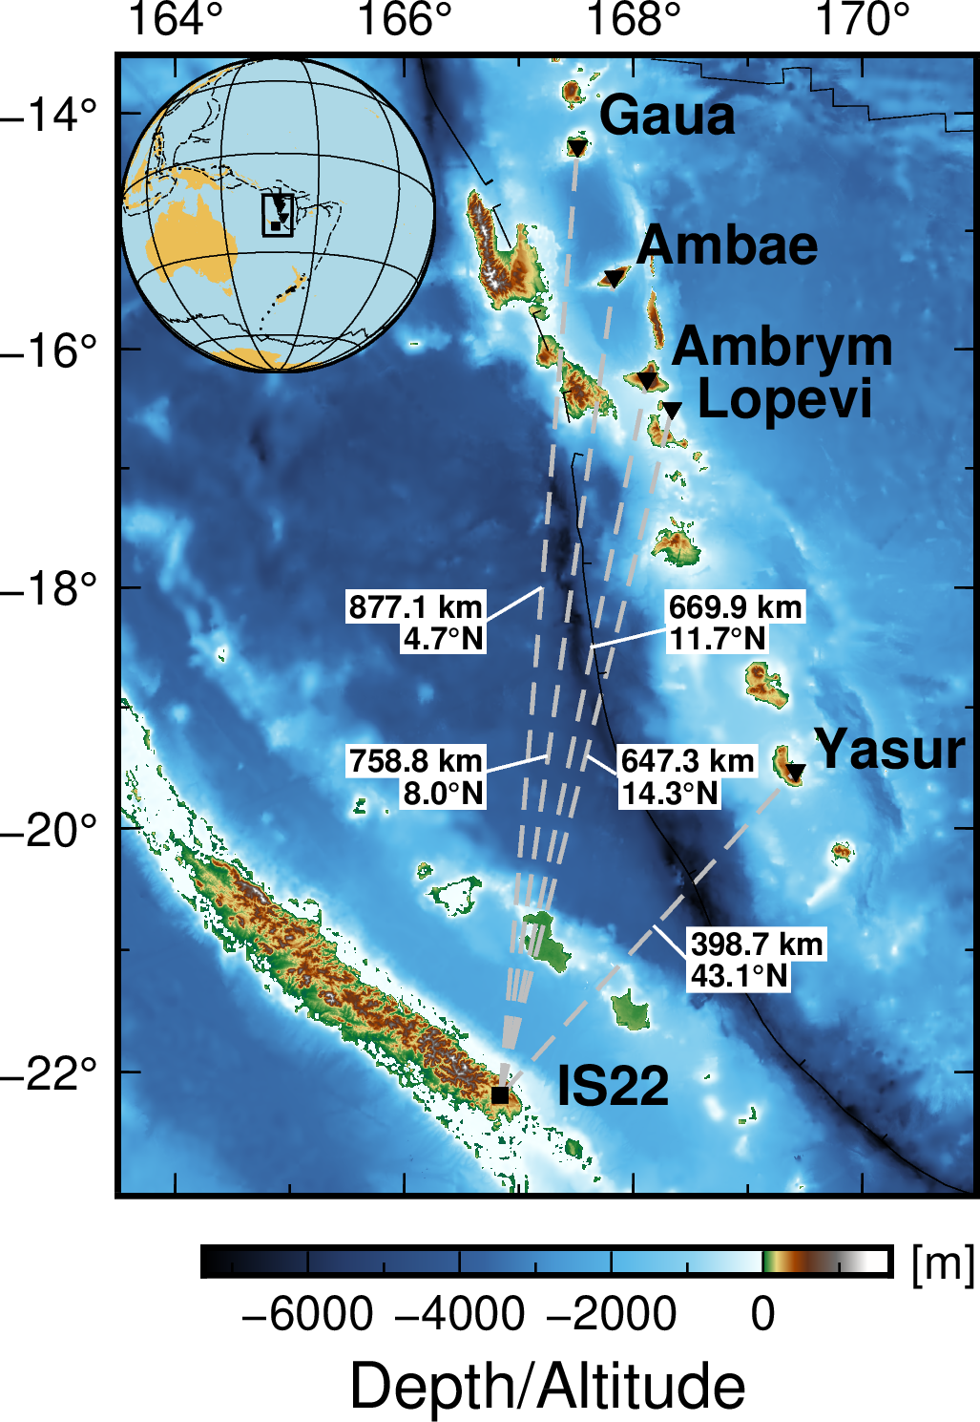
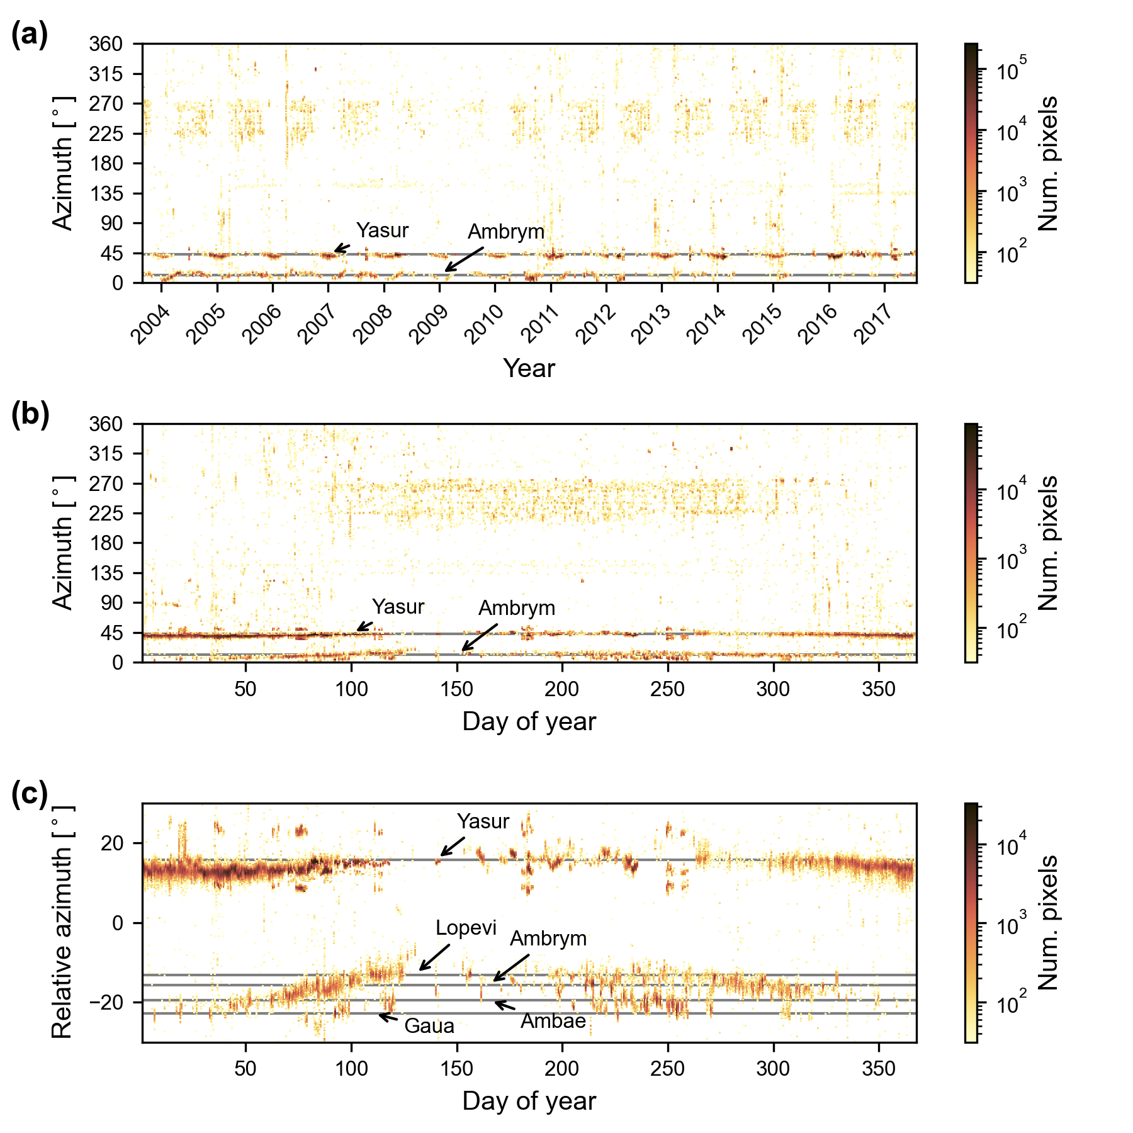
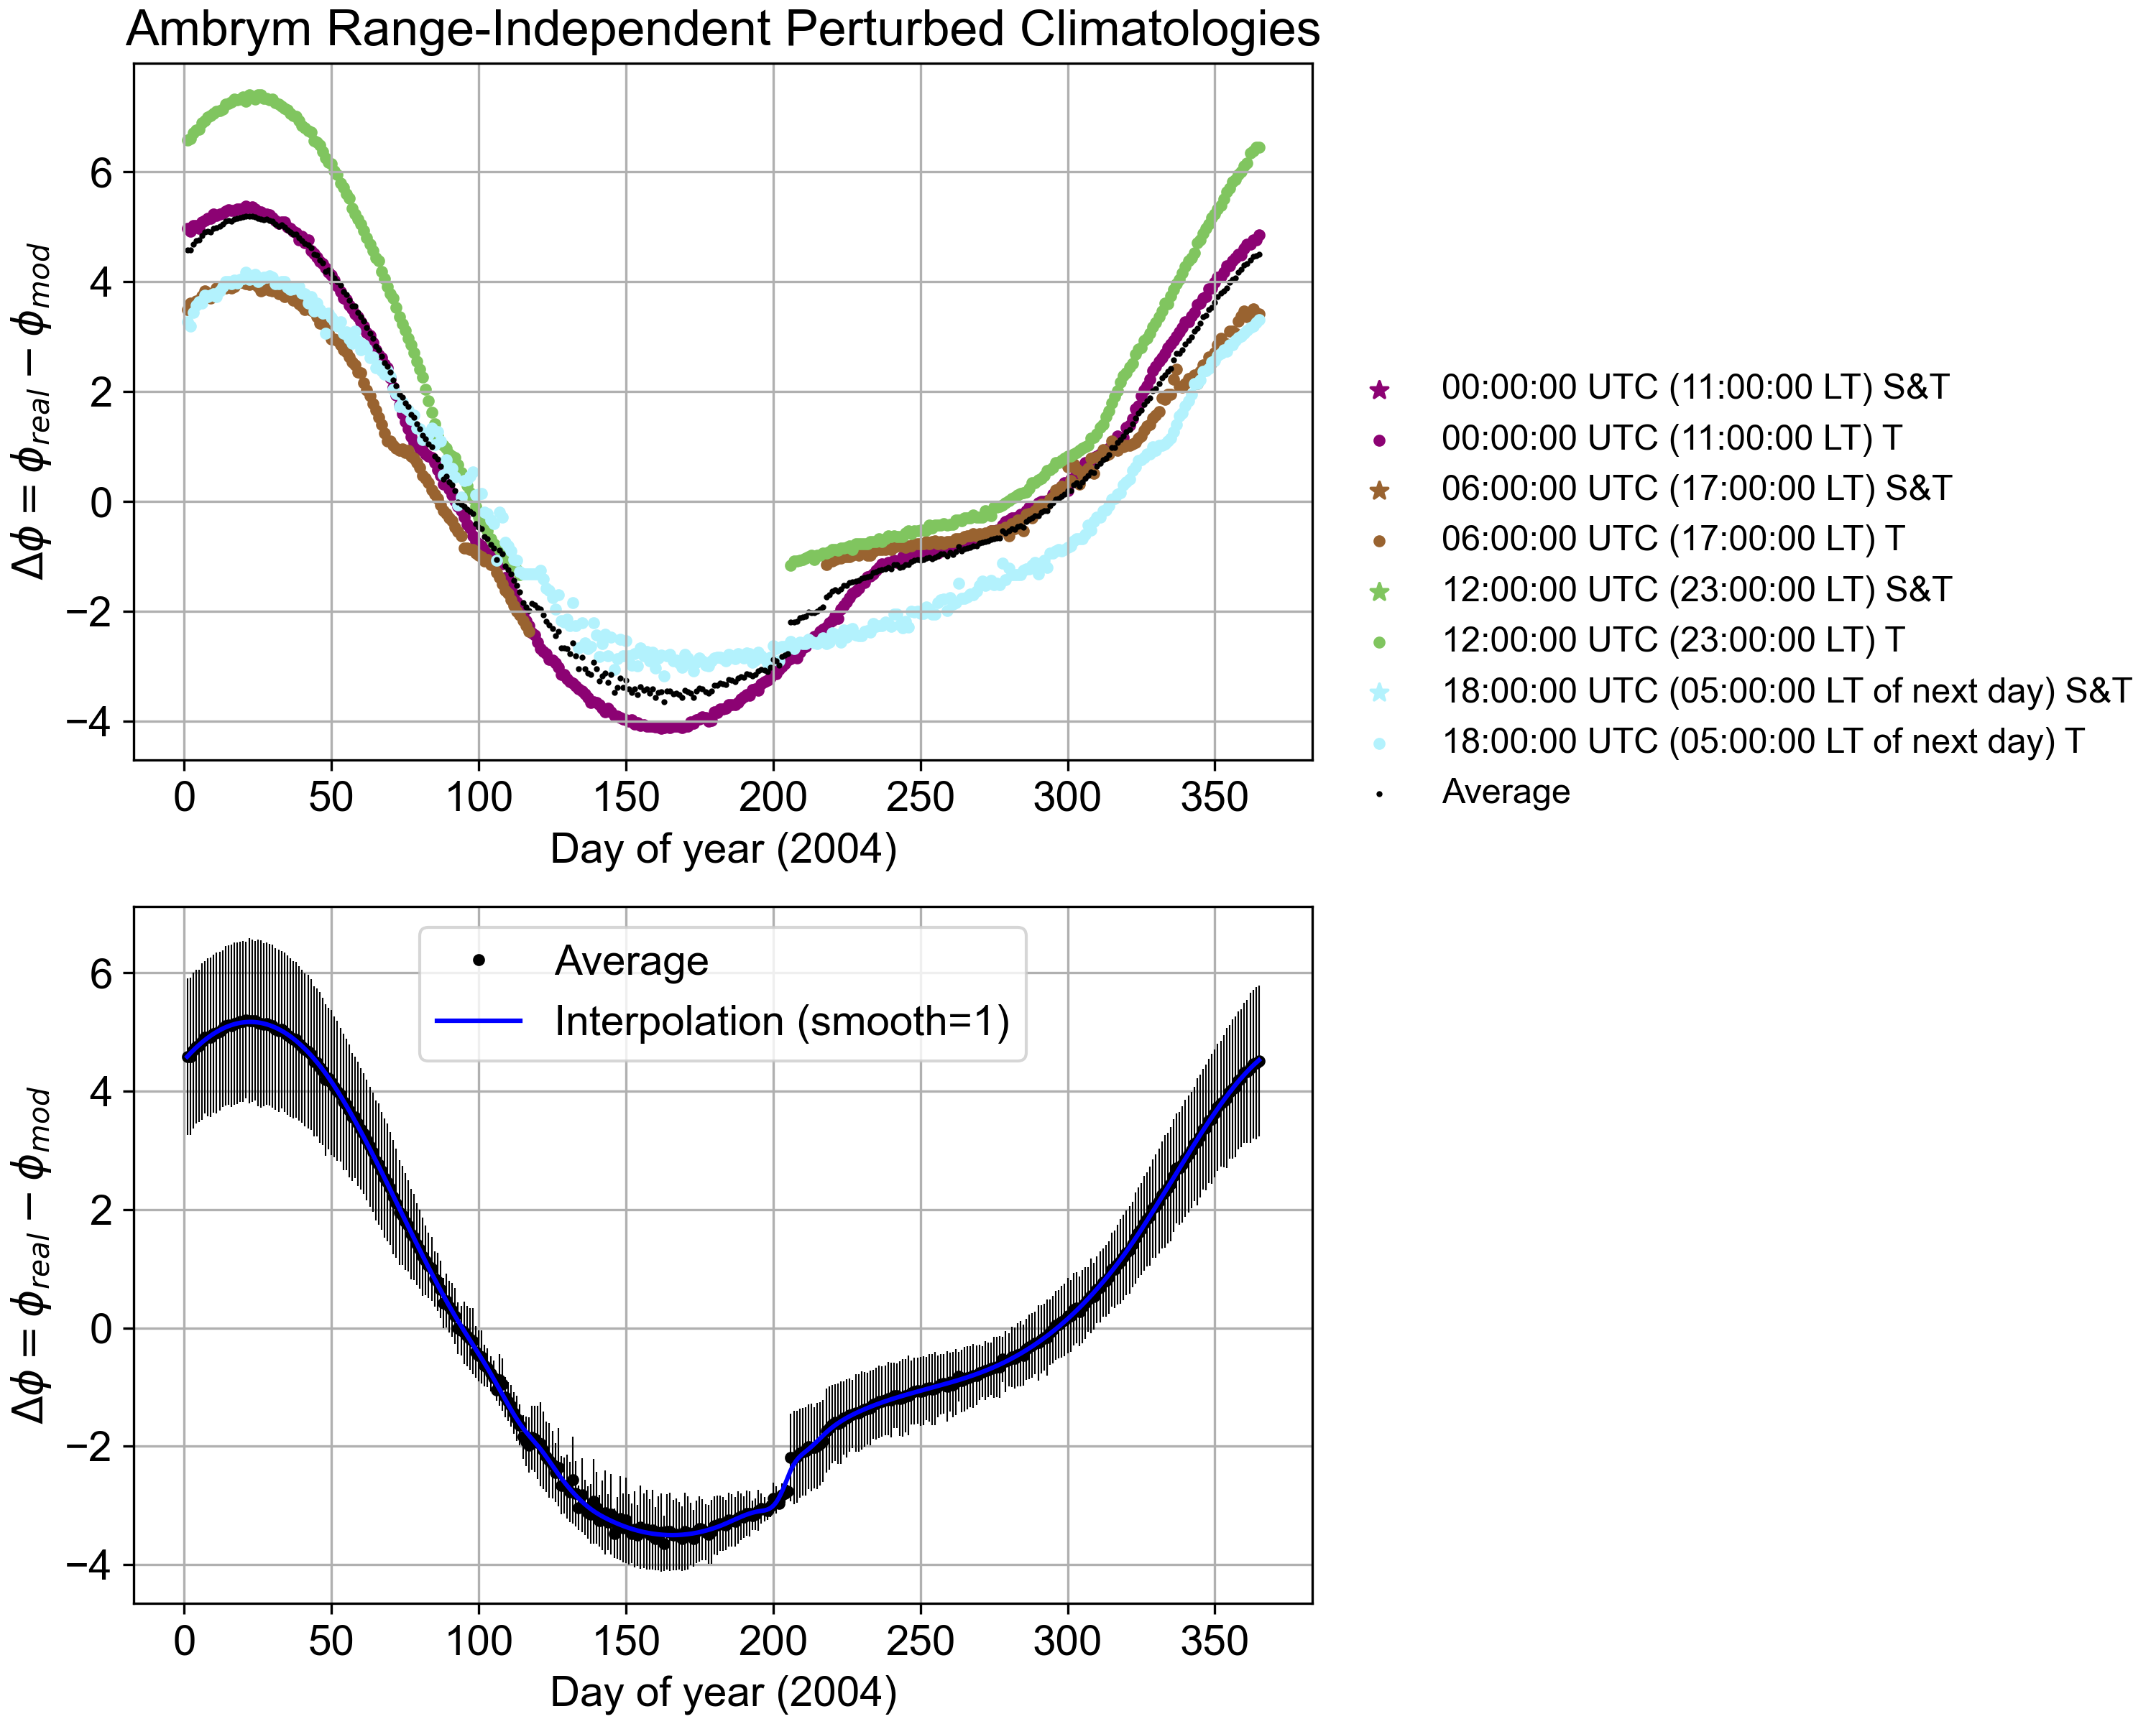
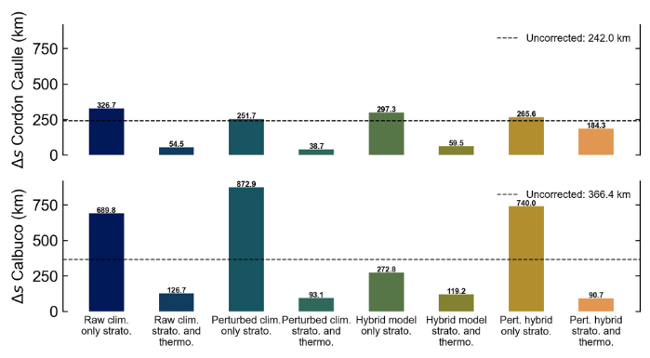
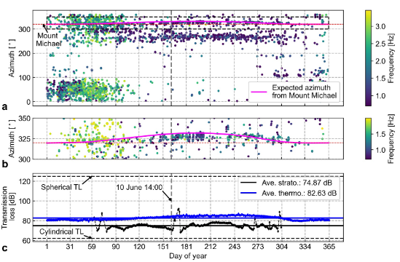
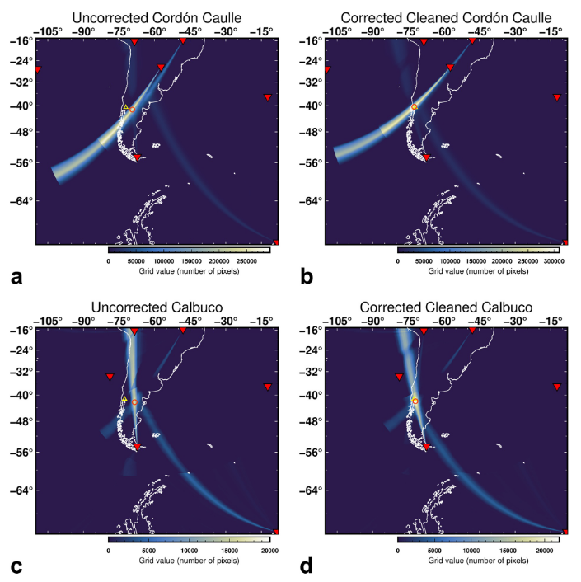
Results
Figure 10. Considered IMS stations and relative position of Puyehue-Cordón Caulle (CC) and Calbuco volcanoes (Modified from [1]). a: Nearest eight stations to CC and Calbuco, from ~700 up to 5000 km. b: Close up around CC and Calbuco.
Figure 13. Location of IS22 (New Caledonia) and the potentially observed volcanoes (Modified from in-submission paper of De Negri et al., 2023).
Figure 15. Example of modeled year-long azimuth deviations for Ambrym. Top: Azimuth deviations colored by time of day and turning height (see legend). Bottom: average azimuth deviation by time of day and interpolated curve. (Modified from in-submission paper of De Negri et al., 2023)
Figure 14. IMS detections from IS22. (a) Chronological data in 2D histograms, with azimuths of Yasur and Ambrym/Lopevi indicated with arrows. (b) Same dataset as (a) but sorted by day of year. (c) Same as (b), but zoomed around azimuths of interest. (Modified from in-submission paper of De Negri et al., 2023)
Figure 8. a: Mount Michael and nearest three IMS stations (Modified from [5]). b: Location of Saunders island relative to South Sandwich Islands. c: Satellite imagery of Mount Michael (Saunders Island). d: Station IS27 sensors (L1 to L9) configuration. e: Photograph of one of the sensors in Antarctica.
With the help of year-long azimuth deviation predictions, it’s possible to associate previously hidden volcanic infrasound from Mount Michael (Figures 8 and 9).
The source mislocation of Puyehue-Cordón Caulle 2011 and Calbuco 2015 eruptions can be reduced from 242 km to 36.7 km, and 366.4 km to 90.7 km, respectively. (Figures 10, 11, and 12).
Multi-year data can be represented at first-order with year-long models for different times of the day (Figures 13, 14, and 15)
Figure 11. Summary of source location misfits for both volcanoes (Modified from [1]).
Figure 12. Comparison of “uncorrected” and best cases with IMS_vASC (Modified from [1]). a and b: Cordón Caulle uncorrected (left) and corrected (right). c and d: Calbuco uncorrected (left) and corrected (right).
P1.1-808
Please do not use this space, a QR code will be automatically overlayed
Figure 9: IS27 detections and modeled detections (Modified from [5]). a: Comparison of all filtered detections by day of year from 2003 to 2020 with modeled detections for Mount Michael (pink line). b: Close up in boxed region of a. c: Modeled stratospheric and thermospheric transmission loss (TL) compared with theoretical spherical and cylindrical.

Slide 6
Conclusion
We developed a method to estimate the expected azimuth deviation that infrasound commonly presents at long distances (ARCADE; https://github.com/rodrum/arcade). This method allows calculating rapid first-order estimates for multiple sources, receivers (stations), and date times, which we store into a look-up table that could be used in near-real time source location scenarios.
For previous short-time eruption test cases (several days) like Puyehue-Cordón Caulle eruption, 2011 and Calbuco eruption, 2015, we have been able to improve the source location of energetic volcanic eruptions from 66% to 89% when providing IMS_vASC with a set of expected deviation values [1].
This method has been useful in helping discern volcanic infrasound that was previously hidden for the remote volcanic activity of Mount Michael from 2003 to 2020 [5].
We are assessing our methodology with year-long set of predictions for station IS22 (New Caledonia) from Ambrym, Lopevi, and Yasur volcanoes. Our preliminary results seem to be in good agreement with multi-decadal PMCC detections (2003-2023).
P1.1-808
Please do not use this space, a QR code will be automatically overlayed

Slide 7
References
[0] Matoza, R. S., Green, D. N., Le Pichon, A., Shearer, P. M., Fee, D., Mialle, P., & Ceranna, L. (2017). Automated detection and cataloging of global explosive volcanism using the International Monitoring System infrasound network. Journal of Geophysical Research: Solid Earth, 122(4), 2946–2971. https://doi.org/10.1002/2016JB013356
[1] De Negri, R., & Matoza, R. S. (2023). Rapid location of remote volcanic infrasound using 3D ray tracing and empirical climatologies: Application to the 2011 Cordón Caulle and 2015 Calbuco eruptions, Chile. Journal of Geophysical Research: Solid Earth, 128, e2022JB025735. https://doi. org/10.1029/2022JB025735
[2] Drob, D. P., Emmert, J. T., Meriwether, J. W., Makela, J. J., Doornbos, E., Conde, M., … Klenzing, J. H. (2015). An update to the Horizontal Wind Model (HWM): The quiet time thermosphere. Earth and Space Science, 2(7), 301–319. https://doi.org/10.1002/2014EA000089
[3] Emmert, J. T., Drob, D. P., Picone, J. M., Siskind, D. E., Jones, M. Jr., Mlynczak, M. G., et al. (2020). NRLMSIS 2.0: A whole‐atmosphere empirical model of temperature and neutral species densities. Earth and Space Science, 7, e2020EA001321. https://doi.org/ 10.1029/2020EA001321
[4] Blom, P., & Waxler, R. (2021) “Characteristics of thermospheric infrasound predicted using ray tracing and weakly non-linear waveform analyses.” J. Acoust. Soc. Am. 149(5): 3174–3188.
[5] De Negri, R. S., Rose, K. M., Matoza, R. S., Hupe, P., & Ceranna, L. (2022). Long-range multi-year infrasonic detection of eruptive activity at Mount Michael volcano, South Sandwich Islands. Geophysical Research Letters, 49, e2021GL096061. https://doi. org/10.1029/2021GL096061
[6] Cansi, Y. (1995). An automatic seismic event processing for detection and location: The PMCC method. Geophysical research letters, 22(9), 1021-1024.
P1.1-808
Please do not use this space, a QR code will be automatically overlayed

