Slide 1
Demonstrating the Improvements in FLEXPART’s Wet Deposition Output After Accounting for Correct Precipitation rate Disaggregation and Interpolation of Cloud-Related Parameters
Anne Tipka^{1,2} and Petra Seibert³
¹IMGW, University of Vienna, Austria; ²now at CTBTO; ³Institute of Meteorology, BOKU, Vienna, Austria
Atmospheric Transport Modelling (ATM) serves as an essential numerical tool to link sources of physical tracers (e.g., CTBT-relevant radionuclides), when injected into the atmosphere, with receptors of these tracers. Wet scavenging is a key element in such (ATM) computations to determine the distribution of these transported masses.
Several algorithms related to the numerical and physical parameterizations of the wet scavenging scheme in FLEXPART 11 were improved, such as the disaggregation of precipitation, the below-cloud scavenging parameterization and the temporal interpolation of cloud related parameters.
This presentation demonstrates the effects of improvements in the numerical and physical parameterizations in the upcoming FLEXPART v11.
Improving the numerical and physical parameterizations show a significant improvement in the high-resolution wet deposition fields, eliminating the banded or artificial checkerboard structures.
Please do not use this space, a QR code will be automatically overlayed
P1.1-502

Slide 2
Introduction
The CTBTO identifies Possible Source Regions (PSR) of a nuclear explosion with relevant radioactive substances measured from samples taken at the International Monitoring Stations (IMS). The PSR also identify IMS stations as a potential receptor of a possible nuclear explosion.
Atmospheric Transport Modelling (ATM) is used to track the movement of radioactive substances in the atmosphere and serves as essential tool to link sources and receptors.
Wet scavenging is an important process in ATM to determine the distribution of trace species (e.g. for CTBT-relevant radionuclides)
The CTBTO uses the ATM FLEXPART with European Centre for Medium-Range Weather Forecast (ECMWF) meteorological data as input.
Precipitation fields from ECMWF datasets refer to a temporal integral rather than being a point value in time, as all other parameters in FLEXPART. The current method leads to distorted results by smoothing or shifting precipitation into dry periods.
This presentation demonstrates the effects of improvements in the numerical
and physical parameterizations in the upcoming FLEXPART version 11.
P1.1-502
Please do not use this space, a QR code will be automatically overlayed
www.flexpart.eu

Slide 3
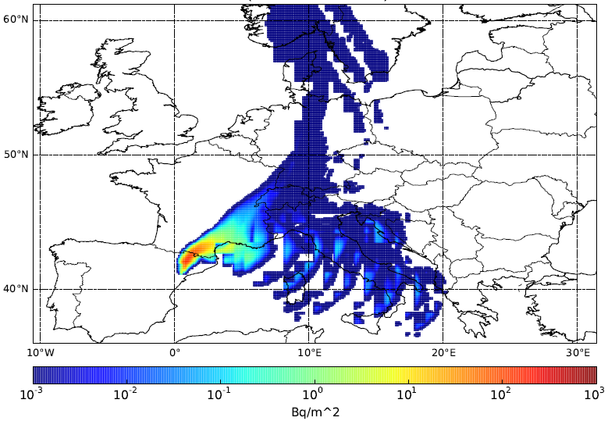
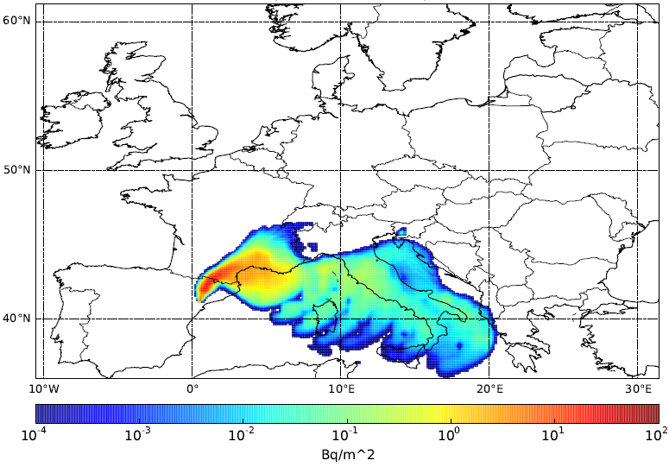
Objectives
Before: deposition field with artifacts
specific case where output grid « input grid size
Improvements in pre-processor flex_extract:
New disaggregation scheme -> DONE; Hittmeir et al., 2018
Improvements in FLEXPART (for release with version 11):
Cloud diagnostics (in progress)
Interpolation with newly disaggregated fields DONE
New parameterization for below cloud scavenging (under testing)
Tipka et al., 2023 under preparation
Afterwards: reduced artifacts
in the deposition field
Aim:
(conceptual demonstration)
e.g.
P1.1-502
Please do not use this space, a QR code will be automatically overlayed
Increase the quality of
the deposition results
www.flexpart.eu

Slide 4
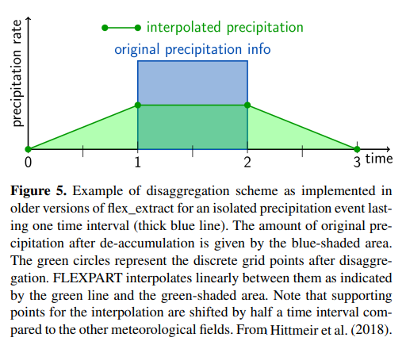
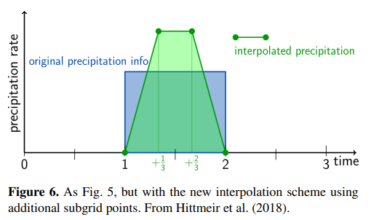
Methods 1/3
Flexpart < v11
Flexpart >= v11
New disaggregation algorithm in the pre-processing
tool flex_extractv7.1.2 (Tipka et al., 2020) accounts for numerical inconsistencies, converting precipitation data to point values.
Precipitation data now has consistency, continuity and mass conservation within each time interval secured.
P1.1-502
Please do not use this space, a QR code will be automatically overlayed
www.flexpart.eu

Slide 5
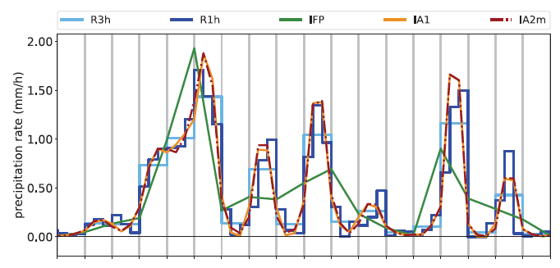
Methods 2/3
The reconstruction algorithm is based on a one-dimensional piecewise linear function with two additional supporting points within each grid cell.
Additional improvements for FLEXPART v11:
Temporal and spatial interpolation for all cloud parameter;
Flexpart v8 “quick fix” solution as a default back-up in case new disaggregation and no cloud liquid/ice water information is used.
R3h | 3-hourly precipitation from ECMWF
IFP | Disaggregation and interpolation of 3 h precipitation to 1 h; using a modified, linear interpolation (old)
R1h | 1-hourly precipitation from ECMWF
IA1 | Disaggregation and interpolation of 3 h precipitation to 1 h; non-negative, geometric mean based algorithm
IA2m | Modified IA1, UNUSED.
Short sequence from a convective precipitation time series. Raw precipitation curves from ECMWF are compared to the interpolated curves from flex_extract.
P1.1-502
Please do not use this space, a QR code will be automatically overlayed
www.flexpart.eu

Slide 6
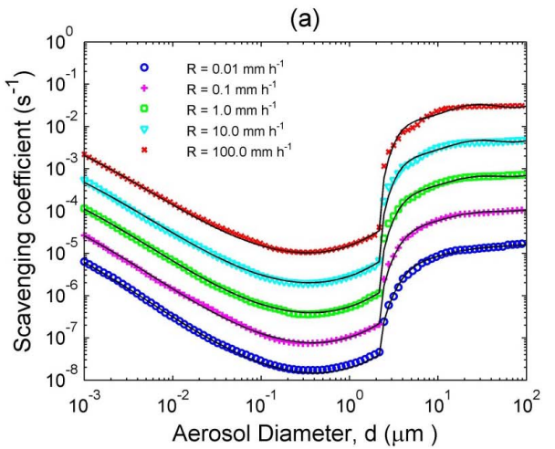
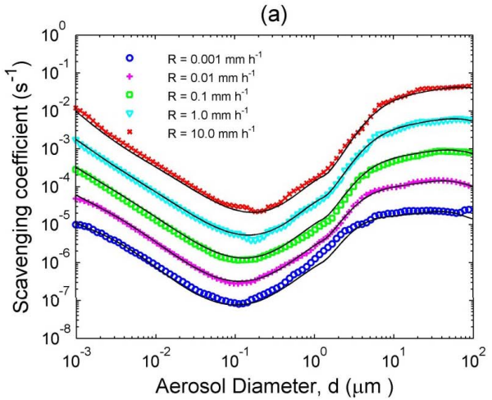
Methods 3/3
Implementation of a new below-cloud algorithm (Based on Wang et al., 2014)
A new semi-empirical parameterization for size-resolved wet scavenging coefficients is used. It is based on the 90th percentile of wet scavenging coefficients values from an ensemble data set calculated using all possible “realizations” of available theoretical wet scavenging coefficients formulas and covering a large range of aerosol particle sizes and precipitation intensities.
P1.1-502
Please do not use this space, a QR code will be automatically overlayed
Parameterized size-resolved rain scavenging coefficient profiles taken from Wang et al. (2014)
Parameterized size-resolved snow scavenging coefficient profiles taken from Wang et al. (2014)
www.flexpart.eu

Slide 7
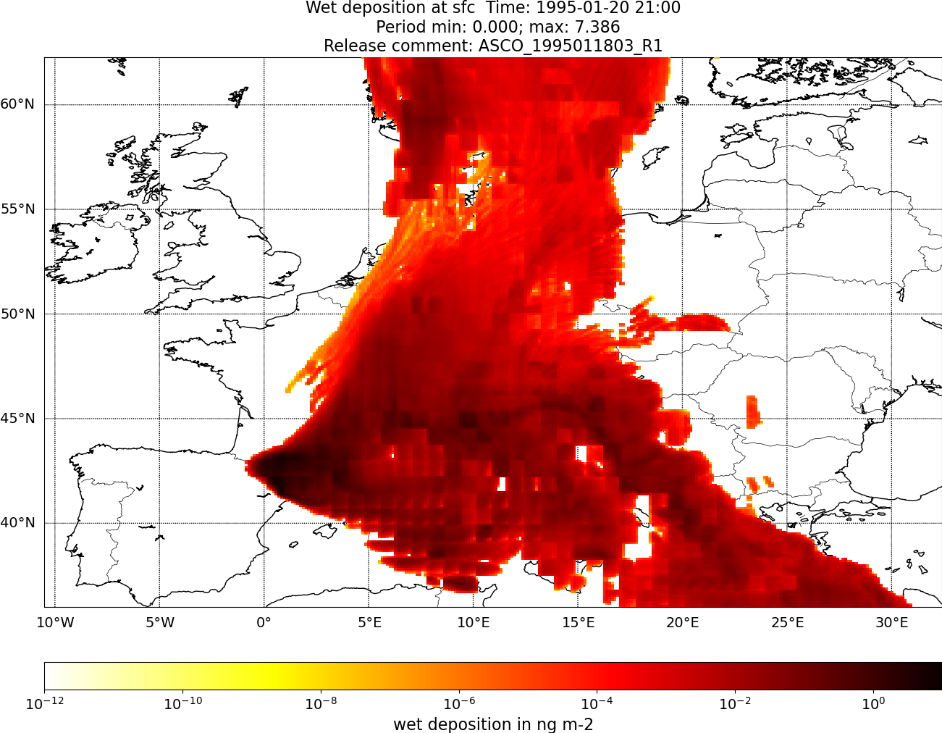
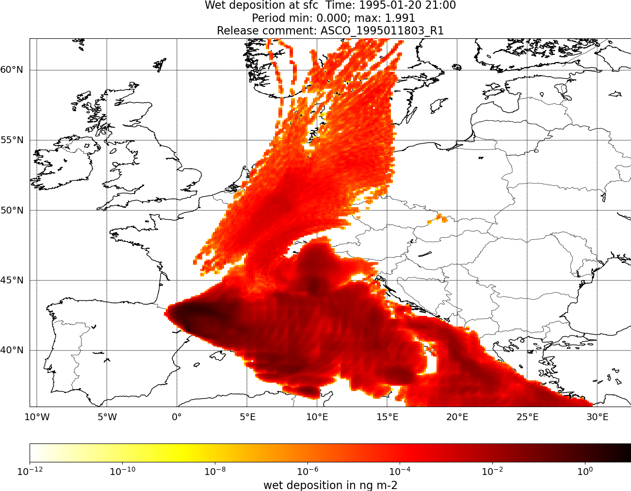
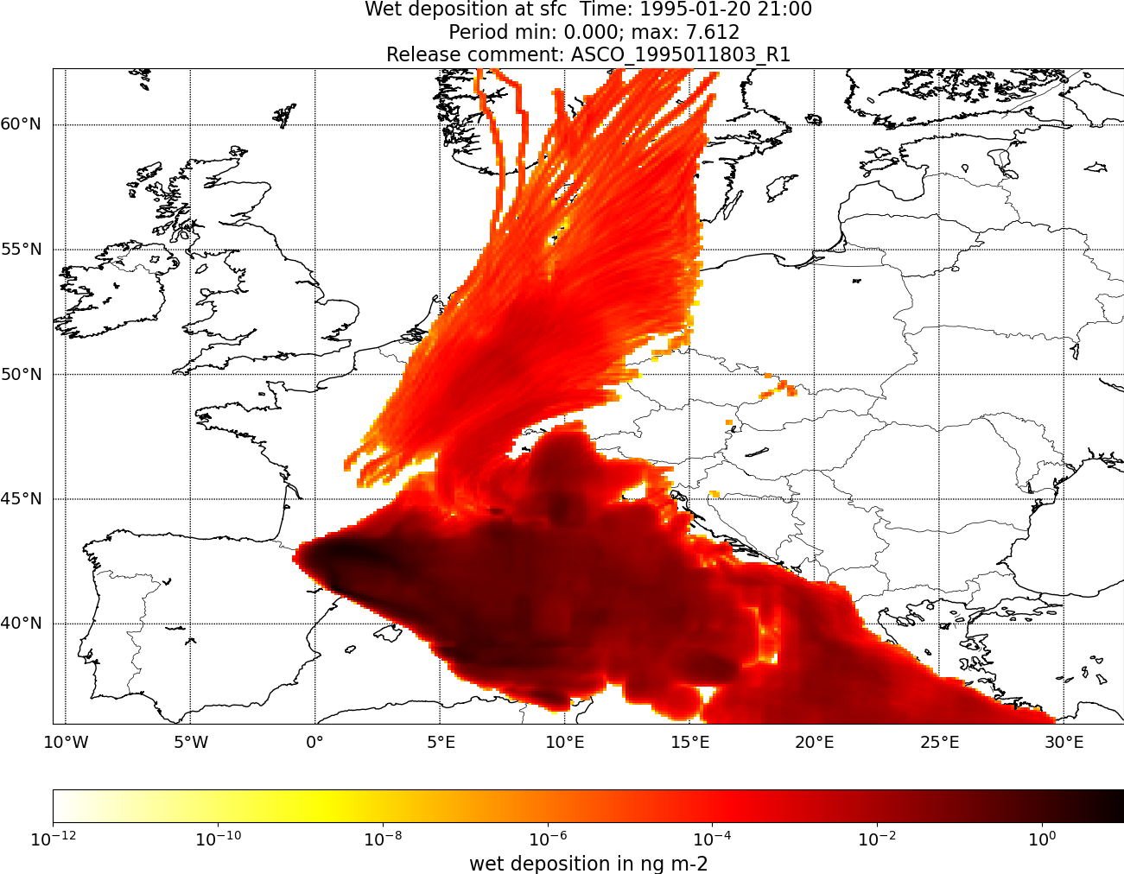
Results
Added interpolation of meteorological fields
relevant for the wet scavenging calculations
Advantage of additional precipitation fields
Obtained from new disaggregation scheme
Original Code
P1.1-502
Please do not use this space, a QR code will be automatically overlayed
3-h temporal resolution
0.75° x 0.75° spatial resolution
www.flexpart.eu

Slide 8
Conclusion
The elimination of banded or artificial checkerboard structures in high-resolution wet deposition results from ATM is accomplished by numerical improvements and parameterization changes.
Using the new disaggregation scheme fulfils the desired requirements by preserving the integral precipitation in each time interval, guaranteeing continuity at interval boundaries, and maintaining non-negativity.
The added temporal interpolations in Flexpart solves the previous existing inconsistencies.
The new below-cloud parameterization is currently under testing, but is expected to have a positive effect since it produces wet scavenging coefficients which are closer to field-derived wet scavenging coefficients than the majority of theoretical formulas.
P1.1-502
Please do not use this space, a QR code will be automatically overlayed
www.flexpart.eu

Slide 9
References
Hittmeir, S., Philipp, A., and Seibert, P.: A conservative reconstruction scheme for the interpolation of extensive quantities in the Lagrangian particle dispersion model FLEXPART, Geosci. Model Dev., 11, 2503–2523, https://doi.org/10.5194/gmd-11-2503-2018, 2018.
Pisso, I., Sollum, E., Grythe, H., Kristiansen, N. I., Cassiani, M., Eckhardt, S., Arnold, D., Morton, D., Thompson, R. L., Groot Zwaaftink, C. D., Evangeliou, N., Sodemann, H., Haimberger, L., Henne, S., Brunner, D., Burkhart, J. F., Fouilloux, A., Brioude, J., Philipp, A., Seibert, P., and Stohl, A.: The Lagrangian particle dispersion model FLEXPART version 10.4, Geosci. Model Dev., 12, 4955–4997, https://doi.org/10.5194/gmd-12-4955-2019, 2019.
Related: SnT2023 e-Poster P1.1-577 by Lucie Bakels et al.
Tipka, A., Haimberger, L., and Seibert, P.: Flex_extract v7.1.2 – a software package to retrieve and prepare ECMWF data for use in FLEXPART, Geosci. Model Dev., 13, 5277–5310, https://doi.org/10.5194/gmd-13-5277-2020, 2020.
Wang, X., Zhang, L., and Moran, M. D.: Development of a new semi-empirical parameterization for below-cloud scavenging of size-resolved aerosol particles by both rain and snow, Geosci. Model Dev., 7, 799–819, https://doi.org/10.5194/gmd-7-799-2014, 2014.
P1.1-502
Please do not use this space, a QR code will be automatically overlayed
www.flexpart.eu

