Slide 1
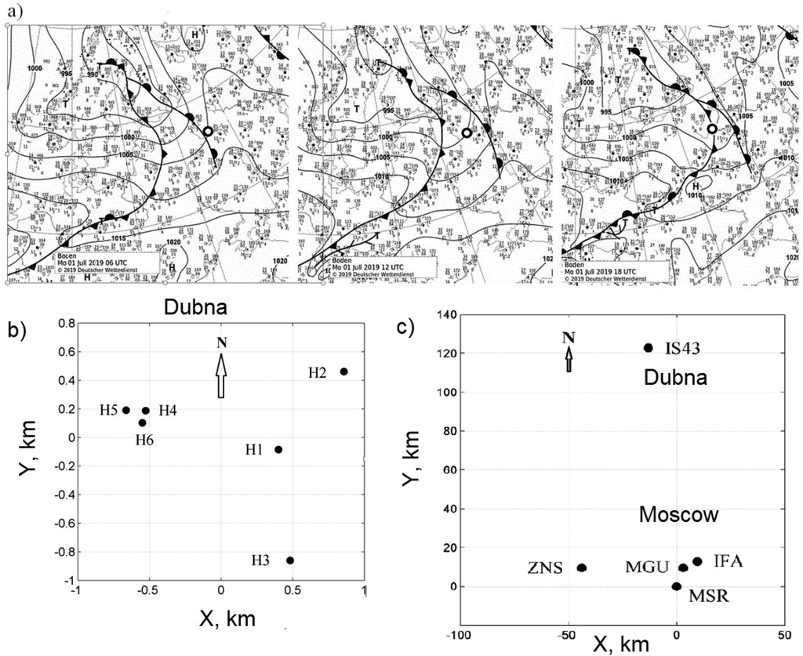
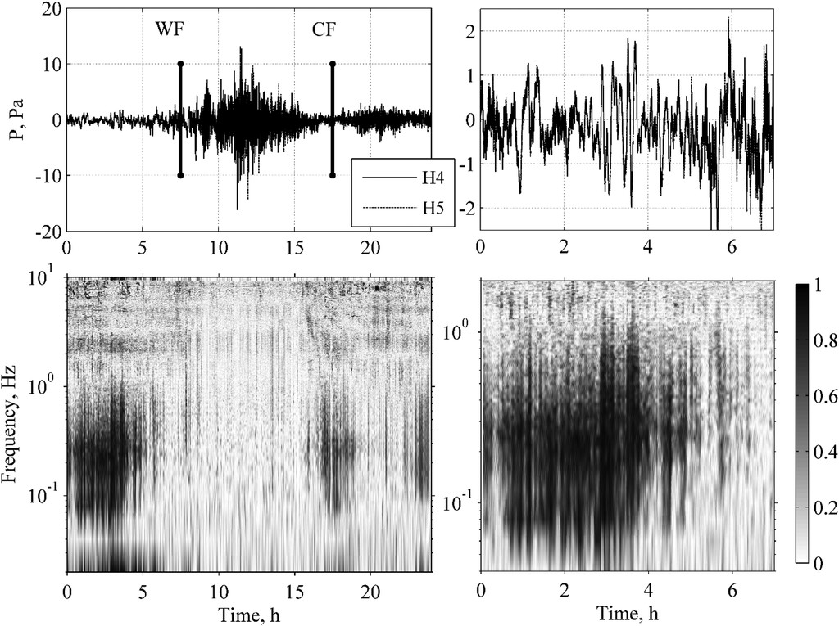
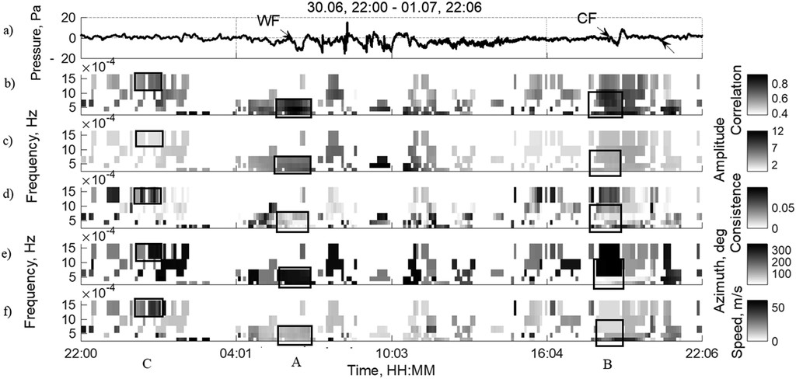
Monitoring Acoustic Gravity Waves Generated by the Atmospheric Storm
Elena Golikova, Igor Chunchuzov, Sergey Kulichkov,Vitaliy Perepelkin, Oleg Popov
A.M. Oboukhov Institute of Atmospheric Physics RAS
P1.1-405
Infrasound parameters (amplitudes, coherences, grazing angles, azimuths, and horizontal phase speeds) derived during the passage of warm and cold fronts through the networks of microbarometers in the cities of Dubna and Moscow are presented.
The significant differences observed in the temporal variations of the parameters of infrasound from warm and cold fronts are discussed.
Such differences must be taken into account when detecting infrasound precursors of atmospheric storms.
The filtering signals from WF and CF in different frequency ranges makes it possible to reveal the transition from internal gravity to infrasonic waves by analyzing a sharp increase in their horizontal phase speeds.

