Slide 1
Monitoring Acoustic Gravity Waves Generated by
the Atmospheric Storm
Elena Golikova, Igor Chunchuzov, Sergey Kulichkov,
Vitaliy Perepelkin, Oleg Popov
A.M. Oboukhov Institute of Atmospheric Physics RAS
The observations and coherent analysis of infrasound signals and internal gravity waves during the passages of warm and cold fronts through observational networks in the cities of Dubna and Moscow are described.
Observational networks on the maps.
Properties of infrasound and gravity waves from the warm and cold fronts.
Investigating a jump in phase speeds when transiting from gravity waves to infrasound.
Significant differences were found in the patterns of time variation of amplitudes, grazing angles, and horizontal phase speeds of IS from warm and cold fronts, associated with the difference in the geometries of these fronts.
Please do not use this space, a QR code will be automatically overlayed
P1.1-405

Slide 2
Introduction
The detection of infrasound signals from powerful convective storms (hurricanes, thunderstorms, tornadoes) and the study of temporal changes in the parameters of these signals (direction of arrival, phase speed, frequency spectrum and coherence) is of practical importance for early forecasting of such hazardous atmospheric phenomena. On the other hand, such studies are also necessary for understanding the mechanism of infrasound generation by storms and their influence on the statistical characteristics of atmospheric pressure and wind velocity fluctuations (variances, frequency spectra, coherence) in the frequency ranges typical for internal gravity waves (0.0001–0.003 Hz) and infrasound (0.0033–10 Hz).
This work is devoted to the study of the temporal variations of the parameters of infrasound signals from meteorological fronts (amplitudes, coherences, grazing angles, azimuths, and horizontal phase speeds) to explain possible generation mechanism and the propagation features of these signals in the atmosphere.
The significant differences observed in the temporal variations of the parameters of infrasound from warm and cold fronts are discussed. Such differences must be taken into account when detecting infrasound precursors of atmospheric storms.
Please do not use this space, a QR code will be automatically overlayed
P1.1-405

Slide 3
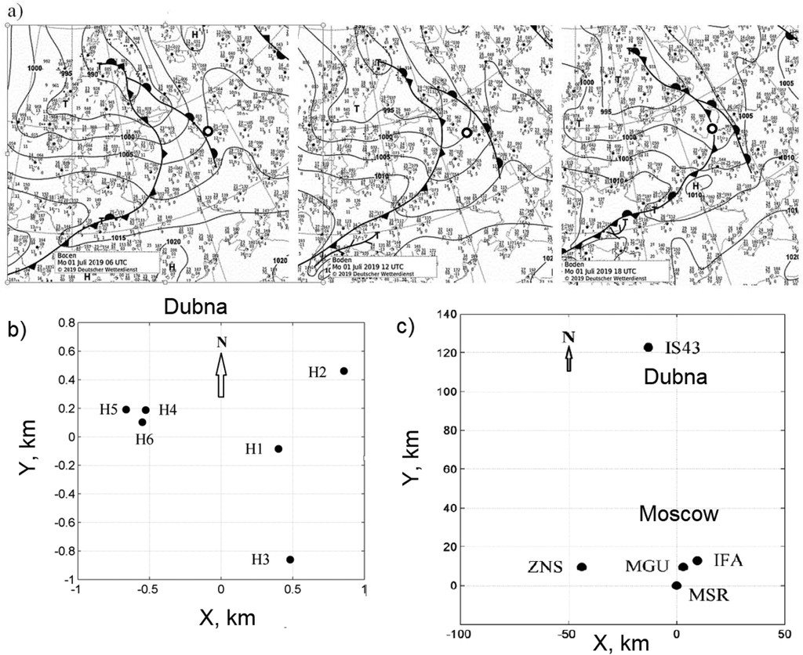
Observational networks on the maps
Synoptic charts for 1 July 2019
The measuring complex includes a network of four microbarographs to measure wave atmospheric-pressure disturbances within a frequency range of infrasounds and IGWs (0.0003–3 Hz) in Moscow (c) and the receivers H1–H6 at the infrasound station IS43 in Dubna (b).
Changes with time of the location of warm (WF) and cold (CF) fronts at 0600, 1200, and 1800 UTC 1 Jul 2019, passing through the cities Dubna (circle) and Moscow (square)(a). The synoptic charts are taken from the archive http://www2.wetter3.de/Archiv/archiv_dwd.htm.
Please do not use this space, a QR code will be automatically overlayed
P1.1-405

Slide 4
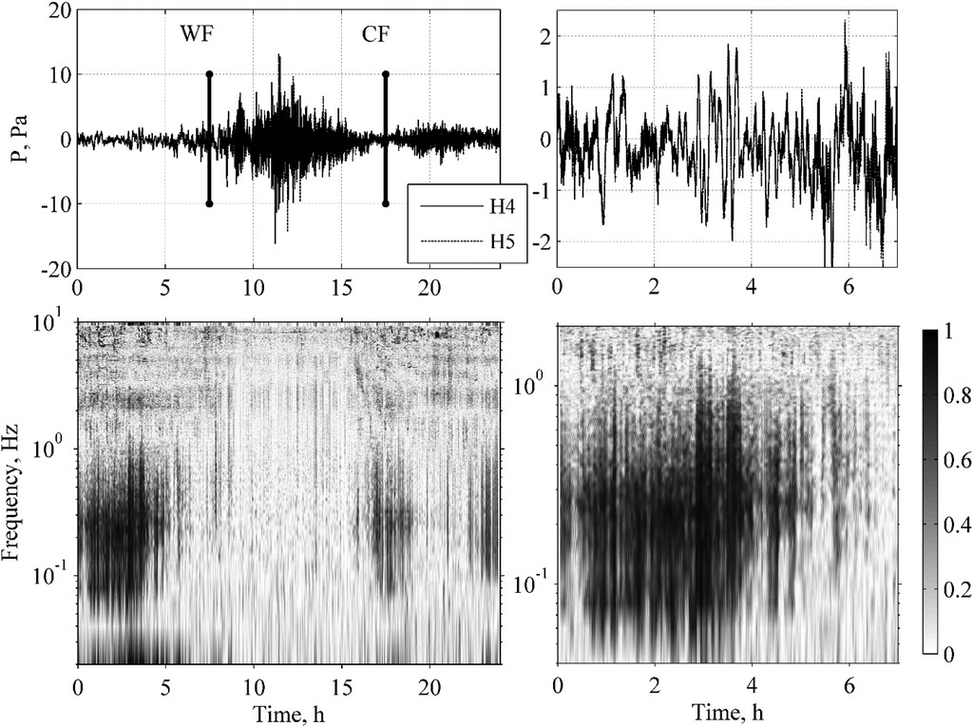
Properties of infrasound and gravity waves
from the warm and cold fronts
At 0600 UTC, a warm front (WF), namely, its near-ground part, approaches the infrasound station IS43 and a cold front (CF) approaches IS43 at about 1900 UTC.
The maximum signal coherence (~0.8–1) in the infrasonic frequency range 0.05–1 Hz was observed both in the time interval 0000–0600 UTC and during the passage of the CF between 1700 and 2000 UTC.
The IS was continuously observed from the time when the “high” (at the tropopause altitudes 10–12 km) forward part of the WF has passed through the receiving network (at that time the horizontal distance from the receivers to the near-ground part of the front was about 300 km).
After the passage of the WF, the coherence of the signal in the frequency range 0.05–1 Hz drops sharply and remains low (less than 0.2) for a long period from 0600 to 1700 UTC. This is a period of intense convection and high amplitudes of the wind speed variations.
Please do not use this space, a QR code will be automatically overlayed
P1.1-405

Slide 5
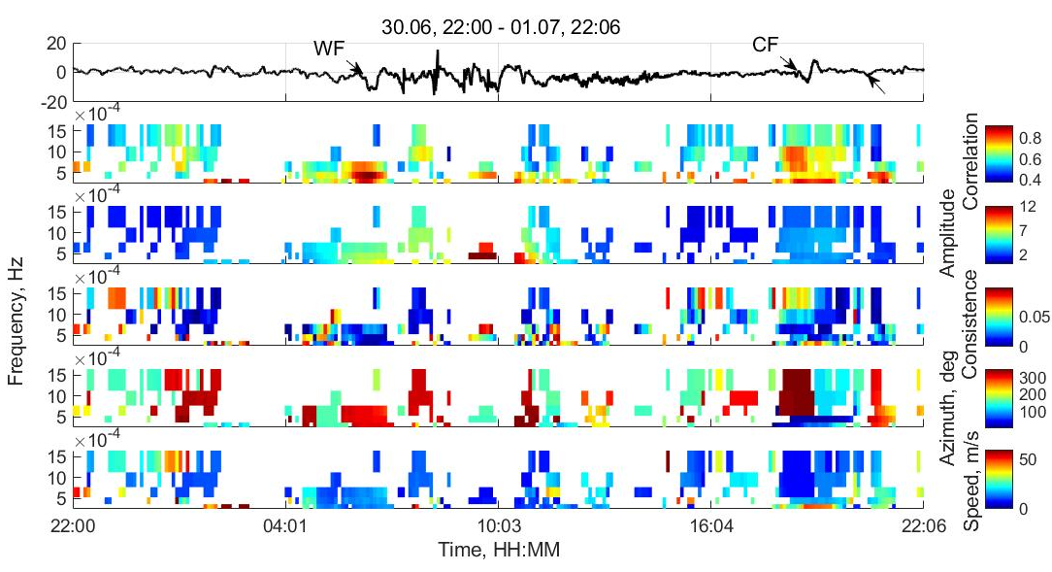
Properties of infrasound and gravity waves
from the warm and cold fronts
a)
The prior the arrival of WF and during its passage through a triangle MGU–IFA–ZNS in the time interval 0530–0700 UTC (this interval is designated by A), the IGWs with low frequencies, less than 0.0007 Hz (the corresponding periods are longer than 25 min) and horizontal phase speeds of 20–30 m s⁻¹ (f) arrive to the Moscow network mainly from the west and northwest, in the azimuth range 300°–310°(e).
In this interval the coherence reaches maximum values 0.8–0.9 (b) and consistency becomes close to zero (less than 0.05,(d)).
Between 1800 and 1900 UTC (the interval is shown by B) before the arrival of the CF, the low-frequency signal with frequencies less than 0.001 Hz arrives mainly from the northeast (0°–30°) and northwest (300°–310°).
b)
c)
d)
e)
f)
C
A
B
(a) Signal (Pa), (b) correlation, (c) spectral amplitudes, (d) sum of the time delays of the arrival of the fluctuations between receivers (consistency), (e) azimuth of the arrival, and (f) horizontal phase speed of IGWs. The rectangles A, B, and C show the parameters of IGWs during different time intervals.
The correlation analysis are used a progressive multi-channel correlation (PMCC) method (Le Pichon and Cansi 2003).
Please do not use this space, a QR code will be automatically overlayed
P1.1-405

Slide 6
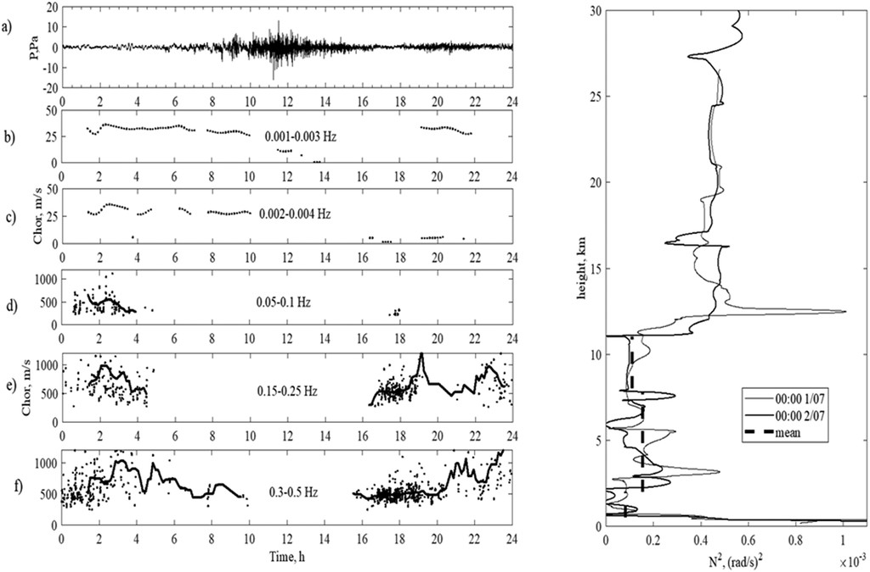
Investigating a jump in phase speeds when transiting from
gravity waves to infrasound
Horizontal phase speed of wave disturbances for different frequency bands.
In the frequency ranges 0.001–0.003 and 0.002–0.004 Hz (b),(c), typical for high-frequency IGWs with periods of 17–4 min, the horizontal phase speeds are low, 20–40 m s⁻¹ (c).
When transiting from IGWs (d-f) to infrasound waves the horizontal phase speed C_{hor} increase to 1000 m s⁻¹ and higher. As a result the arrival to the receivers of acoustic waves at large grazing angles (~30°–85°) from the upper part of the front located at the heights of the upper troposphere, where the random turbulent sources of these waves are.
A tendency C_{hor} decrease from 1000 to 500 m s⁻¹ during period 0300–0700 UTC (f) and increase with period 1900 and 2400 UTC is caused by the arrival of waves first from their sources located on the near-ground part of the CF, and then from ever higher parts of the CF as its near-ground frontal section moves away from the receivers. The time dependences of C_{hor} are associated with the difference in the geometries (slopes) of the WF and CF (Kulichkov et al. 2019).
Please do not use this space, a QR code will be automatically overlayed
P1.1-405

Slide 7
Conclusion
Measurements and coherent analysis of atmospheric pressure fluctuations on the network of receivers of the infrasound station in Dubna and the network of microbarographs near Moscow made it possible to simultaneously detect infrasound (IS) and internal gravity waves (IGWs) generated by meteorological fronts that passed through Dubna and Moscow on 1 July 2019.
Significant differences were found in the patterns of time variation of amplitudes, grazing angles, and horizontal phase speeds of IS from warm and cold fronts, associated with the difference in the geometries of these fronts. These patterns must be taken into account when detecting infrasound precursors of atmospheric storms.
The filtering signals from WF and CF in different frequency ranges makes it possible to reveal the transition from internal gravity to infrasonic waves by analyzing a sharp increase in their horizontal phase speeds which was first observed in Chunchuzov et al. (2018) and Kulichkov et al. (2019). The above-noted time dependences of C_{hor} are associated with the difference in the geometries (slopes) of the WF and CF.
Please do not use this space, a QR code will be automatically overlayed
P1.1-405

Slide 8
References
Le Pichon, A., and Y. Cansi, 2003: PMCC for infrasound data processing. InfraMatics Newsletter, No. 2, 1–9.
Chunchuzov, I. P., S. Kulichkov, O. Popov, and V. Perepelkin, 2018: Acoustic-gravity waves observed during strong atmospheric storms in Moscow region. 17th Int. Symp. on Long Range Sound Propagation, Lyon, France, Centre for Acoustic Research.
Kulichkov, S. N., and Coauthors, 2019: Internal gravity and infrasound waves during the hurricane of May 29, 2017, in Moscow. Izv., Atmos. Oceanic Phys., 55, 167–177, https://doi.org/10.1134/S0001433819020105.
Please do not use this space, a QR code will be automatically overlayed
P1.1-405

