Slide 1

Application of CCM SOCOL-AERv2-BE to cosmogenic beryllium
isotopes: description and validation for polar regions
Ari-Pekka Leppänen
STUK – Radiation and Nuclear Safety Authority, Rovaniemi, Finland
A full 3D transient model of production, transport, and deposition of cosmogenic ⁷Be and ¹⁰Be isotopes in the atmosphere
has been developed. The model is based on Climate Chemistry Model SOCOL and CRAC beryllim production model is called SOCOL-AERv2-BE.
. The measured weekly
concentrations of ⁷Be in near-ground air have been compared with the model prediction for four nearly antipodal high latitude
locations: two in the Northern (Finland and Canada) and two in the Southern (Chile and Kerguelen island) Hemisphere.
The model correctly reproduces the temporal variability of ⁷Be concentrations on the annual and sub-annual scales, including a good reproduction of the annual cycle, which dominates data in the Northern Hemisphere, and the absence of such a cycle in the Southern Hemisphere
The model is recommended to be used in studies related to, e.g., atmospheric dynamical
patterns, extreme solar particle storms, long-term solar activity reconstruction from cosmogenic proxy data, and solar–terrestrial relations..
Please do not use this space, a QR code will be automatically overlayed
P1.1-581

Slide 2

A full 3D time-dependent Climate Chemistry Model SOCOL-AERv2-BE
Cosmic rays from extra terrestrial origin can produce radioactive isotopes in nuclear reactions with atmospheric gases such as nitrogen and oxygen. One of these cosmogenic isotopes is ⁷Be with a half-life of 53.2 days. Production rate of ⁷Be vary in time following the intensity of galactic cosmic rays (GCRs) modulated by solar magnetic activity (the 11-year solar cycle), geomagnetic field strength, and
also sporadic solar energetic particle events (SPEs). In addition to the production pattern defined by cosmic ray fluxes, concentrations of beryllium isotopes at any location are also affected by atmospheric transport and deposition processes, which may essentially distort the production signal.
The production of cosmogenic isotopes primarily takes place in the stratosphere at the altitude of 15km. In the stratosphere the isotopes gets attached to atmospheric aerosols which in turn are transported by atmospheric air flow. The main mechanism to transport ⁷Be to troposphere is the stratosphere-troposphere exchange (STE) which takes place in tropopause at mid-latitudes (lat. 30-40°). In troposphere the aerosols carrying ⁷Be are subject to not only radioactive decay but also vertical and horizontal transport via air currents and wet and dry deposition.
Please do not use this space, a QR code will be automatically overlayed
P1.1-581

Slide 3
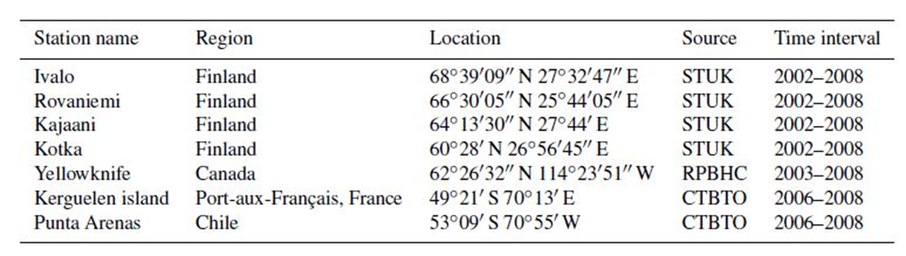
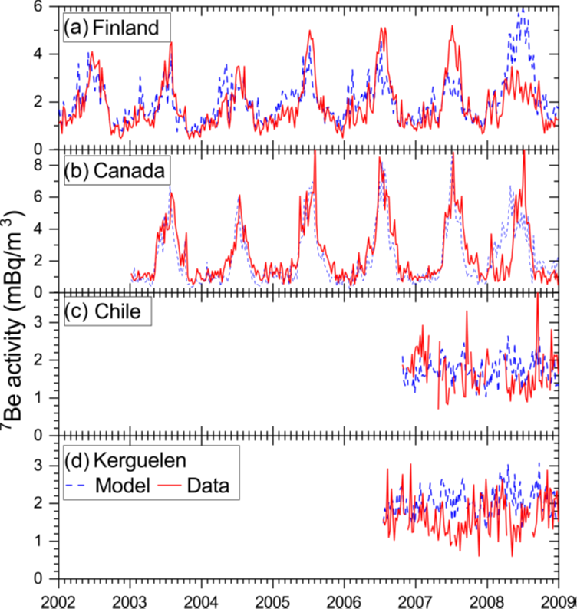
Research methods
The table above shows the location of the measurement stations used in this study. The stations were located nearly antipodally in Northern and Southern hemisphere in Finland, Canada, Chile and Kerguelen Island in the Indian Ocean.
The data for Chile (CLP18) and Kerguelen Island (FRP30) were obtained from the CTBTO’s vDEC database as indicated in the table.
The figure on the right shows the time series of the modelled and observed ⁷Be concentration at each station.
Please do not use this space, a QR code will be automatically overlayed
P1.1-581

Slide 4
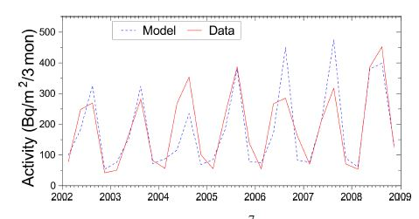
Model results compared with measurements
The figure shows the discrepancy between the modelled ⁷Be concentration in air and model calculations. The red line represents the optimal fit to the model results and the grey bars actual measurements.
The m values in the box stand for the difference between overall mean modelled and measured ⁷Be concentration expressed in mBq/m³. As it can be seen the difference the produces the measured values quite accurately.
The lower figure shows the measured and modelled ⁷Be deposition at Rovaniemi and Ivalo, Finland. The model can also handle deposition of aerosols well.
Please do not use this space, a QR code will be automatically overlayed
P1.1-581

Slide 5
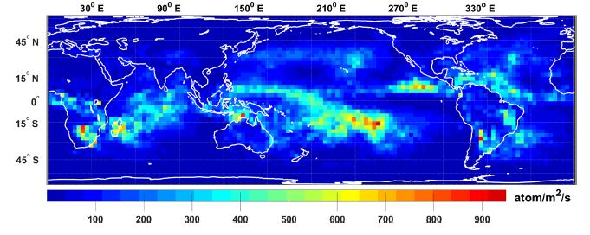
Modelling results
Top figure shows the modelled annual ⁷Be deposition at global scale. The deposition, is not very high at low latitudes because both the production rate and the downward transport of ⁷Be are low in the tropics. The deposition is also low at arid regions and at polar regions.
The figure on the right shows the zonal mean concentration of ⁷Be averaged over the boreal summer and winter for 2002–2008. While the isotope production is symmetric between the hemispheres, the concentrations are not completely symmetric and depend on the large-scale circulation patterns, which are different in the summer and winter hemispheres.
Please do not use this space, a QR code will be automatically overlayed
P1.1-581

Slide 6
Conclusion and summary
A full 3D transient model of production, transport, and deposition of cosmogenic ⁷Be and ¹⁰Be isotopes in the
atmosphere has been developed. The model, named CCM SOCOL-AERv2-BE, is based on CCM SOCOL, specifically
tuned for the best performance in tracing beryllium, and the CRAC production model. Realistic modeling of the
⁷Be isotope was performed for the years 2002–2008, with a 5-year model spin-up during 1996–2001. The
measured weekly concentrations of ⁷Be in near-ground air have been compared with the model prediction for
four nearly antipodal high latitude locations: two in the Northern (Finland and Canada) and two in the Southern
(Chile and Kerguelen island) Hemisphere. The model results generally agree well with the measurements in the
absolute level within error bars, implying that the production, decay, and lateral deposition are correctly
reproduced by the model. However, a larger discrepancy (up to 20 %) was observed at Kerguelen island where
the orographic scale is much smaller than the model grid size. The model correctly reproduces the temporal
variability of ⁷Be concentrations on the annual and sub-annual scales, including a good reproduction of the
annual cycle, which dominates data in the Northern Hemisphere, and the absence of such a cycle in the
Southern Hemisphere.
This validates the newly developed model to be able to correctly simulate the production, transport, and
deposition of the ⁷Be (and hence, ¹⁰Be) isotope on local or regional spatial (in high-latitude regions) and monthly
or annual temporal scales. The modeled ⁷Be distribution is also in general agreement with earlier computations
based on a similar approach.
Please do not use this space, a QR code will be automatically overlayed
P1.1-581

Slide 7
References
This presentation was based on the article:
Kseniia Golubenko¹ , Eugene Rozanov^{2,3,4} , Gennady Kovaltsov⁵ , Ari-Pekka Leppänen⁶, Timofei Sukhodolov^{2,4,7}
, and Ilya Usoskin¹,
¹Space Physics and Astronomy Research Unit, University of Oulu, 90570, Finland
²Physikalisch-Meteorologisches Observatorium Davos and World Radiation Center, Davos Dorf, 7260, Switzerland
³Institute for Atmospheric and Climate Science, ETH Zurich, Zurich, 8092, Switzerland
⁴St. Petersburg State University, St. Petersburg, 198504, Russia
⁵Ioffe Physical–Technical Institute, St. Petersburg, 194021, Russia
⁶Radiation and Nuclear Safety Authority – STUK, Rovaniemi, 96400, Finland
⁷Institute of Meteorology and Climatology, University of Natural Resources and Life Sciences, Vienna, 1180, Austria
⁸Sodankylä Geophysical Observatory, University of Oulu, Sodankylä, 99600, Finland
Application of CCM SOCOL-AERv2-BE to cosmogenic beryllium isotopes: description and validation for
polar regions, Geoscientific Model Development, 14, 7605 – 7620 (2021).
Please do not use this space, a QR code will be automatically overlayed
P1.1-581

